Slide 1
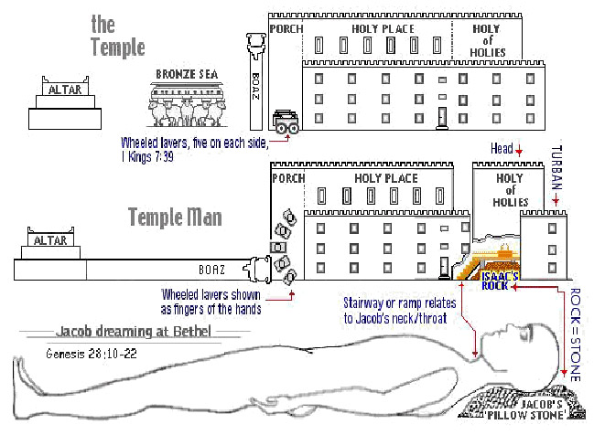
The Sanctuary of our Body
THE THIRD TEMPLE
Series 10
The Urinary System
By : sister rose

Slide 2
2
The Urinary System
Operates and Functions like
(The Tribe of Gad)
“Trample on but overcomes”
Genesis 49:19
Gad, a troop shall overcome him:
but he shall
overcome at the last.

Slide 3
3
Deuteronomy 33:20-21
And of Gad he said Blessed [be] he that enlargeth Gad; he dwelleth as a lion, and teareth the arm with the crown of the head. And he provided the first part for himself, because there, [in] a portion of the lawgiver, [was he] seated; and he came with the heads of the people, he executed the justice of the LORD, and his judgments with Israel.

Slide 4
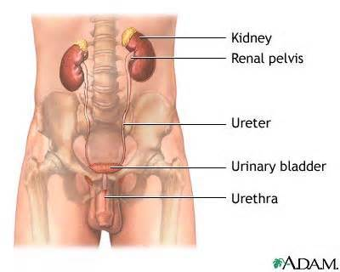
The Urinary System
URINARY SYSTEM DEFINITION
The function of the urinary system,
rids the body of nitrogenous wastes while regulating water, electrolyte, and
acid-base balance of the blood.
The kidneys and bladder together with their connecting tubes, is to maintain the body’s internal balance of
water and salts.
The urinary system works with the lungs, skin, and intestines-all of which also excrete wastes- to keep the chemicals and water in
your body balanced.
This system removes a type of waste called urea from your blood.
4
http://www.the-human-body.net/urinary-system.html

Slide 5
THE URINARY SYSTEM LIKE THE TRIBE OF GAD “TRAMPLE ON BUT OVERCOMES AT LAST”
(Genesis 49:19) (Genesis 30:10-11) (Isaiah 43:25)
"I, even I, am He that blotteth out thy transgressions for Mine own sake, and will not remember thy sins." This system eliminates nitrogenous wastes from the body; regulates water, electrolyte, and acid-base balance of the blood. Also removes waste called urea from the blood, is made up of the organs, tubes, muscles, and nerves that create, store and carry urine.
These include two kidneys, two ureters,
or ducts, the bladder, two sphincter muscles and the urethra, through which it is discharged from the body.
There are two kidneys in the human body. They are the most important part of the urinary system. The function of the kidneys is regulation of electrolytes, maintaining of acid-base balance, regulation of blood pressure, production of urine, etc.
The kidneys help excrete urea and ammonium from the body and reabsorb water, glucose and amino acids.
5

Slide 6
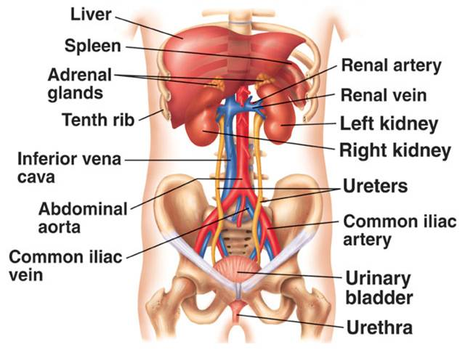
6
The right kidney is in contact with the liver
Through the sacrifice of redemption,
He (Jesus)
was therefore strong to execute justice upon them that despised God's mercy.
In features of Ureters
third layer is call Adventitia:
Fibrous coat with blood vessels, nerves and lymphatic
Kidneys are also going to
regulate the volume of blood.
Another huge function is
to get rid of toxin, normal
metabolic wastes, excess water and ions from
the body.

Slide 7
7
The Kidneys:
Here is the Symbol of our Saviour’s Hiding Power!
(One who was overcome by a troop but, at the last became the victor).
Kidney: Cleanser of the Blood
(Hebrew 9:22-23)
And almost all things are by the law purged with blood; and without shedding of blood is no remission. [It was] therefore necessary that the patterns of things in the heavens should be purified with these; but the heavenly things themselves with better sacrifices than these.
and the blood of Jesus Christ his Son cleanseth us from all sin.
Margin..(1 John 1:7)
That pierced side whence flowed the crimson stream that reconciled man to God—there is the Saviour’s glory, there “the hiding of His power.” “Mighty to save,” through the sacrifice of redemption,
He was therefore strong to execute justice upon them that despised God’s mercy. And the tokens of His humiliation are His highest honor; through the eternal ages the wounds of Calvary will show forth His praise and declare His power.—
{Great Controversy 674}. {Heaven 131.3} (Habakkuk 3:4)

Slide 8
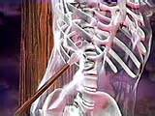
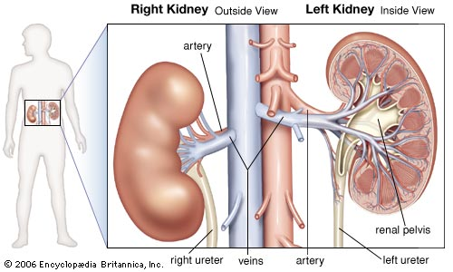
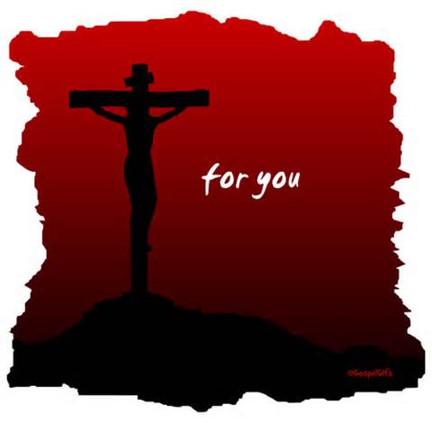
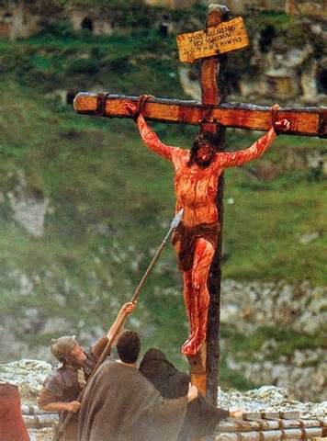
The Kidney
8
The kidneys monitor and maintain the chemical make-up of the blood.
But one of the soldiers with a spear pierced his side, and forthwith came there out blood and water.
(John 19:34)
right ureter veins artery left ureter

Slide 9
9
The kidneys, which maintain the purity and constancy of our internal fluids,
are perfect examples of homeostatic organs. Much like sanitation workers who keep a city’s water supply drinkable and dispose of its waste, the kidneys are usually unappreciated until there is a malfunction and “internal garbage” piles up.
Every day, the kidneys filter gallons of fluid from the bloodstream.
They then process this filtrate, allowing wastes and excess ions to leave the body in urine while returning needed substances to the blood in just the right proportions. Although
the lungs ( A symbol of the Candlestick) (see .Series # 6) and
the skin (A symbol of Christ covering) (see .Series # 4) also play roles in excretion,
the kidneys bear the major responsibility for eliminating nitrogenous (nitrogen-containing)
wastes, toxins, and drugs from the body. (A symbol of our unrighteousness)
We are to say, “He died for me. He bore my soul’s disgrace, that in His name I might be an overcomer and be exalted to His throne.”
{Our Father Cares 138.4}
The kidneys receive some protection from the lower part of
the rib cage (A symbol of Christ Redemption and Reconciliation for what was Lost)
12 rib (A symbol disciples and Israel ) Matthew 10:2-4 Genesis 49:1-27
to the Lumbar 3 vertebra; (A Symbol of the books of the Major Prophet)
(they heard the prophets word fulfill during His ministry for 3 years)(Luke 24:44-47)
12cm (5 inches) long, (A symbol of Christ Ministry in 12 cities)
6cm (2.5 inches) wide (6 is the number of man/ 6 hours hour Saviour was on the cross),
and 3cm (1 inch) :(A symbol of His Fullness and Power to save man) (Colossian 2:9)
Essentials of Human Anatomy & Physiology six Edition pg. 456

Slide 10
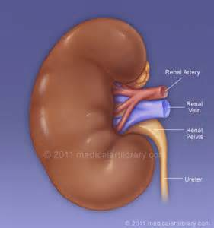
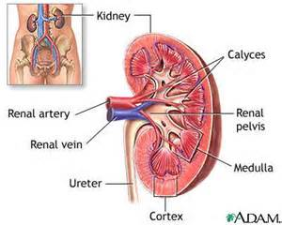
10
The kidneys extend from the 12rib to the L3 (Lumbar) vertebra;
thus they receive some protection from the lower part of the rib cage.
Because it is crowded by the liver, the right kidney is positioned slightly lower than the left. An adult kidney is about 12cm (5 inches) long,
6cm (2.5 inches) wide, and 3cm (1 inch) thick about the side of a large bar of soap.
Essentials of Human Anatomy & Physiology six Edition pg. 456
(Malachi 3:2-3 Margin….) for he [is] like a refiner's fire, and like fullers' soap:
sit [as] a refiner and purifier of silver
It also control what is removed from the blood as waste products
(Waste products: A symbol of our uncleanness).
Most of the fluid that passes through the kidneys is cleaned and returned to the bloodstream. (His Blood Purified us from all unrighteousness)
It’s surrounded by a mass of fat and loose areola tissue.
(Fat: A symbol of sin burned at the brazen Altar)
(Leviticus 4:35)
The left is somewhat longer, and narrower, than the right.
Ureters are 10 inch long tubes that carry urine from kidneys into urinary bladder.

Slide 11
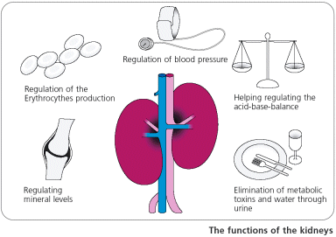
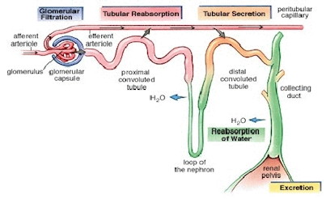
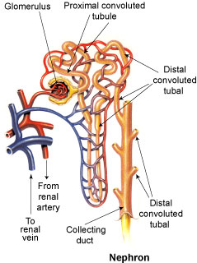
Calcitriol, renin and Erythropoietin [ih-rith-roh-poi-i-tn, -poi-eet-n hormones are produced
by the kidney.
11
.
The blood seems to pass through two distinct systems of capillary vessels in the kidneys,
in its course from the arteries to the veins. They take up from the blood the water; they also eliminate from the blood saline and waste matters, sugar, albumen, etc.

Slide 12
The kidneys and bladder control the balance of water and salt
(Water: A symbol of the Word unto Salvation)
(Proverbs 18:4)
Look, thirsty, bewildered souls! Can ye not see the fountain of life, opened for the weary, wayworn traveler? Can ye not hear the voice of Mercy as she beckons to you, saying,
“ 'Ho, every one that thirsteth, come ye to the waters;' 'whosoever will, let him take the water of life freely'"? The waters of this fountain contain medicinal properties which will heal both spiritual and physical infirmities. Drink deep from the fountain opened for Judah and Jerusalem. Then you can take the refreshing cup to parched, fainting souls.
{Review and Herald, October 15, 1901 par. 10}
(Salt: A symbol of The Believers covered by the Blood of the Lamb
the Christian Life) (Matthew 5:13) (2 King 2:21)
Again: He illustrates the living reality of a Christian life by the saving properties of salt. "Ye are the salt of the earth," He says; "but if the salt have lost his savor, wherewith shall it be salted?" Solemn question! If the saving principles of truth are not exemplified by professing Christians, what benefit does the world derive from their lives? When salt has lost its savor, "it is thenceforth good for nothing; but to be cast out, and to be trodden underfoot of men." When Christians do not reveal Christ, of what value are they? Are they not like savorless salt, "good for nothing"? But when they reveal in their lives the saving principles of the truth, poor, sin-hardened souls are not left to perish in corruption. Good works are seen; for the living principles of righteousness cannot be hidden. The gospel acted is like salt which contains all its savor. It is powerful in the saving of souls.
{Review and Herald , October 15, 1901 par. 7}
12

Slide 13
Two Kidneys: The kidneys filter and clean the blood
(Leviticus 4:7, 18, 25, 30) (Jeremiah 3:22) (Leviticus 4:31; 7:30) (Psalm 37:20).
He had bright beams coming out of His side:
and there was the hiding of His power.
(Habakkuk 3:4, margin)
That pierced side (the Kidney) whence flowed the crimson stream that reconciled man to God--there is the Saviour's glory, there "the hiding of His power." "Mighty to save," through the sacrifice of redemption,
He was therefore strong to execute justice upon them that despised God's mercy.
And the tokens of His humiliation are His highest honor;
through the eternal ages the wounds of Calvary will show forth His praise and declare His power.
Two Sphincter Muscles: Symbols of the Priest
(Leviticus 4:7)
And the priest shall put [some] of the blood upon the horns of the altar of sweet incense before the LORD, which [is] in the tabernacle of the congregation
13

Slide 14
14
The Bladder: The body reservoir:
(Romans 4:7-8)
[Saying], Blessed [are] they whose iniquities are forgiven,
whose sins are covered.
Blessed [is] the man to whom the Lord will not impute sin.
The Lord did not lock the reservoir of heaven after pouring his Spirit upon the early disciples. We, also, may receive of the fullness of his blessing. Heaven is full of the treasures of his grace, and those who come to God in faith may claim all that he has promised. If we do not have his power it is because of our spiritual lethargy, our indifference, our indolence. Let us come out of this formality and deadness. {Review and Herald, June 4, 1889 par. 7}
Is a musculomembranous (mŭs'kyū-lō-mem'bră-nŭs), sac for the urine;
and as its size, position, and relations vary according to the amount of fluid it contains. The bladder expelled from the body through the process of urination.
The bladder or urinary bladder is the organ where the excreted urine by the kidneys is collected before being disposed off by urination. The bladder is a muscular organ that is elastic (distensible) in nature. The bladder is located on the pelvic floor. In males, the base of the bladder is between the rectum and pubic symphysis. In females, it is below the uterus etc. In infants and young children,
the bladder is located in the abdomen even if it is empty.

Slide 15
The Urethra: (Leviticus 6:30) (1 John 1:9)
the two tubes which convey the urine from the kidneys to the urinary bladder. Each commences within the sinus of the corresponding kidney as a number of short cup-shaped tubes, termed calyces, which encircle the renal papillæ.
Since a single calyx may enclose more than one papilla the calyces are generally fewer in number than the pyramids—the former varying from seven to thirteen, the latter from eight to eighteen. The calyces join to form two or three short tubes, and these unite to form a funnel-shaped dilatation, wide above and narrow below, named the renal pelvis, which is situated partly inside and partly outside the renal sinus. It is usually placed on a level with the spinous process of the
first lumbar vertebra (the base on the altar of sacrifice)
(Malachi 4:1-3) (Ezekiel 28:12-19)
Then come, and seek, and find. The reservoir of power is open, is full and free. Come with humble hearts, not thinking that you must do some good thing to merit the favor of God, or that you must make yourself better before you can come to Christ. You can never do anything to better your condition. In the name of Jesus, come with full assurance of faith, because you are a sinner; for Christ said, "I came not to call the righteous, but sinners to repentance." Draw nigh to God, and he will draw nigh to you. You are to ask, to seek, to knock, and to believe that you are accepted through Christ Jesus, trusting him alone to do those things for you which you can never do for yourself. {ST, August 22, 1892 par. 3}
when the righteous are delivered, ashes will be the only reminder of sin and sinners.
15

Slide 16
Next Week:
The Sanctuary of our Body
The Third Temple
Series 11 and 12
The Male and Female Reproductive Systems
Operates and Functions like
(The Two Half Tribes)
(Ephraim was replaced by Joseph)
(and Dan by Manasseh)
“ Fruitful and Causing to forget”

