Slide 1
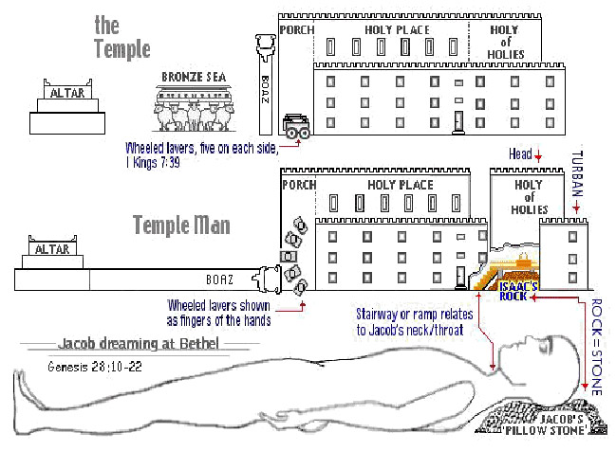
The Sanctuary of our Body
THE THIRD TEMPLE
Series 3
The Skeleton System
By : sister rose

Slide 2
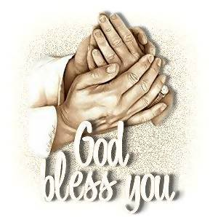
The Skeleton System
Operates and Functions like
(The Tribe of Issachar)
“Our Bones- Strong as a donkey”
Genesis 49:14-15
Issachar [is] a strong ass
couching down between two burdens: And he saw that rest [was] good,
and the land that [it was] pleasant;
and bowed his shoulder to bear,
and became a servant unto tribute.

Slide 3
Deuteronomy 33:18-19
Margin…….Issachar, in thy tents.
They shall call the people unto the mountain; there they shall offer sacrifices of righteousness: for they shall suck [of] the abundance of the seas, and [of] treasures hid in the sand.

Slide 4
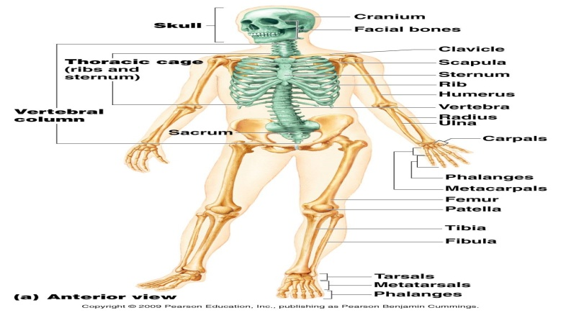
The Skeleton System
SKELENTON SYSTEM DEFINITION
The framework of the body, consisting of bones and other connective tissues, which protects and supports the body tissues and internal organs.
l

Slide 5
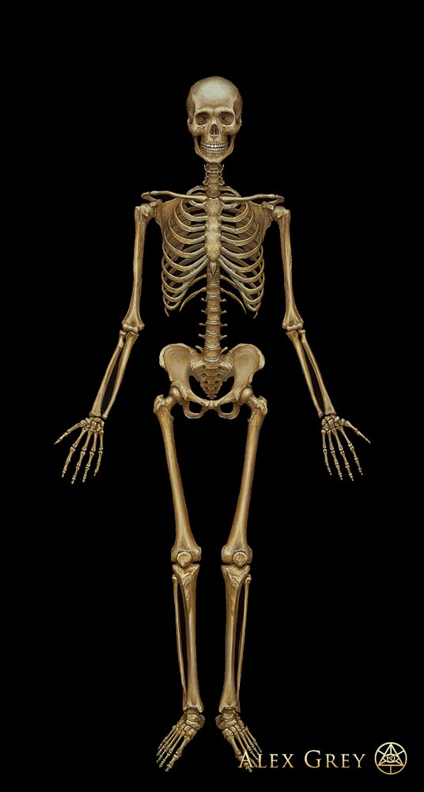
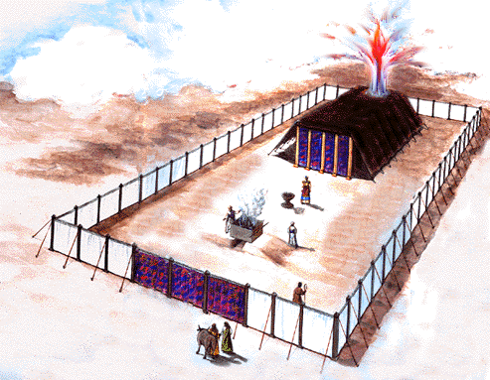
Our Earthly Tabernacle
5
ANTI-TYPE
MEETS TYPE
L
L
L
L
The Most Holy
Most Holy Place
L
L
L
L
Holy Place
Holy Place
L
L
L
L
L
L
L
L
L
The Court Yard
Court Yard
The Frame of our Body

Slide 6
Preserve the Body Temple
Know ye not that ye are the temple of God, and that the
Spirit of God dwelleth in you?
1 Corinthians 3:16
God has given you a habitation to care for and preserve in the best condition for His service and glory. Your bodies are not your own. . . . "Know ye not that ye are the temple of God, and that the Spirit of God dwelleth in you?“
Health is a blessing of which few appreciate the value. . . . Life is a holy trust, which God alone can enable us to keep, and to use to His glory. But He who formed the wonderful structure of the body will take special care to keep it in order if men do not work at cross-purposes with Him. Every talent entrusted to us He will help us to improve and use in accordance to the will of the Giver.
Youth is the time to establish good habits, to correct wrong ones already contracted, to gain and to hold the power of self-control, and to lay the plan, and accustom one's self to the practice of ordering all the acts of life with reference to the will of God.
6

Slide 7
The sacred temple of the body must be kept pure and uncontaminated, that God's Holy Spirit may dwell therein.
We need to guard faithfully the Lord's property, for any abuse of our powers shortens the time that our lives could be used for the glory of God. Bear in mind that we must consecrate all--soul, body, and spirit-- to God. All is His purchased possession, and must be used intelligently, to the end that we may preserve the talent of life.
By properly using our powers to their fullest extent in the most useful employment, by keeping every organ in health, by so preserving every organ that mind, sinew, and muscle shall work harmoniously, we may do the most precious service for God.
When we do all we can on our part to have health, then may we expect that the blessed results will follow, and we can ask God in faith to bless our efforts for the preservation of health.
{ML- Ministry of Healing 134.1 – 134.6}
7

Slide 8
The Frame of our Human Body
8
It is truth enshrined in the soul that makes one a man of God.
{Our Father Cares 92.1}
Those who understand physiology and hygiene will, in their ministerial labor, find it a means whereby they may enlighten others in regard to the proper and intelligent treatment of the physical, mental, and moral powers. Therefore those who are preparing for the ministry should make a diligent study of the human organism, that they may know how to care for the body, not by means of drugs, but from nature's own laboratory. The Lord will bless those who make every effort to keep themselves free from disease, and lead others to regard as sacred the health of the body as well as of the soul. {Review and Herald, January 14, 1902 par. 7}
“Know ye not that ye are the temple of God, and that the Spirit of God dwelleth in you? If any man defile the temple of God, him shall God destroy; for the temple of God is holy, which temple ye are.”
(1 Corinthians 3:16, 17). {Ed-Education 36.3}

Slide 9
(Ephesians 2:21-22)
In whom all the building fitly framed together groweth unto an holy temple in the Lord: In whom ye also are builded together for an habitation of God through the Spirit.
The 206 bones of the adult human body make up a working whole called the Skeleton, or skeletal system. Together, the bones of the skeleton perform many important functions, some of which shall be mentioned in details on (slide#4).
To summarize, the skeletal system:
1. Provides support for the body
2. Provides for movement, with individual bones serving as points of attachment for the skeletal muscles and acting as levers against which muscles (priest) can pull;
3. Protects delicate internal structures such as the brain (the ark), heart
(Table of showbread), lungs (Candlestick);
4. Gives rise to new red (believer through the blood) and white blood (martyrs) cells in its marrow, and
5. Acts as a storehouse for minerals such as calcium and phosphorus
(co-dependent nutrients affecting bone health)
9

Slide 10
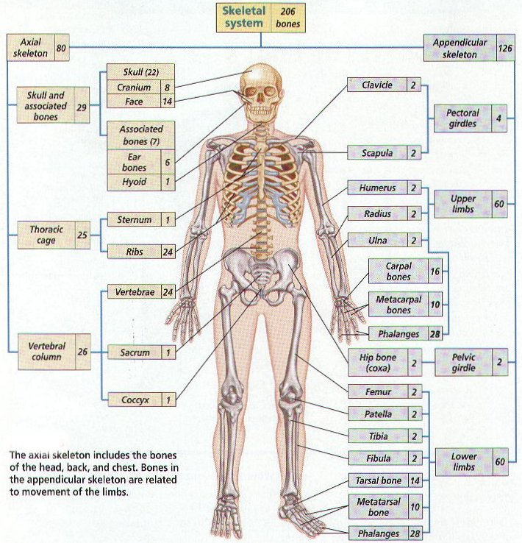
10
“Bones are stones and Stones are bones and Stones are Principles”

Slide 11
11
Christ Jesus
A minister of the sanctuary, and of the true tabernacle, which the Lord pitched, and not man. Who serve unto the example and shadow of heavenly things, as Moses was admonished of God when he was about to make the tabernacle: for, See, saith he, [that] thou make all things according to the pattern showed to thee in the mount.
(Hebrew 8:2,5)
(1 Corinthians 3:16, 17) (Exodus 27:1-3) (Romans 12:1-2)
For the word of God [is] quick, and powerful, and sharper than any twoedged sword, piercing even to the dividing asunder of soul and spirit, and of the joints and marrow, and [is] a discerner of the thoughts and intents of the heart.
Hebrew 4:12
It shall be health to thy navel, and marrow to thy bones.
Proverbs 3:8

Slide 12
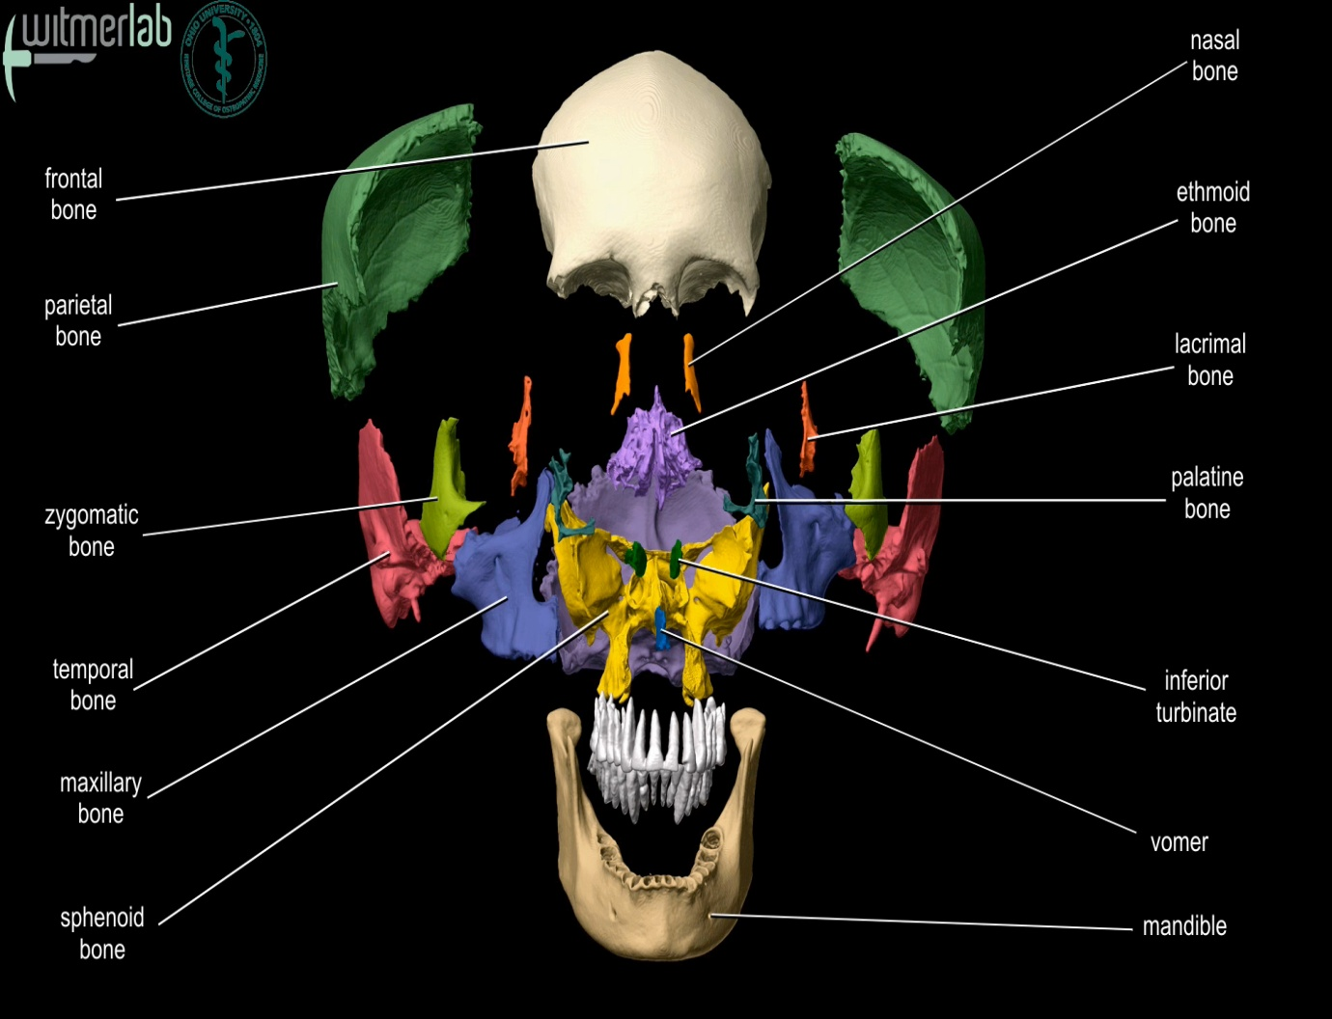
Ten Cranial Bones or Ten Cubits
12
(Exodus 26:16)
L
24 Elders in White
before the Throne
L

Slide 13
13
Ten cubits [shall be] the length of a board, and a cubit and a half [shall be] the breadth of one board.
Ye also, as lively stones, are built up a spiritual house, an holy priesthood, to offer up spiritual sacrifices, acceptable to God by Jesus Christ. (1 Peter 2:5)
The Hole of the vertebral (spinal) known as Magnum Foramen
For then must he often have suffered since the foundation of the world: but now once in the end of the world hath he appeared to put away sin by the sacrifice of himself. (Hebrew 9:26)
And he bearing his cross went forth into a place called [the place] of a skull,
which is called in the Hebrew Golgotha: (John 19:17)
(For other references: (Mark 15:22, Matthew 27:33).
And as it is appointed unto men once to die, but after this the judgment:
So Christ was once offered to bear the sins of many; and unto them
that look for him shall he appear the second time without sin unto salvation. (Exodus26:14-16)

Slide 14
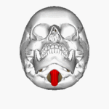
Philippians 1:20
According to my earnest expectation and [my] hope, that in nothing I shall be ashamed, but [that] with all boldness, as always, [so] now also Christ shall be magnified in my body, whether [it be] by life, or by death.
14
The Lamb slain from the foundation of the world can be seen down the Magnum Foramen lifted up on the Sternum on the vertebra.

Slide 15
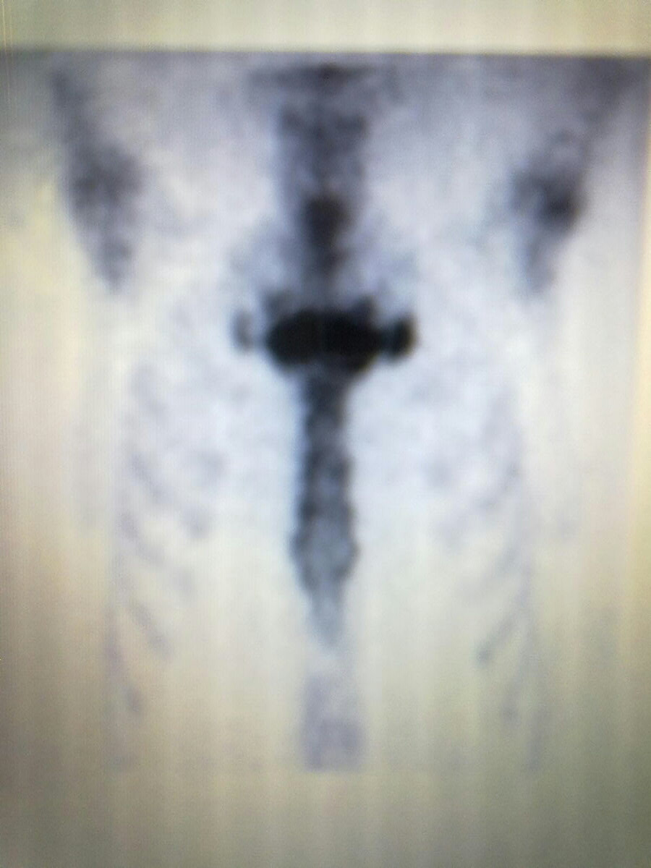
The Sternum Stands as Christ Crucified in us.
15
Christ said! And I, if I be lifted up from the earth, will draw all [men] unto me. (John 12:32)
And Moses made a serpent of brass, and put it upon a pole,
(Num. 21: 8-9)
I am crucified with Christ: nevertheless I live; yet not I, but Christ liveth in me: and the life which I now live in the flesh I live by the faith of the Son of God, who loved me, and gave himself for me. (Galatians 2:20)

Slide 16
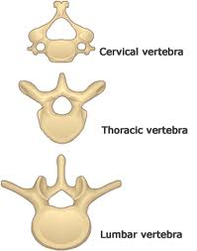
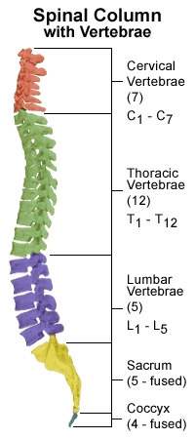
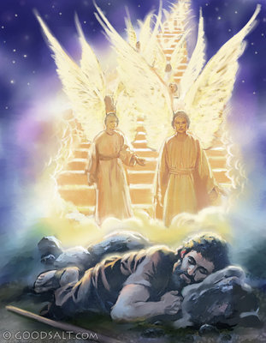
Lest take a look at our Vertebra It consist of 33 bones that form our (spinal) column
16
The Spinal Cord is the highway of the Central Nervous System and is connected to the brain sending messages through neurons.
(The Serpent made of brass lifted up by Moses)
The Highway of ministering Angels ascending and descending known as Jacob’s Latter. latter/a gates
(The heavenly messengers to help aid men)
Genesis 28:22 Revelation 2:17
Genesis 28:11-12, 16

Slide 17
I Am The Way The Truth and
The Life
A Symbol of the Acacias Wood is
(The ladder)
The medium of communication between God and man. Through the mystic ladder the gospel was preached to Jacob. As the ladder stretched from earth, reaching to the highest heavens, and the glory of God was seen above the ladder, so Christ in His divine nature reached immensity and was one with the Father. As the ladder, though its top penetrated into heaven, had its base upon the earth, so Christ, though God, clothed His divinity with humanity and was in the world "found in fashion as a man" (Philippians 2:8).
The ladder would be useless if it rested not on the earth or if it reached not to the heavens. (Isaiah 51: 6)
God appeared in glory above the ladder, looking down with compassion on erring, sinful Jacob.... It is through Christ that the Father beholds sinful man....
The broken links have been repaired. A highway has been thrown up along which the weary and heavy laden may pass. They may enter heaven and find rest.
Our High Calling, Page 66

Slide 18
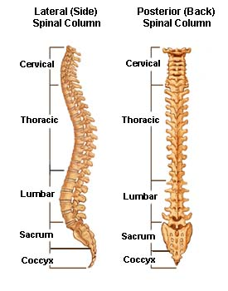
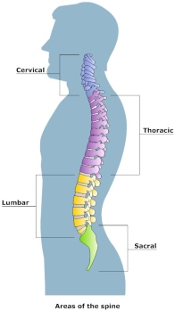
18
Jesus was 33
at His death.
The Serpent of Brass
Remnant Sealed by
7 Pillars
Hewed stone
Proverb 9:1
12 Tribes of Israel
Costly stone
Ephesians 2:20
10 Prophets
5 L+5S =10
Great stone
1 Kings 5: 17
7+12+10+4=33
4 Horns
7=His Perfection 12= His humanity
10= His Righteousness 4= His Divinity

Slide 19
And the LORD said unto Moses, Make thee a fiery serpent, and set it upon a pole: and it shall come to pass, that every one that is bitten, when he looketh upon it, shall live. And Moses made a serpent of brass, and put it upon a pole, and it came to pass, that if a serpent had bitten any man, when he beheld the serpent of brass, he lived.
Christ is the ladder that Jacob saw, whose base rests upon the earth, and whose topmost round reaches into the highest heaven; and round after round, you must mount this ladder until you reach the everlasting kingdom. There is no excuse for becoming more like Satan, more like human nature. God has set before us the height of the Christian's privilege, and it is "to be strengthened with might by His Spirit in the inner man; that Christ may dwell in your hearts by faith; that ye, being rooted and grounded in love, may be able to comprehend with all saints what is the breadth, and length, and depth, and height; and to know the love of Christ, which passeth knowledge, that ye might be filled with all the fulness of God"
(Ephesians 3:16-19). -- Vol. 2 SM-Selected Messages Book 222,223.
This man of faith beholds the ladder presented in Jacob's vision, representing
Christ, who has connected earth with heaven, and finite man with the infinite God. His faith is strengthened as he calls to mind how patriarchs and prophets have relied upon the One who is his support and consolation and for whom he is giving his life. From these holy men who from century to century have borne testimony for their faith, he hears the assurance that God is true.
{Review and Herald, January 4, 1912 par. 22 first part}
19

Slide 20
(1 Peter 2:5-8)
Christ's followers should be instruments of righteousness, workmen, living stones emitting light, that they may encourage the presence of heavenly angels. They are required to be channels, as it were, through which the spirit of truth and righteousness shall flow. Many have partaken so largely of the spirit and influence of the world that they act like the world.
{Chs-Christian Service 21.1} {Volume 2-Testimonies to the Church 126.4}
And the king commanded, and they brought great stones, costly stones, [and] hewed stones, to lay the foundation of the house.
(1 King 5:17)
Apostles and the foundation [was of] costly stones,
Twelve tribes even great stones, stones of ten cubits, and stones of eight cubits. And above [were] costly stones, after the measures of hewed stones, and cedars. (1 King 7:10 -11)
And are built upon the foundation of the apostles and prophets,
Jesus Christ himself being the chief corner [stone]; in whom all the building fitly framed together groweth unto an holy temple in the Lord: In whom ye also are builded together for an habitation of God through the Spirit.
(Ephesians 2:20-22)
20

Slide 21
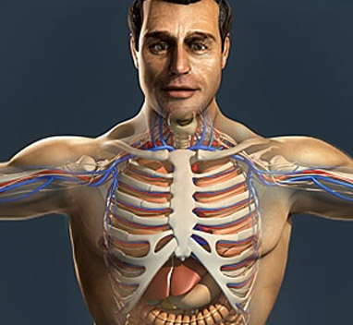
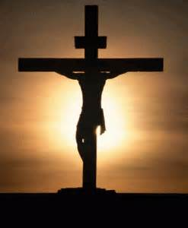
And I, if I be lifted up from the earth, will draw all [men] unto men. John 12:32
THE STERNUM
21
Isaiah 42:21
The LORD is well pleased for his righteousness' sake;
he will magnify the law, and make [it] honourable.
The "sternum" is the medical name for the breastbone, a long, narrow, flat plate that forms the center of the front of the chest. It develops
in three parts:
{Colossians 2:9 }
An upper portion, or manubrium," a middle "body," and a lower "xiphoid process" that projects down. The sternum is very strong and requires great force to fracture. The main danger in this type of injury is not the fracture itself, but the chance that the broken bone may be driven into the heart, which lies just behind it.
Ten ribs touches the Sternum by cartilages and two rib are floating loose below.
Number 21:9 ; Zachariah 3:1-10 John 3:14; 8:28; John 12:32

Slide 22
22
No Rest for Some
Never before was there such a general knowledge of Jesus as when He hung upon the cross. He was lifted up from the earth, to draw all to Him. Into the hearts of many who beheld that crucifixion scene, and who heard Christ's words, was the light of truth to shine.
With John they would proclaim, "Behold the Lamb of God, which taketh away the sin of the world." There were those who never rested until, searching the Scriptures and comparing passage with passage, they saw the meaning of Christ's mission. They saw that free forgiveness was provided by Him whose tender mercy embraced the whole world.
They read the prophecies regarding Christ, and the promises so free and full, pointing to a fountain opened for Judah and Jerusalem
{Vol.5 Bible Commentary 1137.6} (MS 45,1897) (John 1:29; 3:14, 15; Galatians 6:14).
Study All in Light From Cross
The sacrifice of Christ as an atonement for sin is the great truth around which all other truths cluster. In order to be rightly understood and appreciated,
every truth in the Word of God, from Genesis to Revelation, must be studied in the light which streams from the cross of Calvary, and in connection with the wondrous,
central truth of the Saviour's atonement. Those who study the Redeemer's wonderful sacrifice grow in grace and knowledge.
I present before you the great, grand monument of mercy and regeneration, salvation and redemption--the Son of God uplifted on the cross of Calvary.
This is to be the theme of every discourse.
Christ declares, "And I, if I be lifted up from the earth, will draw all men unto me"
{Vol.5 Bible Commentary 1137.7-8} (MS 70, 1901).

Slide 23
23
Look and Live!
Hanging upon the cross Christ was the gospel. Now we have a message,
"Behold the Lamb of God, which taketh away the sins of the world." Will not our church members keep their eyes fixed on a crucified and risen Saviour, in whom their hopes of eternal life are centered? This is our message, our argument, our doctrine, our warning to the impenitent, our encouragement for the sorrowing, the hope for every believer. If we can awaken an interest in men's minds that will cause them to fix their eyes on Christ, we may step aside, and ask them only to continue to fix their eyes upon the Lamb of God. They thus receive their lesson. Whosoever will come after Me, let him deny himself, and take up his cross, and follow Me. He whose eyes are fixed on Jesus will leave all. He will die to selfishness. He will believe in all the Word of God, which is so gloriously and wonderfully exalted in Christ. {Vol. 6 Bible Commentary 1113.1}
(Isaiah 45:21, 22; Matthew 16:24; John 1:29.)
As the sinner sees Jesus as He is, an all compassionate Saviour, hope and assurance take possession of his soul. The helpless soul is cast without any reservation upon Jesus. None can bear away from the vision of Christ Jesus crucified a lingering doubt. Unbelief is gone (MS 49, 1898).
{Vol. 6 Bible Commentary 1113.2}
I

Slide 24
The Cross of Christ Moves the World.
The cross of Calvary challenges, and will finally vanquish every earthly and hellish power. In the cross all influence centers, and from it all influence goes forth.
It is the great center of attraction; for on it Christ gave up His life for the human race. This sacrifice was offered for the purpose of restoring man to his original perfection. Yea, more, it was offered to give him an entire transformation of character, making him more than a conqueror.
Those who in the strength of Christ overcome the great enemy of God and man, will occupy a position in the heavenly courts above angels who have never fallen.
Christ declares, "I, if I be lifted up from the earth, will draw all men unto me." If the cross does not find an influence in its favor, it creates an influence.
Through generation succeeding generation, the truth for this time is revealed as present truth. Christ on the cross was the medium whereby mercy and truth met together, and righteousness and peace kissed each other.
This is the means that is to move the world.
{Vol. 6 Bible Commentary 1113.3-5} (MS 56, 1899)
(Psalm 85:10) (James 2:13) (Acts 9:8, 9).
l
24

Slide 25
The Cross Planted Between Earth and Heaven.
When Christ came to this world, He found that Satan had everything as he wanted it. The adversary of God and man thought that he was indeed the prince of the earth, but Jesus laid hold of the world to take it out of the power of Satan.
He came to redeem it from the curse of sin and the penalty of transgression, that the transgressor might be forgiven. He planted the cross between earth and heaven, and between divinity and humanity; and as the Father beheld the cross, He was satisfied. He said, "It is enough, the offering is complete." God and man may be reconciled. Those who have lived in rebellion against God, may become reconciled, if as they see the cross, they become repentant, and accept the great propitiation that Christ has made for their sins. In the cross they see that "mercy and truth have met together; righteousness and peace have kissed each other“
(Sign of the Time Sept. 30, 1889). {Vol.5Bible Commentary 1137.9}
The Cross a Center in the World.
The cross stands alone, a great center in the world. It does not find friends, but it makes them. It creates its own agencies. Christ proposes that men shall become laborers together with God. He makes human beings His instrumentalities for drawing all men unto Himself.
A divine agency is sufficient only through its operation on human hearts with its transforming power, making men colaborers with God.
(RH Sept. 29, 1891). ( {5BC 1138.1-3} (Galatians 6:14.) (Luke 7:29, 30) (Acts 1:11)
25

Slide 26
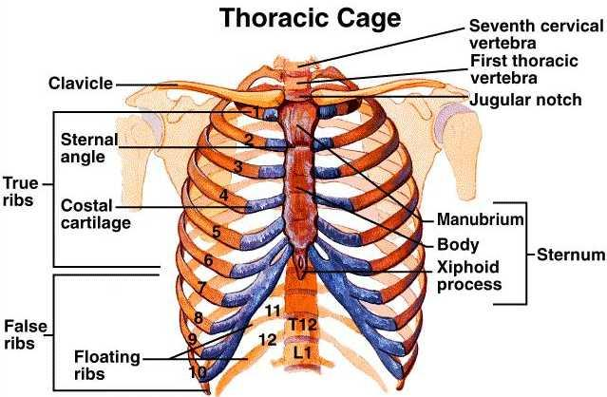
Think not that I am come to destroy the law, or the prophets: I am not come to destroy, but to fulfil.
26
Matthew 5:17
The 10 Ribs =
The Ten Commandments
Colossians2:9
For in him dwelleth all the fulness of the Godhead bodily.
The 2 floating Ribs= The Two
Greatest Commandments
Matthew 22:36-40

Slide 27
Christ came to Magnify the Law and make it Honorable
Jesus said unto him, Thou shalt love the Lord thy God with all thy heart, and with all thy soul, and with all thy mind. This is the first and great commandment. And the second [is] like unto it, Thou shalt love thy neighbour as thyself.
On these two commandments hang all the law and the prophets.
(Matthew 22:38-40)
This [is] the covenant that I will make with them after those days, saith the Lord, I will put my laws into their hearts, and in their minds will I write them;
(Hebrew 10:16)
For this [is] the covenant that I will make with the house of Israel after those days, saith the Lord; I will put my laws into their mind, and write them in their hearts: and I will be to them a God, and they shall be to me a people:
(Hebrew 8:10)
27

Slide 28
Next Week:
The Sanctuary of our Body
The Third Temple
Series 3
The Skeleton System Part 2
Christ is the Sternum in our Tabernacle
I Am the Way The Truth And The Life
And the government shall be
upon his shoulder
(Isaiah 9:6 Margin)

