Slide 1
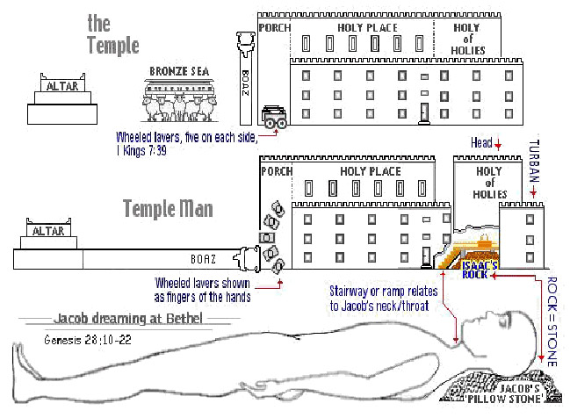
The Sanctuary of our Body
THE THIRD TEMPLE
Series 3
The Skeleton System , Part 2
By : sister rose

Slide 2
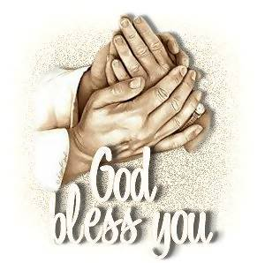
We will continue with part 2 of our lesson!
The Skeleton System
Operates and Functions like
(The Tribe of Issachar)
“Strong as Donkey”
Christ is the Sternum in our Tabernacle
I Am the Way The Truth And The Life.
And the government shall be
upon his shoulder
(Isaiah 9:6 Margin)

Slide 3
Man are Stones
1 Peter 2:5-18
Ye also, as lively stones, are built up a spiritual house, an holy priesthood, to offer up spiritual sacrifices, acceptable to God by Jesus Christ.
Wherefore also it is contained in the scripture, Behold, I lay in Sion a chief corner stone, elect, precious: and he that believeth on him shall not be confounded.
Unto you therefore which believe [he is] precious: but unto them which be disobedient, the stone which the builders disallowed, the same is made the head of the corner,
And a stone of stumbling, and a rock of offence, [even to them] which stumble at the word, being disobedient: whereunto also they were appointed.
But ye [are] a chosen generation, a royal priesthood, an holy nation, a peculiar people; that ye should show forth the praises of him who hath called you out of darkness into his marvellous light:
Proverbs 8: 34-36
Blessed [is] the man that heareth me, watching daily at my gates, waiting at the posts of my doors.
For whoso findeth me findeth life, and shall obtain favour of the LORD.
But he that sinneth against me wrongeth his own soul:
all they that hate me love death.

Slide 4
The breastplate of judgment contained the names of the twelve tribes, and was worn over the heart of the
high priest as he performed the work which typified the work of the judgment. (Revelation 2:17) {HDL 63.4}(Exodus 28:15-21)
As each individual name comes up in review before God in the judgment, Christ will "confess" the names of the overcomers, and their names will remain in the book of life. There is a touching significance in the high priest's wearing the names of all Israel on his shoulders and over his heart as he performed the work which typified the judgment, when the case of every one will come up in review before God.
The breastplate was called "the breastplate of judgment.“ Those names engraved on the stones were a type of the names of the overcomers, which Christ will confess before His father and the angels. Stone is an enduring substance, but far more enduring is the book of life, where the names which Christ has confessed, are written to remain forever.
{1914 SNH, The Cross and Its Shadow 89.2}
( Revelation 3:5)
4

Slide 5
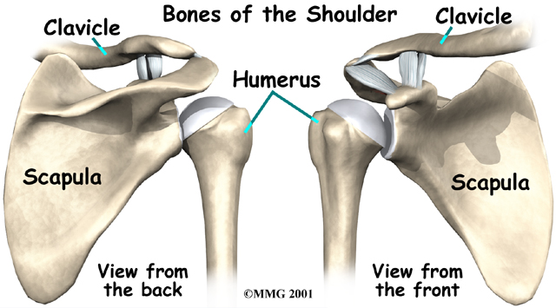
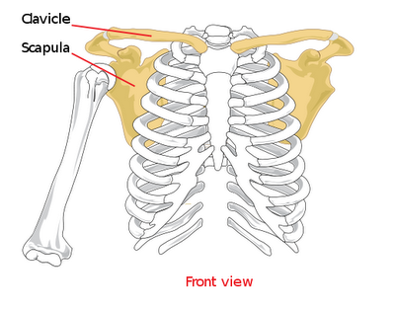
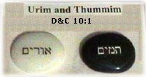
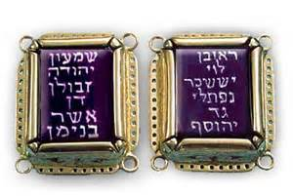
And the government shall be upon his shoulder Isaiah 9:6 margin.
THE SCAPULAR SHOULDER BONES
5
For unto us a child is born, unto us a son is given: and the government shall be upon his shoulder: and his name shall be called Wonderful, Counsellor, The mighty God, The everlasting Father, The Prince of Peace.
(Isaiah 9:6)
And thou shalt put the two stones upon the shoulders of the ephod [for] stones of memorial unto the children of Israel: and Aaron shall bear their names before the LORD upon his two shoulders for a memorial. And he put the breastplate upon him:
also he put in the breastplate the Urim and the Thummim. (Leviticus 8:8)
(Exodus 28: 12, 30)
Ephesians 4:12-15
(Exodus 28:12)
Two Onyx Stones
on his shoulder

Slide 6
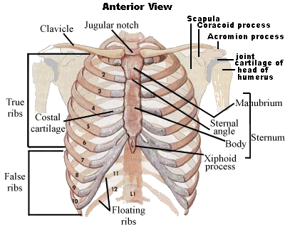
What The Ribs Teach about the Gospel?
6
There are 7 True Ribs Directly Connected to Christ in
Spirit and Truth
is their foundation.
The Remnants and The Disciples
Sealed by Their
Pillars of Faith
All Judgment has been given to Christ
John 5:22
7 True
Ribs
3 False Ribs
There are 3 False ribs separated from Christ: Represents the Three unclean spirits like frogs
The 5 False Ribs like the
5 foolish Virgins: Represent
The 3 False Ribs and the
2 Floating Ribs
Ribs Lacking the Spirit of Christ life in them.
2 Floating
Ribs

Slide 7
The Two Scapulas: Breast Plate of Judgment :Represent
The Thummin/ Urim the two Stones carried on the High Priest shoulders
(Exodus 25:7; 28:15-21, 30)(Psalms 9:7-9)(John 5:22, 27, 30)
(1 Samuel 23:9-12) (Numbers 27:21)
24 Ribs Protects The Lungs And Heart: Represent Christ Government/The Holy
Original and Spiritual Israel
(Zion Jeremiah 6:2 Judah/Kings and Jerusalem Zechariah 8:3 Elders/Priest)
(Matthew 10:2-4 )12 Disciples and (Genesis 49:1-27) 12 Tribe of Israel
10 Ribs: Represent the Ten Commandment (Exodus 20:1-17)
10 Costal Cartilage (Matthew 25:1)
2 Floating Ribs verterbral: Represent The 2 Greatest Commandments
(Mark 12:30-31) (Matthew 22:40)
7 True Ribs verterbrosternal: Represent The Seven Spirit of Christ
(Isaiah 11:1-2). And there shall come forth a rod out of the stem of Jesse, and a Branch shall grow out of his roots: Isaiah 61:3
1)Growth 2)Witnessing 3)Fruit Bearing 4)Unity with Christ 5)Suffering 6)Fellowship 7) Spirit Filling
And the spirit of the LORD shall rest upon him, the spirit of wisdom and understanding, the spirit of counsel and might, the spirit of knowledge
and of the fear of the LORD;
7

Slide 8
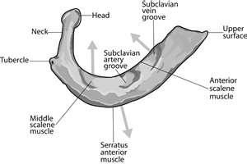
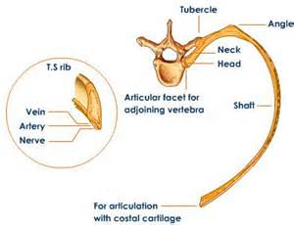
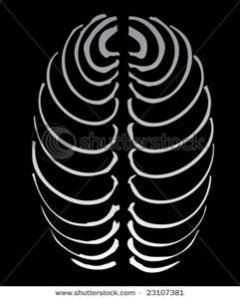
8
The Anchor shape
At the base
The Rib = A Man
They have Veins , Arteries, Nerves
There are 24 Ribs
The Ribs
They are the frame-work of that part of the human trunk termed the chest, in which the lungs and heart are deposited for safe keeping.
{1868 John Norton Loughborough,
Hand Book of Health 36.7}
Represents
24 Elders

Slide 9
7 Cervical Curvature = The Remnant hewed stones (Philippians 3:1-3,7 17, 20)
The Church bind by (Jeremiah 5:24, Hosea 6:3, Joel 2:23)
the Former Rain and the Latter Rain)
(Zechariah 10:1, Upward Look pg 283) (Revelation 5:6; 14:1-4)
The 144,000 a 10% selected from the mix multitude (Mark 8:23-25) (Psalms 91:9)
The Remnant : Pillars of our faith: First, Second and Third Angels Messages (Revelation 14:1-8), The Sanctuary Message Christ our High and The Sabbath Truth Priest
(Hebrew 4), Non immortality of the Soul or State on the Dead (Ecclesiastes 9:5).
(Hebrew 13:12-18) (Roman 11:5) (Micah 2:12-13, 4:5-7)
(Revelation 14:1-6; 18:1-6) (1 Peter 4:14, 15-19)
REDEEMED TAKE SEVEN DAYS TRAVELING TO HEAVEN.—
We all entered the cloud together, and were seven days ascending to the sea of glass, when Jesus brought the crowns, and with His own right hand placed them on our heads. He gave us harps of gold and palms of victory. Here on the sea of glass the 144,000 stood in a perfect square. Some of them had very bright crowns, others not so bright. Some crowns appeared heavy with stars, while others had but few. All were perfectly satisfied with their crowns. And they were all clothed with a glorious white mantle from their shoulders to their feet. Angels were all about us as we marched over the sea of glass to the gate of the city. Jesus raised His mighty, glorious arm, laid hold of the pearly gate, swung it back on its glittering hinges, and said to us, “You have washed your robes in My blood, stood stiffly for My truth, enter in.” We all marched in and felt that we had a perfect right in the city.—
LS-Life Sketches of Ellen G. White pg 66, 67. {Heaven 47.2}
9

Slide 10
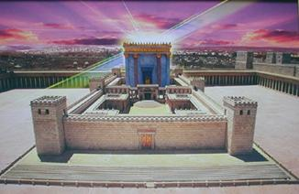
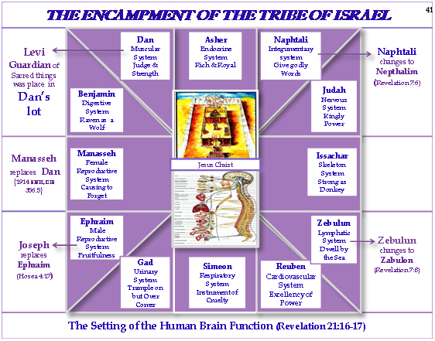
Type
Christ Jesus Our
Anti-type
10
Moses' Tabernacle
Jesus our Sanctuary
Solomon’s Temple

Slide 11
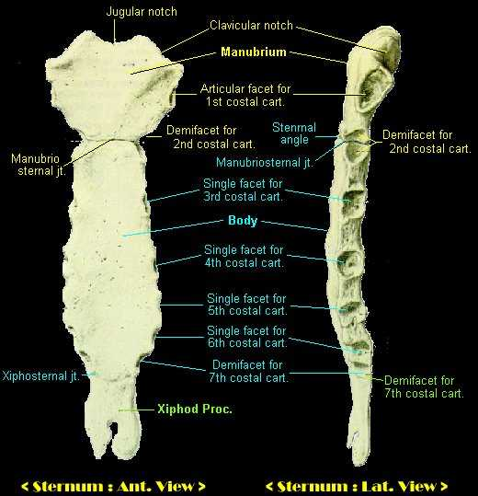
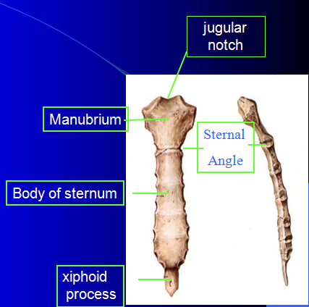
The Sternum as the Body of Christ
11
7 His Perfection

Slide 12
12
The Sternum a Symbol of our Saviour’s Body
(Number 21:9) (Zachariah 3:1-10) (John 3:14; 8:28) (Ephesians 1:14)
I am crucified with Christ: nevertheless I live; yet not I, but Christ liveth in me: and the life which I now live in the flesh I live by the faith of the Son of God, who loved me, and gave himself for me. (Galatians 2:20)
The smitten rock was a figure of Christ, and through this symbol the most precious spiritual truths are taught. As the life-giving waters flowed from the smitten rock, so from Christ, "smitten of God," "wounded for our transgressions," "bruised for our iniquities" (Isaiah 53:4, 5), the stream of salvation flows for a lost race. As the rock had been once smitten, so Christ was to be "once offered to bear the sins of many." Hebrews 9:28.
Our Saviour was not to be sacrificed a second time; and it is only necessary for those who seek the blessings of His grace to ask in the name of Jesus, pouring forth the heart's desire in penitential prayer. Such prayer will bring before the Lord of hosts the wounds of Jesus, and then will flow forth afresh the life-giving blood, symbolized by the flowing of the living water for Israel. {Patriarch Prophets 411.3}
Cells are produce in the bone by marrow within the spongy bone of
THE STERNUM: Christ Jesus the Life Giver
(Job 2:5; 10:11, 15; 19:20; 21:24; 31:22) (Hebrew 4:12) (Gen 2:23; 29:14)
If I be wicked, woe unto me; and [if] I be righteous, [yet] will I not lift up my head. [I am] full of confusion; here fore see thou mine affliction;
(Matthew 27:50; Luke 23:46; develops in three parts: {Colossians 2:9}

Slide 13
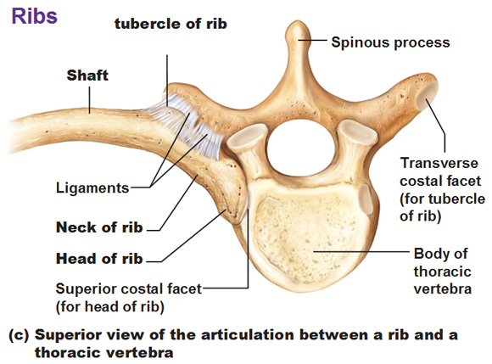
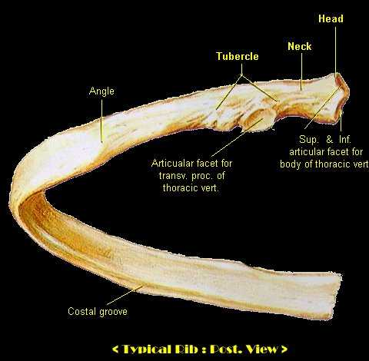
Ephesians 4:16 From whom the whole body fitly joined together and
compacted by that which every joint supplieth, according to the effectual working in the measure of every part, maketh increase of the body unto the edifying of itself in love.
But it was not the spear thrust, it was not the pain of the cross, that caused the death of Jesus. That cry, uttered "with a loud voice“
at the moment of death, the stream of blood and water that flowed from His side, declared that He died of a broken heart.
His heart was broken by mental anguish. He was slain by the sin of the world.
(Matthew 27:50; Luke 23:46) {Desire of Ages 772.2}
13
12 Tribes
of Israel

Slide 14
Twelve Costly Stones
Represented by the 12 Thoracic Curvature bones:
(Exodus 28: 21)
One after another the foremost of the builders fell by the hand of the enemy. Stephen was stoned; James was slain by the sword; Paul was; Peter was crucified; John was exiled. Yet the church grew.
New workers took the place of those who fell, and stone after stone was added to the building. Thus slowly ascended the temple of the church of God. {Acts the Apostles 597.2}
Centuries of fierce persecution followed the establishment of the Christian church, but there were never wanting men who counted the work of building God's temple dearer than life itself. Of such it is written: "Others had trial of cruel mocking and scourging, yea, moreover of bonds and imprisonment: they were stoned,
they were sawn asunder, were tempted, were slain with the sword: they wandered about in sheepskins and goatskins; being destitute, afflicted, tormented;
(of whom the world was not worthy:)
they wandered in deserts, and in mountains, and in dens and caves of the earth."
{Acts and the Apostles 597.3} (Hebrews 11:36-38)
14

Slide 15
12 Thoracic Curvature= The Apostolic Church Twelve Costly Stones
the New Israel (Precious stones) Galatians 6:15-16, Romans 9:6 Ephesians 2:19-20
Representing the 12 Tribes (Exodus 28:10, 17-19)
(Jeremiah 5:24, Hosea 6:3, Joel 2:23) Bind by the Former Rain (Revelation 21:4)
lay foundation on the city) (Matthew 4:17; 10:2-5; 19:27) Jerusalem (Zechariah 8:3) (Genesis 49:1-27) Zion (Jeremiah 6:2) Out of Zion shall come forth the Law .
Lamina: (Mark 6:7)
the pedicles, laminae and spinous process together complete a bony vertebral arch around the vertebral for amen through which the spinal card passes.
It is shape like an Anchor symbolizes: the Commission to be Fisher of Men (Matthew 4:19-20, Mark 3:13-14)
The disciples were to go forth as Christ's witnesses, to declare to the world what they had seen and heard of Him. Their office was the most important to which human beings had ever been called, second only to that of Christ Himself.
They were to be workers together with God for the saving of men.
As in the Old Testament the twelve patriarchs stood as representatives of Israel,
so the twelve apostles stand as representatives of the gospel church.
GW Gospel Workers pg 445.4--Idem, pages 18, 19.
The disciples began to realize the nature and extent of their work. They were to proclaim to the world the wonderful truths which Christ had entrusted to them.
15

Slide 16
16
The 7 Pillars of the Disciples Faith
1. The events of His life,
2. His death
3. And resurrection,
4. The prophecies that pointed to these events
5. The sacredness of the law of God
6. The mysteries of the plan of salvation
7. The power of Jesus for the remission of sins—(Hebrew 5:10-14, 6:1-7, 7:22-28)
to all these things they were witnesses, and they were to make them known to the world.
Three fold message
1. They were to proclaim the gospel of peace
2. and salvation through repentance
3. and the power of the Saviour
"And when He had said this, He breathed on them, and saith unto them, Receive ye the Holy Ghost: Whosesoever sins ye remit, they are remitted unto them; and whosesoever sins ye retain, they are retained." The Holy Spirit was not yet fully manifested; for Christ had not yet been glorified. The more abundant impartation of the Spirit did not take place till after Christ's ascension. Not until this was received could the disciples fulfill the commission to preach the gospel to the world. But the Spirit was now given for a special purpose.
Before the disciples could fulfill their official duties in connection with the church, Christ breathed His Spirit upon them. He was committing to them a most sacred trust, and He desired to impress them with the fact that without the Holy Spirit this work could not be accomplished. {Desire of Ages 805.1-2}

Slide 17
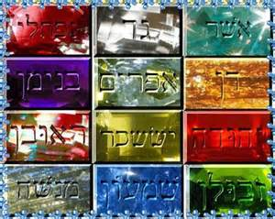
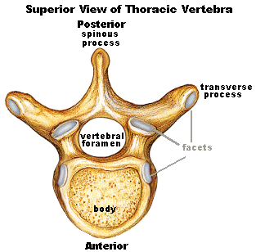
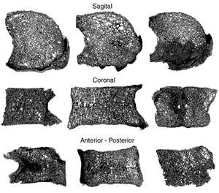
(1 King 5:17)
And the king commanded, and they brought great stones,
costly stones, [and] hewed stones, to lay the foundation of the house.
17

Slide 18
18
When not Connected to Christ The Living Word
(The Lord of the Sabbath)
(Roman 9:29), He is the Light of men John 1:4,9)
We become part of the group without Light.
John 3:19-20
And this is the condemnation, that light is come into the world, and men loved darkness rather than light, because their deeds were evil. For every one that doeth evil hateth the light, neither cometh to the light, lest his deeds should be reproved.
5 Ribs Vertebrochondral: Represents the Five Foolish Virgin
(Matthew 25:2-3, 5)
3 False Ribs with Costal Cartilage: Represent the 3 Unclean Spirit like frog.
Christ-less no connection with Him the Lord of the Sabbath
(Revelation 16:13-14) (2 Timothy 4:3-4) (1 Kings 6:6)
(Catholicism, Apostate Protestantism and Spiritualism) (James 5:2-6)
2 Floating Ribs: without Costal Cartilage (Psalms 11:29; 12:15; 14:1, 16)
these are New Agers and Atheism hang free, (disconnected from Light)
supported by muscles (priest= muscles) not on Christ but by
man’s philosophy and their wisdom.
(Colossians 2:8) Beware lest any man spoil you through philosophy and vain deceit, after the tradition of men, after the rudiments of the world, and not after Christ.

Slide 19
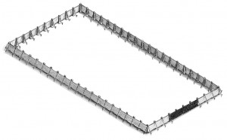
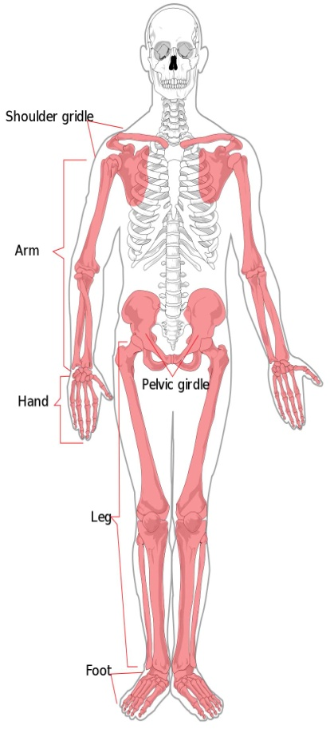
The Frame of the Court Yard are
60 Pillars= 20 south, 20 north, 10 west, 10 east
(Exodus 27:10-12) (Romans 12:1-2)
60 Bones=The Appendicular Skeleton (Revelation 1:15)
Seven and a half feet high (Revelation 19:8)
19
Exodus 27:10-12
10. And the twenty pillars thereof and their twenty sockets [shall be of] brass; the hooks of the pillars and their fillets [shall be of] silver.
11. And likewise for the north side in length [there shall be] hangings of an hundred [cubits] long, and his twenty pillars and their twenty sockets [of] brass; the hooks of the pillars and their fillets [of] silver.
12. And [for] the breadth of the court on the west side [shall be] hangings of fifty cubits: their pillars ten, and their sockets ten.
10
20
20
10

Slide 20
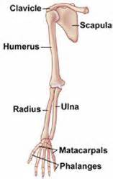
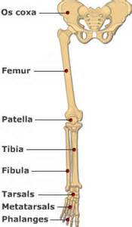
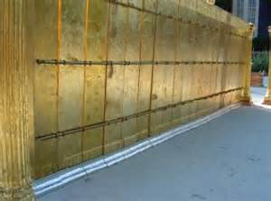
The Boards made Pillars around the Courtyard
20
Courtyard
5
10
4
3
Holy Place
1
2
5
5
5
5
10
4
5
3
2
Holy Place
10
1
The central core of long bones is a hollow cylinder lined with spongy bone, and this cavity is filled with a soft, fatty connective tissue called Yellow bone marrow .

Slide 21
The Fine Twined Linen Christ Righteousness our Wedding Garment
The work of Christ is illustrated by the parable of the marriage of the king's son. All the guests, both bad and good are gathered at the marriage; but when the king comes in to examine the guests, all are ejected except those who are clothed with the wedding garment of Christ's righteousness.
(Revelation 3:18)
"Many are called, but few are chosen.”
(Matthew 22:1-14) {1914 SNH, The Cross and Its Shadow 31.1}
The tabernacle was surrounded by a court one hundred cubits long and fifty cubits wide. This court was enclosed by curtains of fine twined linen hung from Pillars of brass. The pillars were trimmed with chapiters and fillets of silver, and the curtains were suspended from silver hooks. The court formed an oblong, and was placed with its longest sides toward the north and south and the ends toward the east and west. The door, or entrance, of twenty cubits width, was in the center of the east end of the court. The curtains forming the door of the court were of "blue, and purple, and scarlet, and fine twined linen wrought with needlework," and were suspended from four pillars of brass, trimmed with silver.
(Exodus 27:9-18) {1914 SNH, The Cross and Its Shadow 173.1}

Slide 22
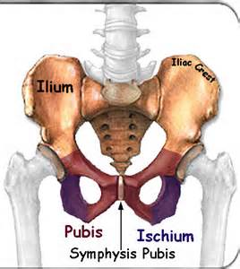
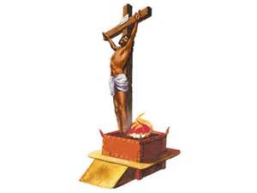
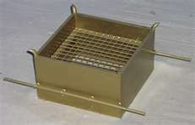
Great Stones
10= 5 Lumbar Curvature + 5 Sacrum= the Patriarchs and Prophets
(James 5:7)
bound by the Early Rain) the setting of His Government the Prophecy of the Promise Messiah. (Daniels 9:24-25)
4 Coccyx Bones=the Horns on the Altar of Scarifies (Ezekiel 10:11-14)
22

Slide 23
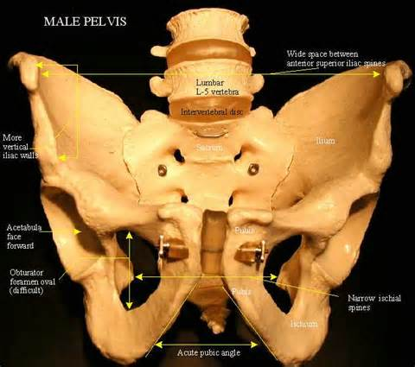
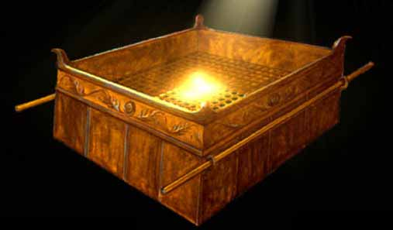
The Brazen Altar
23
The altar was a hollow box, five cubits square and three cubits high, made of boards of acacia wood on each corner.
A network of brass in the center held the fire and draft for it, allowed the ashes to fall beneath. {1914 SNH, CIS 174.2}
All burnt-offerings of the sanctuary were burned upon the brazen altar. The fire was kindled by the Lord Himself, and was kept burning continually. It was never to go out. The fire which destroy all sin from the earth
{1914 SNH, CIS 174.3}
Hebrews 13:10
Leviticus 9:24, 16:15-22
Exodus 38: 1-7

Slide 24
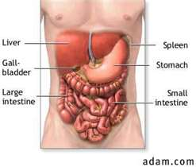
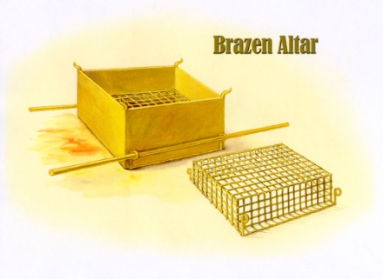
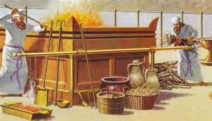
Exodus 29:22
Also thou shalt take of the ram the fat and the rump, and the fat that covereth the inwards, and the caul [above] the liver, and the two kidneys, and the fat that [is] upon them, and the right shoulder; for it [is] a ram of consecration:
24
Upon the Altar
The Organs that are burned as a sweet savor to the Lord

Slide 25
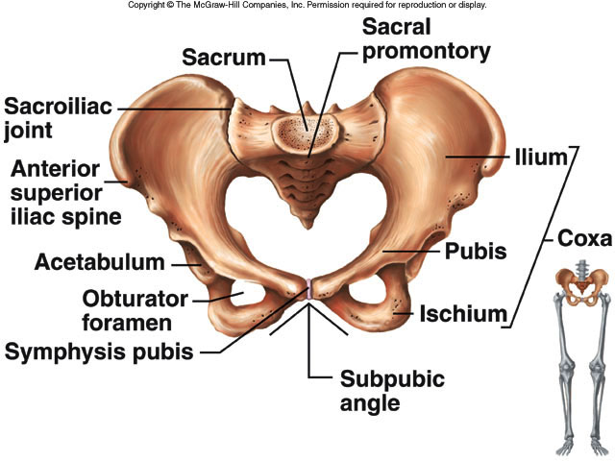
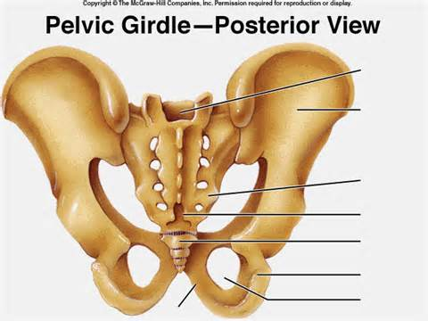
(Exodus 27:1)
And thou shalt make an altar [of] shittim wood, five cubits long, and five cubits broad; the altar shall be foursquare: and the height thereof [shall be] three cubits.
25
(Exodus 40:6-7, 10, 29; 29:37; 27:1-8) (Leviticus 1:2-9,13, 17; 4:7,18, 25, 30; 6:13; 9:24)
(Genesis 2:22-25) (Revelation 1:15) (John 6:45)

Slide 26
26
Sacrum
The sacrum is a large triangular bone at the base of the lower spine.
The sacrum is a strong bone and rarely fractures. The five vertebrae that make up the sacrum are separated in early life, but gradually become fused together between the eighteenth and thirtieth years. The coccyx, or tail bone, is attached by ligaments to the margins of the sacral hiatus
(opening at the tip of the sacrum).
http://www.innerbody.com/image/skelfov.html
No part of the sanctuary or of the court was made according to the plans of men; but every part was fashioned after the divine model. When the Lord had given Moses the directions in regard to making the brazen altar, He added,
"As it was showed thee in the mount, so shall they make it.“
(Exodus 27:8)
The altar was a hollow box, five cubits square and three cubits high, made of boards of acacia wood. There was a horn of the same wood on each corner.
A network of brass in the center held the fire and gave draft for it, and allowed the ashes to fall beneath. The entire altar with the horns was all overlaid with brass.
It was "an altar most holy: whatsoever toucheth the altar shall be holy,“
was the divine decree.
{1914 SNH, The Cross and Its Shadow 174.1-2}

Slide 27
All burnt-offerings of the sanctuary were burned upon the brazen altar. The fire was kindled by the Lord Himself, and was kept burning continually. It was never to go out. The fire which destroys all sin from the earth, like the fire on the brazen a1tar, will come down from God out of heaven, and will not be quenched as long as there is any sin to be consumed.
(Leviticus 9:24; 6:13) (Revelation 20:9; Mark 9:43-48)(Exodus 27:1-8)
{1914 SNH, The Cross and Its Shadow 174.3}
It consumed that which typified sin; and as the fires were continually burning,
it has been called "the altar of continual atonement." Sin separates man from God, and all sin must be put away before the sinner can be at-one-ment with God. Therefore the work done upon this altar was a symbol of the final destruction of sin, which will be necessary before the redeemed can enjoy their eternal inheritance. (Isaiah 59:2)
Paul referred to this altar as a type of Christ. All the work connected with the altar of burnt-offering typified the work connected with the destruction of sin, a work which Christ alone can do. The Father has delivered into the hands of His Son the final destruction of sin and sinners.
(Hebrews 13:10) (Psalms 2:7-9)
{1914 SNH, The Cross and Its Shadow 175.1-2}
27

Slide 28
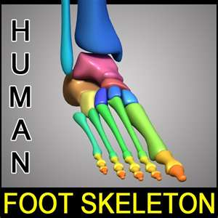
The Gate to Justification The Way to Mercy at the Feet of Jesus
28
Blessed [is] the man that heareth me, watching daily at my Gates, waiting at the posts of my Doors. For whoso findeth me findeth Life, and shall obtain favour of the LORD. (Proverbs 8: 34-35)
And he made an hanging for the tabernacle door [of] blue, and purple, and scarlet: and he overlaid their chapiters and their fillets with gold: but their five sockets
[were of] brass. (Exodus 36:37-38)
Jesus saith unto him, I am the way, the truth, and the life:
no man cometh unto the Father, but by me.
(John 14:6) (Exodus 27:9-18)

Slide 29
29
Hebrew 2:8-11
Thou hast put all things in subjection under his feet. For in that he put all in subjection under him, he left nothing [that is] not put under him. But now we see not yet all things put under him.
But we see Jesus, who was made a little lower than the angels for the suffering of death, crowned with glory and honour; that he by the grace of God should taste death for every man.
For it became him, for whom [are] all things, and by whom [are] all things, in bringing many sons unto glory, to make the captain of their salvation perfect through sufferings.
For both he that sanctifieth and they who are sanctified [are] all of one: for which cause he is not ashamed to call them brethren,
Luke 10:39,41-42
And she had a sister called Mary, which also sat at Jesus' feet, and heard his word. And Jesus answered and said unto her, Martha, Martha, thou art careful and troubled about many things: But one thing is needful: and Mary hath chosen that good part, which shall not be taken away from her.

Slide 30
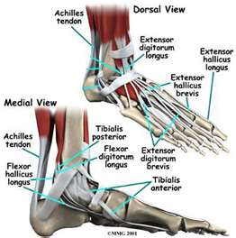
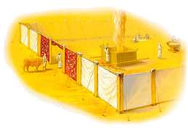
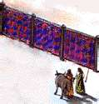
10 Toes= The Gate to Justification The Way to Mercy at the Feet of Jesus. Blessed [is] the man that heareth me, watching daily at my Gates (The Way),
waiting at the posts of my Doors (The Truth).
For whoso findeth me findeth Life (at my Veil), and shall obtain favour of the LORD. (Proverbs 8: 34-35) (John 14:6)
Jesus saith unto him, I am the way, the truth, and the life: no man cometh unto the Father, but by me. (John 14:6) (Exodus 27:9-18) (Exodus 36:37-38)
30
Exodus 38:12-15
Exodus 38:12-15
(Psalms 119:115)

Slide 31
Next Week
We will continue with our Study!
The Sanctuary of our Body
THE THIRD TEMPLE
Series #4
The Integumentary System
The Skin
Operates and Functions like
(The Tribe of Naphtali)
“He giveth goodly words”

