Slide 1
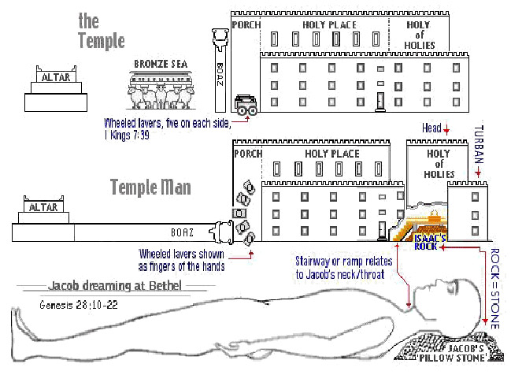
The Sanctuary of our Body
THE THIRD TEMPLE
This study will end our series with
Review Part 2
Our Bodies are a “Temple” in which God desires to dwell.
By: sister rose

Slide 2
In the creation of man was manifest the agency of a personal God.
When God had made man in His image, the human form was perfect in all its arrangements, but it was without life. Then a personal, self-existing God breathed into that form the breath of life, and man became a living, intelligent being. All parts of the human organism were set in action. The heart, the arteries, the veins, the tongue, the hands, the feet, the senses, the faculties of the mind, all began their work, and all were placed under law. Man became a living soul. Through Christ the Word, a personal God created man and endowed him with intelligence and power.
Our substance was not hid from Him when we were made in secret;
His eyes saw our substance, yet being imperfect, and in His book all our members were written when as yet there were none of them.
{Ministry of Healing 415.1- 2}
By a most beautiful and impressive figure, God's word shows the regard He places upon our physical organism and the responsibility resting on us to preserve it in the best condition: What? "Know ye not that your body is a temple of the Holy Spirit [which is] in you, which ye have from God? And ye are not your own." "If any man defile the temple of God, him shall God destroy; for the temple of God is holy, which temple ye are.”
(1 Corinthians 6:19) (Acts 7:48-49) {Education 200.3 }

Slide 3
Let pupils be impressed with the thought that the body is a temple in which God desires to dwell, that it must be kept pure, the abiding place of high and noble thoughts.
As in the study of physiology they see that they are indeed "fearfully and wonderfully made"
they will be inspired with reverence. Instead of marring God's handiwork, they will have an ambition to make all that is possible of themselves, in order to fulfill the Creator's glorious plan. Thus they will come to regard obedience to the laws of health, not as a matter of sacrifice or
self-denial, but as it really is, an inestimable privilege and blessing.
(Psalm 139:14) {Education 201.1}
In the cleansing of the temple, Jesus was announcing His mission as the Messiah, and entering upon His work. That temple, erected for the abode of the divine Presence, was designed to be an object lesson for Israel and for the world. From eternal ages it was God's purpose that every created being, from the bright and holy seraph to man, should be a temple for the indwelling of the Creator. Because of sin, humanity ceased to be a temple for God. Darkened and defiled by evil, the heart of man no longer revealed the glory of the Divine One. But by the incarnation of the Son of God, the purpose of Heaven is fulfilled. God dwells in humanity, and through saving grace the heart of man becomes again His temple. God designed that the temple at Jerusalem should be a continual witness to the high destiny open to every soul. But the Jews had not understood the significance of the building they regarded with so much pride. They did not yield themselves as holy temples for the Divine Spirit. The courts of the temple at Jerusalem, filled with the tumult of unholy traffic, represented all too truly the temple of the heart, defiled by the presence of sensual passion and unholy thoughts. In cleansing the temple from the world's buyers and sellers, Jesus announced His mission to cleanse the heart from the defilement of sin,--from the earthly desires, the selfish lusts, the evil habits, that corrupt the soul.
"The Lord, whom ye seek, shall suddenly come to His temple, even the Messenger of the covenant, whom ye delight in: behold, He shall come, saith the Lord of hosts. But who may abide the day of His coming? and who shall stand when He appeareth? for He is like a refiner's fire, and like fullers' soap: and He shall sit as a refiner and purifier of silver: and He shall purify the sons of Levi,
and purge them as gold and silver." Malachi 3:1-3. {Desire of Ages 161.1}

Slide 4
The Fine Twined Linen Christ Righteousness our Wedding Garment
The work of Christ is illustrated by the parable of the marriage of the king's son. All the guests, both bad and good are gathered at the marriage; but when the king comes in to examine the guests, all are ejected except those who are clothed with the wedding garment of Christ's righteousness. (Matthew 22:1-14) (Revelation 3:18)
"Many are called, but few are chosen.”
{1914 SNH, CIS- The Cross and Its Shadow 31.1}
The tabernacle was surrounded by a court one hundred cubits long and fifty cubits wide. This court was enclosed by curtains of fine twined linen hung from Pillars of brass. The pillars were trimmed with chapiters and fillets of silver, and the curtains were suspended from silver hooks. The court formed an oblong, and was placed with its longest sides toward the north and south and the ends toward the east and west. The door, or entrance, of twenty cubits width, was in the center of the east end of the court. The curtains forming the door of the court were of "blue, and purple, and scarlet, and fine twined linen wrought with needlework," and were suspended from four pillars of brass, trimmed with silver.
(Exodus 27:9-18) {1914 SNH, The Cross and Its Shadow 173.1} (Luke 9:14)
4

Slide 5
5
At night, when the intense heat abated and darkness
covered the desert, then above the holy tabernacle hung the cloud now a great pillar of fire, "in the sight of all the house of Israel, throughout all their journeys." God's immediate, visible presence lighted up the entire encampment, so that all could walk safely through the darkness. What an expressive type was thus given of the Christian's walk! There may be no visible light, but when the light of God's presence surrounds him, his pathway is light. David knew this when he wrote, "Blessed is the people that know the joyful sound they shall walk, O Lord, in the light of Thy countenance.“
(Psalms 89:15) (Exodus 40:38 )
The weakest trusting child of God can have the blessed privilege of being guided by the light of God's countenance, safe from the pitfalls of Satan, if he will surrender his heart to God.
(Isaiah 52:1)
Within the golden walls of the tabernacle, priests of divine appointment performed a work representing in types and symbols the plan of redemption. {1914 SNH, CIS- The Cross and Its Shadow 30.1}

Slide 6
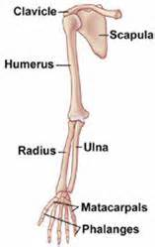
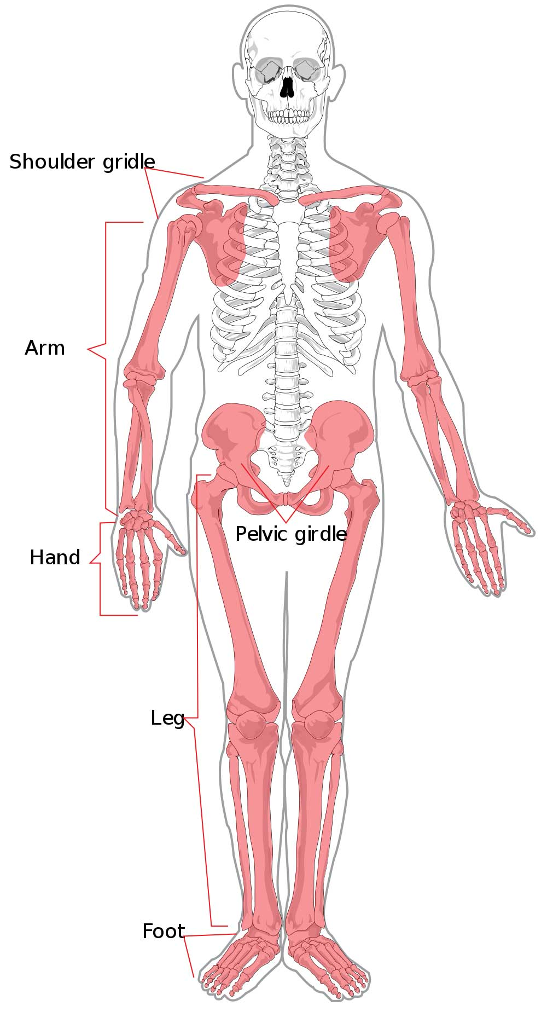
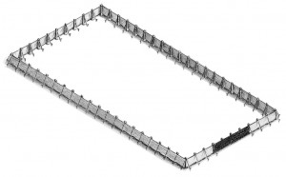
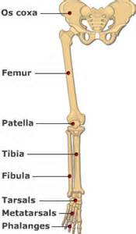
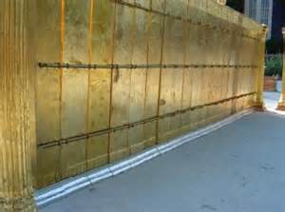
6
The Boards made Pillars around the Courtyard
Courtyard
5
60 Pillars= 20 south, 20 north, 10 west, 10 east
10
4
3
Holy Place
1
2
5
5
5
5
10
Holy Place
4
5
60 Bones:
The Appendicular Skeleton
(Revelation 1:15)
Seven and a half
feet high
(Revelation 19:8)
3
2
10
1
The central core of long bones is a hollow cylinder lined with spongy bone, and this
cavity is filled with a soft, fatty connective tissue called Yellow bone marrow .

Slide 7
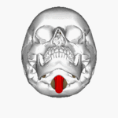
Taken from the Book of Hebrew
Chapter 3:1-7
Wherefore, holy brethren, partakers of the heavenly calling, consider the Apostle and High Priest of our profession, Christ Jesus; Who was faithful to him that appointed him, as also Moses [was faithful] in all his house. For this [man] was counted worthy of more glory than Moses, inasmuch as he who hath builded the house hath more honour than the house. For every house is builded by some [man]; but he that built all things [is] God. And Moses verily [was] faithful in all his house, as a servant, for a testimony of those things which were to be spoken after;
But Christ as a son over his own house; whose house are we, if we hold fast the confidence and the rejoicing of the hope firm unto the end.
Wherefore (as the Holy Ghost saith, To day if ye will hear his voice,
7
Philippians 1:20
According to my earnest expectation and [my] hope, that in nothing I shall be ashamed, but [that] with all boldness, as always, [so] now also Christ shall be magnified in my body, whether [it be] by life, or by death.
The Lamb slain from the foundation of the world can be seen down the Magnum Foramen lifted up on the Sternum on the vertebra.

Slide 8
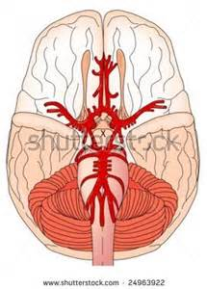
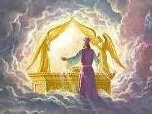
8
The Circle of Will-is (Christ gave us a Power of Will to choose)
The Cross Planted Between Earth and Heaven.--When Christ came to this world, He found that Satan had everything as he wanted it. The adversary of God and man thought that he was indeed the prince of the earth, but Jesus laid hold of the world to take it out of the power of Satan. He came to redeem it from the curse of sin and the penalty of transgression, that the transgressor might be forgiven. He planted the cross between earth and heaven, and between divinity and humanity; and as the Father beheld the cross, He was satisfied. He said, "It is enough, the offering is complete." God and man may be reconciled. Those who have lived in rebellion against God, may become reconciled, if as they see the cross, they become repentant, and accept the great propitiation that Christ has made for their sins. In the cross they see that "mercy and truth have met together; righteousness and peace have kissed each other”
{5Bible Commentary 1137.9} (ST The Signs of the Times Sept. 30, 1889).
The lamb slain from
the foundation
of the world
He is the Alpha
And Omega
The Beginning
and
The End
The Heart
of Christ is
the place
Of His Pleading Blood
Pituitary Gland
Symbol of Christ
Mediating before
The Mercy Seat

Slide 9
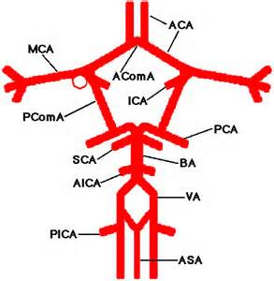
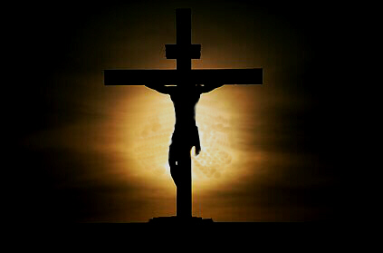
I am Alpha and Omega, the beginning and the ending, saith the Lord, which is, and which was, and which is to come, the Almighty. (Revelation 1:8)
And all that dwell upon the earth shall worship him, whose names are not written in the book of life of the Lamb slain from the foundation of the world. (Revelation 13:8)
ACom A
ICA

Slide 10
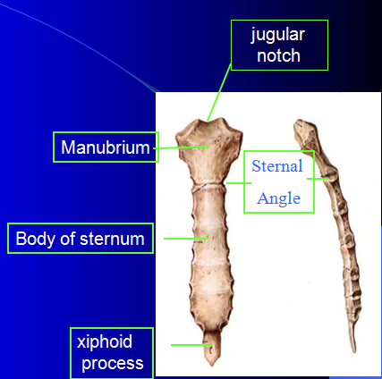
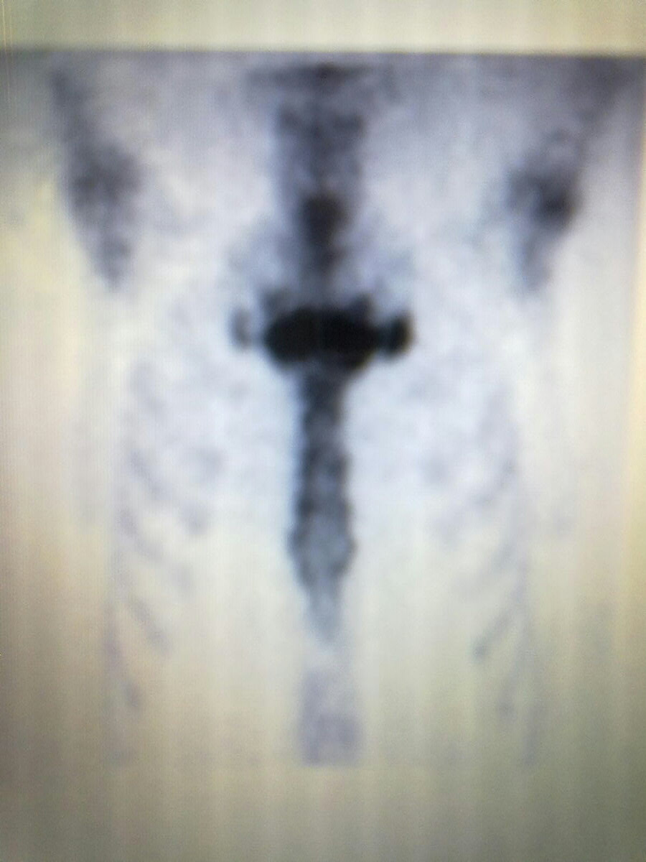
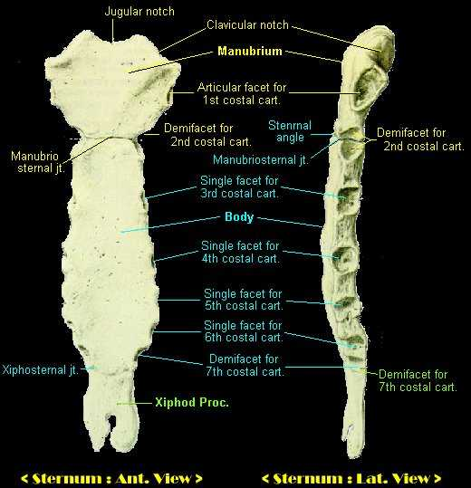
The Skeleton System
10
The Sternum Stands as Christ Crucified in us
Christ said! And I, if I be lifted up from the earth, will draw all [men] unto me. (John 12:32)
And Moses made a serpent of brass, and put it upon a pole,
(Num. 21: 8-9)
I am crucified with Christ: nevertheless I live; yet not I, but Christ liveth in me: and the life which I now live in the flesh I live by the faith of the Son of God, who loved me, and gave himself for me. (Galatians 2:20)

Slide 11
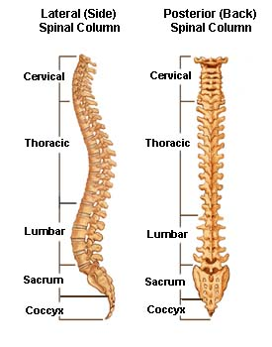
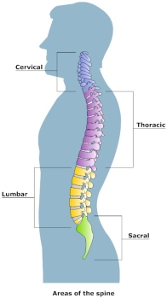
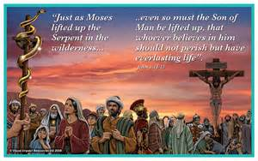
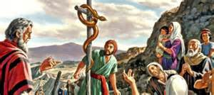
11
Jesus was 33
at His death.
The Serpent of Brass
Remnant Sealed by
7 Pillars
Hewed stone
Proverb 9:1
12 Tribes of Israel
Costly stone
Ephesians 2:20
10 Prophets
5 L+5S =10
Great stone
1 Kings 5: 17
7+12+10+4=33
4 Horns
7=His Perfection 12= His Humanity
10= His Righteousness 4= His Divinity

Slide 12
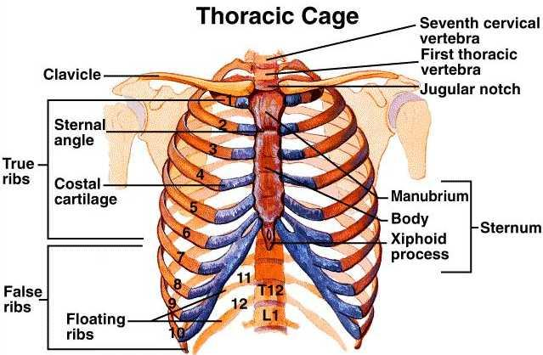
Think not that I am come to destroy the law, or the prophets: I am not come to destroy, but to fulfil.
12
Matthew 5:17
The 10 Ribs =
The Ten Commandments
Colossians2:9
For in him dwelleth all the fulness of the Godhead bodily.
The 2 floating Ribs= The Two
Greatest Commandments
2 Samuels 22:47
The LORD liveth; and blessed [be] my rock; and exalted be the God of the rock of my salvation.
Matthew 22:36-40

Slide 13
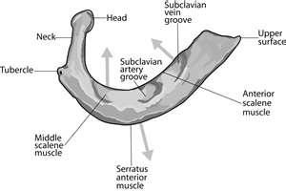
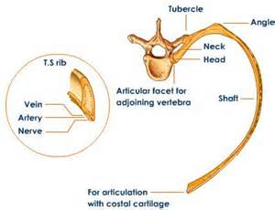
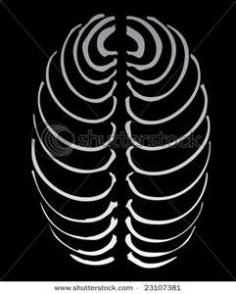
Hebrew 6:19
Which [hope] we have as an anchor of the soul, both sure and stedfast, and which entereth into that within the veil;
The Anchor shape
13
The Rib = A Man
They have Veins , Arteries, Nerves
There are 24 Ribs
The Ribs
They are the frame-work of that part of the human trunk termed the chest, in which the lungs and heart are deposited for safe keeping.
{1868 John Norton Loughborough,
Hand Book of Health 36.7}
Represents
24 Elders

Slide 14
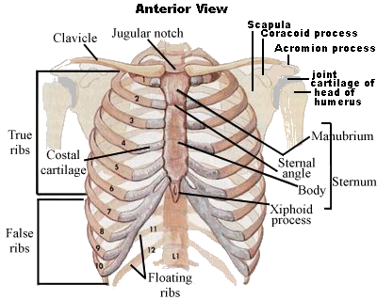
What The Ribs Teach about the Gospel?
14
There are 7 True Ribs Directly Connected to Christ (Sternum) in
Spirit and Truth
is their foundation.
The Remnants and The Disciples
Sealed by Their
Pillars of Faith
All Judgment has been given to Christ
John 5:22
7 True
Ribs
3 False Ribs
There are 3 False ribs separated from Christ: Represents the Three unclean spirits like frogs
The 5 False Ribs like the
5 foolish Virgins: Represent
The 3 False Ribs and the
2 Floating Ribs
Ribs Lacking the Spirit of Christ life in them.
2 Floating
Ribs

Slide 15
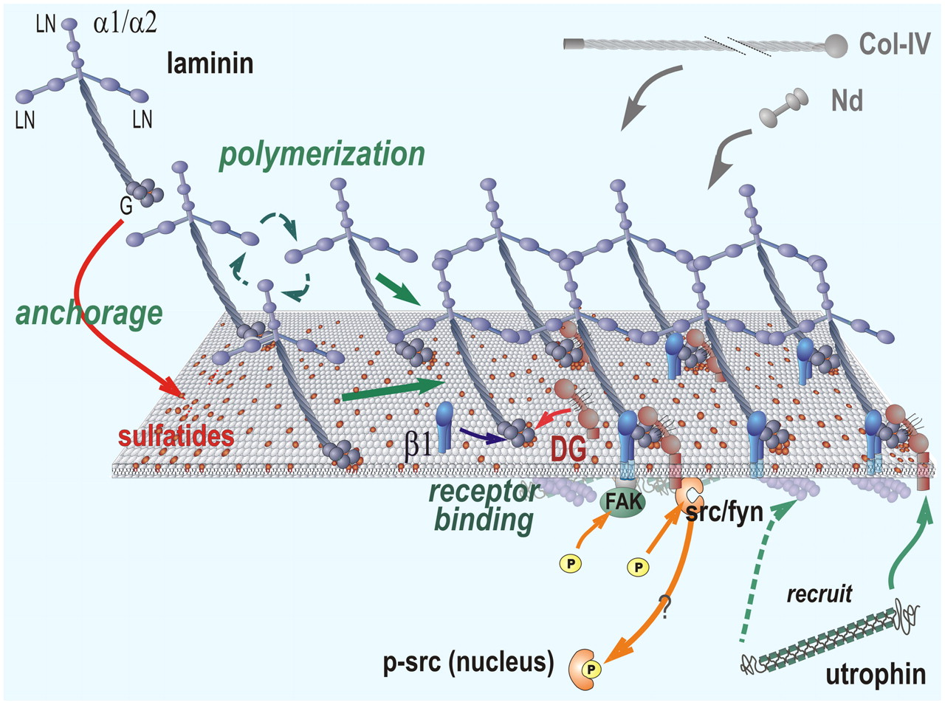
The length of one curtain [shall be] eight and twenty cubits.
15
(The Cross and Its Shadow)
Types-Various Offering
(Step to Christ)
Anti- Type- Our Skin
1. Sin (Our Peace - Chap.17)
2. Burnt (Our Wholeness - Chap.18)
3. Drink (Pouring out of Soul - Chap.19)
4. Meat (Surrendering our Provision - Chap.20)
5. Trespass (Restoration & our Restitution - Chap.21)
6. The Red Heifer (Cleansing Blood - Chap.22)
7. Peace (His Our Stay - Chap.23)
8. Cleansing of the Leper (Our Cleanser - Chap.24)
l
1. Fat (God’s Love For Man - Chap.1.9)
2. Vein (The Sinner’s Need of Christ - Chap.2.19)
3. Sweet Gland (Repentance - Chap.3.25)
4. Arrector (Confession - Chap.4.39)
5. Nerve (Consecration - Chap.5.45)
6. Arteries (Faith and Acceptance - Chap.6.51)
7. Sebaceous(The Test of Discipleship - Chap.7.59)
8. Dermis (Growing Up into Christ - Chap.8.69)
l
Christ’s Covering has Delivered us from all Sin
Isaiah 53:5
But he [was] wounded for our transgressions, [he was] bruised for our iniquities: the chastisement of our peace [was] upon him; and with his stripes we are healed.
The Integumentary System

Slide 16
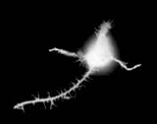
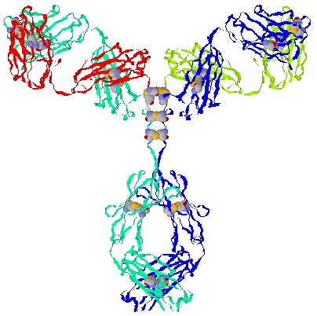
Let’s take a look at what a Laminin looks like.
16
For in him dwelleth all the fullness of the Godhead bodily. (Colossians 2:9)
The Second Person of the Godhead:
Beta
(Revelation 21:13)
and I saw no temple therein:
for the Lord God Almighty and
the Lamb are the temple of it.
First Person of the Godhead: Alpha
(Revelation 22:13)
I am Alpha and Omega, the beginning and the end, the first and the last.
Third Person of the Godhead: Gamma
(Matthew 3:16)
And Jesus, when he was baptized, went up straightway out of the water: and, lo, the heavens were opened unto him, and he saw the Spirit of God descending like a dove, and lighting upon him:
Skin manufactures
Fifteen laminin trimmers.

Slide 17
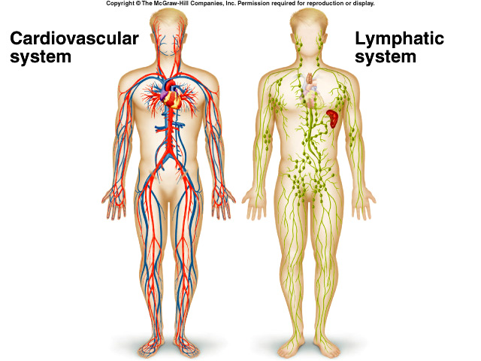
17
I
I
Meets
By the Blood of the
Lamb
By the Power of
God in the Holy Ghost
Type: The System of Sacrifice by Work
through Ordinance
Anti-type: The System of
Righteousness by Faith
Christ Life Merit

Slide 18
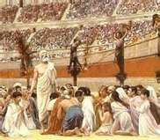
The Lymph are the Martyrs in our Bodies!
Defenders of the Living Truth of God’s Word.
18
Our Lymphatic System
The Martyrs

Slide 19
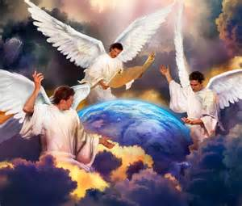
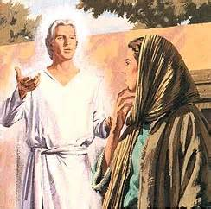
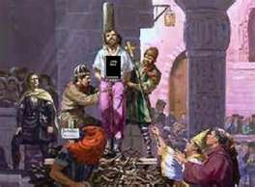
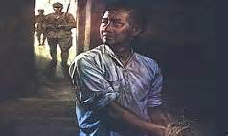
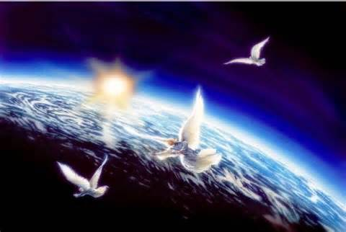
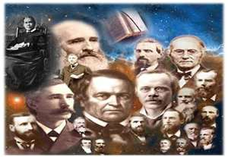
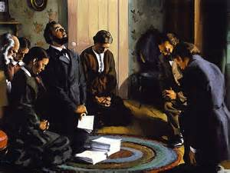
Our Ministering Angels and Saints Defenders of the Body!
19
Martyr’s
Revelation 2:9-11
The Third Angles
Messages (Revelation 14)
(Judges 5:14)
Defenders of
the Faith
they that draw
with the pen

Slide 20
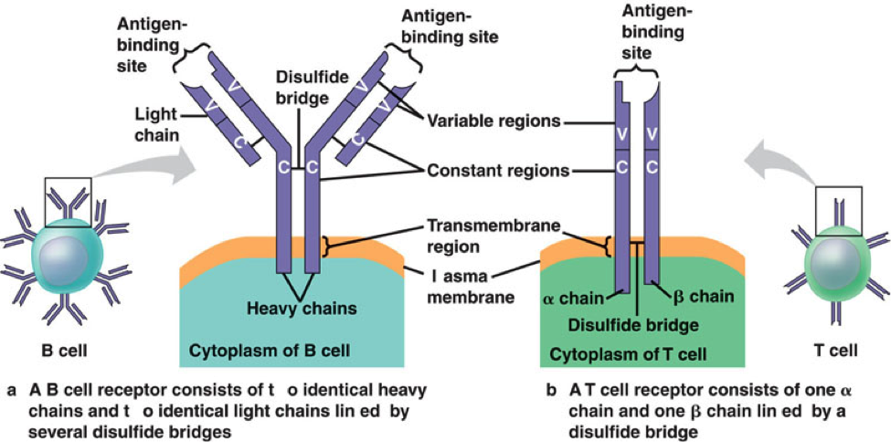
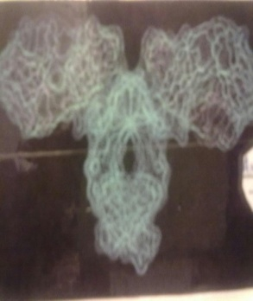
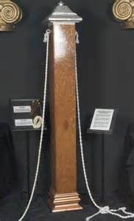
20
Angels
Connected
by
Their Messages
Godly People as
Pillars Connected by
Silver Chapiters
Exodus 38:17-18
Revelation 3:12
Him that overcometh will I make a pillar in the temple of my God,
and he shall go no more out: and I will write upon him the name of my God,
and the name of the city of my God, [which is] new Jerusalem,
which cometh down out of heaven from my God: and [I will write upon him] my new name.

Slide 21
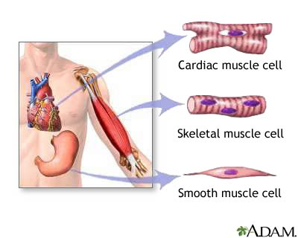
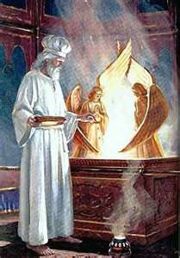
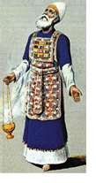
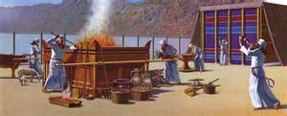
The Muscular System: The Offices of Priesthood and Judges (Muscles and Tendons)
They are the voluntary and the involuntary muscles
21
The Priesthood
HIGH PRIEST
(Hebrew 7:25)
(Hebrew 8:3, 5)
LEVI PRIEST
Our Muscle System
LEVITES PRIEST
The Cross and Its Shadow Section III pages 69-86

Slide 22
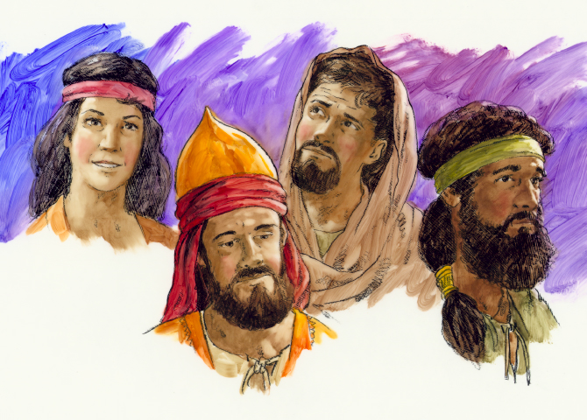
The Judges of Israel Represent
The Tendons in our Bodies.
Tendons are Connective tissue that binds muscles to bones.
(The Priests of God bound by His Living Word and His Laws)
22

Slide 23
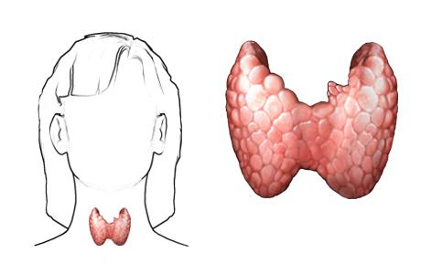
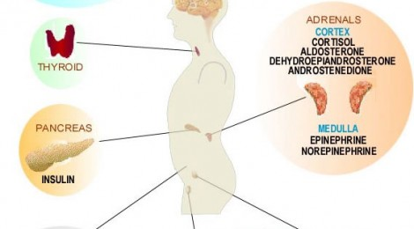
HORMONES
The cranial cavity contains three endocrine glands, located in close proximity to the brain’s structured ability to demand the release or the decline and prohibition of hormones. Hormone production in the endocrine system can be over ridden by the brain’s ability to release or restrict hormones. Likewise, the endocrine system has the ability to over rid the brain’s release or denial of hormone production.
This is a simple but effective form of the body’s system of checks and balances in achieving appropriate hormonal activity. Without this ability, the brain and the endocrine system could easily produce the same hormones for the same location and the body would be overloaded with hormone production. Like wise, a hormonal excretion dysfunction of either system could lead the significant and detrimental denial of basic hormones for one particular body function.
23
See next Side for details
"shield”
Psalms 91: 1-4, 11
The Pancreas Represents the
helpers of the Gospel Order
(Ephesians 4:12-16)
Thyroid

Slide 24
Thyroid Gland: the thyroid gets its name from the Greek word for
"shield”, due to the shape of the related thyroid cartilage.
The thyroid gland controls how quickly the body uses energy, makes proteins and controls how sensitive the body is to other hormones.
(Palms104:4) (Hebrew 1:7) (Genesis 15:1)
Who maketh his angels spirits; his ministers a flaming fire:
(Deuteronomy 33:29) (2 Samuel 22:3, 36) (Luke 22:43-44)
Hormonal output from the thyroid is regulated by TSH and TRH
(Hebrew 1:14)
(TSH) Thyroid Stimulating Hormones produced by the Anterior Pituitary,
which itself is regulated by Christ Jesus (Salvation by His Glory).
(TRH) Thyrotropin-releasing hormone produced by the Hypothalamus.(Holy Spirit)
which itself is regulated by Christ Jesus (Righteousness by His Grace).
The Grace Of God takes men as they are, and works as an educator, using every principle
on which an all-sided education depends. The steady influence of the
Grace of God trains the soul after Christ's methods, and every fierce passion, every defective trait of character, is worked upon the molding influence of the Spirit of Christ,
until the man has a new motive power, and becomes filled with the
Holy Spirit of God, after the likeness of the divine similitude.
The Holy Spirit is the source of all power, and works as a living, active agent in the new life created in the soul. The Holy Spirit is to be in us a divine indweller.
{Healthful Living 300.5, 301.1}

Slide 25
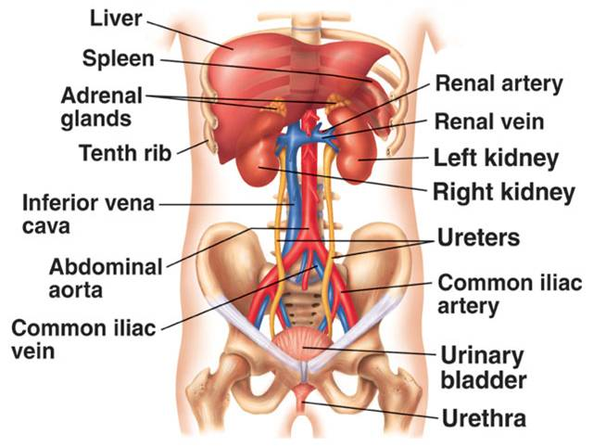
The Urinary System
25
A symbol of His Righteousness
Through the sacrifice of redemption,
He (Jesus)
was therefore strong to execute justice upon them that despised God's mercy.
The right kidney is in contact with the liver
In features of Ureters
third layer is call Adventitia:
Fibrous coat with blood vessels, nerves and lymphatic
Kidneys are also going to
regulate the volume of blood.
Another huge function is
to get rid of toxin, normal
metabolic wastes, excess water and ions from the body.
The Liver is the Heart in The Courtyard: (Ephesians 2:13) (Galatians 3:29)
Only the Perfect Life of our Saviour Jesus Christ Can Remove from us our impurities and create a new man in us.

Slide 26
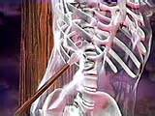
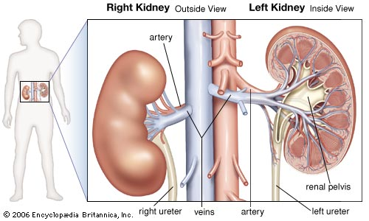
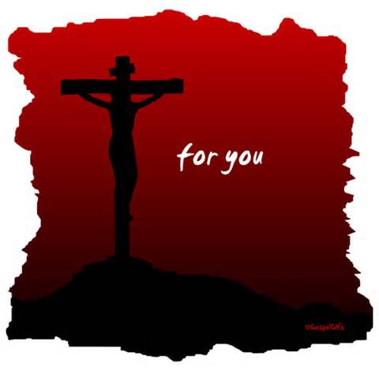
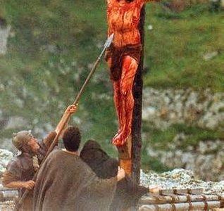
“The Kidney” There is the Saviour’s Glory!
26
The kidneys monitor and maintain the chemical make-up of the blood.
But one of the soldiers
with a spear pierced his
side, and forthwith came
there out blood and water.
(John 19:34)
Behold
the secret
of His
our Saviour’s
Hiding Power
His Blood
right ureter veins artery left ureter

Slide 27
Type
Christ Jesus Our
Anti-type
27
Moses' Tabernacle
Jesus our Sanctuary
Solomon’s Temple

Slide 28
THERE IS A THIRD TEMPLE
The Bible reveals that there are not only these 2 different sanctuaries; the heavenly temple, or the dwelling-place of the Most High where Christ intercedes in our behalf, and the earthly temple, with its typical services, designed to teach mankind the great spiritual truths on the plan of redemption from sin. But there is also a third temple which is extremely important to understand. This is the temple of the human body,
where God's Spirit desires to rule and reign.
This is the new covenant experience which God was referring to through Jeremiah and Paul: "For this is the covenant that I will make with the house of Israel after those days, saith the Lord; I will put my laws into their mind, and write them in their hearts: and I will be to them a God, and they shall be to me a people." Heb. 8:10; Jeremiah 31:33. What a thought! God desires to have you to be His temple in which He can dwell and rule! Yes, friends, both the Father and Jesus Christ love you so much that they do not want to remain trillions of miles away from you in heaven, but desire to dwell directly with you through the Holy Spirit--the Spirit of truth! This is indeed a mystery, but one in which is rich and glorious!
"Even the mystery which hath been hid from ages and from generations, but now is made manifest to his saints: To whom God would make known what is the riches of the glory of this mystery among the Gentiles; which is Christ in you, the hope of glory: Whom we preach, warning every man, and teaching every man in all wisdom; that we may present every man perfect in Christ Jesus: Whereunto I also labour, striving according to his working, which worketh in me mightily." Colossians 1:26-29.
28

Slide 29
But the big question you must ask yourself is: Do I love God enough that I am willing to clean up my life and act in such a way that the Godhead can dwell and live and rule in me as Their holy sanctuary and dwelling place on this earth? What immense blessings can be ours if we will just offer our life to God and allow Him to reign in and through us! Or are you going to decide to continue to live in wickedness and sin, continue to defile your body-temple by intemperate habits, reject God's gracious and merciful offer, and allow the devil to make you his synagogue and dwelling place to live and rule in on this earth? It is either one or the other, for you cannot serve both (see Matthew 6:24).
WHICH WILL YOU CHOOSE?
"But Christ as a son over his own house; whose house (dwelling place) are we, if we hold fast the confidence and the rejoicing of the hope firm unto the end. Wherefore (as the Holy Ghost saith, Today if ye will hear his voice, Harden not your hearts.)...Take heed, brethren, lest there be in any of you an evil heart of unbelief, in departing from the living God." Hebrews 3:6-8, 12.
"Be ye not unequally yoked together with unbelievers: for what fellowship hath righteousness with unrighteousness? and what communion hath light with darkness? And what concord hath Christ with Belial? or what part hath he that believeth with an infidel? And what agreement hath the temple of God with idols? for ye are the temple of the living God; as God hath said, I will dwell in them, and walk in them; and I will be their God, and they shall be my people. Wherefore come out from among them, and be ye separate, saith the Lord, and touch not the unclean thing; and I will receive you, And will be a Father unto you, and ye shall be my sons and daughters, saith the Lord Almighty. Having therefore these promises, dearly beloved, let us cleanse ourselves from all filthiness of the flesh and spirit, perfecting holiness in the fear of God.“ 2 Corinthians 6:14-18, 7:1.
GOD’S SANCTUARY AND DWELLING PLACE
http://www.lightministries.com/Tracts/id178.htm)
29

Slide 30
We have came to the end of our series
The Sanctuary of our Body
The Third Temple
that Operates and Functions like
the Twelve Tribes of Israel
A symbol of the Body of Christ
our Anti-type.
Continue in your Personal Study of the Names and Characters of the Twelve Tribes found in
The Cross and Its Shadow
by
Stephen N. Haskell Pages. 287-378
(The 144,000)

