Slide 1
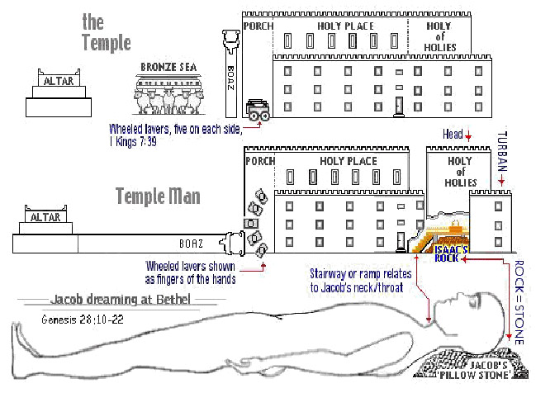
The Sanctuary of our Body
THE THIRD TEMPLE
Review Part 1
Our Bodies are a "Temple” in which God desires to dwell.
By : sister rose

Slide 2
Our Example
Our Lord Jesus Christ came to this world as the unwearied servant of man's necessity.
(Matthew 8:17)
That it might be fulfilled which was spoken by Esaias the prophet, saying, Himself “took our infirmities, and bares our sicknesses,“
That He might minister to every need of humanity.
The burden of disease and wretchedness and sin
He came to remove.
It was His mission to bring to men complete restoration;
He came to give them
health and peace and perfection of character.
{MH- The Ministry of Healing 17.1}
2

Slide 3
3
The Health Reform
The Right hand of The Third Angels Messages
The health reform is one branch of the great work which is to fit a people for the coming of the Lord. It is as closely connected with the third angel's message as the hand is with the body. The law of Ten Commandments has been lightly regarded by man; yet the Lord will not come to punish the transgressors of that law without first sending them a message of warning. Men and women cannot violate natural law by indulging depraved appetite and lustful passions, without violating the law of God.
Therefore he has permitted the light of health reform to shine upon us, that we may realize the sinfulness of breaking the laws which he has established in our very being. Our heavenly Father sees the deplorable condition of men who, many of them ignorantly, are disregarding the principles of hygiene. And it is in love and pity to the race that he causes the light to shine upon health reform. He publishes his law and its penalties, in order that all may learn what is for their highest good. He proclaims his law so distinctly, and makes it so prominent, that it is like a city set on a hill.
All intelligent beings can understand it if they will. None others are responsible.
To make natural law plain, and to urge obedience to it, is a work that accompanies the third angel's message.
{Christian Temperance and Bible Hygiene CTBH 9.1}

Slide 4
All should have an intelligent knowledge of the human frame that they may keep their bodies in the condition necessary to do the work of the Lord. The physical life is to be carefully preserved and developed that through humanity the divine nature may be revealed in its fullness. The relation of the physical organism to the spiritual life is one of the most important branches of education.
It should receive careful attention in the home and in the school.
All need to become acquainted with their physical structure and the laws that control natural life. He who remains in willing ignorance of the laws of his physical being and who violates them through ignorance is sinning against God. All should place themselves in the best possible relation to life and health.
Our habits should be brought under the control of a mind that is itself under the control of God.
{COL- Christ Object Lesson 348.1}
4

Slide 5
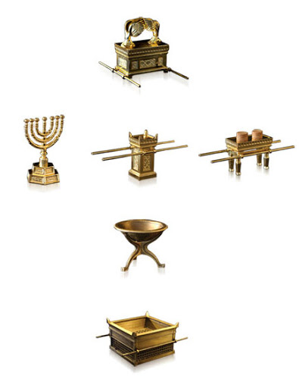
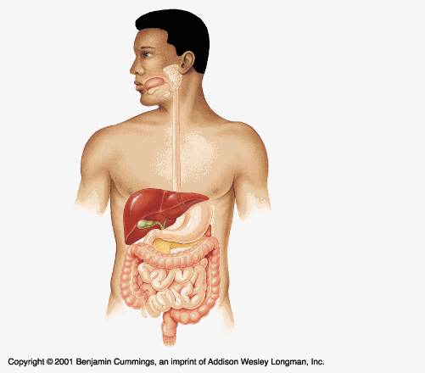
Our Body is a Temple!
5
5
SEEING Christ
in the
Tabernacle
The Ark
The Most Holy Place
The Altar of Incenses
The Table of Shewbread
The Holy Place
The Candlestick
The Laver
The Court Yard
The Alta of Sacrifice
Hebrew3:6; 9:23,24
And let them make me a sanctuary; that I may dwell among them.(Exodus 25:8)
“I am fearfully and wonderfully made.” [Psalm 139:14.]
(1 King 6:7)

Slide 6
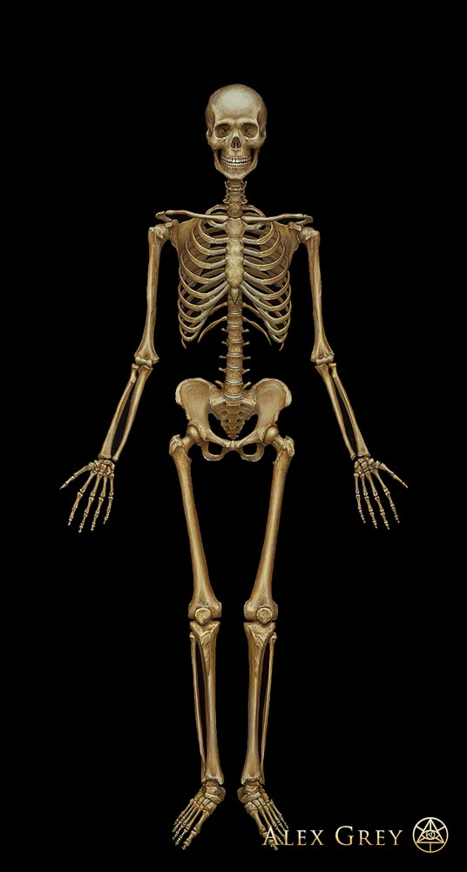
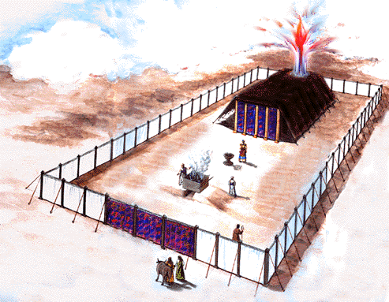
The Tabernacle of the Human Frame
6
"Know ye not that ye are the temple of God, and that the Spirit of God dwelleth in you? If any man defile the temple of God, him shall God destroy; for the temple of God is holy, which temple ye are.“
(1 Corinthians 3:16, 17). {Ed-Education 36.3}
ANTI-TYPE
TYPE
Introducing the Frame of our Tabernacle
Most Holy Place
The Most Holy
Holy Place
Holy Place
The Court Yard
Court Yard
MEETS
In whom all the building fitly framed together groweth unto an holy temple in the Lord:
(Ephesians 2:21) (Hebrew 8:2) (1 Corinthians 3:16, 17) (Exodus 27:1-3) (Romans 12:1-2)

Slide 7
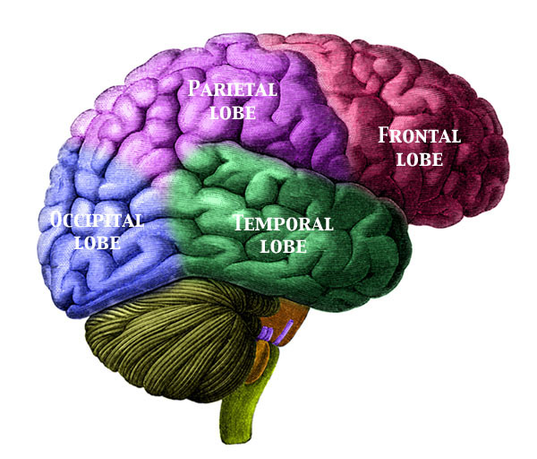
Body sensations, Visual and spatial Perception Priesthood
7
7
Thought processes, behavior, personality, emotion
Kingship
Vision
Likeness
Hearing, understanding speech, language
Swiftness

Slide 8
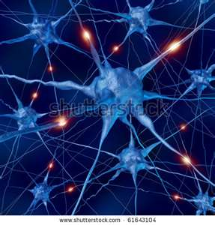
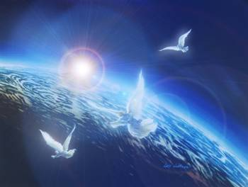
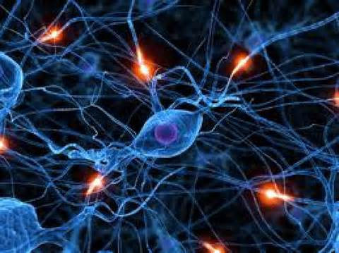
(Your brain weighs about 3 pounds= (the cerebrum, the cerebellum, the brainstem) and contains an amazing 100 billion (100,000,000,000) neurons are specialized cells that conduct nerve impulses.

Slide 9
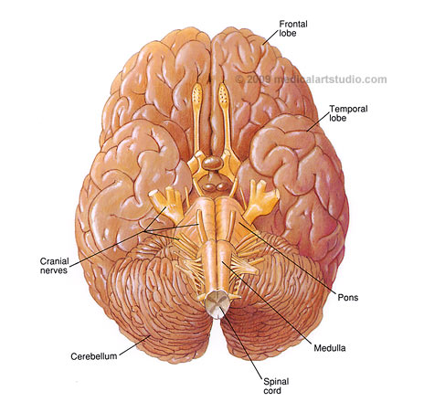
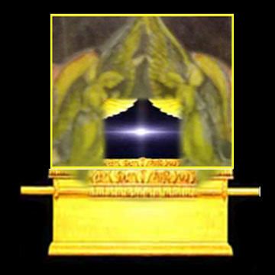
In the Most Holy Place dwells The Ark of the Covenant
The brain is the citadel of the whole man, margin.. {Healthful Living 195.4} Judah [is] my lawgiver; margin. (Psalms. 108:8)
The Ark, The Central article of furniture in the sanctuary, was made to contain the Law of God. (SNH, SDP-The Story of Daniel the Prophet page. 305 book outline study)
The Two Cherubims
The Tribe of Judah
The ark was the central figure of the entire sanctuary. {SNH, CIS The Cross and Its Shadow 45.1}

Slide 10
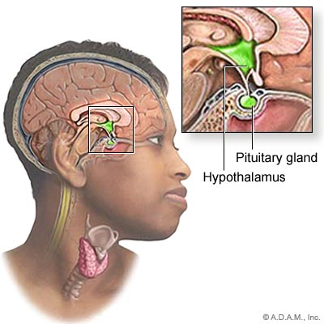
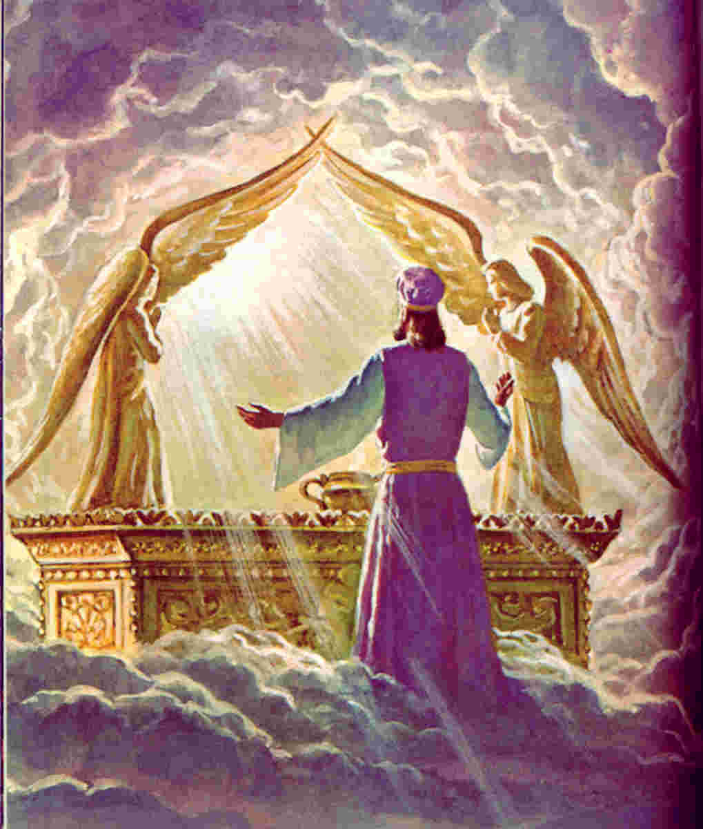
Jesus our High Priest Before the Father
10
(Genesis 49:20)
The eternal God [is thy] refuge, and underneath [are] the everlasting arms:

Slide 11
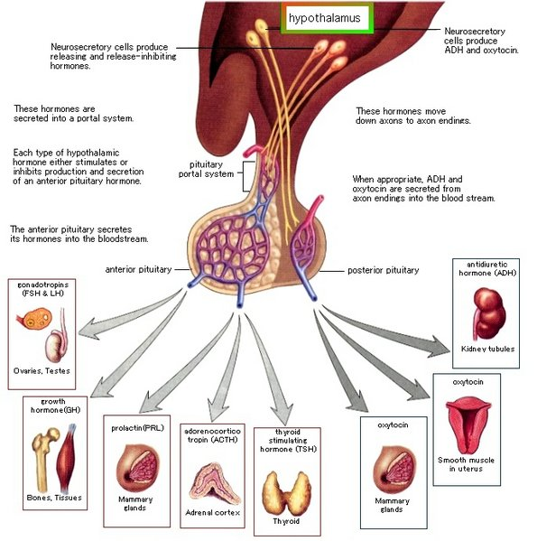
JESUS, MADE AN HIGH PRIEST
11
(Revelation 1:12-18)
Whither the forerunner is for us entered, [even] Jesus, made an high priest for ever after the order of Melchisedec. (Hebrew 6:20)

Slide 12
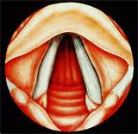
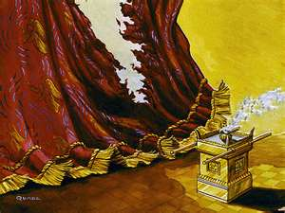
The Veil to the Most Holy The Life of Christ the way to Holiness
Larynx is also known as voice box or Adam’s apple and is formed of 9 cartilage. It extends from the epiglottis to the cricoids cartilage out of which 4 are important. If larynx stops functioning we will be dead in no time.
And so it is written, The first man Adam was made a living soul; the last Adam [was made] a quickening spirit.(1 Corinthians 15:45)
I am the way, the truth, and the life: no man cometh unto the Father, but by me. (John 14:6)
Type of Christ Flesh
(Galatians 2:20)
Altar of Incense

Slide 13
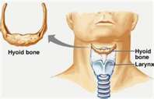
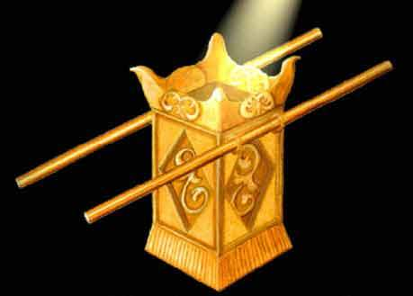
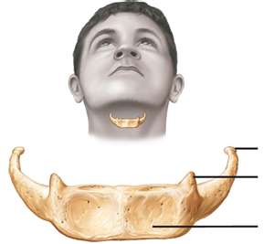
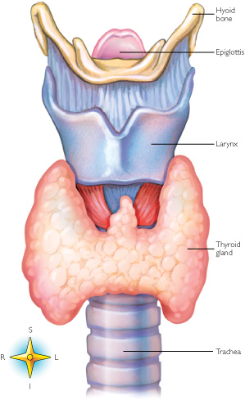
The Greater Horn of Hyoid
13
Hyoid Bones
Leviticus 16:13
Christ Righteousness
Mingle with our Prayers
Windpipe with an
“up escalator”
Psalms 141:2, Exodus 30:6-8
Exodus 30:1-3; 40:26, Revelation 8:3-4

Slide 14
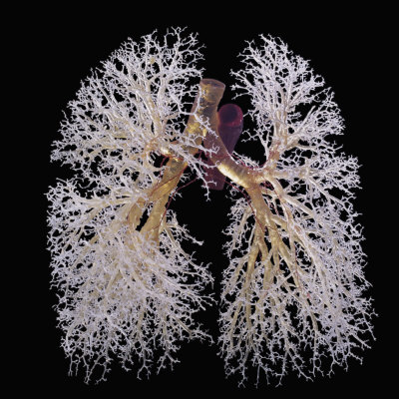
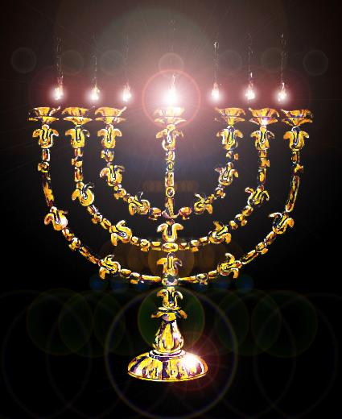
The Candlestick
Our Tree Of Life
14
The Lungs or Respiratory System
Golden Lamp

Slide 15
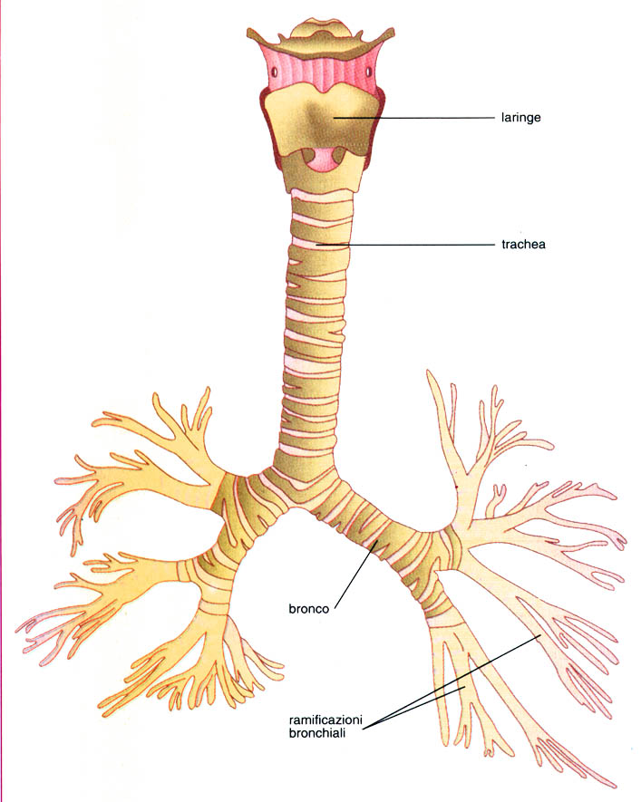
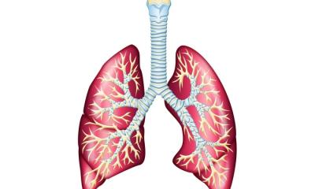
Christ says: "I am the true vine, and my Father is the husbandman.
Every branch in me that beareth not fruit he taketh away; and every branch that beareth fruit, he purgeth it, that it may bring forth more fruit. . . . Abide in me, and I in you. As the branch cannot bear fruit of itself, except it abide in the vine; no more can ye, except ye abide in me. (John 15:1,5)
15
John 1:4,9, 15:4,5;
Revelation 1:13-16
I Am The Vine

Slide 16
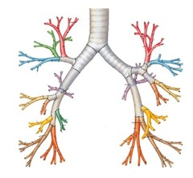
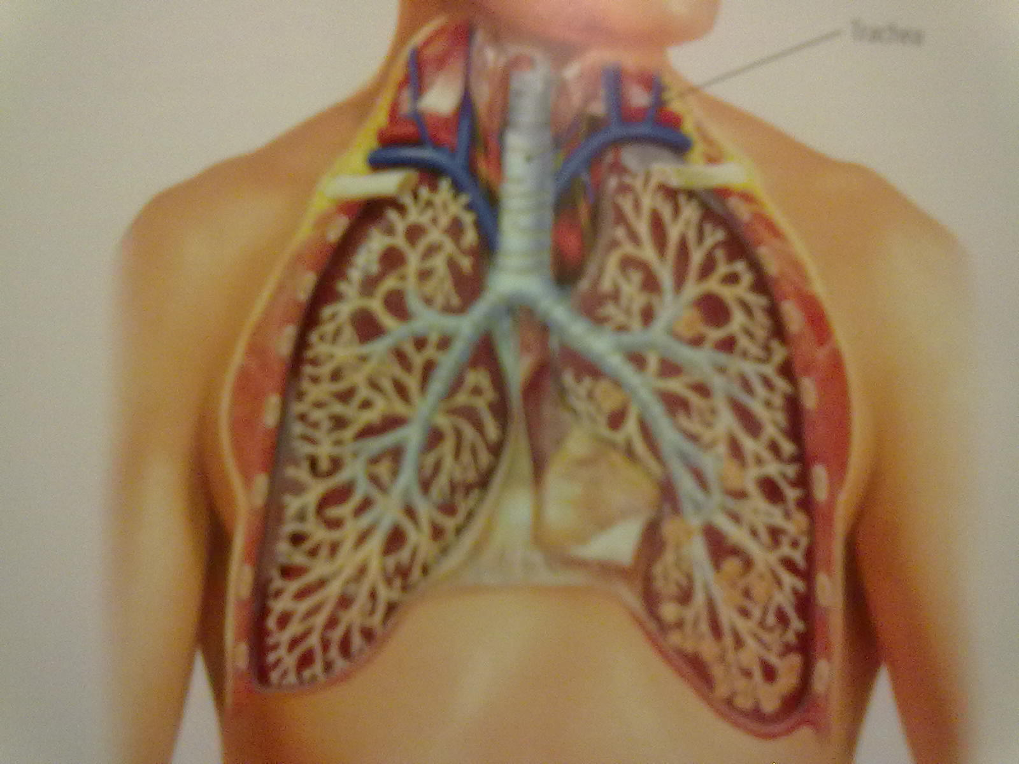
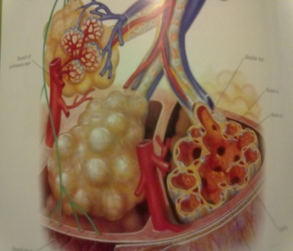
Lets Learn Something Interesting About The Branches!
16
Jesus is in the midst
John 8:23
Why are the braches in our body backwards? And he (Jesus) said unto them Ye are from beneath;
I am from above: ye are of this world; I am not of this world.

Slide 17
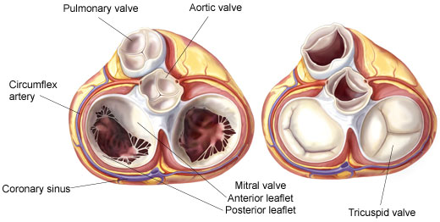
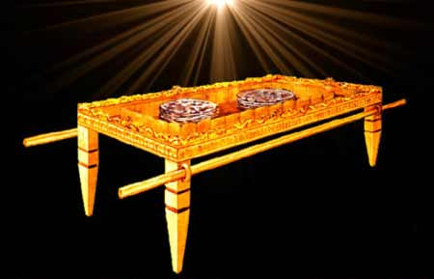
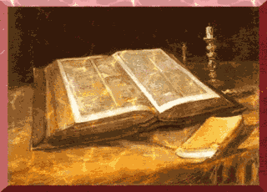
The Table of Showbread
John 6:35
Proverbs 7:2-3, John 6:48
2 Corinthians 3:1-18

Slide 18
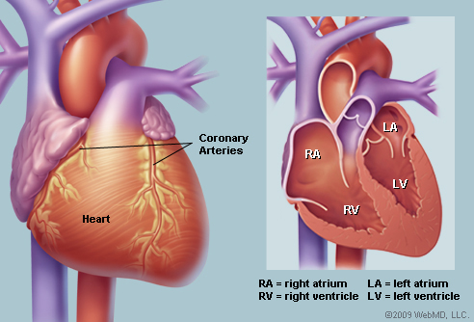
The Heart or Cardiovascular System
Has 4 chambers symbols of the blessings of the First Born.
18
The heart is a double organ; externally it appears to be a single organ, but internally it is double. It is externally about five inches in length, by three and a half in diameter, and weighs about ten ounces. Internally, it contains four compartments; two right,
and two left.
These compartments are called Auricles and Ventricles. These pairs of Auricles and Ventricles have not any communication with each other, therefore they are considered as two distinct hearts. The right is called the venous and the left the arterial side of the heart.
The whole heart will hold nearly a pint.
John Norton Loughbough
{1868 Hand Book of Health 62.2}
The Tribe of Reuben
My Might, My Strength,
The Excellency Of Dignity,
The Excellency Of Power
L
4

Slide 19
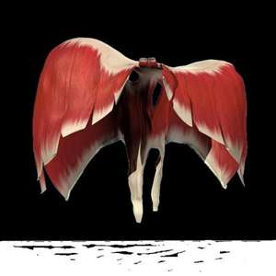
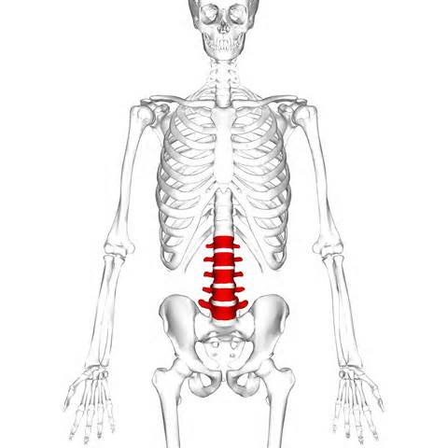
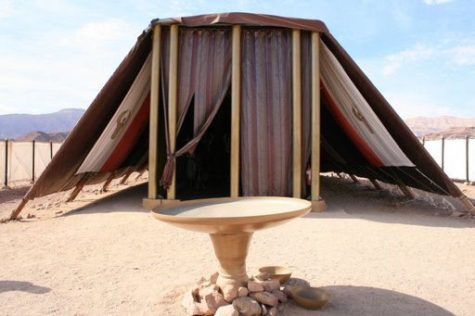
The Door to the Holy The Truth to Sanctification
19
The diaphragm is the primary muscle of inspiration. It is a thin, dome-shaped sheet of muscle that inserts into the lower ribs. The diaphragm moves a centimeter or two up and down, but during exercise, it can move more than (10 centimeter)
The Curtain (the Door) that separates the Holy place and the Courtyard. And thou shalt make an hanging for the door of the tent, [of] blue, and purple, and scarlet, and fine twined linen, wrought with needlework. (Exodus 26:36-37) (John 10:9)
5L- Lumbar Vertebra
Our 5 pillars

Slide 20
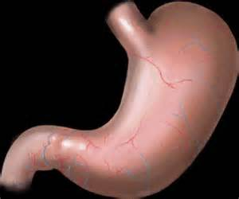
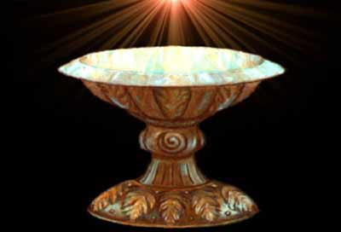
Christ a Symbol of The Laver
20
The Stomach is an expanded J-shape
segment of the digestive track. It is divided in to 4 regions. The very shape give homage to His Creator and Redeemer
(The #4 is a symbol of divinity)
And he made the laver [of] brass, and the foot of it [of] brass, of the looking glasses of [the women] assembling, which assembled [at] the door of the tabernacle of the congregation.
(Exodus 38:8)
The “J” Like Shape of this Organ
Gives His Own Identity
Jesus
Acts 4:10-12
Christ
is become
The head
of the corner
Margin..verse 11
Genesis 49:27
Exodus 30:18-21

Slide 21
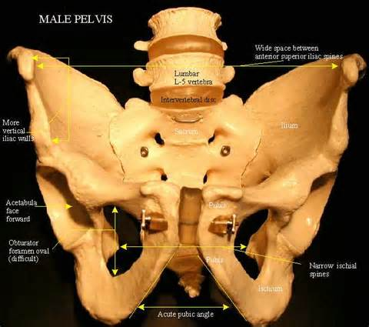
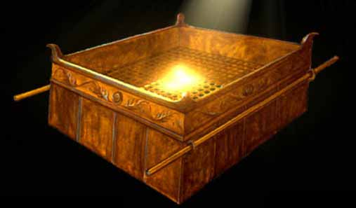
The Brazen Altar
21
The altar was a hollow box, five cubits square and three cubits high, made of boards of acacia wood on each corner.
A network of brass in the center held the fire and draft for it, allowed the ashes to fall beneath. {1914 SNH, CIS 174.2}
All burnt-offerings of the sanctuary were burned upon the brazen altar. The fire was kindled by the Lord Himself, and was kept burning continually. It was never to go out. The fire which destroy all sin from the earth
{1914 SNH, CIS 174.3}
Hebrews 13:10
Leviticus 9:24, 16:15-22
Exodus 38: 1-7

Slide 22
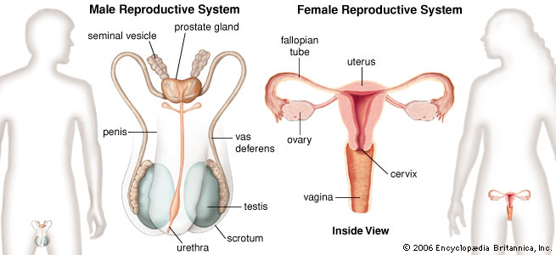
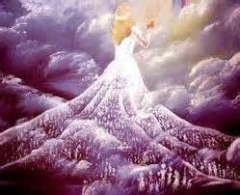
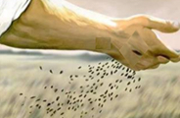
The Reproductive Systems
Female reproductive
opening
Birth canal
http://www.medterms.com/script/main/art.asp?articlekey=5317

Slide 23
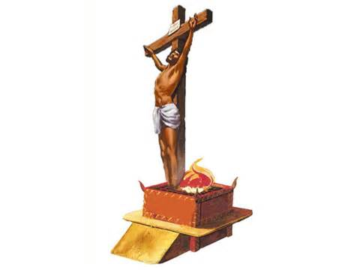
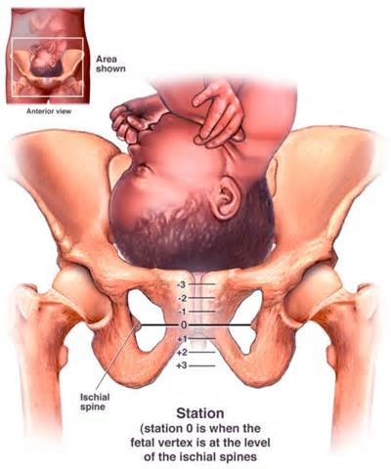
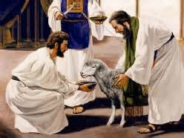
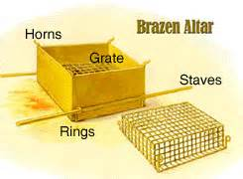
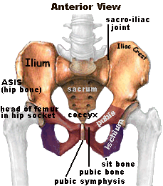
23
And I will put enmity between thee and the woman, and between thy seed and her seed:
and thou shalt bruise his heel.
it shall bruise thy head,
Genesis 3:15

Slide 24
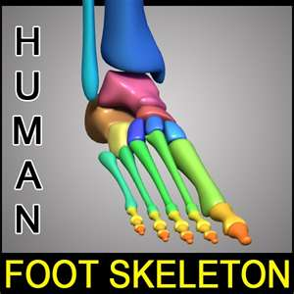
The Gate to Justification The Way to Mercy at the Feet of Jesus
24
Blessed [is] the man that heareth me, watching daily at my Gates, waiting at the posts of my Doors. For whoso findeth me findeth Life, and shall obtain favour of the LORD. (Proverbs 8: 34-35)
And he made an hanging for the tabernacle door [of] blue, and purple, and scarlet: and he overlaid their chapiters and their fillets with gold: but their five sockets
[were of] brass. (Exodus 36:37-38)
Jesus saith unto him, I am the way, the truth, and the life:
no man cometh unto the Father, but by me.
(John 14:6) (Exodus 27:9-18)
For whoso findeth me findeth Life (at my Veil), and shall obtain favour of the LORD.
(Proverbs 8:34-35) (John 14:6)
10 Toes
(Psalms 119:115)

Slide 25
Since the mind and the soul find expression through the body, both mental and spiritual vigor are in great degree dependent upon physical strength and activity; whatever promotes physical health, promotes the development of a strong mind and a well-balanced character. Without health no one can as distinctly understand or as completely fulfill his obligations to himself, to his fellow beings, or to his Creator. Therefore the health should be as faithfully guarded as the character.
A knowledge of physiology and hygiene should be the basis of all educational effort.
By a most beautiful and impressive figure, God's word shows the regard He places upon our physical organism and the responsibility resting on us to preserve it in the best condition: "Know ye not that your body is a temple of the Holy Spirit which is in you, which ye have from God? and ye are not your own."
"If any man defile the temple of God, him shall God destroy; for the temple of God is holy, which temple ye are.“ 1 Corinthians 6:19, margin; 3:17.
Let pupils be impressed with the thought that the body is a temple in which God desires to dwell, that it must be kept pure, the abiding place of high and noble thoughts. As in the study of physiology they see that they are indeed "fearfully and wonderfully made" (Psalm 139:14), they will be inspired with reverence. Instead of marring God's handiwork, they will have an ambition to make all that is possible of themselves, in order to fulfill the Creator's glorious plan. Thus they will come to regard obedience to the laws of health, not as a matter of sacrifice or self-denial,
but as it really is, an inestimable privilege and blessing. {Education 195.1; 200.3- 201.1}

Slide 26
Next Sabbath:
The Sanctuary of our Body
The Third Temple
Review Part 2
Our Bodies are a “Temple” in which God desires to dwell
“Christ our Righteousness”
The Way, The Truth and The Life
He is our Sanctification and Covering

