Slide 1
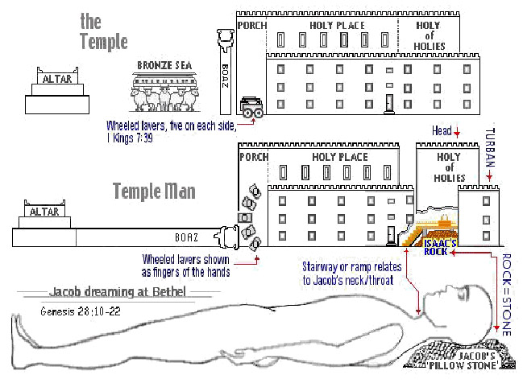
The Sanctuary of our Body
THE THIRD TEMPLE
Series 6
The Respiratory System
By : sister rose

Slide 2
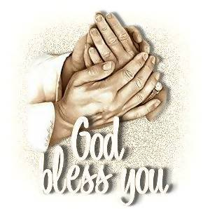
The Skeleton System
Operates and Functions like
(The Tribe of Simeon)
“Instrument of Cruelty”
Genesis 49:5
Simeon and Levi [are] brethren; instruments of cruelty [are in] their habitations.

Slide 3
It may be thought strange by some that the name of a man who was famous only for murder and sin, should be inscribed on one of the gates of the Holy City of God, and that one twelfth of the one hundred and forty-four thousand will enter the city of God bearing the name of that man. But the fact that one has committed sin will never exclude him from the kingdom of God. All have sinned.
It is unconfessed sin that debars any one from receiving eternal life.
{1914 SNH, The Cross and Its Shadow 297.3}
(also see 298.1)

Slide 4
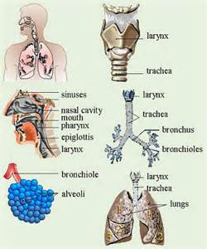
The Respiratory System
THE RESPIRATORY SYSTEM DEFINITION
is an integrated network of organs and tubes that coordinates the exchange of oxygen and carbon dioxide between an organism and its environment.
The organs that are involved in breathing, including the nose, throat, larynx, trachea, bronchi, and lungs. Also known as the respiratory tree.
l http://www.medterms.com/script/main/art.asp?articlekey=5332

Slide 5
The Candlestick
5
The lamps that were a shadow of the Holy Spirit emanating from God, which at some time in life shines into the heart of every one, inviting him to accept the Lord and His service, and which shines continually in the life of the individual who walks in the light, and is faithful to God.
{1914 SNH, The Cross and Its Shadow 182.1}
The candlestick upheld seven lamps; these lamps in the earthly sanctuary, were a type of the “seven lamps of fire burning before the throne in heaven,
which are the seven spirits of God.”
{1905 SNH, The Story of Seer of Patmos 367.1}
(Exodus 25:40, Hebrew 8:5)

Slide 6
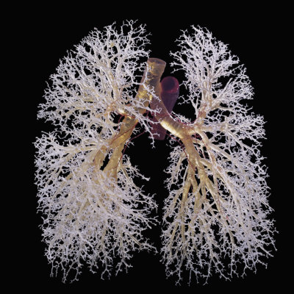
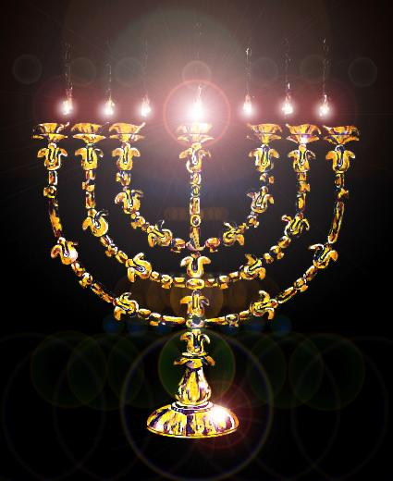
The Candlestick
Our Tree Of Life
6
The Lungs or Respiratory System
Golden Lamp

Slide 7
The Lungs: an symbol of the Candlestick
(Exodus 25:6, 31; 30:1-8; 40:26)
THE RESPIRATORY Operate Like THE TRIBE OF SIMEON
(Revelation 8:3-40) (Isaiah 64:6) (Zechariah 4:2-3)
Holy Spirit a Symbol of the Breath/Air
provides the body with oxygen. (Exodus 37:17-24)
And the LORD God formed man [of] the dust of the ground, and breathed into his nostrils the breath of life;
and man became a living soul. (Genesis 2:7)
The Holy Spirit is the breath of spiritual life in the soul. The impartation of the Spirit is the impartation of the life of Christ. It imbues the receiver with the attributes of Christ. Only those who are thus taught of God, those who possess the inward working of the Spirit, and in whose life the Christ-life is manifested, are to stand as representative men, to minister in behalf of the church.
{DA- Desire of Ages 805.3}
7

Slide 8
When the high priest entered within the most holy, once a year,
and ministered before the ark in the awful presence of God,
he inquired, and God often answered him with an audible voice. When the Lord did not answer by a voice, He let the sacred beams of light and glory rest upon the cherubim upon the right of the ark, in approbation, or favor. If their requests were refused, a cloud rested upon the cherubim at the left.
Four heavenly angels always accompanied the ark of God in all its journeyings, to guard it from all danger and to fulfill any mission required of them in connection with the ark.
Jesus, the Son of God, followed by heavenly angels, went before the ark as it came to Jordan; and the waters were cut off before His presence. Christ and angels stood by the ark and the priests in the bed of the river until all Israel had passed over Jordan.
Christ and angels attended the circuit of the ark around Jericho and finally cast down the massive walls of the city and delivered Jericho into the hands of Israel.
{SR-The Story of Redemption- 184.1-2}
8

Slide 9
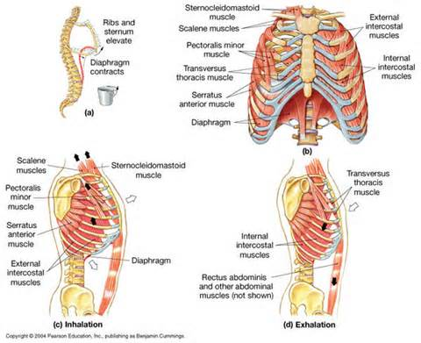
The Tribe of Levi and Simeon
Working Together
9
John 3:14
And as Moses lifted up the serpent in the wilderness, even so must the Son of man be lifted up:

Slide 10
A Personal God Created Man
In the creation of man was manifest the agency of a personal God. When God had made man in His image, the human form was perfect in all its arrangements, but it was without life.
Then a personal, self-existing God breathed into that form the breath of life, and man became a living, breathing, intelligent being. All parts of the human organism were put in action.
The heart, the arteries, the veins, the tongue, the hands, the feet, the senses, the perceptions of the mind--all began their work, and all were placed under law. Man became a living soul. Through Jesus Christ a personal God created man and endowed him with intelligence and power.
Our substance was not hid from Him when we were made in secret. His eyes saw our substance, yet being imperfect;
and in His book all our members were written, when as yet there were none of them.
{8T- Testimonies for the Church Vol.8 264.1-2}
10

Slide 11
11
Above all lower orders of being, God designed that man,
the crowning work of His creation, should express His thought and reveal His glory. But man is not to exalt himself as God. Next in importance to right position are respiration and vocal culture. The one who sits and stands erect is more likely than others to breathe properly.
But the teacher should impress upon his pupils the importance of deep breathing. Show how the healthy action of the respiratory organs, assisting the circulation of the blood, invigorates the whole system, excites the appetite, promotes digestion, and induces sound, sweet sleep, thus not only refreshing the body, but soothing and tranquilizing the mind. And while the importance of deep breathing is shown, the practice should be insisted upon. Let exercises be given which will promote this, and see that the habit becomes established.
{Education 198.4}

Slide 12
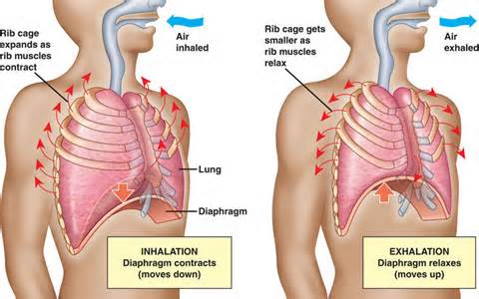
12

Slide 13
13
The training of the voice has an important place in
physical culture, since it tends to expand and strengthen the lungs, and thus to ward off disease. To ensure correct delivery in reading and speaking, see that the abdominal muscles have full play in breathing and that the respiratory organs are unrestricted. Let the strain come on the muscles of the abdomen rather than on those of the throat. Great weariness and serious disease of the throat and lungs may thus be prevented.
Careful attention should be given to securing distinct articulation, smooth, well-modulated tones, and a not-too-rapid delivery.
This will not only promote health, but will add greatly to the agreeableness and efficiency of the student's work.
Margin…..The cramping of the lungs not only prevents their
development, but hinders the processes of digestion and circulation, and thus weakens the whole body. All such practices lessen both physical and mental power, thus hindering the student's advancement and often preventing his success.
{Education 199.1-2}

Slide 14
Jesus Himself supplies the oil to these burning lamps.
He it is that kindles the flame. "In him was life; and the life was the light of men." John 1:4. No candlestick, no church, shines of itself. From Christ emanates all its light. . . . The Lord God Almighty and the Lamb are the light thereof. {Faith to Live By 280.3}
Christ is the Light of the world. He shines in our hearts.
His light in our hearts shines forth from our faces. By beholding the beauty and the glory of Christ, we become changed into the same image. (Manuscript Releases MS 85, 1901). {Vol. 5- Bible Commentary 1143.2}
The lungs are constantly throwing off impurities (see John 16:8-11)
and they need to be constantly supplied with fresh air. Impure air does not afford the necessary supply of oxygen, and the blood passes to the brain and other organs without being vitalized. Hence the necessity of thorough ventilation. To live in close, ill-ventilated rooms, where the air is dead and vitiated weakens the entire system. It becomes peculiarly sensitive to the influence of cold, and a slight exposure induces disease. It is close confinement indoors that makes many women pale and feeble. They breathe the same air over and over until it becomes laden with poisonous matter thrown off through the lungs and pores, and impurities are thus conveyed back to the blood.
14

Slide 15
Only One Source of Light.--Christ "loved the church,
and gave himself for it." It is the purchase of His blood. The divine Son of God is seen walking amid the seven golden candlesticks. Jesus Himself supplies the oil to these burning lamps. He it is that kindles the flame. "In him was life; and the life was the light of men."
(Revelation 2:1; 21:23).
No candlestick, no church, shines of itself. From Christ emanates all its light. The church in heaven today is only the complement of the church on earth; but it is higher, grander--perfect. The same divine illumination is to continue through eternal ages. The Lord God Almighty and the Lamb are the light thereof.
No church can have light if it fails to diffuse the glory it receives from the throne of God (Manuscript Releases-MS 1a, 1890).
The Case Which Contains His Jewels.--The church of Christ is very precious in His sight. It is the case which contains His jewels, the fold which encloses His flock (Manuscript Releases-MS 115, 1899).
(Malachi 3:17) {Vol. 6- Bible Commentary 1118.7-9}
15

Slide 16
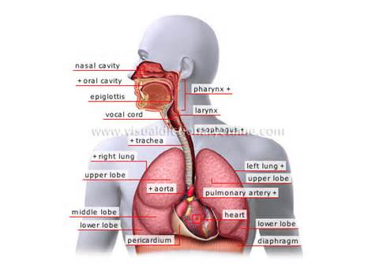
THE RESPIRATORY SYSTEM is an integrated network of organs and tubes
that coordinates the exchange of oxygen and carbon dioxide between an organism and its environment.
16
The anatomical feature of the respiratory system include the heart, the lungs, and the respiratory muscles. It is the location where molecules of oxygen and carbon dioxide are passively exchanged by diffusion, between the gaseous external environment and the blood. This exchange process occurs in the alveolar region of the lungs.
https://kleczekbiology.wikispaces.com/Respiratory+System

Slide 17
17
Christ in the Midst of the Candlestick
Only One Source of Light.--Christ "loved the church,
and gave himself for it." It is the purchase of His blood.
The divine Son of God is seen walking amid the seven golden candlesticks.
Jesus Himself supplies the oil to these burning lamps.
He it is that kindles the flame.
“In him was life; and the life was the light of men.” Ephesians 5:25
And this is the condemnation, that light is come into the world, and men loved darkness rather than light, because their deeds were evil.
(John 1:4; 3:19-21; Revelation 2:1; 21:23).
Who walketh in the midst of the seven golden candlesticks; Margin..
For the glory of God did lighten it, and the Lamb [is] the light thereof. Margin…
No candlestick, no church, shines of itself. From Christ emanates all its light.
The church in heaven today is only the complement of the church on earth;
but it is higher, grander--perfect. The same divine illumination is to continue through eternal ages. The Lord God Almighty and the Lamb are the light thereof. No church can have light if it fails to diffuse the glory it receives from the throne of God . (MS- Manuscript Releases 1a, 1890) {Vol. 6-Bible Commentary 1118.7-8}

Slide 18
18
The Golden Candlestick represented the church of God.
It was of beaten work, many heavy strokes of the hammer were necessary to blend the pieces of gold into one complete whole and form the perfect candlestick.
(Exodus 25:37; 40: 24-25; 30:7,8) (Leviticus 24:2)
The Holy Spirit is the breath of life in the soul. The breathing of Christ upon his disciples was the breath of true spiritual life. The disciples were to interpret this as imbuing them with the attributes of their Saviour, that in purity, faith, and obedience, they might exalt the law, and make it honorable.
{Review and Herald, June 13, 1899 par. 6} ( John 1:9)
In like manner, it takes many trials and chastisements to eradicate pride,
envy and covetousness from the people of God, and blend them into one complete church, "without spot, or wrinkle, or any such thing.”The candlestick upheld seven lamps; these lamps in the earthly sanctuary, were a type of the
"seven lamps of fire burning before the throne in heaven, which are the seven spirits of God.“
{1905 SNH, The Story of the Seer of Patmos 367.1}
(Revelation 4:2,5)

Slide 19
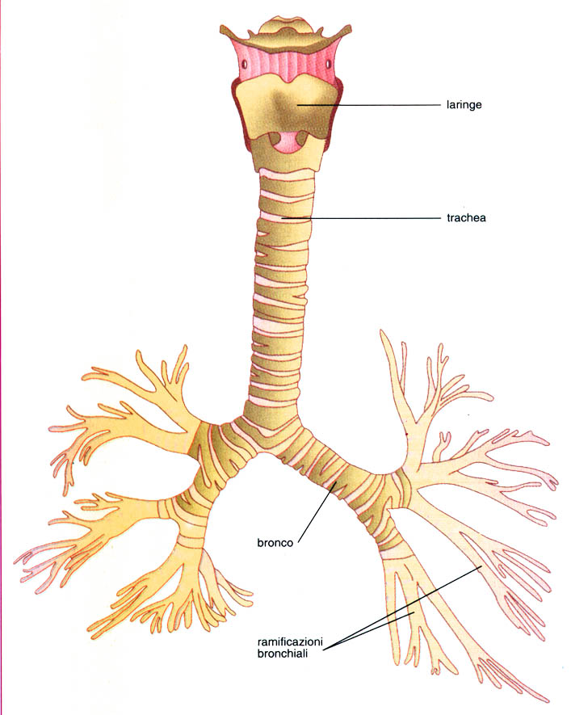
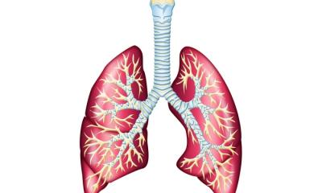
Christ says: "I am the true vine, and my Father is the husbandman.
Every branch in me that beareth not fruit he taketh away; and every branch that beareth fruit, he purgeth it, that it may bring forth more fruit. . . . Abide in me, and I in you. As the branch cannot bear fruit of itself, except it abide in the vine; no more can ye, except ye abide in me. (John 15:1,5)
19
John 1:4,9, 15:4,5;
Revelation 1:13-16
I Am The Vine

Slide 20
I Am The Vine, Ye Are The Branches.
I am the true vine, and my Father is the husbandman.
Every branch in me that beareth not fruit he taketh away: and every [branch] that beareth fruit, he purgeth it, that it may bring forth more fruit. (John 15:1-2, 5) Margin..
Christ says of the church, "Ye are the light of the world."
The Spirit of God shines forth upon the earth through the church.
The church, the candlestick, upholds the light, guiding souls to the Lord.
The candlestick was one whole piece. An individual that is out of harmony with the body, the church, is not a part of the candlestick. The work of dressing the lamps every morning and evening was not given to the Levites; but Aaron, the high priest, the one who represented Christ in the fullest sense,
cleaned and refilled the lamps.
He served "unto the example and shadow of heavenly things." In the heavenly sanctuary, every day Christ performs the work of which this was a type.
It is the privilege of every child of God to believe, as each morning he pleads for strength and wisdom for the day, that Christ in heaven is pouring out an abundant supply of His Holy Spirit to meet every need. At the close of the day, as he reviews his failures and mistakes, he may know that as on earth the high priest lighted the lamps every evening, so Christ, the great High Priest, is giving of His Holy Spirit to cover all the work of the day.
{1905 SNH, The Story of the Seer of Patmos 367.2}
20

Slide 21
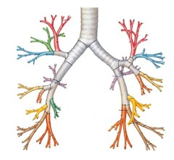
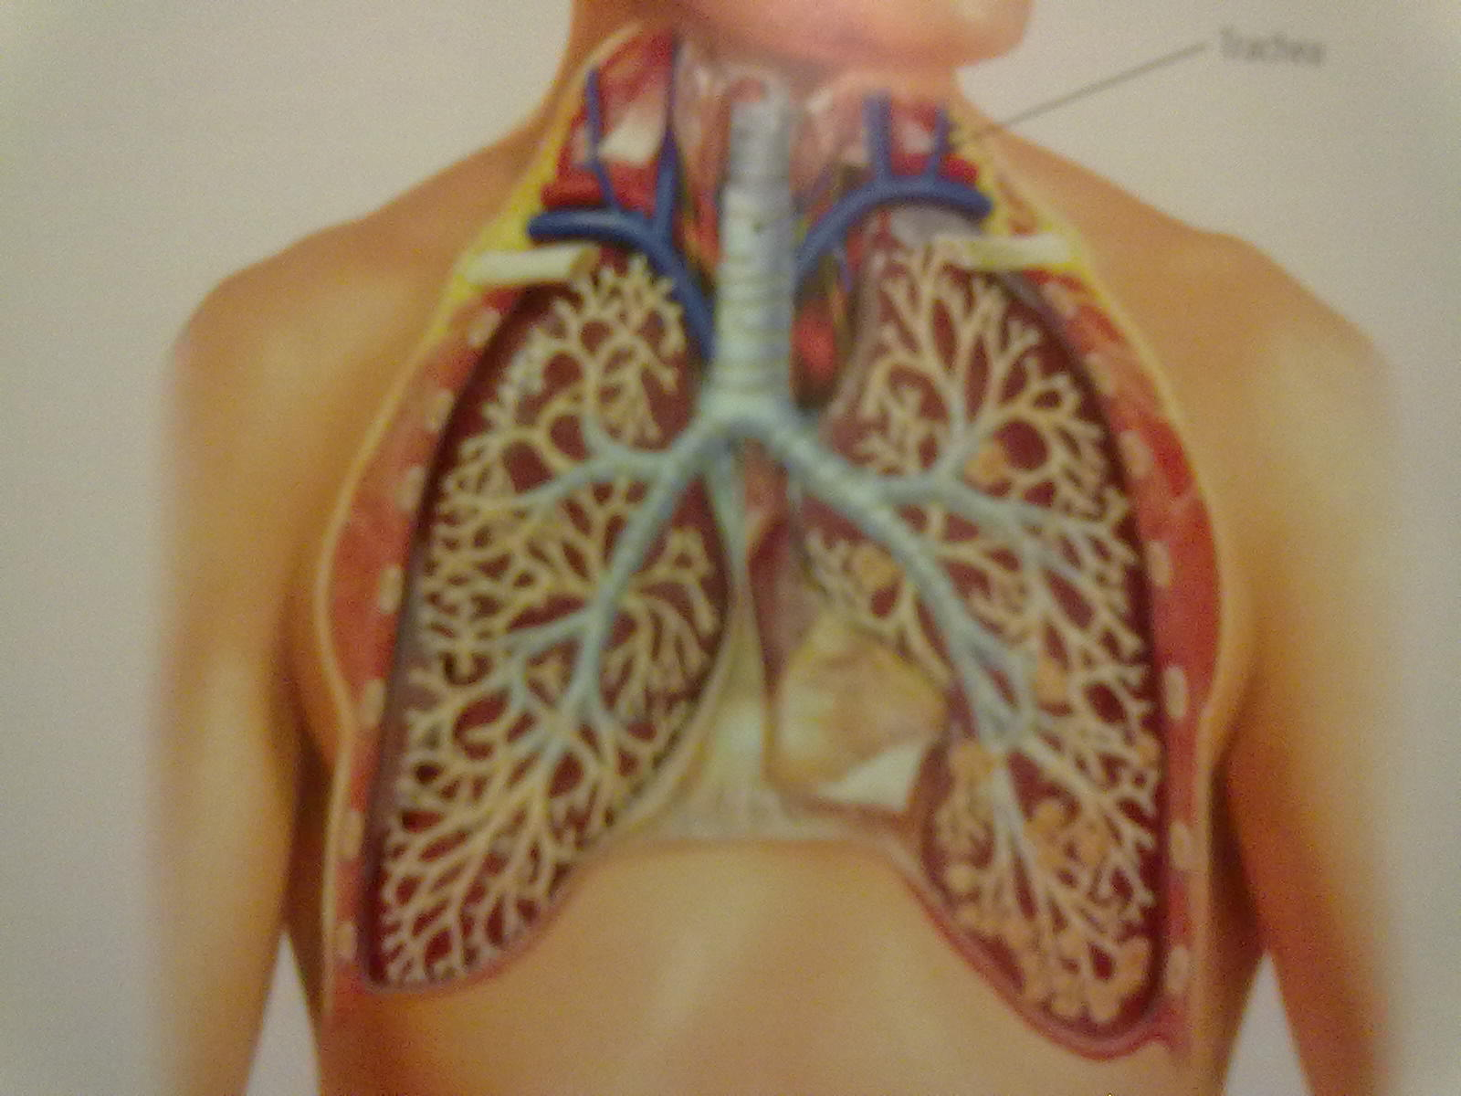
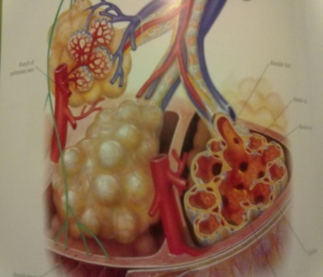
Lets Learn Something Interesting About The Branches!
21
Jesus is in the midst
John 8:23
Why are the braches in our body backwards? And he (Jesus) said unto them Ye are from beneath;
I am from above: ye are of this world; I am not of this world.

Slide 22
22
Its Seven Branches, each holding aloft a lamp,
represented the church of God.
{1914 SNH, The Cross and Its Shadow 50.3}
Jesus Himself supplies the oil to these burning lamps. He it is that kindles the flame. "In him was life; and the life was the light of men." John 1:4.
No candlestick, no church, shines of itself. From Christ emanates all its light…. The Lord God Almighty and the Lamb are the light thereof.
{Faith to Live By 280.3}
Revelation 21:23
And the city had no need of the sun, neither of the moon, to shine in it: for the glory of God did lighten it, and the Lamb [is] the light thereof.
Exodus 30:7,8
And Aaron shall burn thereon sweet incense every morning: when he dresseth the lamps, he shall burn incense upon it. And when Aaron lighteth the lamps at even, he shall burn incense upon it, a perpetual incense before the LORD throughout your generations.
Hebrews 4:15
For we have not an high priest which cannot be touched with the feeling of our infirmities; but was in all points tempted like as [we are, yet] without sin.

Slide 23
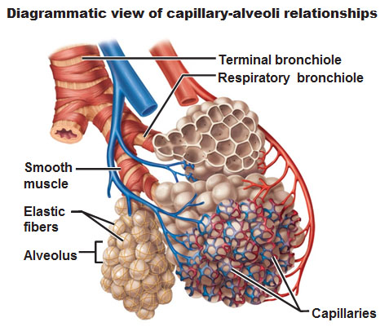
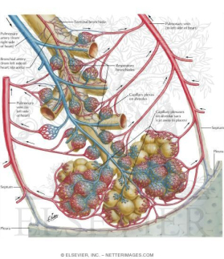
The Branches of the Candlestick
23
And [there shall be] a knop under two branches of the same, and a knop under two branches of the same, and a knop under two branches of the same, according to the six branches that proceed out of the
candlestick.
( Exodus 25:35)
Three bowls made like unto almonds, [with] a knop and a flower in one branch; and three bowls made like almonds in the other branch, [with] a knop and a flower: so in the six branches that come out of the candlestick.
(Exodus 25:33)
Knobs
Almonds
Flowers
It took many a hard and skilful blow to form those delicate flowers and bowls;
but the candlestick was to be made after the heavenly model to teach heavenly lessons to mankind. (Exodus 25:40, margin ) {1914 SNH, The Cross and Its Shadow 50.1}

Slide 24
24
The individual that forms a part of the "church of the first-born, which are enrolled in heaven,“ will often feel the workman's hammer; “for we are His (God's) workmanship, created in Christ Jesus unto good works.” Then, "beloved, think it not strange concerning the fiery trial which is to try you, as though some strange thing happened unto you”
It is only the Master-workman fashioning you to become a part of the great church enrolled in heaven.
{1914 (SNH, The Cross and Its Shadow 51.1}
(Hebrew 12:23, margin ) (Ephesians 2:10) (I Peter 4:12)
The candlestick in the type held seven lamps. The beloved disciple also had a view of the heavenly lamps, of which the earthly ones were models. Before the throne of God in heaven he saw the seven lamps of fire, "which are the seven Spirits of God.“ The church of Christ is the candlestick to hold up the light in the midst of moral darkness. The Saviour says, "Ye are the light of the world." The Spirit of the Lord is said to be the eyes of the Lord which "run to and fro throughout the whole earth, strongly to hold with them whose heart is perfect toward Him.“
Then the brightness of our light depends upon the condition of our heart. The Spirit is searching throughout the earth for those whose hearts are perfect toward God, and it will "strongly hold" with such ones: their light will not burn dim.
{1914 SNH, The Cross Its Shadow 51.2} (Revelation 4:2,5; 2 Chronicles 16:9 margin)

Slide 25
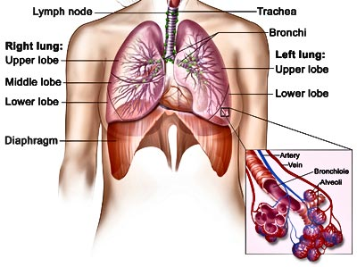
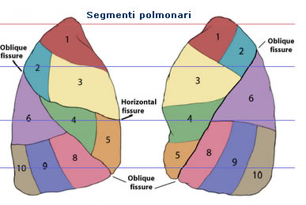
25
The Spiritual Law

Slide 26
Sin: A Symbol of Carbon dioxide: It rids the body of carbon dioxide.
(Romans 8:26-27)
Likewise the Spirit also helpeth our infirmities: for we know not what we should pray for as we ought: but the Spirit itself maketh intercession for us with groanings which cannot be uttered. And he that searcheth the hearts knoweth what [is] the mind of the Spirit, because he maketh intercession for the saints according to [the will of] God.
The lungs should be allowed the greatest freedom possible. Their capacity is developed by free action; (Galatians 5:1, 13) it diminishes if they are cramped and compressed. Hence the ill effects of the practice so common, especially in sedentary pursuits of stooping at one's work. In this position it is impossible to breathe deeply. Superficial breathing soon becomes a habit, and the lungs lose their power to expand. . . .
Thus an insufficient supply of oxygen is received. The blood moves sluggishly. {My Life Today 128.4}
The Trachea: A symbol of our Windpipe has a flap of skin at the top to prevent food from entering.
(Exodus 26:33) and thou shalt hang up the veil under the taches, that thou mayest bring in thither within the veil the ark of the testimony: and the veil shall divide unto you between the holy [place] and the most holy.
26

Slide 27
The Seven Bronchi:
And in the midst of the seven candlesticks [one] like unto the Son of man, clothed with a garment down to the foot, and girt about the paps with a golden girdle. (Revelation 1:13)
Seven Branches:
I am the vine, ye [are] the branches: He that abideth in me,
and I in him, the same bringeth forth much fruit:
for without me ye can do nothing. (John15:5-7) (Matthew 5:14-16)
Its seven branches each holding aloft a lamp, represented the seven churches. (Revelation 1:20)
"Every branch that beareth fruit, he purgeth it, that it may bring forth more fruit." Our fruit-bearing testifies whether we are really abiding in Christ. . . . {5BC 1143.1} (Exodus 25:40) (Revelation 1:12-20) (Hebrew 12:23) (Ephesians 2:10) (1 Peter 4:12) (2 Chronicles 16:9) (John 1:9)
Identity With Christ Needed.--The branches in the True Vine are the believers who are brought into oneness by connection with the Vine. {Vol. 5 Bible Commentary 1143.3 (John 15:1-5).
27

Slide 28
The branches of the vine cannot blend into each other;
they are individually separate; yet every branch must be in fellowship with every other if they are united in the same parent stock. They all draw nourishment from the same source; they drink in the same life-giving properties. So each branch of the True Vine is separate and distinct, yet all are bound together in the parent stock. There can be no division.
They are all linked together by His will to bear fruit wherever they can find place and opportunity. But in order to do this,
the worker must hide self. He must not give expression to his own mind and will. He is to express the mind and will of Christ.
The human families are dependent upon God for life and breath and sustenance. God has designed the web, and all are individual threads to compose the pattern.
The Creator is one, and He reveals Himself as the great Reservoir of all that is essential for each separate life.
{BC- Bible Commentary Vol.5 1143.5}
28

Slide 29
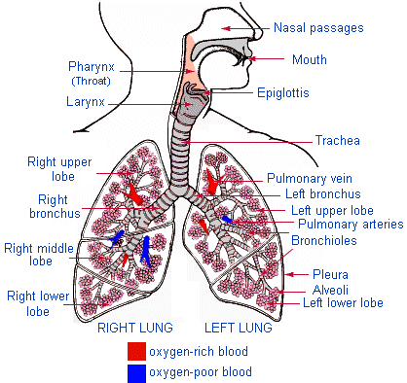
Next in importance to right position are respiration and vocal culture.
The one who sits and stands erect is more likely than others to breathe properly. .
To ensure correct delivery in reading and speaking, see that the abdominal muscles have full play in breathing, and that the respiratory organs are unrestricted. Let the strain come on the muscles of the abdomen rather than on those of the throat. Great weariness and serious disease of the throat and lungs may thus be prevented.
{My Life Today 128.5}
Bowls, Knops, Flowers: A symbol of
Alveolus, Bronchioles, Alveoli
Three bowls made like unto almonds, [with] a knop and a flower in one branch; and three bowls made like almonds in the other branch, [with] a knop and a flower: so in the six branches that come out of the candlestick. (Exodus 25:31, 33-36)
29

Slide 30
Next Week:
The Sanctuary of our Body
The Third Temple
Series 7
The Cardiovascular System
Operates and Functions like
(The Tribe of Reuben )
“The Heart: Excellency of dignity,
and the Excellency of Power ”
The Table of Showbread

