Slide 1
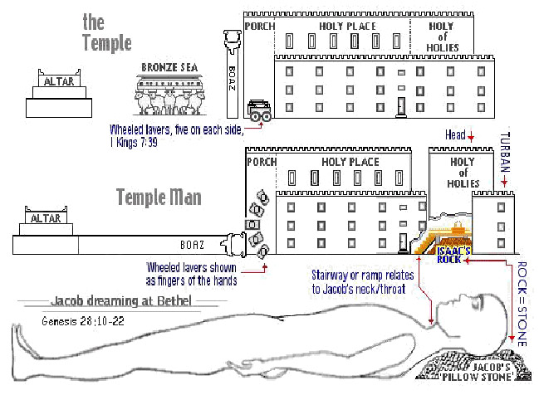
The Nervous System of our Study Series The Sanctuary of our Body
THE THIRD TEMPLE
By: Sister rose

Slide 2
The Nervous System
Operates and Functions like
The Tribe of Judah
“Kingly Power”
Genesis 49:10
The sceptre shall not depart from Judah, nor a lawgiver from between his feet, until Shiloh come; and unto him [shall] the gathering of the people [be].

Slide 3
Deuteronomy 33:7
and this [is the blessing] of Judah: and he said, Hear, LORD, the voice of Judah, and bring him unto his people: let his hands be sufficient for him; and be thou and help [to him] from his enemies.

Slide 4
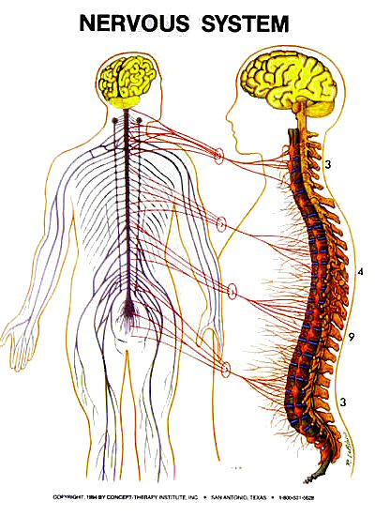
The Nervous System
NERVOUS SYSTEM DEFINITION
The sum total of the tissues that record and distribute information within a person, and does so by electrical and chemical means. The nervous system has two distinct parts -- central and peripheral.
The central part is made up of the brain and spinal cord.
Together they are the central nervous system (CNS).
The peripheral part of the nervous system is said to be peripheral because it is outside the CNS. The function of the peripheral nervous system is to transmit information back and forth between the CNS and the rest of the body.
http://www.medterms.com/script/main/art.asp?articlekey=4542

Slide 5
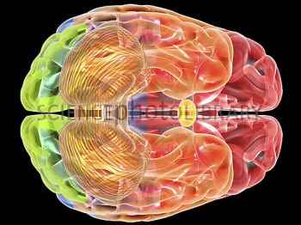
In the Most Holy Place dwells The Ark of the Covenant
The brain is the citadel of the whole man, margin.. {Healthful Living 195.4} Judah [is] my lawgiver; margin. (Psa. 108:8)
The Ark, The Central article of furniture in the sanctuary, was made to contain the Law of God. (SNH, SDP 305 book outline study)
The Two Cherubims
The Tribe of Judah
The ark was the central figure of the entire sanctuary. {SNH, CIS The Cross and Its Shadow 45.1}

Slide 6
Let’s Take a look at these few Quotes stated in slide#3
{Healthful Living 195.4}
The brain is the citadel of the whole man, and wrong habits of eating, dressing, or sleeping affect the brain, and prevent the attaining of that which the student desires,--a good mental discipline. Any part of the body that is not treated with consideration will telegraph its injury to the brain.
Exodus 25:21-22
And thou shalt put the mercy seat above upon the ark; and in the ark thou shalt put the testimony that I shall give thee.
And there I will meet with thee, and I will commune with thee from above the mercy seat, from between the two cherubims which [are] upon the ark of the testimony, of all [things] which I will give thee in commandment unto the children of Israel.

Slide 7
The Physiology of the Nervous System.
Healthful Living pages 193-194
Each faculty of the mind and each muscle has its distinctive office, and all require to be exercised in order to become properly developed and retain healthful vigor.
Every organ of the body was made to be servant of the mind.
The brain is the capital of the body, the seat of all the nervous forces and of mental action. The nerves proceeding from the brain control the body.
By the brain nerves, mental impressions are conveyed to all the nerves of the body as by telegraph wires; and they control the vital action of every part of the system. All the organs of motion are governed by the communications they receive from the brain.
The senses . . . are the avenues to the soul.

Slide 8
The brain nerves which communicate with the entire system are the only medium through which Heaven can communicate with man, and affect his inmost life. Whatever disturbs the circulation of the electric currents in the nervous system, lessens the strength of the vital powers, and the result is a deadening of the sensibilities of the mind.
Any part of the body that is not treated with consideration will telegraph its injury to the brain.
The nervous system, having been unduly excited, borrowed power for present use from its future resources of strength.
Anything that hinders the active motion of the living machinery, affects the brain very directly.
A calm, clear brain and steady nerve are dependent upon a well-balanced circulation of the blood.

Slide 9
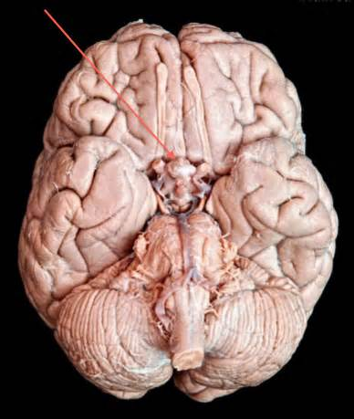
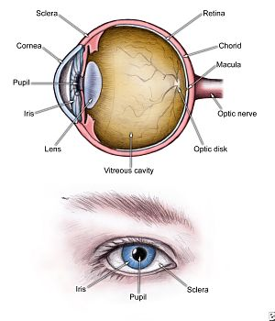
Eyes Fixed on Sanctuary.--As a people, we should be earnest students of prophecy; we should not rest until we become intelligent in regard to the subject of the sanctuary, which is brought out in the visions of Daniel and John
9

Slide 10
10
The Eyes
The light of the body is the eye: if therefore thine eye be single, thy whole body shall be full of light. But if thine eye be evil, thy whole body shall be full of darkness, If therefore the light that is in thee be darkness, how great is that darkness"
(Matthew 6:19-23). {1SAT 318.2} Sermons and Talks Volume One
Correct Views for the Conscience.-- The eye is the sensitive conscience, the inner light, of the mind. Upon its correct view of things the spiritual healthfulness of the whole soul and being depends. The"eyesalve," the Word of God, makes the conscience smart under its application; for it convicts of sin. But the smarting is necessary that the healing may follow, and the eye be single to the glory of God. The sinner, beholding himself in God's great moral looking glass, sees himself as God views him, and exercises repentance toward God and faith toward our Lord Jesus Christ.. {7 Bible Commentary 965.5} (Matthew 6:22; James 1:23-25.)

Slide 11
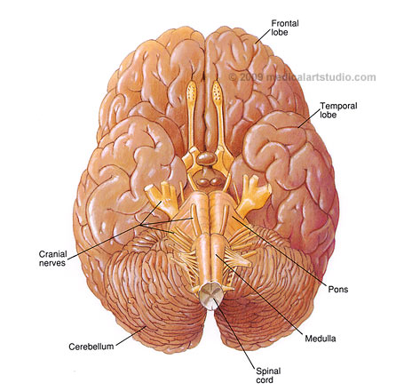
Here is a clearer Look! Can you see the Cherubims upon the mercy seat in our brain?
Exodus 26:8-9, 34
Exodus 25:20

Slide 12
12
The “Eye salve”
I counsel thee to buy of me gold tried in the fire, that thou mayest be rich; and white raiment, that thou mayest be clothed, and [that] the shame of thy nakedness do not appear; and anoint thine eyes with eyesalve, that thou mayest see. (Revelation 3:8)
The “Eye salve”
the Word of God, makes the conscience smart under its application; for it convicts of sin.
Virtues Wanting Among Us.--The gold that Jesus would have us buy of Him is gold tried in the fire; it is the gold of faith and love, that has no defiling substance mingled with it. The white raiment is the righteousness of Christ, the wedding garment which Christ alone can give. The eyesalve is the true spiritual discernment that is so wanting among us, for spiritual things must be spiritually discerned
(Review and Herald April 1, 1890). {7BC -Bible Commentary 965.1}

Slide 13
13
The Cross Planted Between Earth and Heaven.--When Christ came to this world, He found that Satan had everything as he wanted it. The adversary of God and man thought that he was indeed the prince of the earth, but Jesus laid hold of the world to take it out of the power of Satan. He came to redeem it from the curse of sin and the penalty of transgression, that the transgressor might be forgiven. He planted the cross between earth and heaven, and between divinity and humanity; and as the Father beheld the cross, He was satisfied. He said, "It is enough, the offering is complete." God and man may be reconciled. Those who have lived in rebellion against God, may become reconciled, if as they see the cross, they become repentant, and accept the great propitiation that Christ has made for their sins. In the cross they see that "mercy and truth have met together; righteousness and peace have kissed each other”
{5BC 1137.9} (ST The Signs of the Times Sept. 30, 1889).

Slide 14
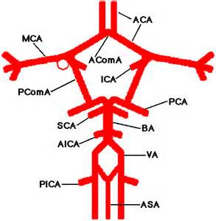
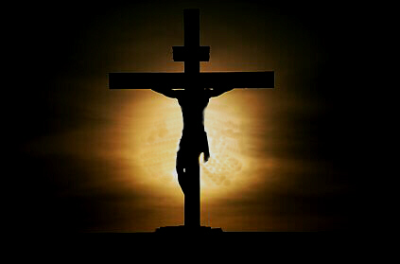
I am Alpha and Omega, the beginning and the ending, saith the Lord, which is, and which was, and which is to come, the Almighty. Revelation 1:8
And all that dwell upon the earth shall worship him, whose names are not written in the book of life of the Lamb slain from the foundation of the world. (Revelation 13:8)

Slide 15
The Efficacy of the Cross.
—The death of Christ upon the cross made sure the destruction of him who has the power of death, who was the originator of sin. When Satan is destroyed, there will be none to tempt to evil; the atonement will never need to be repeated; and there will be no danger of another rebellion in the universe of God. That which alone can effectually restrain from sin in this world of darkness, will prevent sin in heaven. The significance of the death of Christ will be seen by saints and angels. Fallen men could not have a home in the paradise of God without the Lamb slain from the foundation of the world. Shall we not then exalt the cross of Christ? The angels ascribe honor and glory to Christ, for even they are not secure except by looking to the sufferings of the Son of God. It is through the efficacy of the cross that the angels of heaven are guarded from apostasy. Without the cross they would be no more secure against evil than were the angels before the fall of Satan. Angelic perfection failed in heaven. Human perfection failed in Eden, the paradise of bliss. All who wish for security in earth or heaven must look to the Lamb of God. {5BC 1132.8}
The plan of salvation, making manifest the justice and love of God, provides an eternal safeguard against defection in unfallen worlds, as well as among those who shall be redeemed by the blood of the Lamb. Our only hope is perfect trust in the blood of Him who can save to the uttermost all that come unto God by Him. The death of Christ on the cross of Calvary is our only hope in this world, and it will be our theme in the world to come. Oh, we do not comprehend the value of the atonement! If we did, we would talk more about it. The gift of God in His beloved Son was the expression of an incomprehensible love. It was the utmost that God could do to preserve the honor of His law, and still save the transgressor. Why should man not study the theme of redemption? It is the greatest subject that can engage the human mind. If men would contemplate the love of Christ, displayed in the cross, their faith would be strengthened to appropriate the merits of His shed blood, and they would be cleansed and saved from sin
(ST Dec. 30, 1889). {5BC 1132.9}
15

Slide 16
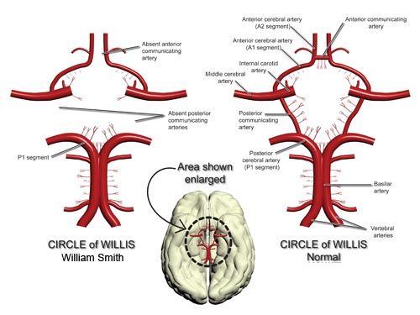
The Cross a Center in the World.
--The cross stands alone, a great center in the world. It does not find friends, but it makes them. It creates its own agencies. Christ proposes that men shall become laborers together with God. He makes human beings His instrumentalities for drawing all men unto Himself. A divine agency is sufficient only through its operation on human hearts with its transforming power, making men colaborers with God.
(Review & Herald Sept. 29, 1891). {vol.5 Bible Commentary 1138.1} (Galatians 6:14.)
16

Slide 17
17
No Rest for Some.--Never before was there such a general knowledge of Jesus as when He hung upon the cross. He was lifted up from the earth, to draw all to Him. Into the hearts of many who beheld that crucifixion scene, and who heard Christ's words, was the light of truth to shine. With John they would proclaim, "Behold the Lamb of God, which taketh away the sin of the world." There were those who never rested until, searching the Scriptures and comparing passage with passage, they saw the meaning of Christ's mission. They saw that free forgiveness was provided by Him whose tender mercy embraced the whole world. They read the prophecies regarding Christ, and the promises so free and full, pointing to a fountain opened for Judah and Jerusalem.
(Manuscript Releases MS 45, 1897). see EGW on Galatians 6:14).
Study All in Light From Cross.--The sacrifice of Christ as an atonement for sin is the great truth around which all other truths cluster. In order to be rightly understood and appreciated, every truth in the Word of God, from Genesis to Revelation, must be studied in the light which streams from the cross of Calvary, and in connection with the wondrous, central truth of the Saviour's atonement. Those who study the Redeemer's wonderful sacrifice grow in grace and knowledge.
I present before you the great, grand monument of mercy and regeneration, salvation and redemption--the Son of God uplifted on the cross of Calvary. This is to be the theme of every discourse. Christ declares, "And I, if I be lifted up from the earth,
will draw all men unto me“
(Manuscript Releases MS 70, 1901) {vol. 5 Bible Commentary 1137.6-8 paragraph }

Slide 18
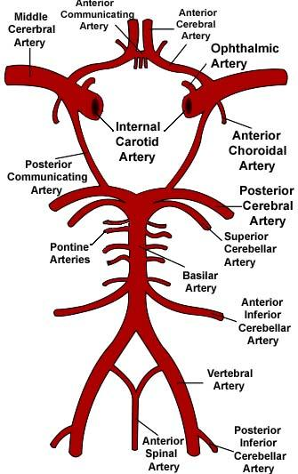
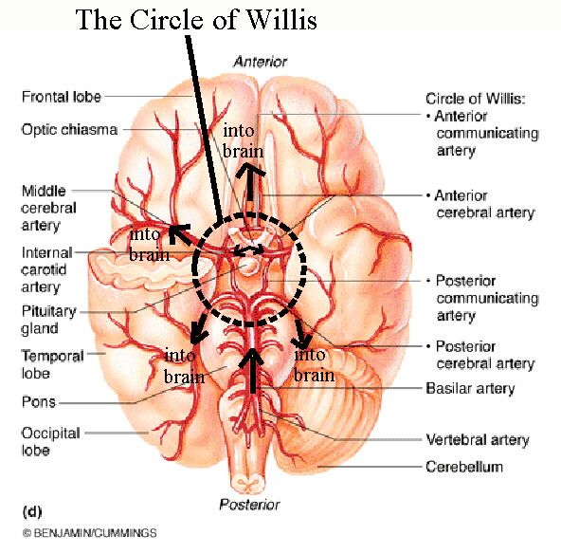
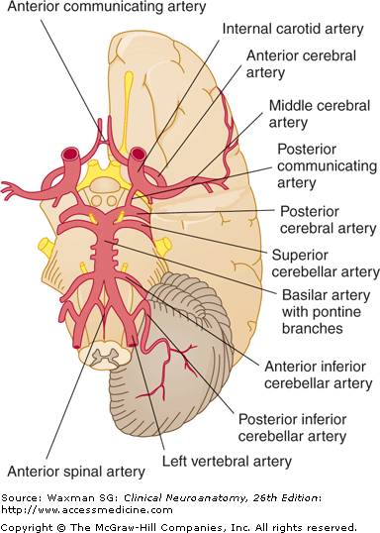
The Circle Will-is
18

Slide 19
19
The Will Is The Deciding Power
Be not conformed to this world: but be ye transformed by the renewing of your mind, that ye may prove what is that good, and acceptable,
and perfect, will of God. Romans 12:2.
Our Fathers Cares{60.1-60.6}
There is nothing that can keep you away from God but a rebellious will.
The will is the governing power in the nature of man. If the will is set right, all the rest of the being will come under its sway. The will is not the taste or the inclination, but it is the choice, the deciding power, the kingly power, which works in the children of men unto obedience to God or to disobedience.
You will be in constant peril until you understand the true force of the will. You may believe and promise all things, but your promises and your faith are of no account until you put your will on the right side. If you will fight the fight of faith with your will power,
there is no doubt that you will conquer.

Slide 20
20
Your part is to put your will on the side of Christ. When you yield your will to His, He immediately takes possession of you, and works in you to will and to do of His good pleasure. Your nature is brought under the control of His Spirit. Even your thoughts are subject to Him. If you cannot control your impulses, your emotions, as you may desire, you can control the will, and thus an entire change will be wrought in your life. When you yield up your will to Christ, your life is hid with Christ in God. It is allied to the power which is above all principalities and powers. You have a strength from God that holds you fast to His strength; and a new life, even the life of faith, is possible to you. You can never be successful in elevating yourself, unless your will is on the side of Christ, cooperating with the Spirit of God. Do not feel that you cannot; but say, “I can, I will.” And God has pledged His Holy Spirit to help you in every decided effort.
The Lord Jesus Christ, the divine Son of God, existed from eternity, a distinct person, yet one with the Father. He was the surpassing glory of heaven.
He was the commander of the heavenly intelligences, and the adoring homage of the angels was received by Him as His right.—
Christ the Word, the Only Begotten of God, was one with the eternal Father—one in nature, in character, and in purpose—the only being in all the universe that could enter into all the counsels and purposes of God.—
RH April 5, 1906. {The Truth about Angel 23.3, 24.3} GC 493

Slide 21
A Merchantman Laden With Riches.--The great Redeemer represents Himself as a heavenly merchantman, laden with riches, calling from house to house, presenting His priceless goods [Revelation 3:18-20 {7Bible Commentary 965.7-9 paragraph}
Knocking at the Heart's Door.--The Lord knocks at the door of your heart, desiring to enter, that He may impart spiritual riches to your soul. He would anoint the blind eyes, that they may discover the holy character of God in His law, and understand the love of Christ, which is indeed gold tried in the fire
(Job 22:21-25.)
Spiritual Riches for the Soul.--Jesus is going from door to door, standing in front of every soul temple, proclaiming, "I stand at the door, and knock." As a heavenly merchantman, He opens His treasures and cries, "Buy of me gold tried in the fire, that thou mayest be rich; and white raiment, that thou mayest be clothed, and that the shame of thy nakedness do not appear." The gold that He offers is without alloy, more precious than that of Ophir; for it is faith and love. The white raiment He invites the soul to wear is His own robe of righteousness; and the oil for anointing is the oil of His grace, which will give spiritual eyesight to the soul in blindness and darkness, that he may distinguish between the workings of the Spirit of God and the spirit of the enemy. "Open your doors," says the great Merchantman, the possessor of spiritual riches, "and transact your business with Me. It is I, your Redeemer, who counsels you to buy of Me“
(Isaiah 13:12; Matthew 13:45, 46.)

Slide 22
The Brain and the Nervous System.
White Matter: The Righteousness of Law
(Exodus 26:1-10)
Moreover thou shalt make the tabernacle [with] ten curtains [of] fine twined linen, and blue, and purple, and scarlet: [with] cherubims of cunning work shalt thou make them.
The length of one curtain [shall be] eight and twenty cubits, and the breadth of one curtain four cubits:
(The human Brain can be described as having)
Four main parts call Lobes:
1.Frontal lobe (Lion) 2.Parietal Lobe (Ox or Calf)
3.Temporal Lobe (Eagle) 4.Occipital Lobe (Like a Man)
and every one of the curtains shall have one measure.
(Ezekiel 1:1-12; 10: 3, 4)

Slide 23
Continuing verse 3-6: The five curtains shall be coupled together one to another; and [other] five curtains [shall be] coupled one to another. And thou shalt make loops of blue upon the edge of the one curtain from the selvedge in the coupling; and likewise shalt thou make in the uttermost edge of [another] curtain, in the coupling of the second. Fifty loops shalt thou make in the one curtain, and fifty loops shalt thou make in the edge of the curtain that [is] in the coupling of the second; that the loops may take hold one of another. And thou shalt make fifty taches of gold, and couple the curtains together with the taches: and it shall be one tabernacle.
Verse 7: And the eleven curtains shalt thou make. Cerebral Cortex/Gray Matter
11 functions see slide #33 for detail . (Exodus 26: 7-8) margin..
Verse 8-9 : The length of one curtain [shall be] thirty cubits, (Although the cerebral cortex is only a few millimeters thick, it has a tremendous surface area. It gains this surface area by lying in deep folds called convolutions (Couple shape). These convolutions increase the surface area of the cerebral cortex 30 times) ; and the breadth of one curtain four cubits: thee human brain can be described as having four main parts: Celebrum, Cerebellum, Diencephalon (thalamus &hypothalamus), Brainstem (spinal cord).
Your brain weighs about 3 pounds an amazing 100 billion neurons, a number that does not include neuroglial (supporting) cells; Both types of cells work together to form the intricate structure of the brain). [shall be all] of one measure. And thou shalt couple five curtains (If laid flat, it would cover an area of 5 square feet.)
by themselves and six curtains by themselves, and shalt double the sixth curtain in the forefront of the tabernacle.

Slide 24
Lets Take a Close Look at these Scriptures and their
Cubits Numbers!
The length of one curtain [shall be] thirty cubits, and the breath of one curtain four cubits: and the eleven curtains [shall be all] of one measure. And thou shalt coupled five curtains by themselves, and six curtains by themselves, and shalt double the sixth curtain in the forefront of the tabernacle.
(Exodus 26:8-9)
And the cherubims shall stretch forth [their] wings on high, covering the mercy seat with their wings, and their faces [shall look] one to another; toward the mercy seat shall the faces of the cherubims be.
(Exodus 25:20)

Slide 25
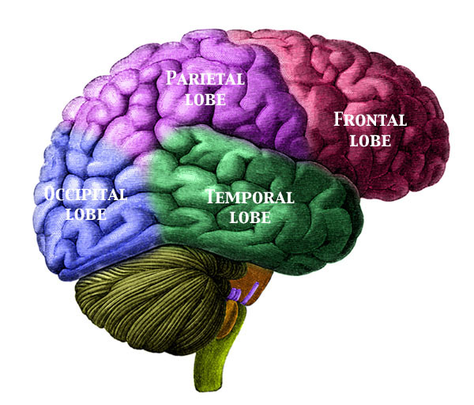
25
Body sensations, Visual and spatial Perception Priesthood
25
Thought processes, behavior, personality, emotion
Kingship
Vision
Likeness
Hearing, understanding speech, language
Swiftness

Slide 26
Cerebrum, Cerebellum and Brainstem:
Each part of the central Nervous System plays its own unique role in integration! (Like the Role of the Godhead)
(Exodus 37:6-9) And he made the mercy seat [of] pure gold: two cubits and a half [was] the length thereof, and one cubit and a half the breadth thereof. And he made two cherubims [of] gold, beaten out of one piece made he them, on the two ends of the mercy seat; One cherub on the end on this side, and another cherub on the [other] end on that side: out of the mercy seat made he the cherubims on the two ends thereof. And the cherubims spread out [their] wings on high, [and] covered with their wings over the mercy seat, with their faces one to another; [even] to the mercy seatward were the faces of the cherubims. (The Son the sympathetic and Father the parasympathetic )
Of The Cerebrum the dominant, which is mostly White Matter
The Cerebrum is split into two halves or hemisphere, the right and left sides of the brain.
(Exodus 36:14-15) (Psalms 18:10-14)
Thalamus: The Headcounters of Ministering Angels
(Hebrew 1:7, 14) (Psalm 104:4) (Matthew 13:41)
*Relays most sensory information from the spinal cord and certain parts of the brain to the cortex.
*Interprets certain sensory messages such as those of pain, temperature, and pressure.

Slide 27
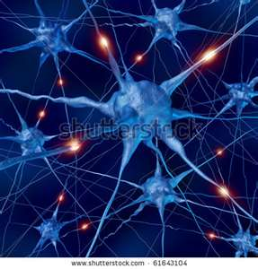
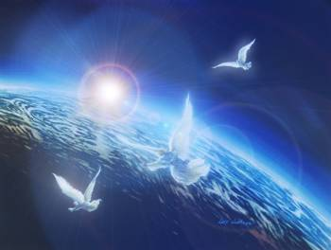
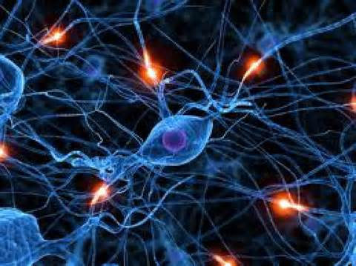
(Your brain weighs about 3 pounds= (the cerebrum, the cerebellum, the brainstem) and contains an amazing 100 billion (100,000,000,000) neurons are specialized cells that conduct nerve impulses.

Slide 28
28
28
Let's Take a Close Look at these Scriptures To compare
the Neurons functions of our body and the Angelic Host!
A neuron is a nerve cell that is the basic building block of the nervous system. Neurons are similar to other cells in the human body in a number of ways, but there is one key difference between neurons and other cells. Neurons are specialized to transmit information throughout the body. Neurons are the core components of the nervous system, which includes the brain, spinal cord, and peripheral ganglia.
Angels are interested in the spiritual welfare of all who are seeking to restore the moral image of God in man; and the human family are to connect with the heavenly family in binding up the wounds and bruises that sin has made. Angelic agencies, though invisible, are co-operating with visible human agencies, forming a relief-association with men. {Review & Herald, 3-19-1901.8}

Slide 29
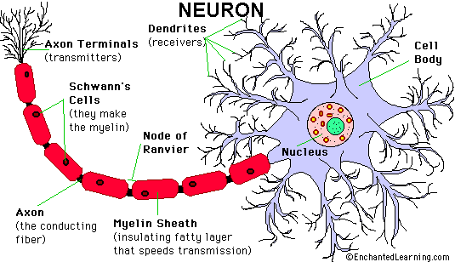
29
Each Neuron has three main parts: a cell body, several branching dendrites that carry impulses to the cell body, and an axon that conveys impulses away from the cell body.
They Represent =The Heavenly Host
And I beheld, and I heard the voice of many angels round about the throne and the beasts and the elders: and the number of them was ten thousand times ten thousand, and thousands of thousands; Saying with a loud voice, Worthy is the Lamb that was slain to receive power, and riches, and wisdom, and strength, and honour, and glory, and blessing, Margin…. (Revelation 5:11-12)
All the furniture of the tabernacle was made of solid gold, or plated with gold. The curtains of the tabernacle were of a variety of colors, most beautifully arranged, and in these curtains were wrought, with threads of gold and silver, cherubims, which were to represent the angelic host, who are connected with the work of the heavenly sanctuary, and who are ministering angels to the saints upon the earth. {Spirit of Prophecy vol. 1 273.2}

Slide 30
Gray and White Matter
The Host of Heaven Angels
Cherubim's (Ezekiel 1:14, 20, 24), Seraphim (Isaiah 6:2), Cherub (Psalm 18:10) (Ezekiel 1:22)
We need to understand better than we do the mission of the angel visitants. It would be well to consider that in all our work we have the co-operation and care of heavenly beings. Invisible armies of light and power attend the meek and lowly ones who believe and claim the promises of God. Cherubim and seraphim and angels that excel in strength--ten thousand times ten thousand and thousands of thousands--stand at His right hand, "all ministering spirits, sent forth to minister for them who shall be heirs of salvation."
Hebrews 1:14. Christ Object Lesson page. 177
The Cerebral Cortex of each hemisphere of the brain is divided into 4 sections
by deep grooves among its many convolutions.) Cortex means “rind” or “bark”
The Cerebral cortex: Gray matter covers an underlying solid white region of myelinated nerves fibers. These nerve fibers are the highways of the brain, bringing messages from one part of the brain to another. These highways, like the message highways in all parts of the nervous system, are composed of individual axons all bundled together like the strands of a telephone cable.)
Your cortex cap is densely packed with neuron cell bodies. Because these cell bodies and their dendrites are unmyelinated, the cerebral cortex appears gray and is referred to as gray matter Basal nuclei.
30

Slide 31
The Number and Power of Angels
We are informed in Scripture as to the number, and the power and glory, of the heavenly beings, of their connection with the government of God, and also of their relation to the work of redemption. “The Lord hath prepared His throne in the heavens; and His kingdom ruleth over all.” And, says the prophet, “I heard the voice of many angels round about the throne.” In the presence chamber of the King of kings they wait—“angels, that excel in strength,” “ministers of His, that do His pleasure,” “hearkening unto the voice of His word.”
Psalm 103:19-21; Revelation 5:11. {TA 9.3}
Ten thousand times ten thousand and thousands of thousands, were the heavenly messengers beheld by the prophet Daniel. Daniel 7:10; Hebrews 12:22.
The apostle Paul declared them “an innumerable company.”
As God's messengers they go forth, like “the appearance of a flash of lightning,” (Ezekiel 1:14), so dazzling their glory, and so swift their flight. The angel that appeared at the Saviour's tomb, his countenance “like lightning, and his raiment white as snow,” caused the keepers for fear of him to quake, and they “became as dead men.” Matthew 28:3, 4. {TA 10.1}
Angels are the ministers sent forth to do the will of Him who sits as King. Some are light-bearers to worlds, others are guardian angels for little children upon earth; but whatever the mission, whether great or small, as measured in humanity's scales, there is the same obedience to the mandates of Jehovah Issuing from the presence of the Father, clothed in the reflection of His own light, those messengers disappear like flashes of lightning.
{1905 SNH, SSP 96.2 Story of the Seer of Patmos} margin…..
31

Slide 32
32
Ministry of Holy Angels.--We need to understand better than we do the mission of the angels. It would be well to remember that every true child of God has the co-operation of heavenly beings. Invisible armies of light and power attend the meek and lowly ones who believe and claim the promises of God. Cherubim and seraphim, and angels that excel in strength, stand at God's right hand, "All ministering spirits, sent forth to minister for them who shall be heirs of salvation.“
Thousands of Angels.--In working for perishing souls you have the companionship of angels. Thousands upon thousands, and ten thousand times ten thousand angels are waiting to co-operate with members of our churches in communicating the light that God has generously given, that a people may be prepared for the coming of Christ.--
They Are Ever Near.--Those who labor for the good of others are working in union with the heavenly angels. They have their constant companionship, their unceasing ministry. Angels of light and power are ever near to protect, to comfort, to heal, to instruct, to inspire. The highest education, the truest culture, and the most exalted service possible to human beings in this world are theirs.
Sent to Help Us.--Nothing is apparently more helpless, yet really more invincible, than the soul that feels its nothingness and relies wholly on the merits of the Saviour. God would send every angel in heaven to the aid of such a one, rather than allow him to be overcome.
Our canvassers are having marked success. And why should they not? The heavenly angels are working with them. Hundreds of those who believe the truth will, if they keep their hearts humble, do a good work, in the companionship of heavenly angels. God will use those who humble the heart before him, and sanctify themselves in faith and humility, following the example of the Great Teacher, and speaking words that will enlighten those not of our faith. We are to work patiently and disinterestedly, as the servants of the Lord, opening the Scriptures to others. {Colporteur Ministry CM 110.1- 111.2}

Slide 33
The Nervous System
Functions like
The Tribe of Judah
Part 2
Genesis 49:10
The sceptre shall not depart from Judah, nor a lawgiver from between his feet, until Shiloh come; and unto him [shall] the gathering of the people [be].

Slide 34
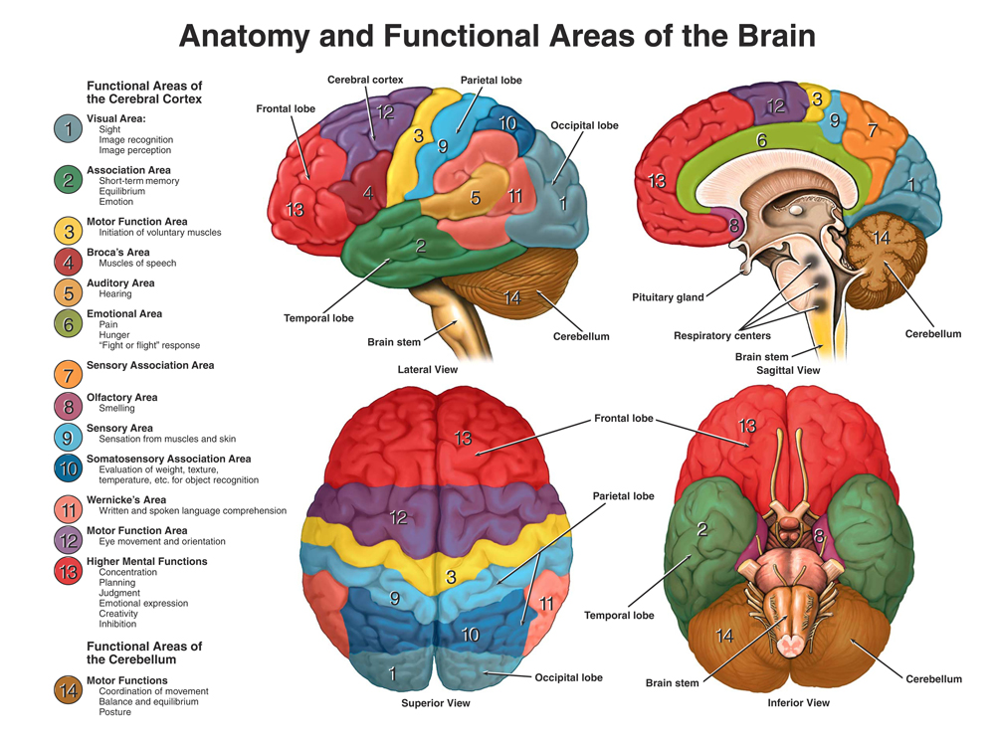
34
The Eleven Curtains
(Exodus 36:14-15)
Eleven Functions:
Conscious thought
Speech
Primary motor
Smell
Primary Sensory
Taste
Hearing
Body awareness
Language
Reading
Vision

Slide 35
THE FUNCTION OF HUMAN BRAIN
The primary structure that controls and coordinates the electrical stream of life is the brain. The brain is the Chief Executive Officer (CEO) of the body. It contains the blueprint, the formula for strong, healthy, high-energy lifestyle that according to the latest Harvard research, should last for 120-130 years. Our creator has implanted the most amazing system that communicates billions of messages from the brain down through the spinal cord and into the periphery in a split-second’s time. This amazing system of neural connections we call the nervous system. Life is all about moving, adapting, and recreating to mirror the demands of our environment. The ability of our body to run this electrical current of information through various pathways as mediated by the Central Nervous System is what makes up our life experience.
http://exodushc.com/wp/?p=12
35

Slide 36
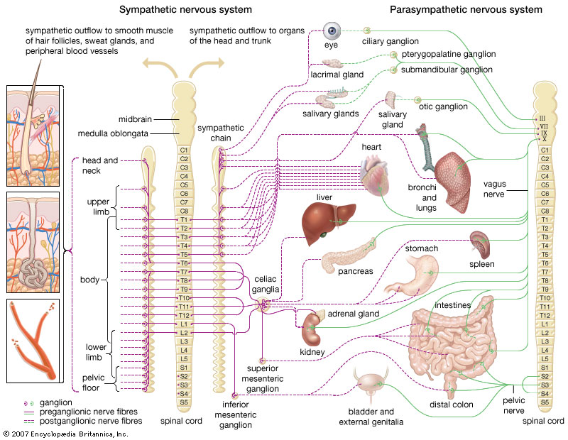
36

Slide 37
Sympathetic Nervous Disturbances.
{Healthful Living pages 195-196 }
God himself has formed us with distinctive organs and faculties. These he designs should act together in harmony. If we injure one, all are affected.
Every wrong habit which injures the health of the body, reacts in effect upon the mind.
The brain is the citadel of the whole man, and wrong habits of eating, dressing, or sleeping affect the brain, and prevent the attaining of that which the student desires,--a good mental discipline. Any part of the body that is not treated with consideration will telegraph its injury to the brain.
It is impossible for the brain to do its best work when the digestive powers are abused. Many eat hurriedly of various kinds of food, which set up a war in the stomach, and thus confuse the brain. . . . At meal-time cast off care and taxing thought. Do not be hurried, but eat slowly and with cheerfulness, your heart filled with gratitude to God for all his blessings; and do not engage in brain labor immediately after a meal. Exercise moderately, and give a little time for the stomach to begin its work.

Slide 38
When the mind or body is taxed heavily after eating, the process of digestion is hindered. The vitality of the system, which is needed to carry on the work in one direction, is called away and set to work in another.
What the users of these stimulants call strength is only received by exciting the nerves of the stomach, which convey the irritation to the brain, and this in turn is aroused to impart increased action to the
heart.
Those who are changing from three meals a day to two, will at first be troubled more or less with faintness, especially about the time they have been in the habit of eating the third meal. But if they persevere
for a short time, this faintness will disappear.

Slide 39
The New Jerusalem the City of God
39
And the city lieth foursquare, and the length is as large as the breadth: and he measured the city with the reed, twelve thousand furlongs. The length and the breadth and the height of it are equal. And he measured the wall thereof, an hundred [and] forty [and] four cubits, [according to] the measure of a man, that is, of the angel. (Revelation 21:16-17)
Before entering the city, the saints are arranged in a hollow square, with Jesus in the midst. In height he surpasses both the saints and the angels. His majestic form and lovely countenance can be seen by all in the square. Upon the heads of the overcomers the Saviour, with his own right hand, places the crowns of glory. For every saint there is a crown, bearing his new name, and the inscription, "Holiness to the Lord." In every hand is placed the victor's palm and the shining harp. The commanding angels strike the note, and every voice is raised in grateful praise, every hand sweeps the harp-strings with skillful touch, awaking sweet music in rich, melodious strains.
{Spirit of Prophecy vol. 4 464.3}
And I saw no temple therein: for the Lord God Almighty and the
Lamb are the temple of it.
(Revelation 21:22)

Slide 40
40
The Story of the Seer of Patmos
BY
STEPHEN N. HASKELL.
The streets of the city are of pure gold,-so pure that they are transparent like crystal. The light from the countenance of Christ falls upon the beautifully blended colors of the wall, and then is reflected again and again on the polished streets. Men have lavished wealth on buildings, but no earthly edifice ever equaled the beauties of this capital city. In this wall are twelve gates; in number the same as the twelve tribes of the children of Israel,-the twelve patriarchs, whose names appear graven in living characters upon them. Each gate is a single pearl. The pearl, as we know it, is formed by the life fluid of the oyster covering a foreign substance. The pearls of heaven represent the abundant righteousness of Christ called forth by sin; but which, flowing full and free, covers every blemish in the character to which it is applied. {1905 SNH, SSP 345.2}
As the redeemed enter the city, they are arranged according to the tribes of ancient Israel, character forming the basis of division. The twelve taken together reflect the fullness of Christ. The character portrayed in the blessings pronounced upon the sons of Jacob, reveals the many sides of the life of the Son of God, as manifested in redemption. {1905 SNH, SSP 346.1}

Slide 41
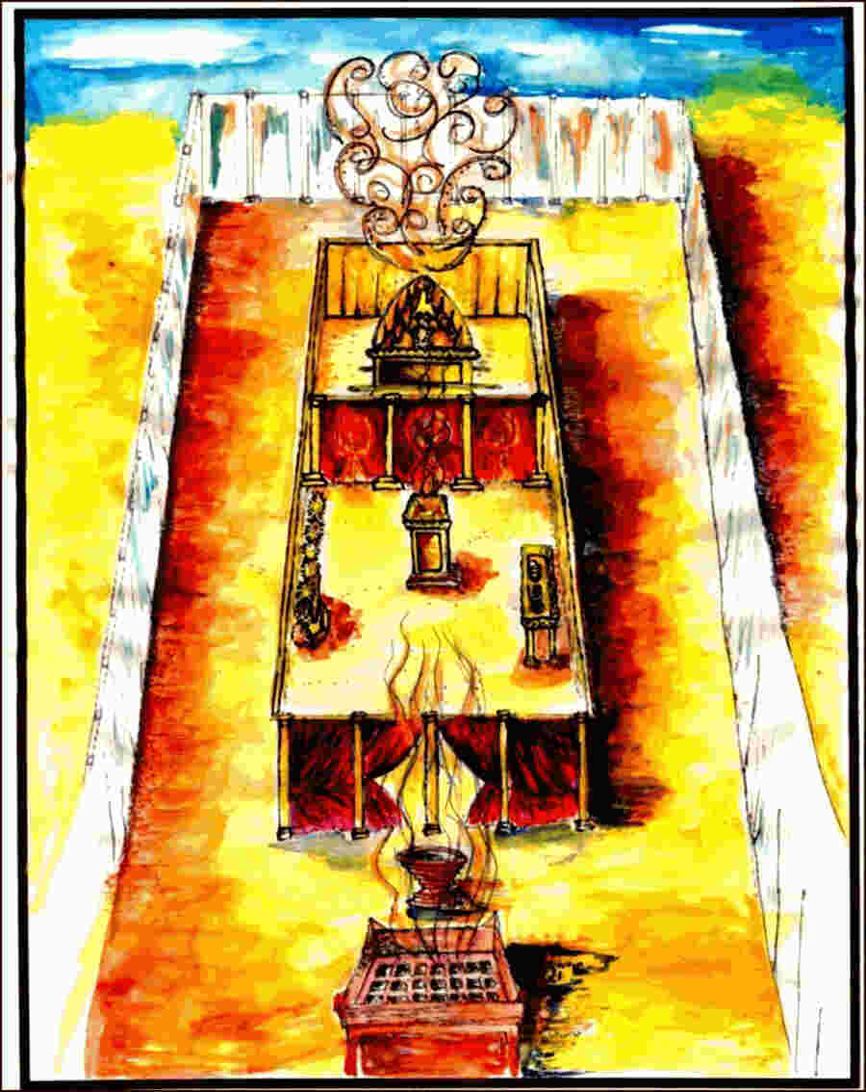
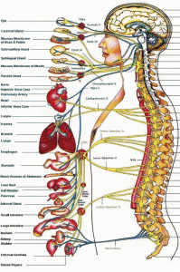
THE ENCAMPMENT OF THE TRIBE OF ISRAEL
41
Levi Guardian of Sacred things was place in Dan’s
lot
Dan
Muscular System
Judge & Strength
Asher
Endocrine System
Rich & Royal
Naphtali Integumentary system
Give godly Words
Naphtali changes to Nepthalim (Revelation 7:6)
Judah Nervous System
Kingly Power
Benjamin
Digestive System
Raven as a Wolf
Manasseh
replaces Dan
{1914 SNH, CIS 356.5}
Manasseh Female Reproductive System
Causing to Forget
Issachar Skeleton System
Strong as Donkey
Jesus Christ
Joseph replaces Ephraim
(Hosea 4:17)
Ephraim
Male Reproductive System
Fruitfulness
Zebulun
Lymphatic System
Dwell by the Sea
Zebulun changes to Zabulon
(Revelation 7:8)
Gad
Urinary System
Trample on but Over Comer
Simeon Respiratory System
Instrument of Cruelty
Reuben Cardiovascular System
Excellency of Power
The Setting of the Human Brain Function (Revelation 21:16-17)

Slide 42
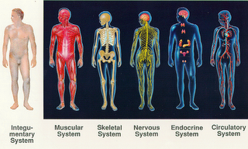
The Twelve Tribes of Israel
Naphtali Levi Issachar Judah Asher Reuben
42
The
skin

Slide 43
43
The Cross and its Shadow
BY
STEPHEN N. HASKELL.
The Lord names individuals according to their character, and since He has chosen the names of the twelve sons of Jacob,-whence came the twelve tribes of Israel,-as names of the twelve divisions of the one hundred and forty-four thousand, there must be something in the character of Jacob's sons and of the twelve tribes of Israel worthy of careful study.
{1914 SNH, CIS 287.1} ( Revelation 7:4)
The company of one hundred and forty-four thousand, who will be redeemed from among men when the Saviour comes, and who throughout eternity will "follow the Lamb whithersoever He goeth," will enter the city of God marshaled in twelve companies, each bearing the name of one of the twelve tribes of Israel. From these instances we conclude that there was a special significance to the names given to the twelve sons of Jacob. {1914 SNH, CIS 288.1}

Slide 44
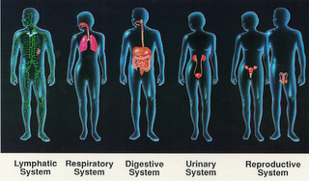
Zebulon Simeon Benjamin Gad Dan Ephraim
44
Manasses Joseph
(Revelation 7:6,8)

Slide 45
We all need to study character and manner that we may know how to deal judiciously with different minds, that we may use our best endeavors to help them to a correct understanding of the Word of God, and to a true Christian life. We should read the Bible with them, and draw their minds away from temporal things to their eternal interests. It is the duty of God's children to be missionaries for Him, to become acquainted with those who need help. If one is staggering under temptation, his case should be taken up carefully and managed wisely; for his eternal interest is at stake, and the words and acts of those laboring for him may be a savor of life unto life, or of death unto death.—Testimonies, vol. 4, pp. 68, 69. (1876)
{Ev 352. 2-3 paragraph} Evangelism
The Guardianship Plan.--In Christ we are all members of one family. God is our Father, and He expects us to take an interest in the members of His household, not a casual interest, but a decided, continual interest. As branches of the parent vine, we derive nourishment from the same source, and by willing obedience, we become one with Christ.

Slide 46
Revelation 5:11-12
And I beheld, and I heard the voice of many angels round about the throne and the beasts and the elders: and the number of them was ten thousand times ten thousand, and thousands of thousands; Saying with a loud voice, Worthy is the Lamb that was slain to receive power, and riches, and wisdom, and strength, and honour, and glory, and blessing.
Psalm 18:10
And he rode upon a cherub, and did fly: yea, he did fly upon the wings of the wind.
Psalm 34:7
The angel of the LORD encampeth round about them that fear him, and delivereth them.
Psalm 91:11
For he shall give his angels charge over thee, to keep thee in all thy ways.
Ezekiel 1: 14, 20, 22,24
And the living creatures ran and returned as the appearance of a flash of lightning. Whithersoever the spirit was to go, they went, thither [was their] spirit to go; and the wheels were lifted up over against them: for the spirit of the living creature [was] in the wheels. And the likeness of the firmament upon the heads of the living creature [was] as the colour of the terrible crystal, stretched forth over their heads above. And when they went, I heard the noise of their wings, like the noise of great waters, as the voice of the Almighty, the voice of speech, as the noise of an host: when they stood, they let down their wings.
Matthew 13:41
The Son of man shall send forth his angels, and they shall gather out of his kingdom all things that offend, and them which do iniquity;

Slide 47
Brain Stem=Headquarters of the Heavenly Host= Midbrain, Pons, and Medulla (Genesis 28:17)
Christ our High Priest before the Mercy Seat=The Pituitary
(Hebrew 2:17; 7:25; 9:11, 24-25) gland is a small endocrine organ that controls a multitude of important functions in the body. It is divided into an anterior lobe, posterior lobe, all of which are involved in hormone production. The posterior pituitary is composed of axons from the neurons of the hypothalamus. Blood vessel connections between;
The Hypothalamus= Represents the Holy Spirit and the pituitary= Represents Christ our Mediator (John 15:26-27) allows hypothalamic hormones to control pituitary hormone secretion and Controls various homeostatic functions such as body temperature, respiration, and heartbeat.
The pituitary gland is termed the "Master Gland" because it directs other organs and endocrine glands, (Christ Ministry and Mission to redeem man) such as the adrenal glands, to suppress or induce hormone production.
Function: The pituitary gland is involved in several functions of the body including: Growth Hormone Production, Production of Hormones That Act on Other Endocrine Glands, Production of Hormones That Act on the Muscles and the Kidneys, Endocrine Function Regulation, Storage of Hormones Produced by the Hypothalamus

Slide 48
Next Sabbath:
We will continue Part 3
Of our Series In our study!
The Third Temple our Body
The Endocrine System
(The Tribe of Asher)

