Slide 1
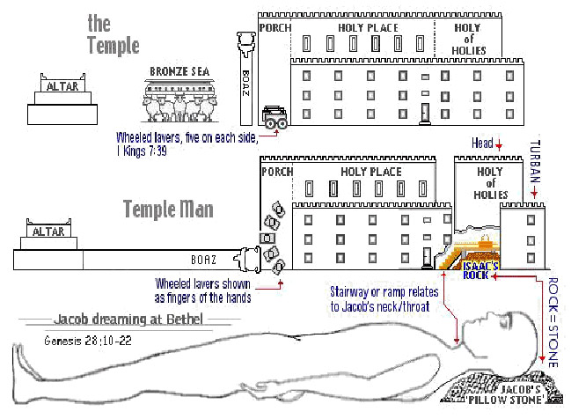
The Sanctuary of our Body
THE THIRD TEMPLE
Series 5
The Muscular System
By : sister rose

Slide 2
The Muscular System
Operates and Functions like
(The Tribe of Levi)
“joined” or “attached”
Genesis 49:5
Simeon and Levi [are] brethren; instruments
of cruelty [are in] their habitations.

Slide 3
Deuteronomy 33: 8-11
And of Levi he said, [Let] thy Thummim and thy Urim [be] with thy holy one, whom thou didst prove at Massah, [and with] whom thou didst strive at the waters of Meribah;
Who said unto his father and to his mother, I have not seen him; neither did he acknowledge his brethren, nor knew his own children: for they have observed thy word, and kept thy covenant. They shall teach Jacob thy judgments, and Israel thy law: they shall put incense before thee, and whole burnt sacrifice upon thine altar.
Bless, LORD, his substance, and accept the work of his hands: smite through the loins of them that rise against him, and of them that hate him, that they rise not again.

Slide 4
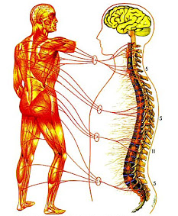
The Muscular System
MUSCULAR SYSTEM
DEFINITION
The muscular system is one of the largest and most important body systems. There are three types of muscle present throughout the body: skeletal, cardiac and smooth muscle. The muscular system functions to allow the body to produce movement and allows our internal organs to function as they should. The muscular system is involved in almost every function of the body, including function of the heart, breathing, digestion and regular daily activities such as walking and running.
4
http://www.livestrong.com/article/123735-information-muscular-system/

Slide 5
In the Bible the human body is used as an object lesson to help us understand more about God’s spiritual body, the church
(1 Corinthians 12:27) tells us that “ye are the body of Christ, and members in particular.” Each member of God’s church on earth has a special part to perform in building up the body. “Every part maketh increase of the body unto the edifying* of itself in love”
(Ephesians 4:16)
The Muscular System
There is needed a special set of organs by means of which motions of various sorts can be made. This need is exactly supplied by the muscular system, acting in connection with the bones and the nervous system. The bones serve as points of attachment for the muscles, by which they are used as levers. The nervous system furnishes the impulse, and the muscles carry out the order by contracting.
(The Body book#2 Pages 38, 42 Son Light Education Ministry)
Muscles
Whether attached to bones or to internal organs and blood vessels, are responsible for movement. Internal movement involves the contraction and relaxation of muscles found in viscera, and external movement is accomplished by the contraction and relaxation of muscles that are attached to the bones.
5

Slide 6
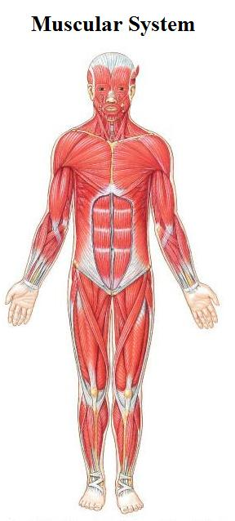
The muscles provide the forces that enable the body to move.
Muscles stretch across joints to link one bone with another and work in groups to respond to nerve impulses.
6

Slide 7
God's throne is a movable structure.
As in the type His visible presence was manifested in the outer apartment of the earthly sanctuary, so in heaven the throne of God was in the first apartment when Christ ascended and sat at the right hand of His Father. But Daniel saw not only the Father and Christ change their position, but the position of the thrones also was changed, when the "judgment was set, and the books were opened." Type had met antitype. The High Priest in the heavenly sanctuary entered the most holy place, and as in the type God Promised to meet the high priest in the most holy, so the Father passed into the holy of holies before the High Priest, and was there when the angels bore Christ triumphantly in before Him.
{1914 SNH, The Cross and Its Shadow 214.1}

Slide 8
8
The human body contains more than 650 individual
muscles which are attached to the skeleton,
which provides the pulling power for us to move around.
The main job of the muscular system is to provide movement for the body (Tabernacle).
They work in pairs: one muscle moves the bone in one direction
and the other moves it back again. The muscular system is an
organ system consisting of skeletal, smooth and cardiac muscles.
It permits movement of the body, maintains posture, and circulates blood throughout the body.
The muscular system in vertebrates is controlled through the nervous system (the Law), although some muscles
(such as the cardiac muscle) can be completely autonomous
(the law of the Spirit).
Muscles provide strength, balance, posture, movement and heat for the body to keep warm.

Slide 9
9
The Order of Priesthood
The Muscles provide the forces that enable the body to move. Muscles stretch across joints to link one bone with another and work in groups to respond to nerve impulses.
They provide strength, balance, posture, movement and heat to keep warm.
(The Law giver for the movements of our body)
The Office of the Priest and assignments in the body.
There were two orders of the priesthood, the Melchizedek (12) serve as sons of the Aarons and the Levitical (24) serve in the Courtyard and a High Priest (1) who ministers in the Holy Place and Most Holy ones a year.
They are the guardians of sacred things. (Exodus 28:1)
The Muscular System:
The Office of The Judges
(Represents: The Tendons of our Muscular System)

Slide 10
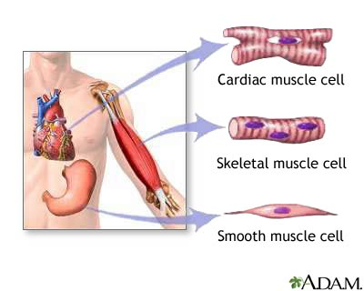
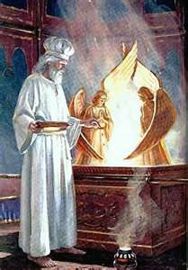
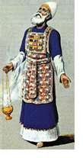
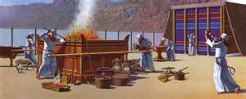
The Muscular System: The Offices of Priesthood and Judges (Muscles and Tendons)
They are the voluntary and the involuntary muscles
10
The Priesthood
HIGH PRIEST
(Hebrew 7:25)
(Hebrew 8:3, 5)
LEVI PRIEST
LEVITES PRIEST
The Cross and Its Shadow Section III pages 69-86

Slide 11
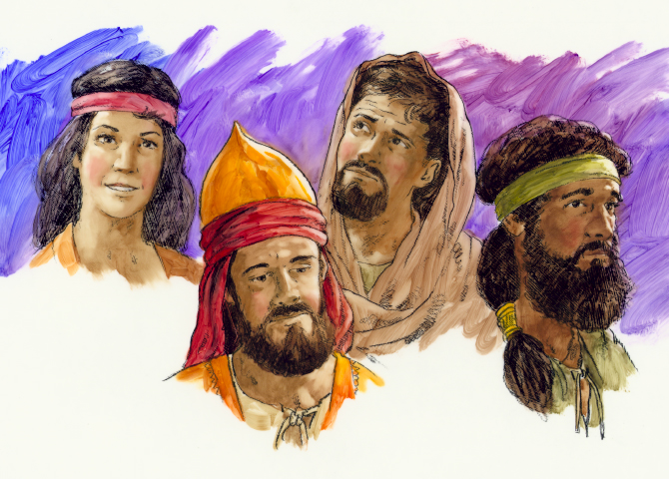
The Judges of Israel Represent
The Tendons in our Bodies.
Tendons are Connective tissue that binds muscles to bones.
(The Priests of God bound by His Living Word and His Laws)
11

Slide 12
The Tendons of our Muscular System the Judges.
12
The Tribe of Dan: shall judge his people, as one of the tribes of Israel
The blessing pronounced upon Dan by Jacob, portrays his character:
"Dan shall judge his people, as one of the tribes of Israel.
(Genesis 49:16,17) {Margin…1914 SNH, The Cross and Its Shadow -CIS 375.3}
Symbol of our Tendon
Wisdom (judge) & Principle (Strength):
Tendons: Symbols of the Tribe of Dan
Judges the helpers in the priesthood (the tribe of Dan to help carry the burden with the Levi covenant made by Moses and his father-in law Jethro, the priest of Midian.
(72 men was taking from his tribe Dan to help judge all the small matters)
(Genesis 18:1, 14-22, 25-27; 49:16)
Dan was the first son born of the concubines, but the old patriarch gave him an honored place among the tribes of Israel. Naturally he was endowed with the quick, keen discernment that makes a good judge; but he did not exercise the gift as God designed; he used it in detecting the evil in others, instead of the good.
{1914 SNH, The Cross and Its Shadow- CIS 375.4}

Slide 13
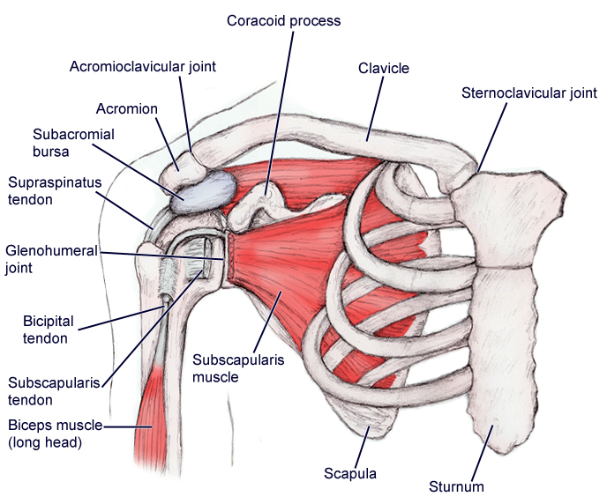
13
l
l
L
l
Judges
llll

Slide 14
The nearly 700 muscles of Skeletal muscles, attached
To Bone by means of connective tissue called Tendons.
Muscles: Represents The Priest
Tendons : Represents The Judges
One end of a muscle (Priest) is attached to a stationary bone (The Law)
(the Origin) and the other to a movable bone the Insertion).
The Origin Anchors The Bone (Tabernacle Movable Structure)
as it pulls at the insertion producing movement by bending the skeleton at movable joints.
The connecting tendon closest to the body or head is called
the Proximal attachment: this is termed the Origin Of The Muscle
The other end, the Distal attachment, is called the Insertion.
During contraction, the Origin Remains Stationary and
the Insertion Moves.
The muscle in which we are allow to control by ourselves are called the voluntary muscles (The skeleton or the tabernacle structure)
and the ones we can’t controls are the involuntary muscles
14

Slide 15
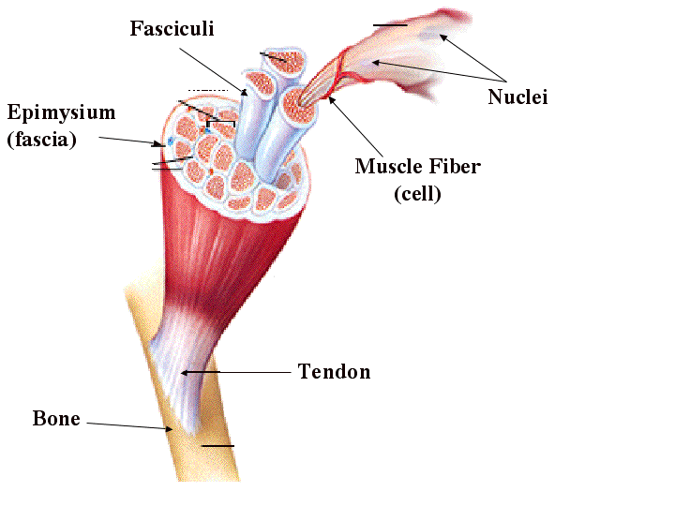
Size
Our muscle structure consists of densely packed groups of elongated cells known as muscle fibres.
These fibres are held together by
fibrous connective tissue.
Capillaries penetrate this tissue to keep the muscles supplied with oxygen and nutrients
that are needed to fuel contraction.
In a relaxed muscle the thick
and thin threads within a muscle fibre overlap a little. When a muscle contracts, the thick filaments slide further in between the thin filaments like interlacing fingers. This action shortens the entire fibre.
15

Slide 16
The Levitical Order of The Priesthood
There were two orders of the priesthood, the Melchizedek and the Levitical. The Melchizedek order preceded the Levitical order. In Abraham's day the priest Melchizedek was king of Salem as well as priest of the Most High God. 1 Although there is not much said in the Bible of the Melchizedek order of the priesthood, it was superior to the Levitical order, for Christ was made a priest after the order of Melchizedek. (Genesis 14:17-20) (Hebrews 6:20)
The Levitical order extended from the time Israel came out of Egypt until the cross; since that time we have the priesthood of Christ, of which all earthly priests were a type.
Christ being a priest after the order of Melchizedek, we are now living under the Melchizedek order of the priesthood. There are many particulars given in regard to the Levitical order; and as all the Levitical priests served "unto the example and shadow of heavenly things," when we study the Levitical priesthood we are really studying the priestly work of our Lord and Saviour Jesus Christ. {1914 SNH, The Cross and Its Shadow 79.1-2}
16

Slide 17
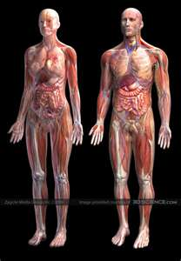
17
The Tribe of Levi
The Guardians of Sacred things in the Sanctuary
They shall teach Jacob thy judgments, and Israel thy law:

Slide 18
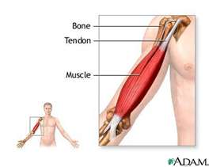
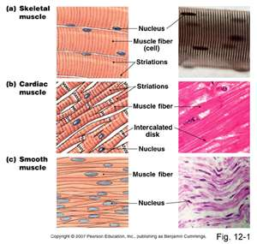
The Muscular System: The Office of Priesthood and Judges
(Muscles and Tendons)
They are the voluntary and the involuntary muscles
18
LEVI PRIEST
HIGH PRIEST
LEVITES PRIEST

Slide 19
Muscles provide strength, balance, posture, movement and
heat for the body to keep warm.
The muscular system consists of three different types of muscle tissues:
(Levitical represent (24) and Melchizedek represents (12)
Priest and High Priest (1)
Nuclei: Skeletal Muscles the 24 Elders (the Levitical priesthood)
(1 Chronicles 24:1-9) (Number 3:10)
Two orders of the priesthood
The skeletal muscle is composed of long muscle fibers. Each of these muscles fiber is a cell which contains several nuclei. It controls the contraction of the muscle. Many of the skeletal muscle contractions are automatic. However we still can control the action of the skeletal muscle. And it is because of this reason that the skeletal muscle is also called: voluntary muscle
(Leviticus 1:3, 8:16, 25).
19

Slide 20
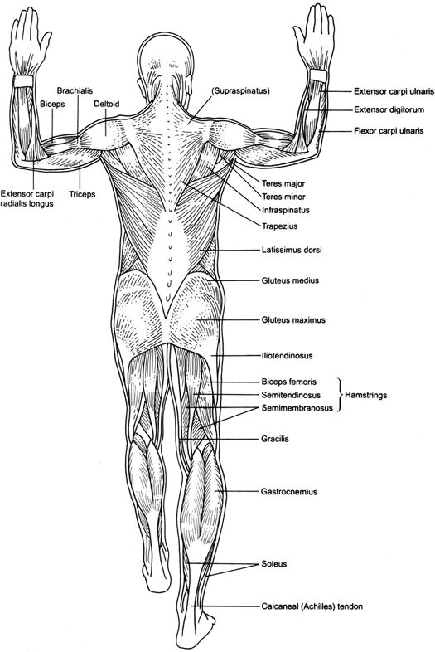
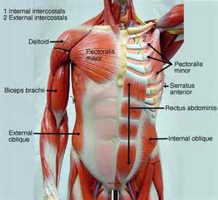
The 24 Priest of The Levitical Order
20
The 12 Priest Melchizedek Order
Anterior (View)
of Muscles
Posterior (View)
of Muscles

Slide 21
21
The Old Testament Priest by Oath
The Gospel Veil in Types
These different tissues has the ability to contract, which then allows body movements and functions.
The muscle that are voluntary get their signals from the
Peripheral Nervous System, and it’s because of this that the skeletal muscle are under conscious or voluntary control.
The New Testament Priest By Divine Commissions
The Gospel Reveal in Anti-Type
The Heart, or cardiac muscle is an example of involuntary muscle.
The involuntary muscle (smooth and cardiac muscles) receive their nerve supply from The Central Nervous System and functions involuntarily without conscious control.
(Ezekiel 36:26-27)
A new heart also will I give you, and a new spirit will I put within you: and I will take away the stony heart out of your flesh, and I will give you an heart of flesh. and ye shall keep my judgments, and do [them]. Margin..

Slide 22
22
There Are Two Order Of Priesthood
in The Muscular System they are:
The Voluntary muscles= (TYPE) Aaron the High Priest and
Moses the Mediator with the 24 priest, beside the 10% of all the first born from the 12 tribe of Israel giving to Aaron as son for the courtyard office.
(Genesis 14:17-20)
the muscle that are voluntary get their signals from the Peripheral Nervous system, and it’s because of this that the skeletal muscle are under conscious or voluntary control.
12 Tribes of Israel: (Hebrew 7:11, 16) (Exodus 29:24) (Leviticus 23:10-11)
(Luke 24:1-3)(1 Chronicles 24:1-19)(Numbers 3:10)
The Involuntary muscles = (ANTI-TYPE) Christ our High Priest and Mediator and 24 resurrected souls, of the dead.
(Revelation 4:4; 5:8) (Luke 1:8)
The involuntary muscle (smooth and cardiac muscles) receive their nerve supply from the central Nervous System and functions involuntarily without
conscious control.
12 Disciples Represented the Spiritual Israel:(Mark 6:7,8) (John3:14)
22

Slide 23
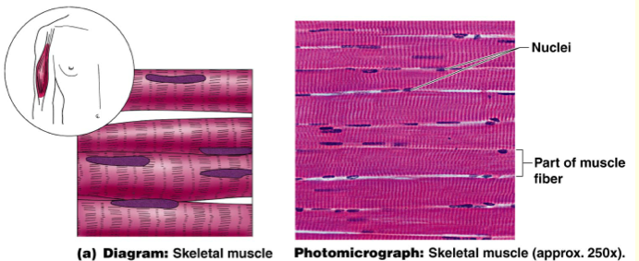
23
The Tribe Of Issachar
Going Back to the Origin
To re-establish God’s
Judgment By Principle
(Isaiah 58:12)
Skeletal muscle is composed of bundles of long striated fibres.

Slide 24
Nuclei: Skeletal Muscles
These Muscle Represent the Levitical Order of Priesthood
(The time period lasted from Sinai until the Crucifixion)
The Skeletal muscles oppose each other in this way; such opposing muscles pairs are called antagonists. In this case, the action of the triceps opposes the action of the biceps. The triceps sits on the back of the arm with one of its three heads originating on edges of the scapula near that back side of the humerus. Another head originates along the upper half of the back side of the humerus and the third along the lower half of the ulna near the elbow. When the triceps shortens, its insertion is brought closer to its origin and the forearm is brought downward.
The distance between the origin and insertion is measured as the length of the muscle (priest) and tendons (judgment by principle).
The point of attachment of the muscle to the stationary bone called ORIGIN (Beginning) of the muscle.
God The Father is responsible for these functions:
The Legs, Arms, Abdomen, Chest, Neck, Face.
These Muscle contract from the weakest to the strongest
Nuclei: Contain producing substance repair as they wear out. (Isaiah 58:12)
24

Slide 25
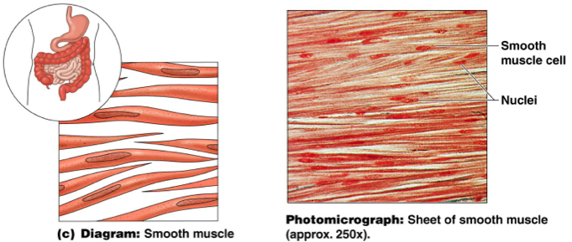
25
The Tribe Of Benjamin
Paul’s Commission
to establish the Gospel to the Gentiles
(Acts 9:15)
Smooth muscle which is found in the walls of internal organs such as intestines is made of short spindle-shaped fibres packed together
in layers.

Slide 26
Nuclei: Smooth Muscle
These Muscle Represent the order of Priesthood after Melchisedec (From Christ Resurrection until Present The Apostles)
(Mark 6:7, 8) (John 3:14)
Much of our internal organs is made up of smooth muscles.
They are found in the urinary bladder, our respiratory organs,
in a female, the uterus, gallbladder, arteries, and veins.
Also the digestive tract is made up of smooth muscle as well.
The smooth muscles are controlled by the nervous system and hormones.
(represents: the Law and the Testimonies (Isaiah 8:20).
We cannot consciously control the smooth muscle that is why they are often called involuntary muscles.
Smooth muscle can stretch and maintain tension over extended periods.
Functions such as heart beat and lungs
(which are capable of being willingly controlled, be it to a limited extent)
are involuntary muscles but are not smooth muscles.
26

Slide 27
God The Son (Jesus Christ) is responsible for these functions:
The Stomach, Intestine, The Lungs, The Blood Vessels and Bladder
These are not under conscious control they are Involuntary muscles
Smooth muscles are involuntary muscles - in other words we do not have to think about contracting them because they are controlled automatically by the Nervous System.
It would be pretty inconvenient if we had to think about digesting our food, for example:
The chewing of food, moving the food to the Stomach unto the Intestine, To Digestions, to Blood vessels circulation and for breading.
Nucleus: there is only one nucleus present in the centre of each cardiac fibre and adjacent fibres branch but are linked to each other by so-called muscle bridges. (He is Our Bridge to Eternal Life) (John 14:6)
This is a unique tissue found only in the walls of the heart. Cardiac (Heart) Muscle Tissue shows some of the characteristics of smooth muscle and some of skeletal muscle tissue.

Slide 28
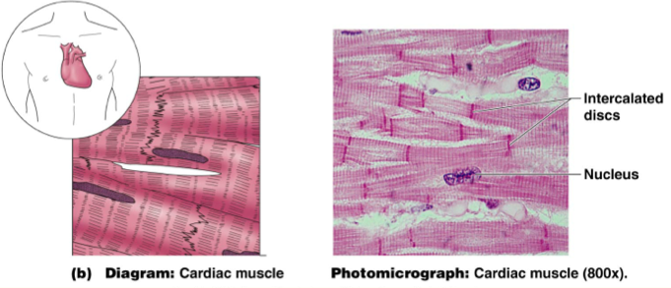
28
The Tribe Of Reuben
Peter’s Commission
to Establish the Gospel
to the Jews
(Romans 12:13; John 21: 17)
Cardiac muscle found only in the heart has short interconnecting fibres

Slide 29
Nucleus: Cardiac Muscle
This Muscle Represent Christ our High Priest
after the order of Melchisedec
(John 5:26, 30, Hebrew 6:20)
Cardiac muscle is found only in the heart. Cardiac muscle is classified as a twitch muscle, meaning it only contracts in short, single contractions. This type of muscle is under involuntary control and has properties of both smooth and skeletal muscle. According to "The Atlas of Anatomy," the cardiac muscles contract in an organized manner and regulate the beating of the heart. Cardiac muscle can stretch like smooth muscle and can contract like skeletal muscle.
http://www.livestrong.com/article/123735-information-muscular-system/
For as the Father hath life in himself; so hath he given to the Son to have life in himself; I can of mine own self do nothing: as I hear, I judge: and my judgment is just; because I seek not mine own will, but the will of the Father which hath sent me. The Heart muscles are distinct from skeletal muscles because the Muscles Fibers are laterally connected to each other. The smooth muscles are not controlling themselves. The Heart muscles are controlled by the Sinus Node influenced by the Autonomic Nervous System
Each of these different tissues has the ability to contract, which then allows body movements and functions.
29

Slide 30
30
God The Holy Spirit is responsible for this function:
The Heart
The Last Message of Mercy
Remnant Movement
(1 Peter 2:9)
But ye [are] a chosen generation, a royal priesthood, an holy nation, a peculiar people; that ye should show forth the praises of him who hath called you out of darkness into his marvellous light:
The New Jerusalem
The Twelve Tribe of Israel Seal with the Merit of Christ
by The Power of Holy Spirit
Israel means “An Over comer”
A man’s Name Stand for His Character.
(The Cross and Its Shadow - CIS Section IX pages 287-378)
12,000 of each Tribe (Revelation 7:2-8)
144,000 of Tribe of Israel as the 10% of the living
(Revelation20:15; 1 Peter 2:4) (Hebrew 7:16-17; 9:11; 12:22-27)
(1 Corinthians 15:22, 23) (Revelation 14:12; 21:12-18, 21-22)

Slide 31
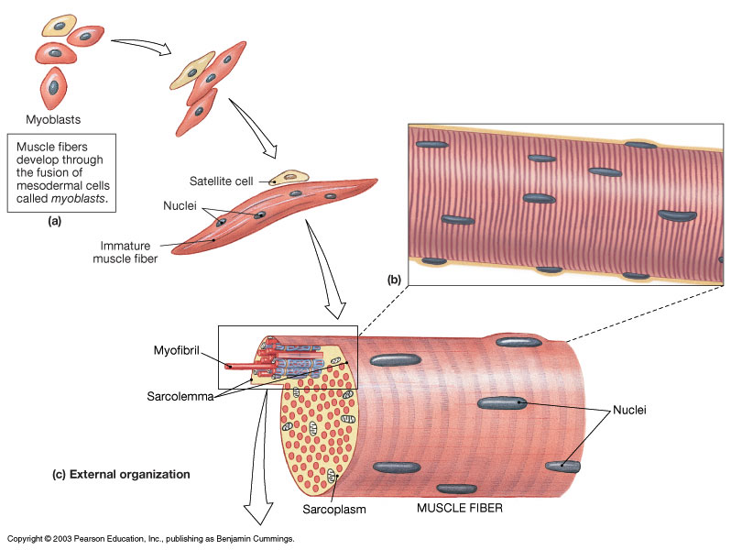
31
Muscles as Cell Fibers
(Thousands of tiny cylindrical sausage shaped (mitochondria energy)

Slide 32
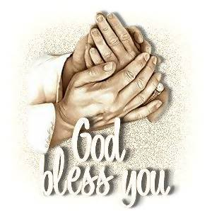
Next Week
We will continue with our Study
The Sanctuary of our Body
THE THIRD TEMPLE
Series #6
The Respiratory System
Operates and Functions like
(The Tribe of Simeon )
The Lungs
“Instrument of Cruelty”

