Slide 1
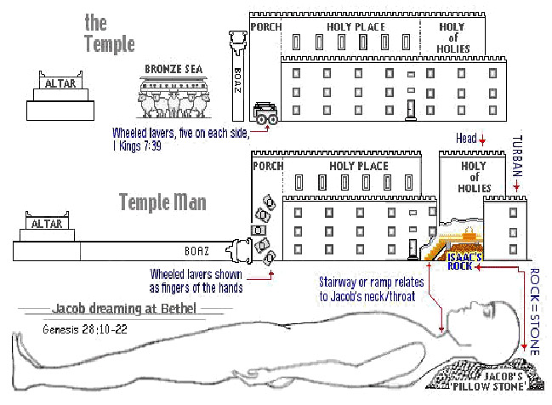
1
The Sanctuary of our Body
THE THIRD TEMPLE
Introduction
By : sister rose

Slide 2
THERE IS A THIRD TEMPLE
The Bible reveals that there are not only these 2 different sanctuaries; the heavenly temple, or the dwelling-place of the Most High where Christ intercedes in our behalf, and the earthly temple, with its typical services, designed to teach mankind the great spiritual truths on the plan of redemption from sin. But there is also a third temple which is extremely important to understand. This is the temple of the human body, where God's Spirit desires to rule and reign.
This is the new covenant experience which God was referring to through Jeremiah and Paul: "For this is the covenant that I will make with the house of Israel after those days, saith the Lord; I will put my laws into their mind, and write them in their hearts: and I will be to them a God, and they shall be to me a people." Heb. 8:10; Jeremiah 31:33. What a thought! God desires to have you to be His temple in which He can dwell and rule! Yes, friends, both the Father and Jesus Christ love you so much that they do not want to remain trillions of miles away from you in heaven, but desire to dwell directly with you through the Holy Spirit--the Spirit of truth! This is indeed a mystery, but one in which is rich and glorious!
"Even the mystery which hath been hid from ages and from generations, but now is made manifest to his saints: To whom God would make known what is the riches of the glory of this mystery among the Gentiles; which is Christ in you, the hope of glory: Whom we preach, warning every man, and teaching every man in all wisdom; that we may present every man perfect in Christ Jesus: Whereunto I also labour, striving according to his working, which worketh in me mightily." Colossians 1:26-29.
2

Slide 3
But the big question you must ask yourself is: Do I love God enough that I am willing to clean up my life and act in such a way that the Godhead can dwell and live and rule in me as Their holy sanctuary and dwelling place on this earth? What immense blessings can be ours if we will just offer our life to God and allow Him to reign in and through us! Or are you going to decide to continue to live in wickedness and sin, continue to defile your body-temple by intemperate habits, reject God's gracious and merciful offer, and allow the devil to make you his synagogue and dwelling place to live and rule in on this earth? It is either one or the other, for you cannot serve both (see Matthew 6:24).
WHICH WILL YOU CHOOSE?
"But Christ as a son over his own house; whose house (dwelling place) are we, if we hold fast the confidence and the rejoicing of the hope firm unto the end. Wherefore (as the Holy Ghost saith, Today if ye will hear his voice, Harden not your hearts.)...Take heed, brethren, lest there be in any of you an evil heart of unbelief, in departing from the living God." Hebrews 3:6-8, 12.
"Be ye not unequally yoked together with unbelievers: for what fellowship hath righteousness with unrighteousness? and what communion hath light with darkness? And what concord hath Christ with Belial? or what part hath he that believeth with an infidel? And what agreement hath the temple of God with idols? for ye are the temple of the living God; as God hath said, I will dwell in them, and walk in them; and I will be their God, and they shall be my people. Wherefore come out from among them, and be ye separate, saith the Lord, and touch not the unclean thing; and I will receive you, And will be a Father unto you, and ye shall be my sons and daughters, saith the Lord Almighty. Having therefore these promises, dearly beloved, let us cleanse ourselves from all filthiness of the flesh and spirit, perfecting holiness in the fear of God.“ 2 Corinthians 6:14-18, 7:1.
GOD’S SANCTUARY AND DWELLING PLACE
http://www.lightministries.com/Tracts/id178.htm)
3

Slide 4
4
Preserve The Body Temple
Know ye not that ye are the temple of God, and that the Spirit of God dwelleth in you? 1 Corinthians 3:16. {OFC-Our Father Cares 48.1- 48.6}
God has given you a habitation to care for and preserve in the best condition for His service and glory. Your bodies are not your own. . . . “Know ye not that ye are the temple of God, and that the Spirit of God dwelleth in you?”
Health is a blessing of which few appreciate the value. . . . Life is a holy trust, which God alone can enable us to keep, and to use to His glory. But He who formed the wonderful structure of the body will take special care to keep it in order if men do not work at cross-purposes with Him. Every talent entrusted to us He will help us to improve and use in accordance to the will of the Giver.
Youth is the time to establish good habits, to correct wrong ones already contracted, to gain and to hold the power of self-control, and to lay the plan, and accustom one’s self to the practice of ordering all the acts of life with reference to the will of God.
The sacred temple of the body must be kept pure and uncontaminated, that God’s Holy Spirit may dwell therein. We need to guard faithfully the Lord’s property, for any abuse of our powers shortens the time that our lives could be used for the glory of God. Bear in mind that we must consecrate all—soul, body, and spirit—to God. All is His purchased possession, and must be used intelligently, to the end that we may preserve the talent of life. By properly using our powers to their fullest extent in the most useful employment, by keeping every organ in health, by so preserving every organ that mind, sinew, and muscle shall work harmoniously, we may do the most precious service for God.
When we do all we can on our part to have health, then may we expect that the blessed results will follow, and we can ask God in faith to bless our efforts for the preservation of health.

Slide 5
We are the Temple of the Holy Ghost
and God's Workmanship.
1. God is the owner of the whole man. Soul, body, and spirit are his. God gave his only begotten Son for the body as well as the soul, and our entire life belongs to God, to be consecrated to his service, that through the exercise of every faculty he has given, we may glorify him.--{ {HL-Healthful Living 9.1- 9.3} Y. I., Sept. 7, 1893.
2. From the first dawn of reason the human mind should become intelligent in regard to the physical structure of the body. Here Jehovah has given a specimen of himself; for man was made in the image of God.--U. T., Jan. 11, 1897.
3. The living organism is God's property. It belongs to him by creation and by redemption; and by a misuse of any of our powers we rob God of the honor due him.
4. We are God's workmanship, and his word declares that we are "fearfully and wonderfully made." He has prepared this living habitation for the mind; it is "curiously wrought,“ a temple which the Lord himself has fitted up for the indwelling of the Holy Spirit.
5. The very flesh in which the soul tabernacles, and through which it works, is the Lord‘s—. U. T., Aug. 30, 1896 H U. T., Oct. 12, 1896 L 10.1}
5

Slide 6
Lets take a look at these scriptures!
Until I went into the sanctuary of God; [then] understood I their end.
(Psalms 73:17)
Thy way, O God, [is] in the sanctuary: who [is so] great a God as [our] God? (Psalms 77:13)
The voice of the LORD maketh the hinds to calve, and discovereth the forests:
and in his temple doth every one speak of [his] glory.
(Psalms 29:9)
What? Know ye not that your body is the temple of the Holy Ghost [which is] in you, which ye have of God, and ye are not your own? For ye are bought with a price: therefore glorify God in your body, and in your spirit, which are God's.
(1 Corinthians 6:19-20)
And what agreement hath the temple of God with idols? for ye are the temple of the living God; as God hath said, I will dwell in them, and walk in [them]; and I will be their God, and they shall be my people.
(2 Corinthians 6:16)
6

Slide 7
The Third Temple brought to view in the Bible is the Temple of the Human Body.
The Jews had lost sight of the fact that their bodies were to be the temples of the Spirit of God; and when the Saviour said, "Destroy this temple, and in three days I will raise it up“(John 2:19), they thought only of the massive structure of marble and stone, and replied that it had taken forty-six years to build the temple, not perceiving that "he spake of the temple of his body.“
Glorious rays of light shine from the heavenly sanctuary upon those who study the typical work in the earthly. These rays, when gathered into the temple of the body, reflect the character of our great High Priest in the heavenly courts.
In the beginning the body of man was created to be a dwelling place for the Holy Spirit; but Satan gained possession, and man partook of an evil nature. Before the body could again become a fit temple for the Spirit of God, the evil nature must die. Christ offered his life for the sinner, and before the foundation of the world he was counted as a "Lamb slain.“ Margin….
{1901 SNH, SDP (The Story of Daniel Prophet) 135.2 – 135.4}
7

Slide 8
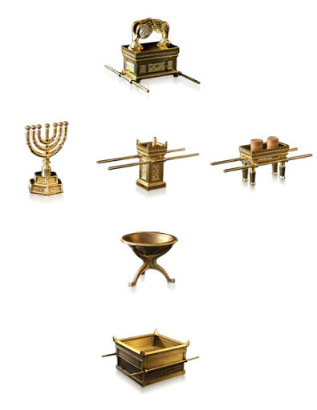
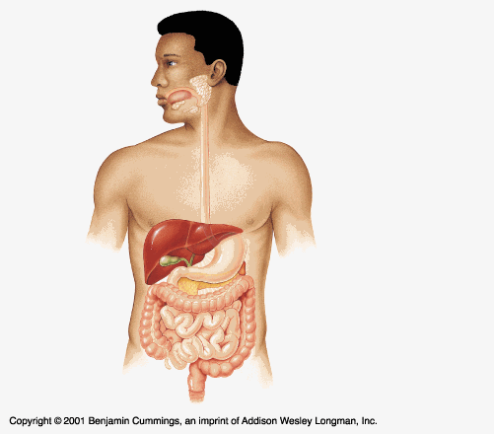
Let’s take a close look at our Body!
8
The Ark
The Most Holy Place
The Altar of Incenses
The Table of Shewbread
The Holy Place
The Candlestick
The Laver
The Court Yard
The Alta of Sacrifice
Hebrew3:6; 9:23,24
And let them make me a sanctuary; that I may dwell among them.(Exodus 25:8)
“I am fearfully and wonderfully made.” [Psalm 139:14.]
(1 King 6:7)

Slide 9
Our Example
Our Lord Jesus Christ came to this world as the unwearied servant of man's necessity.
(Matthew 8:17) That it might be fulfilled which was spoken by Esaias the prophet, saying, Himself “took our infirmities, and bares our sicknesses,“
That He might minister to every need of humanity.
The burden of disease and wretchedness and sin
He came to remove.
It was His mission to bring to men complete restoration; He came to give them health and peace and perfection of character. {MH- The Ministry of Healing 17.1}
9

Slide 10
Health
Health is a blessing of which few appreciate the value; yet upon it the efficiency of our mental and physical powers largely depends. Our impulses and passions have their seat in the body, and it must be kept in the best condition physically and under the most spiritual influences in order that our talents may be put to the highest use.
Anything that lessens physical strength enfeebles the mind and makes it less capable of discriminating between right and wrong. We become less capable of choosing the good and have less strength of will to do that which we know to be right.
The misuse of our physical powers shortens the period of time in which our lives can be used for the glory of God. And it unfits us to accomplish the work God has given us to do. By allowing ourselves to form wrong habits, by keeping late hours, by gratifying appetite at the expense of health, we lay the foundation for feebleness. By neglecting physical exercise, by overworking mind or body, we unbalance the nervous system. Those who thus shorten their lives and unfit themselves for service by disregarding nature's laws, are guilty of robbery toward God. And they are robbing their fellow men also. The opportunity of blessing others, the very work for which God sent them into the world, has by their own course of action been cut short. And they have unfitted themselves to do even that which in a briefer period of time they might have accomplished. The Lord holds us guilty when by our injurious habits we thus deprive the world of good. {COL -Christ Object Lesson 346.2- 346.4}
10

Slide 11
2) Peace
Our Peace
When we believe in Christ as our personal Saviour, the peace of Christ is ours. The reconciliation provided for us in the atonement of Christ, is the foundation of our peace. Gloomy feelings are no evidence that the promises of God are of no effect. You look at your feelings, and because your outlook is not all brightness, you begin to draw more closely the garment of heaviness about your soul. You look within yourself, and think that God is forsaking you. You are to look to Christ. "In Me," Christ says, "ye shall have peace." Entering into communion with the Saviour, we enter the region of peace.
Let us pledge ourselves before God and the angels of heaven that we will not dishonor God by speaking words of discouragement or unbelief. If we talk faith, we shall have faith, we shall be confirmed in faith. Close the door to distrust, and open the door wide to faith. Invite into the soul-temple the heavenly guests. Entertain the precious thought that Jesus loves us, each one. In this way the clouds of despondency and gloom will be rolled back from the soul, and we shall be enabled to make melody in our hearts to God.
The Sighs of Times {ST, August 11, 1909 par. 13- 14} {RH, July 24, 1894 par. 4}
also see {9MR 257.2- 9MR 258.2}
[IMPOSSIBILITY OF ATTAINING CHRISTIAN PERFECTION WHILE GIVING REINS TO APPETITE--356] {CD 44.2} (1868) 2T 70, 71
11

Slide 12
3) Perfection of Character
When Sanctification Is Impossible
Health Reformer, March, 1878
52. A large proportion of all the infirmities that afflict the human family, are the results of their own wrong habits, because of their willing ignorance, or of their disregard of the light which God has given in relation to the laws of their being. It is not possible for us to glorify God while living in violation of the laws of life. The heart cannot possibly maintain consecration to God while lustful appetite is indulged. A diseased body and disordered intellect, because of continual indulgence in hurtful lust, make sanctification of the body and spirit impossible. The apostle understood the importance of the healthful conditions of the body for the successful perfection of Christian character. He says, "I keep under my body, and bring it into subjection: lest that by any means, when I have preached to others, I myself should be a castaway." He mentions the fruit of the Spirit, among which is temperance.
"They that are Christ's have crucified the flesh with the affections and lusts."
12

Slide 13
53. It is a duty to know how to preserve the body in the very best condition of health, and it is a sacred duty to live up to the light which God has graciously given. If we close our eyes to the light for fear we shall see our wrongs, which we are unwilling to forsake, our sins are not lessened, but increased. If light is turned from in one case, it will be disregarded in another. It is just as much sin to violate the laws of our being as to break one of the ten commandments, for we cannot do either without breaking God's law. We cannot love the Lord with all our heart, mind, soul, and strength while we are loving our appetites, our tastes, a great deal better than we love the Lord. We are daily lessening our strength to glorify God, when He requires all our strength, all our mind. By our wrong habits we are lessening our hold on life, and yet professing to be Christ's followers, preparing for the finishing touch of immortality.
Counsels on Diet and Foods {CD 44.2- CD 44.3}
See also {The Acts of Apostles 531- 532.1}
13

Slide 14
The Health Reform
The Right hand of The Third Angels Messages
The health reform is one branch of the great work which is to fit a people for the coming of the Lord. It is as closely connected with the third angel's message as the hand is with the body. The law of Ten Commandments has been lightly regarded by man; yet the Lord will not come to punish the transgressors of that law without first sending them a message of warning. Men and women cannot violate natural law by indulging depraved appetite and lustful passions, without violating the law of God.
Therefore he has permitted the light of health reform to shine upon us, that we may realize the sinfulness of breaking the laws which he has established in our very being. Our heavenly Father sees the deplorable condition of men who, many of them ignorantly, are disregarding the principles of hygiene. And it is in love and pity to the race that he causes the light to shine upon health reform. He publishes his law and its penalties, in order that all may learn what is for their highest good. He proclaims his law so distinctly, and makes it so prominent, that it is like a city set on a hill.
All intelligent beings can understand it if they will. None others are responsible. To make natural law plain, and to urge obedience to it, is a work that accompanies the third angel's message. {Christian Temperance and Bible Hygiene CTBH 9.1}
14

Slide 15
Transgression of physical law is transgression of the
moral law; for God is as truly the author of physical laws as He is the author of the moral law.
If any man defile the temple of God, him shall God destroy; for the temple of God is holy, which [temple] ye are.; 1 Corinthians 3:17
His law is written with His own finger upon every nerve, every muscle, every faculty, which has been entrusted to man. And every misuse of any part of our organism is a violation of that law.
{Christ Object Lesson 347.1} {Reflecting Christ 140.6}
Meats for the belly, and the belly for meats: but God shall destroy both it and them. Now the body [is] not for fornication, but for the Lord; and the Lord for the body.
1 Corinthians 6:13
15

Slide 16
All should have an intelligent knowledge of the human frame that they may keep their bodies in the condition necessary to do the work of the Lord. The physical life is to be carefully preserved and developed that through humanity the divine nature may be revealed in its fullness. The relation of the physical organism to the spiritual life is one of the most important branches of education.
It should receive careful attention in the home and in the school.
All need to become acquainted with their physical structure and the laws that control natural life. He who remains in willing ignorance of the laws of his physical being and who violates them through ignorance is sinning against God. All should place themselves in the best possible relation to life and health. Our habits should be brought under the control of a mind that is itself under the control of God.
{COL- Christ Object Lesson 348.1}
16

Slide 17
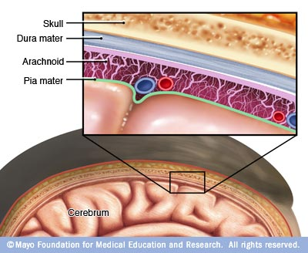
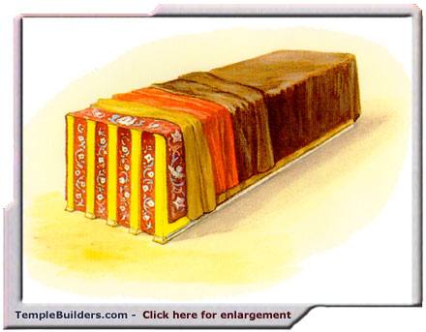
The Covering of the Tabernacle
17
(Exodus 26: 1-14; 7-9; 40:3)
goat’s hair
rams' skins dyed red
badgers' skins
Curtains with Cherubim's

Slide 18
The Covering of the Tabernacle Where the Most Holy and Holy Dwell
18
The tabernacle [with] ten curtains [of] fine twined linen, and blue, and purple, and scarlet: [with] cherubims of cunning work.
(Exodus 35:6-7)
other Ref. (Exodus 35: 25-26) (Exodus 25:4-5)
Curtain of goats' hair, above that a covering of rams' skins dyed red, and over all a covering badgers' skins, all forming a perfect protection from the weather.
{1914 SNH, CIS- 29.1}
The Cross and its Shadow (Exodus 39:19)

Slide 19
The Roof or Covering of the Tabernacle
19
The roof, or covering, of the tabernacle consisted of
four curtains of cloth and skins.
The inside curtain, like that at the entrance of the tabernacle, was of blue, purple, scarlet, and fine twined linen, with golden cherubim wrought in it by a cunning embroiderer. (Exodus 26:1)
This formed the ceiling, which was a faint representation of the canopy of glory above the throne of God, with the myriads of angels ready to fulfill His commands. (Ezekiel 1:28)
Over this was a curtain of goats' hair, above that a covering of rams' skins dyed red, and over all a covering of badgers' skins, all forming a perfect protection from the weather. (Exodus 26:1-14)
The different colors in the coverings, blending with the golden wall and the gorgeous entrance curtain, or veil, as it was called, combined to make a structure of surpassing glory.
{1914 SNH, CIS- The Cross and its Shadow 29.1}

Slide 20
The Layers of our head
Covering of the Tabernacle (Most Holy Place)
(Exodus 26:1-14)
The Brain: are three layers of Meninges that cover
and protect the brain and spinal cord: The fibrous outside layer the Middle layer of collagen and elastin, and the inner.
The blue (Dura mater) is the fibrous Outside Layer,
The rams' skins dyed red (Arachnoid mater) is the Middle Layer
The purple (Pia mater) is the Inner Layer
Over these Layers in our Tabernacle are:
The fine linen (Aponeurosis)
The scarlet (Connective Tissue)
The goats’ hair (our Hair)
The badgers' skins ( our Skin)
The shittim wood (our Skull bone)
(Exodus 35:6-7, 25-26) (Exodus 36:14-15) (Exodus25:4-5)
20

Slide 21
Christ our Covering
21
The work of Christ has two distinct phases, one performed in the first apartment of the heavenly sanctuary, the other in the second apartment.
He offers salvation free to every one. Many accept and start out on the Christian pathway. Christ reaches down His infinite arm to encircle and support every one who calls upon His name, and no power of earth or Satan can force a child of God out of His protecting care.
(John 10:28,29)
The only way any can be lost is by letting go their hold upon that infinite hand. Like Peter, if they take their gaze from Christ and fix it upon the sea of life, they sink, unless, like him, they cry out,
"Lord, save me," and are rescued by the Saviour.
(Matthew 14:28-31) {1914 SNH, CIS- The Cross and its Shadow 30.2}

Slide 22
22
There were Two Apartments in the Sanctuary, or Tabernacle.
In the first apartment a service was performed daily throughout the year which typified the work of inviting the guests and gathering them to His marriage.
On one day at the end of the year a service was performed in the second apartment which typified the work of choosing out from among the many that have accepted the call, those who are worthy of eternal life, as illustrated in the parable by the king examining the guests.
{1914 SNH, CIS- The Cross and its Shadow 31.2}
(Hebrew 8:1-5; 9:1-3)

Slide 23
23
Next Sabbath
We will continue our study with Part 2 of
The Introduction
THE THIRD TEMPLE
Our Body!
The Sanctuary

