Slide 1
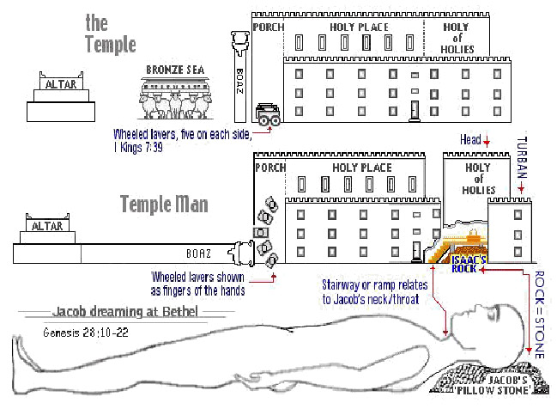
The Introduction , Part 2 Of our Study The Sanctuary of our Body
THE THIRD TEMPLE
By: Sister rose
1

Slide 2
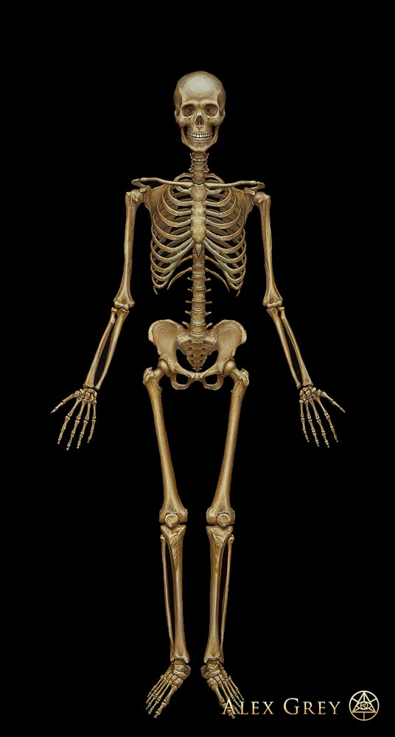
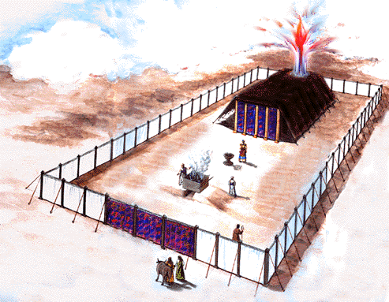
The Tabernacle of the Human Frame
2
"Know ye not that ye are the temple of God, and that the Spirit of God dwelleth in you? If any man defile the temple of God, him shall God destroy; for the temple of God is holy, which temple ye are.“
(1 Corinthians 3:16, 17). {Ed-Education 36.3}
ANTI-TYPE
TYPE
Introducing the Frame of our Tabernacle
Most Holy Place
The Most Holy
Holy Place
Holy Place
The Court Yard
Court Yard
MEETS
In whom all the building fitly framed together groweth unto an holy temple in the Lord: (Ephesians 2:21) (Hebrew 8:2) (1 Corinthians 3:16, 17) (Exodus 27:1-3) (Romans 12:1-2)))

Slide 3
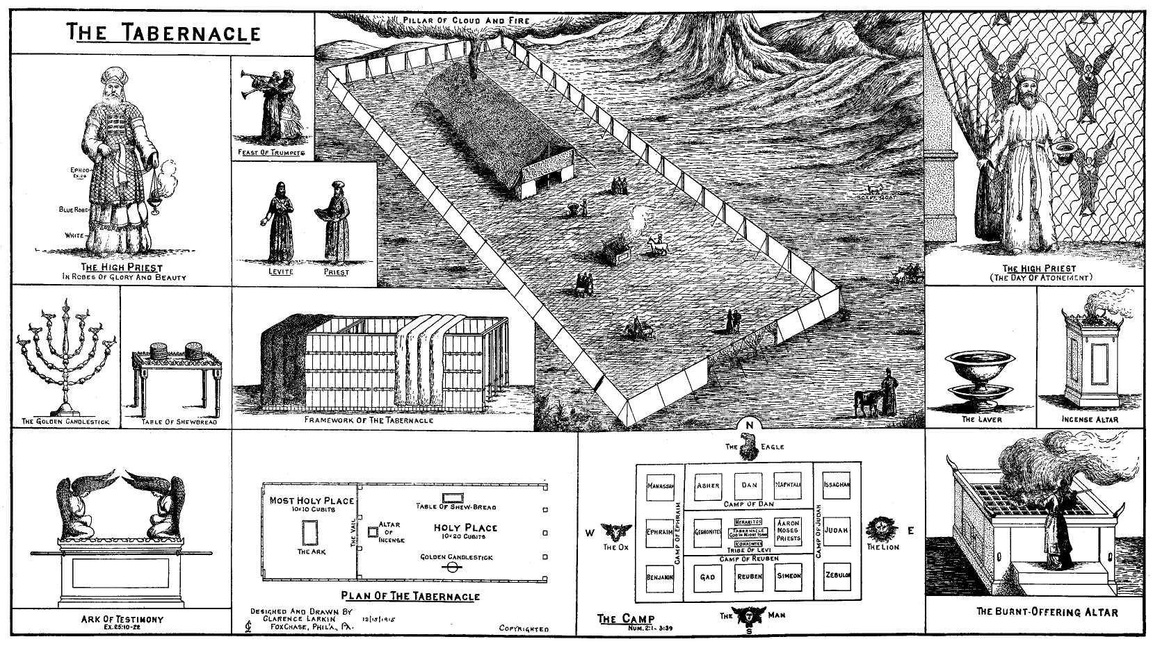
3

Slide 4
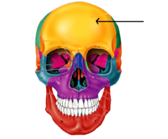
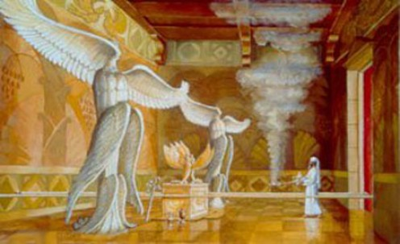
4
This is were the
Most Holy Place
is located
The Skull: (10 =8 cranial + 1 Frontal Bone +1 Back Bone)
Boards of Shittim Woods or (acacia) Ten cubits [shall be] the length of a board, and a cubit and a half [shall be] the breadth of one board.
(Ex 26:15-30; 36:21)
Ye also, as lively stones, are built up a spiritual house, an holy priesthood, to offer up spiritual sacrifices, acceptable to God by Jesus Christ. (1 Peter 2:5)

Slide 5
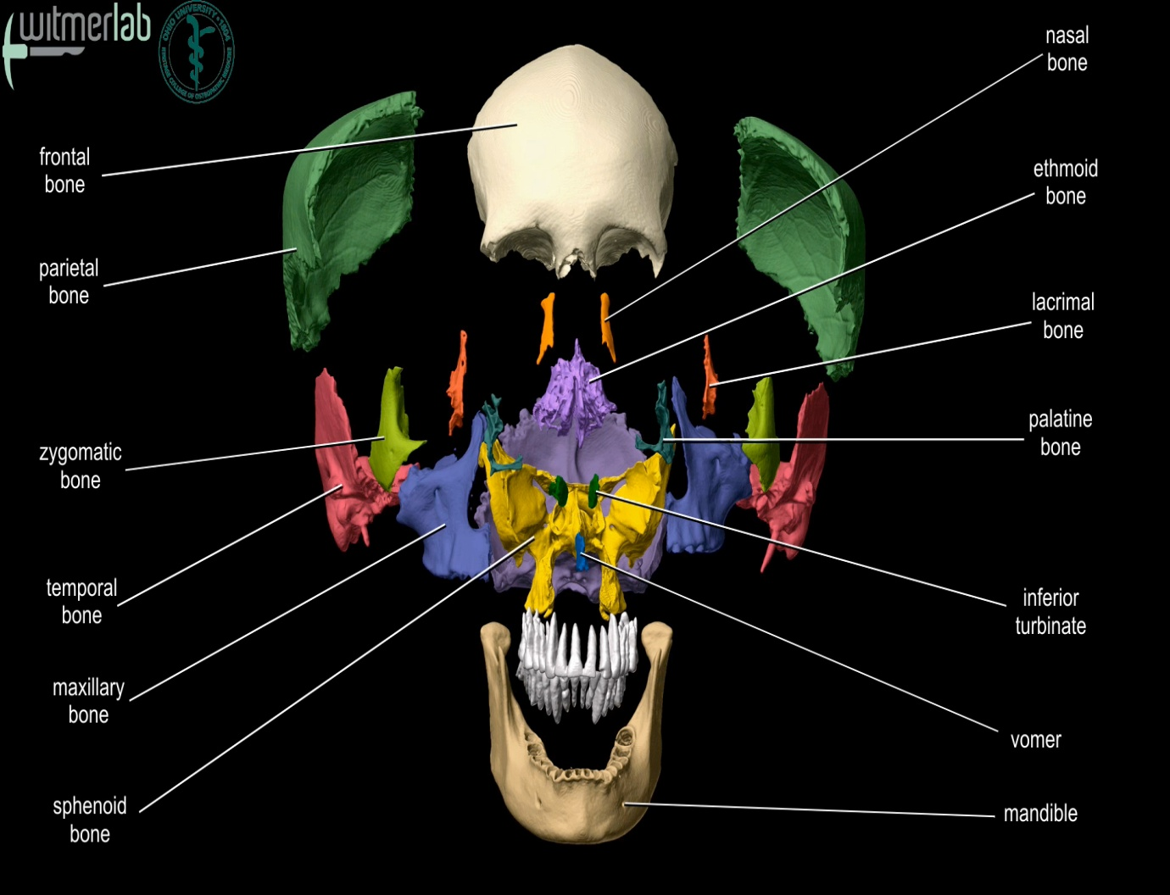
The 24 Elders before the Throne
5
Ten Cranial Bones or Ten Cubits
frontal
bone
(Exodus 26:16)
Crista galli (Christ Gallery)
L
24 Elders in White
before the Throne
L

Slide 6
Ethmoid Bone
(Ezekiel 1:22) And the likeness of the firmament upon the heads of the living creature [was] as the colour of the terrible crystal, Stretched forth over their heads above.
Crista galli or Christ Gallery = the Place Christ is Pleading before the presence of God.
(Revelation 7: 11-12) And all the angels stood round about the throne, and [about] the elders and the four beasts, and fell before the throne on their faces, and worshipped God, Saying, Amen: Blessing, and glory, and wisdom, and thanksgiving, and honour, and power, and might, [be] unto our God for ever and ever. Amen.
(Revelation 19:4)
And the four and twenty elders and the four beasts fell down and worshipped God that sat on the throne, saying, Amen; Alleluia.
(Daniel 7:9)
I beheld till the thrones were cast down, and the Ancient of days did sit, whose garment [was] white as snow, and the hair of his head like the pure wool: his throne [was like] the fiery flame, [and] his wheels [as] burning fire.
6

Slide 7
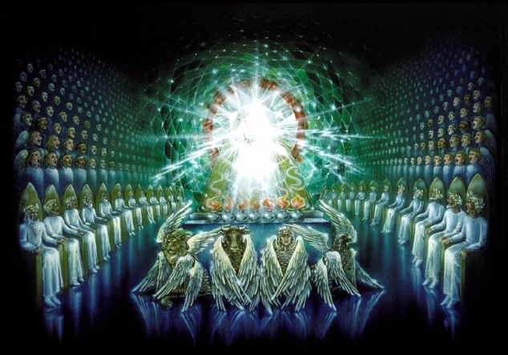
The Most Holy Place seeing In the Human Skull
7
The Four Creatures
The 24 Elders
in White Throne
Revelation 19:4 ; 4:4; , 5:8-10
(1 Corinthians 2:6-13) (Colossians 2:2-3)
Hebrew 9:26-8; Revelation 13:8
(John 19:17) (Mark 15:22)(Matthew 27:33)

Slide 8
8
Turning from the Father, who sat upon the throne, John saw four and twenty seats round about the throne.
These seats where occupied by four and twenty elders, "clothed in white raiment; and they had on their heads crowns of gold." These also represent the atoning work of Christ. They represent men from every kindred, tongue, and people, redeemed by the blood of Christ, clothed with the white raiment of His righteousness, and wearing on their heads the crowns of victory, which are promised to every overcomer. They were of that company who arose from the grave when Christ came from the tomb, and who are spoken of by Paul as a "multitude of captives," offered to the Father as the first fruits from the dead. The work of these four and twenty elders is described in the fifth chapter, and for that reason, they are but mentioned in this connection as sitting near the throne. {1905 SNH, SSP -The Story of the Seer of Patmos 96.1}
Margin…But those who came forth from the grave at Christ’s resurrection were raised to everlasting life. They were the multitude of captives who ascended with Him as trophies of His victory over death and the grave. . . {CTr Christ Triumphant 286.2}, {DA 786.1-2}
(Matthew 27:52,53)
And, behold, the veil of the temple was rent in twain from the top to the bottom; and the earth did quake, and the rocks rent; And the graves were opened; and many bodies of the saints which slept arose, And came out of the graves after his resurrection, and went into the holy city, and appeared unto many.

Slide 9
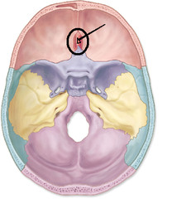
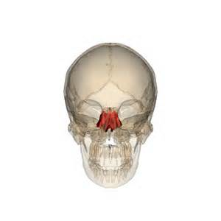
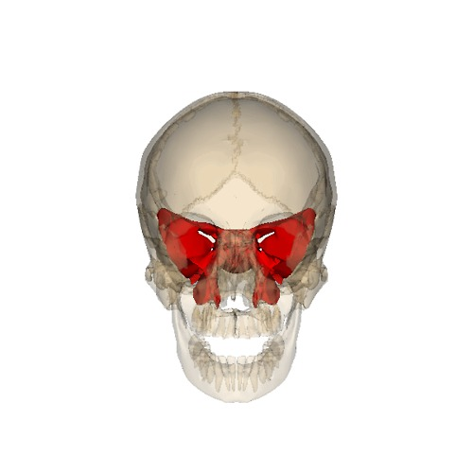
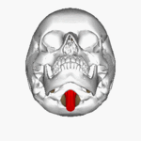
Ezekiel 1:22
9
This is the Place
of the Crista Galli
In other words
Christ Gallery
Cherubim
Lesser wings
Greater Wings
Magnum Foramen
The Lamb slain from the foundation of the world can be seeing down the Magnum Foramen lifted up on the Sternum on the vertebra

Slide 10
Magnum Foramen
For then must he often have suffered since the foundation of the world: but now once in the end of the world hath he appeared to put away sin by the sacrifice of himself.
(Heb 9:26)
And he bearing his cross went forth into a place called [the place] of a skull, which is called in the Hebrew Golgotha:
(John 19:17)
(For other references: Mark 15:22, Matthew 27:33).
And as it is appointed unto men once to die, but after this the judgment: So Christ was once offered to bear the sins of many; and unto them that look for him shall he appear the second time without sin unto salvation. (Exodus26:14-16)
10

Slide 11
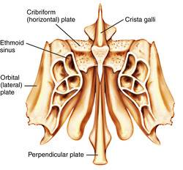
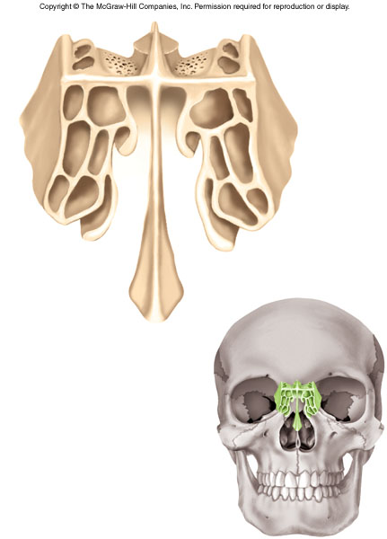
And the likeness of the firmament upon the heads of the living creature [was] as the colour of the terrible crystal stretched forth over their heads above. (Ezekiel 1:22)
11
Crista galli
The Place where the Seal
of our Saviour is cradled between two bones

Slide 12
III. Christ Ministering in Heavenly Sanctuary
We are in the great day of atonement, and the sacred work of Christ for the people of God that is going on at the present time [1882] in the heavenly sanctuary, should be our constant study. –
Testimonies, vol. 5, p. 520. {7ABC 481.2- 481.4}
O that all could behold our precious Saviour as He is, a Saviour. Let His hand draw aside the veil which conceals His glory from our eyes. It shows Him in His high and holy place. What do we see? Our Saviour, not in a position of silence and inactivity. He is surrounded with heavenly intelligences, cherubims and seraphims, ten thousand times ten thousand of angels. All these heavenly beings have one object above all others, in which they are intensely interested,--His church in a world of corruption.--Letter 89c, 1897. {7ABC 481.3}
He is in His holy place, not in a state of solitude and grandeur, but surrounded by ten thousand times ten thousand of heavenly beings who wait to do their Master's bidding. And He bids them go and work for the weakest saint who puts his trust in God. High and low, rich and poor, have the same help provided. –
Letter 134, 1899. {7ABC 481.4}
12

Slide 13
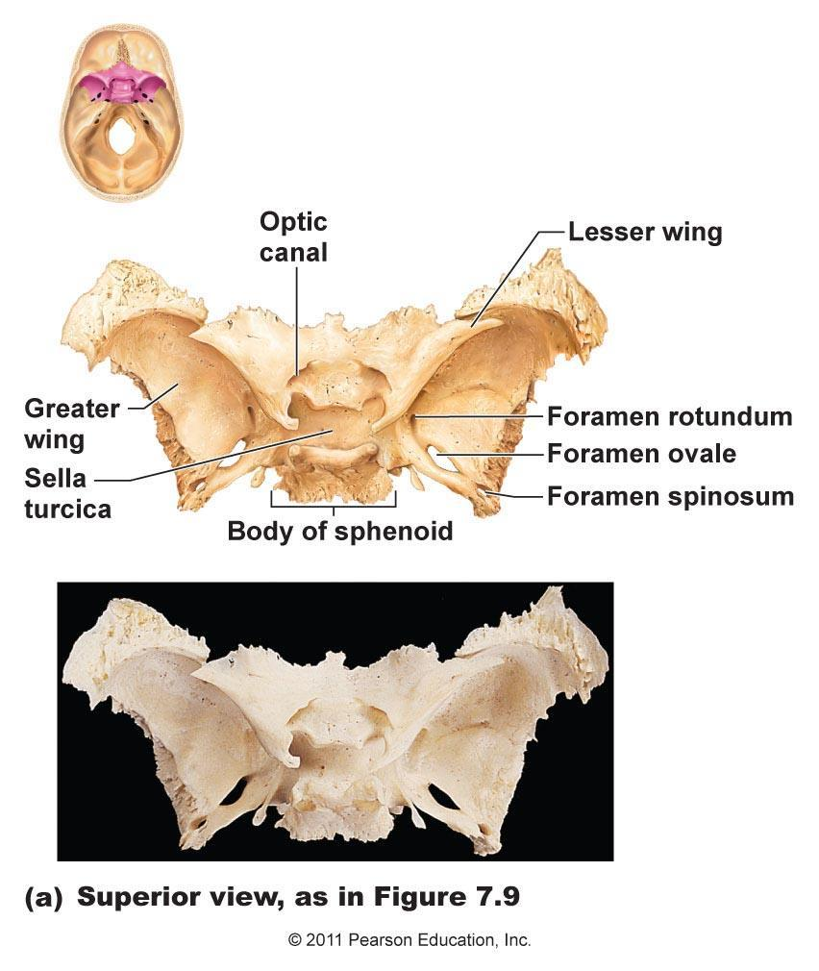
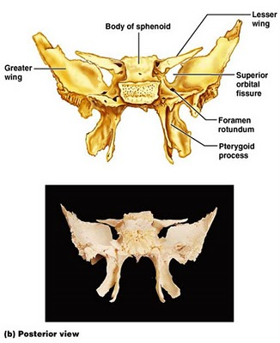
Angels with Great wings
13
(Ezekiel 1:23) And under the firmament [were] their wings straight, the one toward the other: every one had two, which covered on this side, and every one had two, which covered on that side, their bodies.
The Sphenoid Bone

Slide 14
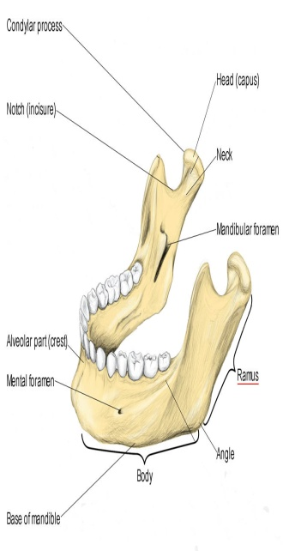
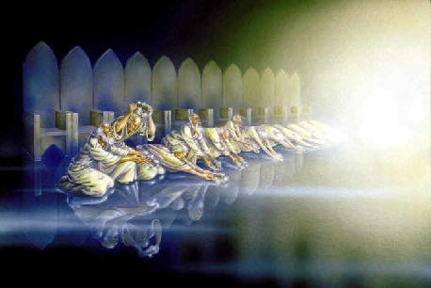
Tooth: Represents Twenty Four Elders on the Mandibular foramen sitting on the Mandible
(There are upon the throne)
14

Slide 15
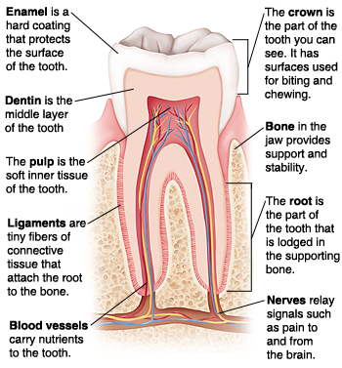
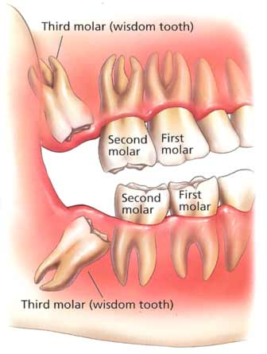
15
(Colossians 2:2-3) And all the angels stood round about the throne, and [about] the elders and the four beasts, and fell before the throne on their faces, and worshipped God, Saying, Amen: Blessing, and glory, and wisdom, and thanksgiving, and honour, and power, and might, [be] unto our God forever and ever. Amen. And the four and twenty elders and the four beasts fell down and worshipped God that sat on the throne, saying, Amen; Alleluia

Slide 16
After his resurrection, Christ did not show himself to any save his followers; but testimony in regard to his resurrection was not wanting. Those who were raised with Christ "appeared unto many," declaring, Christ has risen from the dead, and we are risen with him. They bore testimony in the city to the fulfillment of the scripture, "Thy dead men shall live, together with my dead body shall they arise. Awake and sing, ye that dwell in dust: for thy dew is as the dew of herbs, and the earth shall cast out the dead." These saints contradicted the lie which the Roman guard had been hired to circulate,--that the disciples had come by night and stolen him away. This testimony could not be silenced.
(The Youth's Instructor ) YI.1898-08-11.004
Christ was the first-fruits of them that slept. It was to the glory of God that the Prince of life should be the first-fruits, the antitype of the wave-sheaf. "For whom he did foreknow, he also did predestinate to be conformed to the image of his Son, that he might be the first-born among many brethren." This very scene, the resurrection of Christ from the dead, had been celebrated in type by the Jews. When the first heads of grain ripened in the field, they were carefully gathered; and when the people went up to Jerusalem, these were presented to the Lord as a thank-offering. The people waved the ripened sheaf before God, acknowledging him as the Lord of the harvest. After this ceremony the sickle could be put to the wheat, and the harvest gathered.
(The Youth's Instructor ) YI.1898-08-11.005
16

Slide 17
So those who had been raised were to be presented to the universe as a pledge of the resurrection of all who believe in Christ as their personal Saviour. The same power that raised Christ from the dead will raise his church, and glorify it with Christ, as his bride, above all principalities, above all powers, above every name that is named, not only in this world, but also in the heavenly courts, the world above. The victory of the sleeping saints will be glorious on the morning of the resurrection. Satan's triumph will end, while Christ will triumph in glory and honor. The Life-giver will crown with immortality all who come forth from the grave.
(The Youth's Instructor ) YI.1898-08-1.006
The work of the Saviour on earth was finished. The time had come for him to return to his heavenly home. "And he led them [the disciples] out as far as to Bethany, and he lifted up his hands, and blessed them. And it came to pass, while he blessed them, he was parted from them, and carried up into heaven."
(The Youth's Instructor ) YI.1898-08-11.007
17

Slide 18
As Christ ascends while in the act of blessing his disciples, an army of angels encircle him as a cloud.
Christ takes with him the multitude of captives.
He will himself bring to the Father the first-fruits of them that slept, as an evidence that he is conqueror of death and the grave. At the portals of the city of God, an innumerable company of angels await his coming.
As they approach, the escorting angels address the company at the gate in triumphant tones:--
“Lift up your heads, O ye gates; And be ye lift up, ye everlasting doors; And the King of glory shall come in.”
(The Youth's Instructor ) YI.1898-08-11.008
18

Slide 19
(1 Corinthians 2:6-13)
Howbeit we speak wisdom among them that are perfect: yet not the wisdom of this world, nor of the princes of this world, that come to nought: But we speak the wisdom of God in a mystery, [even] the hidden [wisdom], which God ordained before the world unto our glory: Which none of the princes of this world knew: for had they known [it], they would not have crucified the Lord of glory.
But as it is written, Eye hath not seen, nor ear heard, neither have entered into the heart of man, the things which God hath prepared for them that love him.
But God hath revealed [them] unto us by his Spirit: for the Spirit searcheth all things, yea, the deep things of God. For what man knoweth the things of a man, save the spirit of man which is in him? even so the things of God knoweth no man, but the Spirit of God. Now we have received, not the spirit of the world, but the spirit which is of God; that we might know the things that are freely given to us of God. Which things also we speak, not in the words which man's wisdom teacheth, but which the Holy Ghost teacheth; comparing spiritual things with spiritual.

Slide 20
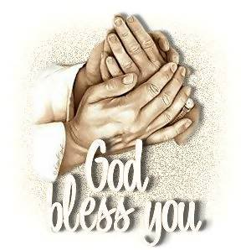
Next Sabbath
We will continue Part 2 in our study,
The Third Temple our Body!
20
The Ark
Our Cerebrum the Nervous System
A symbol of The Tribe of Judah
(The Law Giver)

