Slide 1
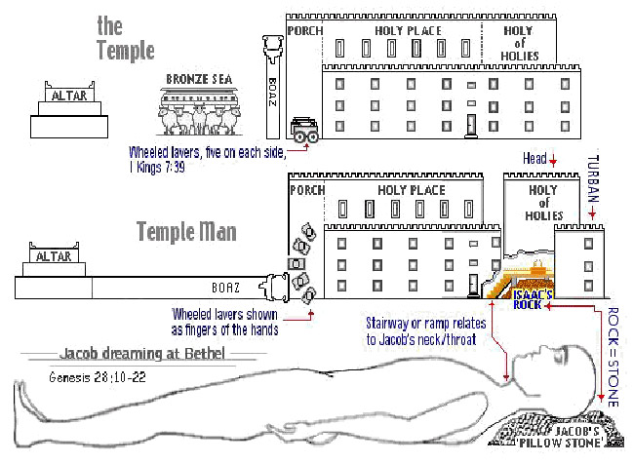
The Sanctuary of our Body
THE THIRD TEMPLE
Series 4
The Integumentary System
By : sister rose

Slide 2
The Integumentary System
Operates and Functions like
(The Tribe of Naphtali)
“He giveth goodly words”
Genesis 49:21
Naphtali [is] a hind let loose:
he giveth goodly words
Our Skin a Symbol of the Godhead holding us together
Through Christ Righteousness the true Covering
(from dangers in the environment and weathering)

Slide 3
Deuteronomy 33:23
And of Naphtali he said, O Naphtali,
satisfied with favour,
and full with the blessing of the LORD: possess thou the west and the south.

Slide 4
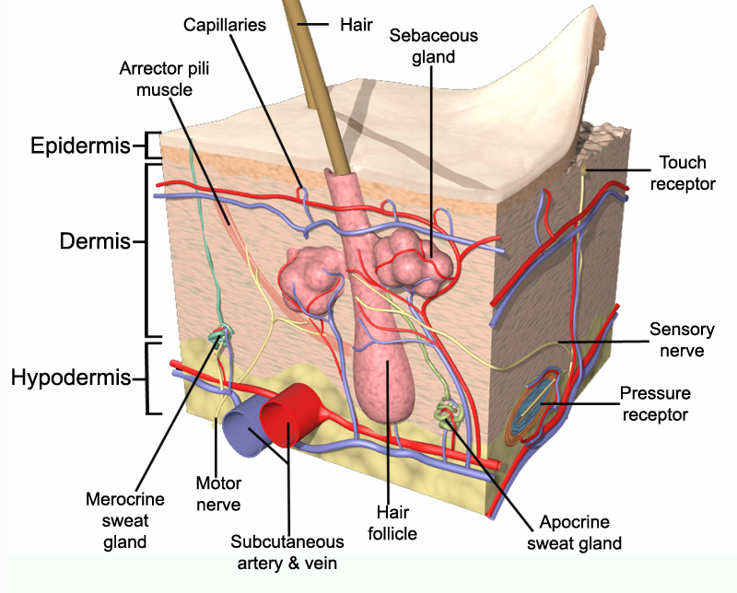
The Integumentary System
INTEGUMENTARY
DEFINITION
The skin is the largest organ of the body, with a total area of
about 20 square feet.
The skin protects us from microbes and the elements, helps regulate body temperature, and permits the sensations of touch, heat, and cold.
Skin has three layers:
The epidermis, the outermost layer of skin, provides a waterproof barrier and creates our skin tone.
The dermis, beneath the epidermis, contains tough connective tissue, hair follicles, and sweat glands.
The deeper subcutaneous tissue (hypodermis) is made of fat and connective tissue.
4
http://gettysburghs.libguides.com/content.php?pid=279103&sid=2319316

Slide 5
The Integumentary System (Skin): A Symbol of the Covering
Christ Righteousness by the Power of our Godhead
(Exodus 25:8; 26:7-9, 16; 40:3)
(Genesis 49:21) (Genesis 30:7-8) (Deuteronomy 33:23) (Judges 5:18) (1 Corinthians 10:1)
The Skin is the Covering of the Body : Christ our only covering which Himself has provided can make us meet to appear in God's presence. This covering, the robe of His own righteousness, Christ will put upon every repenting, believing soul. . . .
This robe, woven in the loom of heaven, has in it not one thread of human devising. Margin… {Maranatha 78.3} (Romans 4:7)
God's workmen must have increased protection. To those laboring in the heat of the conflict, God says, "The Lord is thy shade upon thy right hand."
{Vol.3Bible Commentary 1153.7} Margin…(Psalms 121:5) (Romans 3:26) (Zechariah 3:1-5)
The length of one curtain [shall be] eight and twenty cubits, and the breadth of one curtain four cubits: and every one of the curtains shall have one measure. (Exodus 26:2)
(The skin is the largest organ of the body, with a total area of about 20 square feet)
Its Functions are: Protects deeper tissues from
(Mechanical damage/bumps, Chemical damage/acids and bases, Bacterial damage, Ultraviolet radiation/damaging effects of sunlight, Thermal damage/heat or cold, Desiccation/ drying out)
"not having spot, or wrinkle, or any such thing.“
(Ephesians 5:27)
5

Slide 6
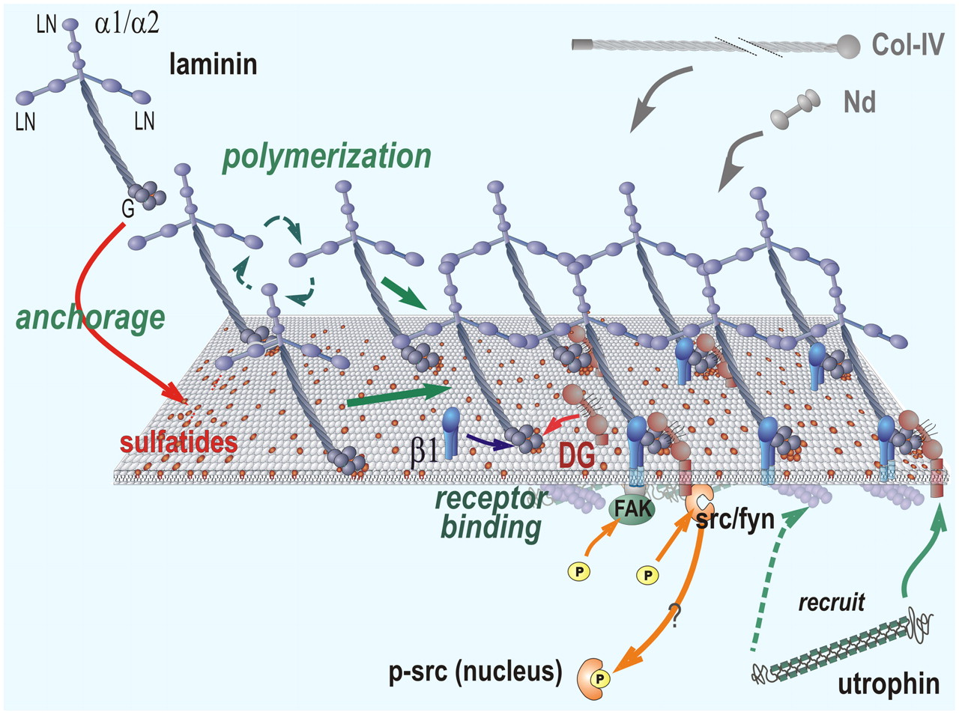
The length of one curtain [shall be] eight and twenty cubits.
6
(The Cross and Its Shadow)
Types-Various Offering
(Step to Christ)
Anti- Type- Our Skin
1. Sin (Our Peace - Chap.17)
2. Burnt (Our Wholeness - Chap.18)
3. Drink (Pouring out of Soul - Chap.19)
4. Meat (Surrendering our Provision - Chap.20)
5. Trespass (Restoration & our Restitution - Chap.21)
6. The Red Heifer (Cleansing Blood - Chap.22)
7. Peace (His Our Stay - Chap.23)
8. Cleansing of the Leper (Our Cleanser - Chap.24)
1. Fat (God’s Love For Man - Chap.1.9)
2. Vein (The Sinner’s Need of Christ - Chap.2.19)
3. Sweet Gland (Repentance - Chap.3.25)
4. Arrector (Confession - Chap.4.39)
5. Nerve (Consecration - Chap.5.45)
6. Arteries (Faith and Acceptance - Chap.6.51)
7. Sebaceous(The Test of Discipleship - Chap.7.59)
8. Dermis (Growing Up into Christ - Chap.8.69)
Christ Covering has Delivered us from all Sin
Isaiah 53:5

Slide 7
7
Aids in body heat loss or heat retention(Controller by the nervous system) (Psalms 105:39)
Aids in excretion of urea and uric acid: Christ "was manifested to take away our sins (1 John 3:5)
Synthesizes vitamin D: Divine strength & vitality only given by the
(Sun of Righteousness Malachi 4:2)
Human Skin is composed of two kinds of tissue:
The outer Epidermis is made up of stratified squamous epithelium that is capable of keratinizing, or becoming hard and tough.
The underlying dermis is made up of dense connected tissue (Exodus 25:3; 26:14).
The epidermis and dermis are firmly connected.
However, a burn or friction may cause them to separate, which results in a blister.
The Artery represents: Suffering The Red (2 kings 3:22; Hebrew 5:8-9;Luke22:44)
The Vein represents: Obedience The Blue (Numbers15:37-41)
The Organs of the Integumentary system include skin, accessory organs such as
hair, nails, sweat glands, and sebaceous glands.
These parts protect underlying tissues;
regulate body temperature, house a variety of sensory receptors and have
laminin proteins the glue that holds us together.

Slide 8
How the Godhead holds us Together through
The Intergumentary System our Skin?
For the invisible things of him from the creation of the world are clearly seen, being understood by the things that are made,
[even] his eternal power and Godhead;
so that they are without excuse:
(Romans 1:20)
Forasmuch then as we are the offspring of God,
we ought not to think that the Godhead is like unto gold,
or silver, or stone, graven by art and man's device.
(Acts 17:29 2:9)
For in him dwelleth all the fulness of the Godhead bodily.
(Colossians 2:9)
8

Slide 9
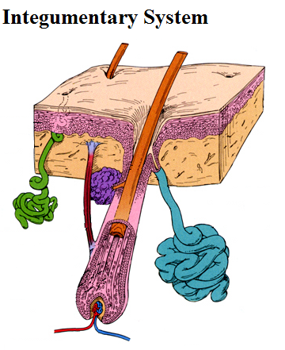
The Skin Functions
1. Covering your body
2. Protecting the inside of the body
3. Regulating body temperature
4. Providing sense of touch
5. Sensing painful and pleasurable Stimuli
6. Provide a protective barrier
7. Maintaining a balance of water and electrolytes
Epidermis: Prevents Bacteria and others foreign substances from entering the body
Dermis: Supports the epidermis and gives the skin the flexibility and strength
Hypodermis: is a layer of fats cell providing insulation protective patters.
9
The skin’s color is created by special cells called melanocytes,
which produce the pigment melanin.
Melanocytes are located in the epidermis.

Slide 10
The Laminin made up of three important factors:
Alpha, Beta, Gamma
For in him dwelleth all the fullness of the Godhead bodily.
(Colossians 2:9)
And about the ninth hour Jesus cried with a loud voice, saying,
Eli, Eli, lama sabachthani? That is to say, My God, my God, why hast thou forsaken me?
First Person of the Godhead: Alpha (Revelation 22:13)
I am Alpha and Omega, the beginning and the end, the first and the last.
The Second Person of the Godhead: Beta (Revelation 21:13)
and I saw no temple therein: for the Lord God Almighty and the Lamb are the temple of it.
Third Person of the Godhead: Gamma (Matthew 3:16)
And Jesus, when he was baptized, went up straightway out of the water: and, lo, the heavens were opened unto him, and he saw the Spirit of God descending like a dove, and lighting upon him: Skin manufactures Fifteen laminin trimmers.
10

Slide 11
Fifteen laminin trimmers have been identified.
The laminins are combinations of different
alpha-, beta-, and gamma-chains.
There are five forms of alpha-chains: LAMA1, LAMA2, LAMA3, LAMA4, LAMA5
I am Alpha and Omega, the beginning and the end, the first and the last. (Revelation 22:13)
And about the ninth hour Jesus cried with a loud voice, saying, Eli, Eli, lama sabachthani? that is to say, My God, my God, why hast thou forsaken me?
(Matthew 27:46)
There are four of beta-chains: LAMB1, LAMB2, LAMB3, LAMB4
And looking upon Jesus as he walked, he saith, Behold the Lamb of God!
(John 1:36)
And I saw no temple therein: for the Lord God Almighty and the Lamb are the temple of it. (Revelation 21:22)
There are three of gamma-chains: LAMC1, LAMC2, LAMC3 (Matthew 3:16)
And Jesus, when he was baptized, went up straightway out of the water: and, lo, the heavens were opened unto him, and he saw
the Spirit of God descending like a dove, and lighting upon him:
11

Slide 12
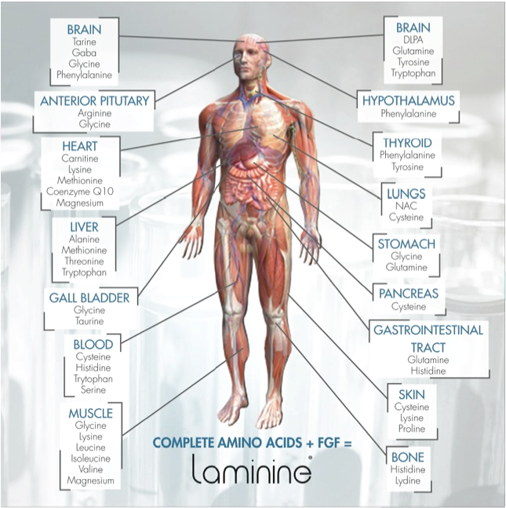
12

Slide 13
Laminin it's an important protein that makes
up body structures
Laminin is a protein found in the "extracellular matrix", the sheets of protein that form the substrate of all internal organs also called the "basement membrane".
It has four arms that can bind to four other molecules.
The three shorter arms are particularly good at binding to other laminin molecules,
which is what makes it so great at forming sheets.
The long arm is capable of binding to cells, which helps anchor the actual organs to the membrane.
Hebrews 6:19
Which [hope] we have as an anchor of the soul, both sure and stedfast, and which entereth into that within the veil;
13

Slide 14
14
{Review and Herald, June 9, 1896 par. 3}
It is true that we are exposed to great moral peril; it is true that we are in danger of being corrupted. But this danger threatens us only as we trust in self, and look no higher than our own human efforts. In doing this we shall make shipwreck of faith. Our hope of salvation is an anchor to the soul, both sure and steadfast, when it entereth into that which is within the vail. Anchored in Christ, the soul, like a ship amid the raging elements, tempest-tossed and driven, is immovable. It is not driven on the rocks or drawn into the whirlpool. "Wherefore didst thou doubt?" said Christ to the sinking Peter. The same question may be addressed to us. Why do we dishonor God with our shameful unbelief? The Lord has pledged himself to give us strength to enable us to stand. As we search the Scriptures, we find ground for confidence, provision for sufficiency. It is our privilege to say boldly, yet humbly, The Lord is my helper, therefore I shall not be moved from my steadfastness. My life is hid with Christ in God. Because he lives, I shall live also. Let us pledge ourselves before God and the angels of heaven that we will not dishonor God by speaking

Slide 15
15
Continuing
words of discouragement or unbelief. Let us pledge ourselves before God and the angels of heaven that we will not dishonor God by speaking words of discouragement or unbelief. If we talk faith, we shall have faith; we shall be confirmed in faith. Close the door to distrust, and open the door wide to faith. Invite into the soul temple the heavenly Guest. Let every word we utter, every line we trace with the pen, give evidence of unwavering faith. Let us not think that Jesus is the Saviour of some one else, but that he is our personal friend. Entertain the precious thought that Jesus loves me. In this way the cloud of despondency and gloom will be rolled back from the soul, and we shall be enabled to make melody in our hearts unto God. We may triumph in the Lord, every day acknowledging the fact that our heavenly treasure, our everlasting portion, is sure to us through the atonement and righteousness of Jesus Christ. Believing this ourselves, we shall be able to aid others to see that their only help is in God, and encourage them to flee for refuge to Christ, laying hold on the hope set before us in the gospel.

Slide 16
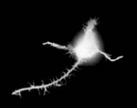
Let’s take a look at what a Laminin looks like.
16

Slide 17
The Laminin
It's actually made up of three separate parts, called
the A, B1, and B2 chains.
That gives it really a total of six "ends", which accounts for a lot of its flexibility in connecting up various kinds of molecules.
Because of this, scientists who create biomaterials are extremely interested in the whole family of laminins.
They use them to create artificial substrates for transplants.
Laminin is extremely important to making sure that your overall body structures hold together.
If laminin isn't produced correctly, your muscles may form improperly, giving you a form of muscular dystrophy.
http://askville.amazon.com/Laminin/AnswerViewer.do?requestId=4925085
17

Slide 18
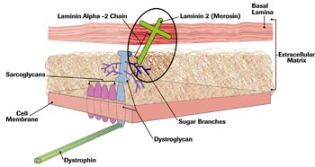
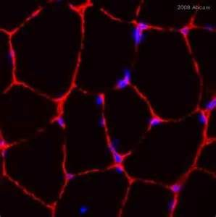
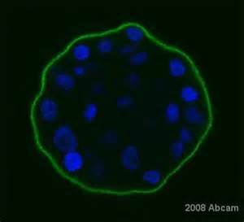
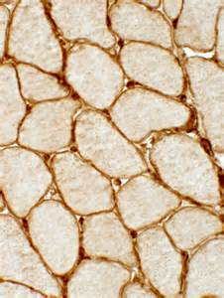
18
Laminin Alpha -2 Antibody
Laminin beta-1 Antibody

Slide 19
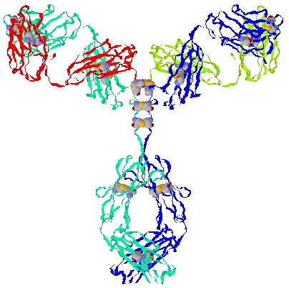
The Third chain
19
The Laminin is composed of 3 chains, the third one Gamma in the chain is shaped like a Dove.
As the Third Person of the Godhead manifested Himself in the form of a dove, Take a look!

Slide 20
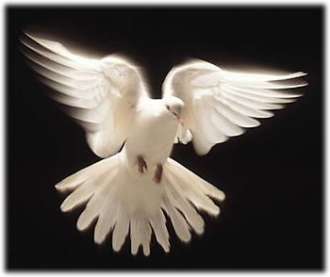
The Third chain known as Gamma
20
Laminin, gamma 1 (formerly) LAMB2
(Matthew 3:16, Luke 3:22)

Slide 21
But unto you that fear my name shall the Sun of righteousness Arise
with healing in his wings; and ye shall go forth, and grow up as calves of the stall. (Malachi 4:2)
In him was life; and the life was the light of men
[That] was the true Light, which lighteth every man that cometh into the world.
(John 1:4, 9)
This vitamin helps the body absorb calcium from the digestive tract.
Because we wear clothes and may not be in the sun for lengthy periods,
our diets must be supplemented with vitamin D and with a D fortified diet.
The Skin is the largest organ of your body.
In an adult human, 15% of the total body weight is skin.
The tissues are made up of a variety of specialized cells.
In fact, one typical square centimeter of human skin contains 200 nerve endings; its rich capillary network and sweat glands (both controlled by the nervous system) play an important role in regulating heat loss from the body surface.
It contain 10 hairs , (Exodus 25:4; 26:15)
with accompanying microscopic muscles, 100 , (Exodus 27:11)
sweat glands, 15 oils, (Exodus 25:6)
glands, 3 blood vessels, (Colossians 2:9; Proverbs 3:8-9)
12 heat receptors, 2 cold receptors (Exodus 25:10), and
25 pressure-sensing receptors
21

Slide 22
The Human Skin Contains
22
100 Sweet Gland
(Exodus 27:11) Margin.. hangings of an hundred [cubits] long
15 Oil Gland,
3 Blood Vessels
(Exodus 27:14-15) Margin…. fifteen cubits: their pillars three,
(Exodus 25:6) Margin…. Oil for the light, spices for anointing oil,
(Proverbs 3:8 ) Margin… and marrow to thy bones.
10 Hair
(Exodus 25:4) Margin… and goats' [hair],
Skin Receptors receives sensory information from the Nervous System (Cerebral cortex)
2 Cold receptors
25 Pressure-sensing receptors
12 Heat receptors
(Exodus 25:4) Margin… which I will give thee in commandment unto the children of Israel.
(Revelation 22:16) I Jesus have sent mine angel to testify unto you these things in the churches I am the root and the offspring of David, [and] the bright and morning star.

Slide 23
23
We Are Objects Of Infinite Love
But God, who is rich in mercy, for his great love wherewith he loved us, even when we were dead in sins, hath quickened us together with Christ. Ephesians 2:4, 5. {Our Fathers Care 283.1- 6}
The heart surrendered to God’s wise discipline will trust every working out of His providence. . . . Temptation will come to discourage, but what is gained by yielding to any such temptations? Is the soul made any better by murmuring and complaining of its only source of strength? Is the anchor cast within the vail. Will it hold in sickness? Will it be the testimony borne in the last closing scenes of life when the lips are becoming palsied with death? The anchor holds! I know that my Redeemer liveth. . .
O Precious, loving, long-suffering, long-forbearing Jesus, how my soul adores Thee! That a poor, unworthy, sin-polluted soul can stand before the Holy God, complete in the righteousness of our Substitute and Surety! Wonder, O Heavens, and be astonished, O earth, that fallen man is the object of His infinite love and delight. He rejoices over them with celestial songs, and man defiled with sin, having become cleansed through the righteousness of Christ, is presented to the Father free from every spot and stain of sin, “not having spot, or wrinkle, or any such thing.” (Ephesians 5:27)
“Who shall lay any thing to the charge of God’s elect? It is God that justifieth.”
(Romans 8:33)

Slide 24
Let every weak, tempest-tossed soul find anchorage in Jesus Christ and not become so self-centered that he can think only of his little disappointments and the interruption of his plans and hopes. Is not the subject of the plan of salvation all-absorbing? If the infinite God justifies me, “who is he that condemneth?
It is Christ that died.” (Romans 8:34)
He has in His dying for man revealed how much He loves man—enough to die for Him! The law condemns the sinner and drives him to Christ.
It is God that justifies and pardons.
Satan will accuse and seek permission to destroy,
but it is God that opens the door of refuge. It is God that justifieth him that entereth that door.
Then if God be for us, who can be against us? Oh, the bright glorious truth.
Why do not men discern it? Why not walk in its bright beams?
Why do not all who believe talk of Christ’s matchless love? . . .
God lives and reigns. All who are saved must fight manfully as soldiers of Jesus Christ; then they will be registered in heaven’s books as true and faithful.
They are to work the works of Jesus Christ, fight the good fight of faith.
24

Slide 25
25
"My anchor holds". He who builds upon any other foundation than
that which has been laid, builds upon shifting sand. God calls for a reformation.
But he who seeks to bring about a reformation without the aid of the Holy Spirit's reviving power will find himself adrift. Those who turn from human foolishness and frailty, from man's seductive arts, from Satan's planning, to Christ, the Shepherd and Bishop of our souls, will stand secure upon the platform of eternal truth.
Margin…{Battle Creek Letters 83.3}
The doctrines must be plainly understood. The men accepted to teach the truth must be anchored; then their vessel will hold against storm and tempest, because the anchor holds them firmly. The deceptions will increase, and we are to call rebellion by its right name. We are to stand with the whole armor on.
My brethren, you are not meeting men only, but principalities and powers. We wrestle not against flesh and blood.
Let Ephesians 6:10-18 be read carefully
(Letter 1, 1897). { Vol.1 Bible Commentary 1114.6}

Slide 26
Ephesians 6:10-18
Finally, my brethren, be strong in the Lord,
and in the power of his might.
Put on the whole armour of God, that ye may be able to stand against the wiles of the devil. For we wrestle not against flesh and blood, but against principalities, against powers, against the rulers of the darkness of this world, against spiritual wickedness in high [places]. Wherefore take unto you the whole armour of God, that ye may be able to withstand in the evil day, and having done all, to stand. Stand therefore, having your loins girt about with truth, and having on the breastplate of righteousness; And your feet shod with the preparation of the gospel of peace; Above all, taking the shield of faith, wherewith ye shall be able to quench all the fiery darts of the wicked. And take the helmet of salvation, and the sword of the Spirit, which is the word of God: Praying always with all prayer and supplication in the Spirit, and watching thereunto with all perseverance and supplication for all saints;

Slide 27
Next Week
We will continue with our Study
The Sanctuary of our Body
THE THIRD TEMPLE
Series #5
The Muscular System
Operates and Functions like
(The Tribe of Levi)
Guardian of Sacred Things
“joined” or “attached”

