Slide 1
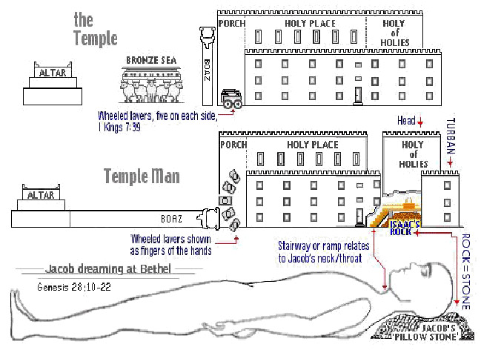
The Sanctuary of our Body
THE THIRD TEMPLE
Series 11
The Female Reproductive System
By : sister rose

Slide 2
The Female Reproductive System
Operates and Functions like
(The Tribe of Manasseh)
“Causing to forget ,”
her labor after the birth of her child.
Genesis 49:25
[Even] by the God of thy father, who shall help thee; and by the Almighty, who shall bless thee with blessings of heaven above, blessings of the deep that lieth under,
blessings of the breasts, and of the womb:

Slide 3
Deuteronomy 33:17
His glory [is like] the firstling of his bullock, and his horns [are like] the horns of unicorns: with them he shall push the people together to the ends of the earth: and they [are] the ten thousands of Ephraim, and they [are] the thousands of Manasseh.

Slide 4
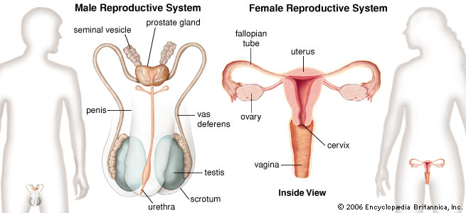
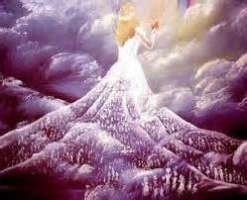
The Female Reproductive System
DEFINITION
The female reproductive system contains both organs inside the body and external structures on the body.
Its function is to enable reproduction of the species, so it is involved maturation as well as the actual process of birth.
It’s designed to carry out several functions, including producing the female egg cells, conception are directly involved in producing eggs and in conceiving and carrying babies.
Female reproductive
opening
Birth canal
http://www.medterms.com/script/main/art.asp?articlekey=5317

Slide 5
The Female Reproductive System
Represents a symbol of the Brazen Altar (Sacral Canal and Pelvic)
(Deuteronomy 33:17, 27) (Joshua 13:12) (Psalms 92:10) (Job 33:17)(Genesis 41:51)
“The blood was all poured out at the base of the altar of burnt-offering.”
By His life and His death, Christ has achieved even more than recovery from the ruin wrought through sin. Desire of Ages page 25.3 the first sentence…
For we are His by creation and we are His by redemption.
These are the, “Two Greatest Miracles” given to man by the Godhead through Jesus.
For God, [said he], hath made me forget all my toil, and all my father's house.
(“Causing to forget” her labor after the birth of her child.)
A woman when she is in travail hath sorrow, because her hour is come: but as soon as she is delivered of the child, she remembereth no more the anguish, for joy that a man is born into the world. And ye now therefore have sorrow: but I will see you again, and your heart shall rejoice, and your joy no man taketh from you.
(John 16:21-22)
Because thou hast made the LORD, [which is] my refuge, [even] the most High, thy habitation; Because he hath set his love upon me, therefore will I deliver him:
I will set him on high, because he hath known my name. He shall call upon me, and I will answer him: I [will be] with him in trouble; I will deliver him, and honour him.
With long life will I satisfy him, and show him my salvation. (Psalms 91:9, 14-15)
Can a woman forget her sucking child, that she should not have compassion on the son of her womb? yea, they may forget, yet will I not forget thee. Behold, I have graven thee upon the palms of [my] hands; thy walls [are] continually before me. (Isaiah 49:15-16)
5

Slide 6
Christ took humanity upon Himself. He laid aside His royal robe and kingly crown,
and stepped down from His high command in the heavenly courts. Clothing His divinity with humanity, Christ encircled the race with His long human arm. He stands at the head of humanity, not as a sinner but as a Saviour. It is because there is no spot or stain of sin upon His divine soul that He can stand there as the sinner's surety. Because He is sinless He can take away our sins and place us on vantage ground with God, if we will believe in Him and trust Him as the One that will be your sanctification and righteousness.
{2SAT- Sermons Talks Volume Two 165.1}
Who is the Real Life Giver? Let’s take a look in the Beginning!(Genesis 1:26)
Margin… And God said, Let us make man in our image, after our likeness:
The Hebrew word for God is 'Elohiym is plural or more than one God (Godhead).
The Creation of Life through the Female Reproductive System FSH: Follicle Stimulating Hormone
Represents: A symbol of her God ( the Father, the Son, the Holy Spirit).
FSH targets the ovaries and triggers the maturation of the egg each month.
It stimulates cells in it to secrete female hormones called Estrogens.
Luteinizing hormone (LH) in female a surge of LH near the middle of the menstrual cycle stimulates the release of eggs. In addition it triggers the development of cells within the ovaries that produces another female hormone called progesterone.
(Hebrew 6:1-2) (Luke 6:12-17) (Matthew 10:1) (Revelation 7:6)
As parents, can we save our children with our righteousness?
No! give them the words of life so they can seek Christ for their Salvation.
Ezekie14:20
Though Noah, Daniel, and Job, [were] in it, [as] I live, saith the Lord GOD, they shall deliver neither son nor daughter; they shall [but] deliver their own souls by their righteousness.
6

Slide 7
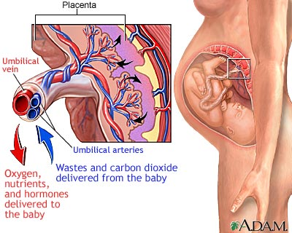
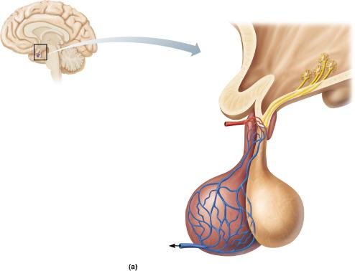
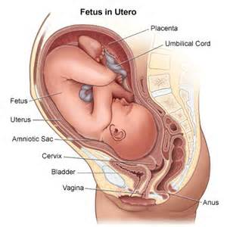
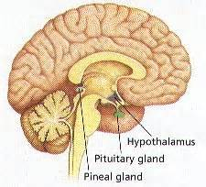
7
Christ
our Mediator
Sends out His virtue
His Word
a symbol of Himself
the
Seed of Life
The Birth of the Natural Woman
(Mary) Type
Matthew 1:18, 20
The Birth of the
Spiritual Woman
(Remnant People) Anti-type
Romans 4:11, 24

Slide 8
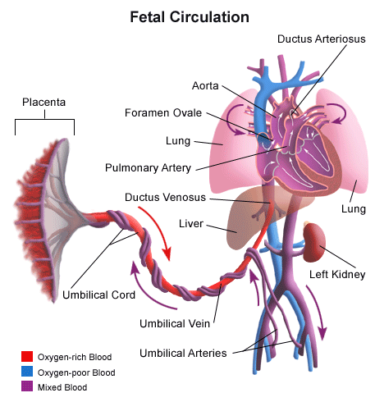
Blood Circulation in the Fetus and Newborn How does the fetal circulatory system work? During pregnancy, the fetal circulatory system works differently than after birth: The fetus is connected by the umbilical cord to the placenta, the organ that develops and implants in the mother's uterus during pregnancy. Through the blood vessels in the umbilical cord, the fetus receives all the necessary nutrition, oxygen, and life support from the mother through the placenta. Waste products and carbon dioxide from the fetus are sent back through the umbilical cord and placenta to the mother's circulation to be eliminated.
http://www.chop.edu/healthinfo/blood-circulation-in-the-fetus-and-newborn.html#
The book of Genesis gives quite a definite account of social and individual life, and yet we have no record of an infant's being born blind, deaf, crippled, deformed, or imbecile.
There is not an instance upon record of a natural death in infancy, childhood, or early manhood. There is no account of men and women dying of disease. Obituary notices in the book of Genesis run thus: "And all the days that Adam lived were nine hundred and thirty years: and he died." "And all the days of Seth were nine hundred and twelve years: and he died.“ . . . {Conflict and Courage 21.2} Ecclesiastes 7:29

Slide 9
9
Internal reproductive organs
The uterus, or womb, is a hollow organ located centrally in the pelvis.
(the Altar was a hollow box) (Exodus 27:1-2, 8 )
It houses the developing fetus during pregnancy. The lower portion of the uterus is called the cervix and opens into the birth canal. An opening in the cervix allows for the passage of sperm (male cell) into the uterus and the exit of menstrual blood from the uterine lining.
A symbol of: The Seed of Christ
(Christ is our Sanctification)
(Once Christ is imputed the impurities of our filthiness will cease in our bodies)
This same opening dilates during labor to allow passage of the baby through the birth canal. Arising from the upper portion of the uterus on each side are the Fallopian tubes. These are channels that allow eggs from the ovaries to enter the uterus.
The process of fertilization of an egg by a sperm cell typically happens in the Fallopian tubes, and the fertilized egg moves into the uterus where it is implanted.
Beside the uterus on each side and near the opening of the Fallopian tubes are the small, oval ovaries, the female reproductive organs. They produce hormones and contain eggs.
At birth, a female has 1 to 2 million eggs already present in the ovaries,
but only about 300 of them will mature during a woman's lifetime. Margin….
http://www.medicinenet.com/female_reproductive_system/article.htm
Gideon the greatest of the judges, was of the tribe of Manasseh
and the 300 Warriors. (Judges 7:16)
A Symbol of the Gideon (band) sounding the trumpet Proclaiming the Message .
God's Ways Are Not Our Ways {Vol. 2 Bible Commentary 1004.2}

Slide 10
The female reproductive system consists of the ovaries,
fallopian tubes, uterus, and the female reproductive organ.
Uterus
The uterus or womb is the most important part of the female reproductive system.
The uterus is the organ where the fetus develops during gestational period. The other functions of the uterus is to provide support and structural integrity to the bladder, bowel and pelvic organs. It is a very important part of reproductive response in females as it directs the blood flow to the pelvis, ovaries, and female reproductive organs. The uterus is also very important as it accepts the ovum from the fallopian tube and implants it into the endometrium wall. Here, it nourishes the ovum till it is fertilized. And unfertilized ovum along with the blood and endometrial lining is pushed out of the uterus. Thus, leading to the beginning of menstrual cycle every month in women after attaining puberty.
The Menstrual Cycle
The menstrual cycle is the monthly cycle of follicle and egg maturation, release of an egg (ovulation), and preparation of the uterine lining for pregnancy. If a woman does not become pregnant, the uterine lining tissue is shed as menstrual bleeding. Most menstrual cycles are 28 days in length. Menarche is the time in during adolescence when menstrual periods begin. Menstrual periods continue to occur until a woman reaches menopause.
Ovaries
The ovaries are internal organs of the female body. They are ovum producing reproductive organs that are present in pairs. The ovaries are located in the lateral wall of the pelvis. This region is called the ovarian fossa that is present below the external iliac artery and in front of the internal iliac artery and ureter. www.medicinenet.com/female_reproductive_system/article.htm

Slide 11
The Fruit of the Tree of Life
(like the Candlestick, only the Fire of God can Kindle Life)
Two almond-shaped organs are about 3 centimeters long produce eggs and female hormones; remaining structure serves as sites for fertilization and development of the fetus.
Mammary glands of female breast produce milk to nourish the newborn. (Hebrew 5:12-13)
In humans, ovum contains a great deal of cytoplasm, but virtually no yolk.
The developing human derives nourishment from the mother after implantation.
The Female eggs cells or ova): is called oogenesis literally “the making of eggs”
Represents: The church without the seed of Christ, having no life in her.
(the female egg cells contains 6 parts: 6 being the number of men)
1. Corona radiate 2. Zona pellucida 3. Cytoplasm
4. Cell membrane 5. Haploid nucleus of egg, 6. Polar bodies.
The Seed of Life is needed for a new life to be formed.
Also, He (Christ) supports development of embryos (New creation in Christ Jesus) and functions in the birth process. (Esther 2:12-13) (John 2:6)
The Male cells (sperm cells):
Represents Jesus Christ the seed of Life with living power for Creation.
Only through the imputed Righteousness of our Redeemer transported in men’s heart. Without the seed there is no fruit (a fetus):
Christ in us is the new Birth/ The inner Man for us and in us.
Birth takes place at the end of the Third trimester, (John 16:21-22) (Isaiah 26:17-21)
A symbol (3 days) The believers experience of His Death and Resurrection.
11

Slide 12
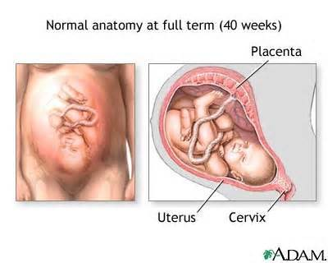
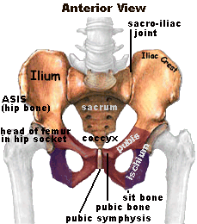
See below for explanation of the Spiritual Birth of the seed of Jesus in us, taking from:
The Hebrew word for “filthy” means “menstrual flux” (Strong’s #5708), and the Hebrew word for “rags” means “clothing or garment” (Strong’s #899). So “filthy rags” literally means clothing or garments that have been soiled by the menstrual flux of a woman’s monthly cycle, and in Leviticus it mentions that this menstrual issue of blood defiles and makes unclean everything that it comes in contact with (see Leviticus 15:19-27). http://www.lightministries.com/SDA/id43.htm
This is a very descriptive picture of someone contaminated with sin, and thus any good deeds of righteousness which they might do could not be accepted by God because it was done while their garments were contaminated by filth.
12
Normal Anatomy at full Term (40 Weeks) 40 a symbol of Sanctification
Hebrew 9:26-28.
Christ put away sin by offering Himself. Desire of Ages pg 25.

Slide 13
The Divine Power Working in Us
13
Once we are born again, these filthy garments are removed from us, we are then cleansed and clothed in Christ’s robe of righteousness, and the seed or Jesus Christ is now planted within us. Now when a women becomes impregnated with seed, what happens to her menstruation cycle? It ceases, and so there is no more blood to defile her garments. So in this born again condition, we become, as it were, impregnated with the seed or we have Christ living within us. Or in other words, we are united with Divinity.
Now what happens when humanity and Divinity is combined? “Whosoever is born of God doth not commit sin”! So once our weak efforts to obey God combines with the Divine strength and grace of Christ, what happens? We will not sin, but we will do the will of God! So you can see that we could then do works of righteousness that would be accepted by God since we are no longer clothed in the filthy rags experience we had while living in sin and in fulfilling the lusts of the flesh.
“Simon Peter, a servant and an apostle of Jesus Christ, to them that have obtained like precious faith with us through the righteousness of God and our Saviour Jesus Christ: Grace and peace be multiplied unto you through the knowledge of God, and of Jesus our Lord, According as his divine power hath given unto us all things that pertain unto life and godliness, through the knowledge of him that hath called us to glory and virtue:
Whereby are given unto us exceeding great and precious promises:
that by these ye might be partakers of the divine nature, having escaped the corruption that is in the world through lust.”
(2 Peter 1:1-4) http://www.lightministries.com/SDA/id43.htm

Slide 14
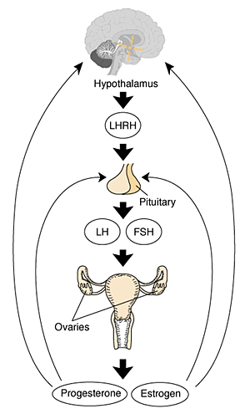
Follicular phase
The follicular phase is the beginning of the menstrual cycle. It starts on the first day of the menstrual cycle and usually lasts about 14 days. (Christ Death)
The hormones follicle-stimulating hormone (FSH) and luteinizing hormone (LH) are released from the pituitary gland to stimulate the ovaries. In turn, the ovaries produce estrogen and stimulate the maturation of about 15 to 20 eggs in the ovaries inside small areas known as follicles. Once estrogen levels begin to rise, the secretion of (FSH) is reduced by a feedback system so that follicle stimulation ceases at the appropriate time. With time, one of the egg follicles (or rarely, two or more) becomes dominant, and maturation of the other follicles is interrupted.
The dominant follicle continues to make estrogen. (1 Corinthians 5:7)
The Passover lamb was slain on the fourteenth day of Abib, or Nisan.
(1 Chronicles 12:19-22)
7 Mighty Warriors
From the tribe of Manasseh
Exodus 12:6
Christ Before
the mercy seat
Mediating by Blood
The Holy Spirit
Mediating by
Prayer
Led by the
Holy Spirit
Follicle Stimulating
Hormone

Slide 15
Temperance and Self-Control
Especially does responsibility rest upon the mother. She, by whose lifeblood the child is nourished and its physical frame built up, imparts to it also mental and spiritual influences that tend to the shaping of mind and character. It was Jochebed, the Hebrew mother, who, strong in faith, was "not afraid of the king's commandment" (Hebrews 11:23), of whom was born Moses, the deliverer of Israel. It was Hannah, the woman of prayer and self-sacrifice and heavenly inspiration, who gave birth to Samuel, the heaven-instructed child, the incorruptible judge, the founder of Israel's sacred schools. It was Elizabeth the kinswoman and kindred spirit of Mary of Nazareth, who was the mother of the Saviour's herald. The carefulness with which the mother should guard her habits of life is taught in the Scriptures. When the Lord would raise up Samson as a deliverer for Israel, "the angel of Jehovah" appeared to the mother, with special instruction concerning her habits, and also for the treatment of her child. "Beware," he said, "and now drink no wine nor strong drink, neither eat any unclean thing.“ Judges 13:13, 7.
The effect of prenatal influences is by many parents looked upon as a matter of little moment; but heaven does not so regard it. The message sent by an angel of God, and twice given in the most solemn manner, shows it to be deserving of our most careful thought.
In the words spoken to the Hebrew mother, God speaks to all mothers in every age. “
Let her beware," the angel said; "all that I commanded her let her observe." The well-being of the child will be affected by the habits of the mother. Her appetites and passions are to be controlled by principle. There is something for her to shun, something for her to work against, if she fulfills God's purpose for her in giving her a child. If before the birth of her child she is self-indulgent, if she is selfish, impatient, and exacting, these traits will be reflected in the disposition of the child. Thus many children have received as a birthright almost unconquerable tendencies to evil. {MH- The Ministry of Healing 372. 1- 4}

Slide 16
16
Common problems related with Reproductive System
The reproductive system must be well protected as any threat to its health jeopardizes the ability to have a child. Diseases of the reproductive system include sexually transmitted diseases as well as ovarian cysts and uterine cancer in women.
The defenses of the reproductive system are among the toughest in the body. Infectious organisms entering a woman’s body though the reproductive system are met by a well-organized network of defenses. Acid and white blood cells in the mucus secreted by the vaginal lining and the adverse current created by the cilia are able to kill most invading microorganisms. However, as it is critical for male sperm entering the reproductive tract to pass through, the protective mucus of the female reproductive organ and the cervix thin considerably during ovulation. http://preventivescience.org/reproductive.html Even a fetus in a mother’s womb is at peril from the mother’s immune system.
As the embryo contains genetic material from both father and mother, the mother’s immune system identifies the embryo as something that does not belong to her body and produces antibodies to attack it. Thankfully, the womb can prevent the entry of most antibodies to protect the fetus from the mother’s natural defense mechanism.
A symbol of the two laws warring within us; Spiritual and the Carnal Romans 7:23
But if the mother unswervingly adheres to right principles, if she is temperate and self-denying, if she is kind, gentle, and unselfish, she may give her child these same precious traits of character. Very explicit was the command prohibiting the use of wine by the mother. Every drop of strong drink taken by her to gratify appetite endangers the physical, mental, and moral health of her child, and is a direct sin against her Creator.
{MH- MH-The Ministry of Healing 373.1}

Slide 17
Next Week:
The Sanctuary of our Body
The Third Temple
Series 12
The Male Reproductive System
Operates and Functions like
(The Tribe of Joseph)
“Fruitfulness”

