Slide 1
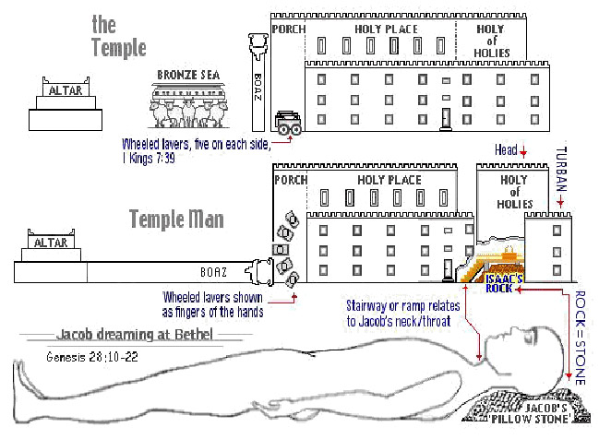
The Sanctuary of our Body
THE THIRD TEMPLE
Series 2
The Endocrine System
By : sister rose

Slide 2
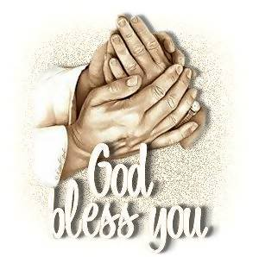
The Endocrine System
Operates and Functions like
(The Tribe of Asher)
“Rich & Royal ”
Genesis 49:20
Out of Asher his bread [shall be] fat,
and he shall yield
royal dainties.

Slide 3
Deuteronomy 33:24-25
And of Asher he said, [Let] Asher [be] blessed with children; let him be acceptable to his brethren, and
let him dip his foot in oil.
Thy shoes [shall be] iron and brass; and as thy days, [so shall] thy strength [be].

Slide 4
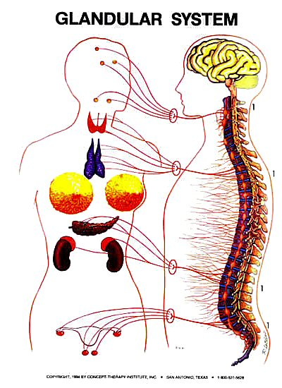
The Endocrine System
ENDOCRINE SYSTEM DEFINITION
The Endocrine System is made up of glands that produce and secrete hormones, chemical substances produced in the body that regulate the activity of cells or organs. These hormones regulate the body's growth, metabolism (the physical and chemical processes of the body), and sexual development and function. The hormones are released into the bloodstream and may affect one or several organs throughout the body.
l http://www.emedicinehealth.com/anatomy_of_the_endocrine_system/article_em.htm

Slide 5
Endocrine System
The nervous system sends electrical messages to control and coordinate the body. The endocrine system has a similar job, but uses chemicals to “communicate”. These chemicals are known as hormones. A hormone is a specific messenger molecule synthesized and secreted by a group of specialized cells called an endocrine gland. These glands are ductless, which means that their secretions (hormones) are released directly into the bloodstream and travel to elsewhere in the body to target organs, upon which they act. Note that this is in contrast to our digestive glands, which have ducts for releasing the digestive enzymes. http://biology.clc.uc.edu/courses/bio105/endocrin.htm
In the holiest I saw an ark; on the top and sides of it was purest gold. On each end of the ark was a lovely cherub, with its wings spread out over it. Their faces were turned toward each other, and they looked downward. Between the angels was a golden censer. Above the ark, where the angels stood, was an exceeding bright glory, that appeared like a throne where God dwelt. Jesus stood by the ark, and as the saints’ prayers came up to Him, the incense in the censer would smoke, and He would offer up their prayers with the smoke of the incense to His Father. Margin….(Early Writings, 32.3)
{Pr – Prayer 218.4} {AG- God's Amazing Grace 86.1-86-6}
5

Slide 6
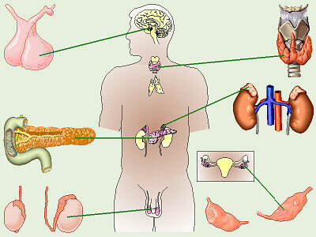
(Pituitary, Larynx, Adrenal Gland on Kidney, Ovaries, Testis)
6
Mediators
The Thyroid Gland
Altar of Incense
The Hypothalamus
and Pituitary Gland
The Adrenal Glands
Purifier of Blood
The Pancreas
The Male Testes
The Female Ovaries

Slide 7
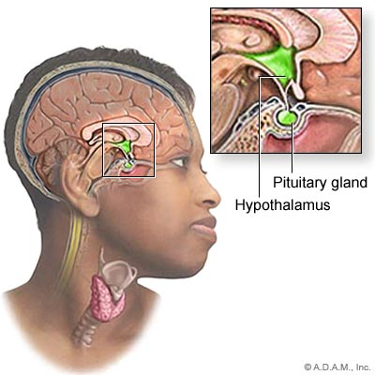
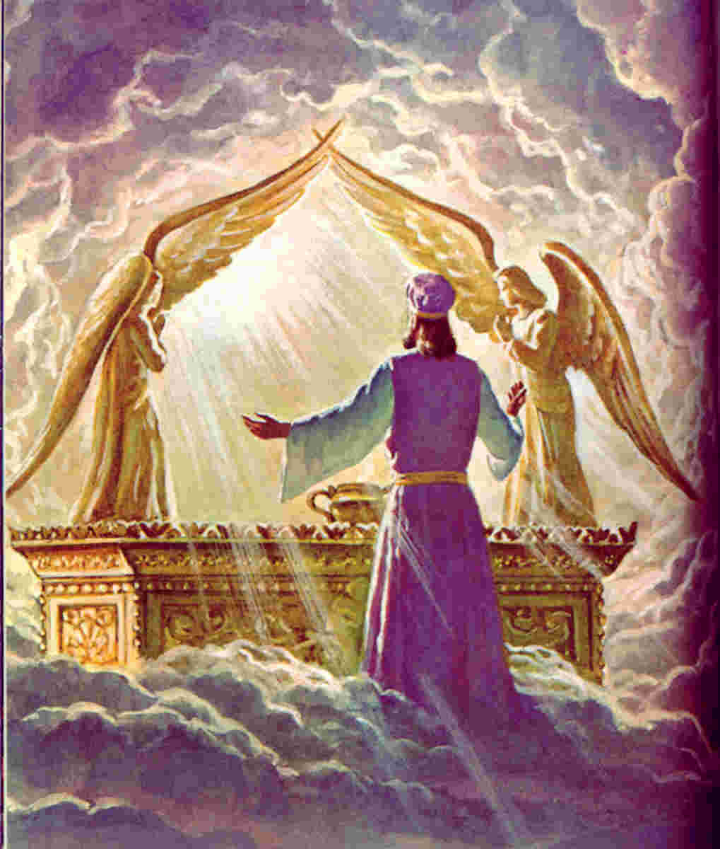
Jesus our High Priest Before the Father
7
(Genesis 49:20)
The eternal God [is thy] refuge, and underneath [are] the everlasting arms:

Slide 8
Efficiency of Christ's Priesthood.
Let us remember that our great High Priest is pleading before the mercy seat in behalf of His ransomed people. He ever liveth to make intercession for us. "If any man sin, we have an advocate with the Father, Jesus Christ the righteous.”
The blood of Jesus is pleading with power and efficacy for those who are back-slidden, for those who are rebellious, for those who sin against great light and love. Satan stands at our right hand to accuse us, and our Advocate stands at God's right hand to plead for us. He has never lost a case that has been committed to Him. We may trust in our Advocate; for He pleads His own merits in our behalf. Hear His prayer before His betrayal and trial. Listen to His prayer for us; for He had us in remembrance. {Bible Commentary Vol.7 948.4-5}
The Pituitary (puh-Too-ih-tare-ee) is a powerful gland that secretes nine major hormones. Although it secretes so many hormones, it is amazingly tiny---slightly smaller than a marble. It hangs from the underside of the brain, supported and cradled within a bony depression of the sphenoid bone.
8

Slide 9
ENDOCRINE GLANDS
The endocrine glands secrete their product directly into the bloodstream, bypassing the need for a duct system that the exocrine glands require.
( include the salivary glands, sweat glands and glands within the Gastrointestinal tract)
Chemicals that can not be deposited into the blood are deposited into the interstitial fluid which surrounds the gland.
The Pituitary Gland is termed the "Master Gland“
(Christ Ministry in Heaven and Mission to redeem man)
because it directs other organs and endocrine glands,
such as the adrenal glands, to suppress or induce hormone production.
Function: The pituitary gland is involved in several functions of the body including:
Growth Hormone Production, Production of Hormones that Act on Other Endocrine Glands, Production of Hormones that Act on the Muscles and the Kidneys, Endocrine Function Regulation,
Storage of Hormones Produced by the Hypothalamus
9

Slide 10
Christ Our Mediator
Operates Like our Master Gland
Christ our High Priest before the Mercy Seat functions in our body
Like The Pituitary Gland
Is a small endocrine organ that controls a multitude of important functions in the body. (Hebrew 2:17; 7:25; 9:11, 24-25)
It is divided into an Anterior Lobe, Posterior Lobe, all of which are involved in hormone production.
The posterior pituitary is composed of axons from the
neurons of the hypothalamus.
Blood vessel connections between; the hypothalamus and pituitary.
The Hypothalamus= Represents the Holy Spirit and
The Pituitary= Represents Christ our Mediator
allows hypothalamic hormones to control pituitary hormone
secretion and Controls various homeostatic functions such as
body temperature, respiration, and heartbeat. (John 15:26-27)
10

Slide 11
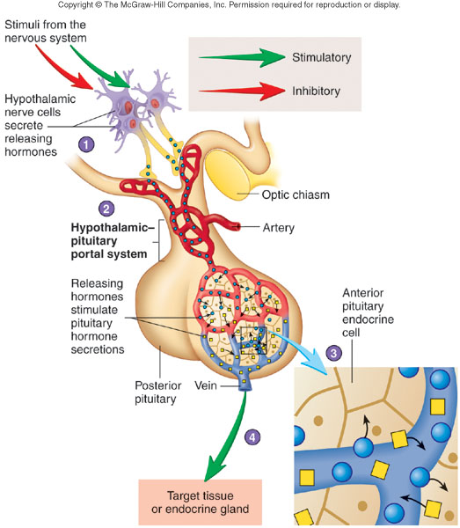
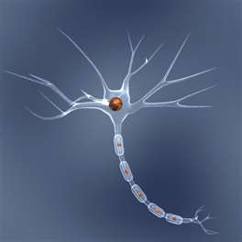
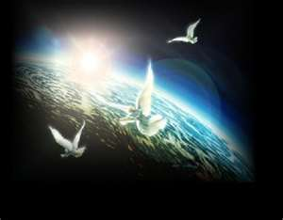
11

Slide 12
The Terms of Our Election.
[Hebrews 7:25 quoted].
By His spotless life, His obedience, His death on the cross of Calvary, Christ interceded for the lost race. And now not as a mere petitioner does the Captain of our salvation intercede for us, but as a conqueror claiming His victory. His offering is complete, and as our intercessor He executes His self-appointed work, holding before God the censer containing His own spotless merits and the prayers, confessions, and thanksgiving of His people. Perfumed with the fragrance of His righteousness, the incense ascends to God as a sweet savor. The offering is wholly acceptable, and pardon covers all transgression. To the true believer Christ is indeed the minister of the sanctuary, officiating for him in the sanctuary, and speaking through God's appointed agencies.
{Bible Commentary Vol. 7 930.17} (Revelation 8:1, 2; 2 Peter 1:10; Revelation 8:3, 4.)
Personal Character of Christ's Intercession.
Christ is watching. He knows all about our burdens, our dangers, and our difficulties; and He fills His mouth with arguments in our behalf. He fits His intercessions to the needs of each soul, as He did in the case of Peter. . . . Our Advocate fills His mouth with arguments to teach His tried, tempted ones to brace against Satan's temptations. He interprets every movement of the enemy He orders events . (Letter 90, 1906). Bible Commentary Vol, 7 931.2}

Slide 13
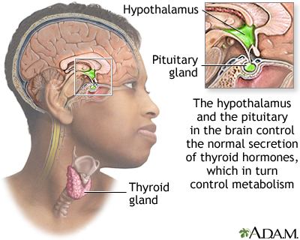
13
13
In the service of the Jewish priesthood we are continually reminded of the sacrifice and intercession of Christ.
All who come to Christ today are to remember that His merit is the incense that mingles with the prayers of those who repent of their sins and receive pardon and mercy and grace.
Our need of Christ's intercession is constant.
Manuscript 14, 1901.
{Bible Commentary Vol. 7 482.5}

Slide 14
Christ a Symbol of our Master Glad
14
Pituitary :Master Glad
Fixing Our Eyes Upon Our Advocate.--In all our acts of true devotion, we fix our eye of faith upon our Advocate, who is standing between man and the eternal throne, waiting to meet our every effort, and by His Spirit assist us to a more perfect knowledge of God (MS 7, 1898). (Bible Commentary Vol . 7 948.8)
V. Perpetual Intercession
The incense, ascending with the prayers of Israel, represents the merits and intercession of Christ, His perfect righteousness, which through faith is imputed to His people, and which can alone make the worship of sinful beings acceptable to God. Before the veil of the most holy place, was an altar of perpetual intercession, before the holy, an altar of continual atonement. By blood and by incense, God was to be approached--symbols pointing to the great Mediator, through whom sinners may approach Jehovah, and through whom alone mercy and salvation can be granted to the repentant, believing soul.
Patriarchs and Prophets, p. 353. {7ABC 482.4}

Slide 15
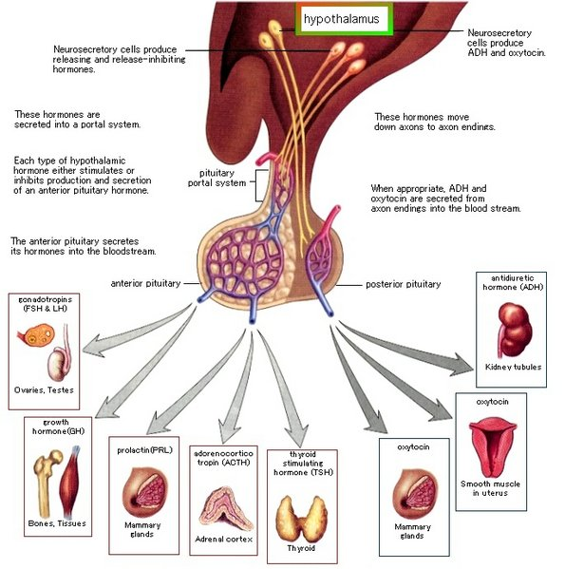
JESUS, MADE AN HIGH PRIEST
15
(Revelation 1:12-18)
Whither the forerunner is for us entered, [even] Jesus, made an high priest for ever after the order of Melchisedec. (Hebrew 6:20)

Slide 16
Christ’s Gifts to the Body for Service
16
The Pituitary the Master Gland, Secretes Nine Major Hormones,
7 from its large front lobe, 2 from its small lobe.
1 Corinthians 12:8-10
For to one is given by the Spirit the word of wisdom; to another the word of knowledge by the same Spirit; To another faith by the same Spirit; to another the gifts of healing by the same Spirit; To another the working of miracles; to another prophecy; to another discerning of spirits; to another [divers] kinds of tongues; to another the interpretation of tongues:
Anterior Pituitary: Produces 7 hormones = Represents the 7 Spirit of Christ sent to
the churches .
(Isaiah 11:1-2) 7 Pillar of the Faith (Revelation 1:20)
And the spirit of the LORD shall rest upon him, the spirit of wisdom and understanding, the spirit of counsel and might, the spirit of knowledge
and of the fear of the LORD;
Posterior Pituitary: Produces 2 hormones = Represents 2 gifts from the Glory of God
sent to seal us.
From Glory to Glory But we all, with open face beholding as in a glass the glory of the Lord, are changed into the same image from glory to glory, [even] as by the Spirit of the Lord. (2 Corinthians 3:18)

Slide 17
(Ephesians 4:13)
Till we all come in the unity of the faith, and of the knowledge of the Son of God, unto a perfect man, unto the measure of the stature of the fullness of Christ:
Anterior Pituitary: Produces 7 hormones= It Represents
the 7 Spirit of Christ sent to the churches
Wisdom hath builded her house, she hath hewn out her seven Pillars
(Proverbs 9:1)
(Isaiah 11:1-2)
(7 Spirit of Christ sent out to seal us with the 7 Pillars of the Faith)
17
The Spirit of Christ
1. The spirit of the LORD
2. The spirit of wisdom
3. The spirit understanding,
4. The spirit of counsel
5. The spirit of might,
6. The spirit of knowledge
7. The spirit of fear of the LORD;
Our Pillar
First Angel Message
Second Angel Message
Sanctuary Message (heavenly temple)
Christ our High Priest
Third Angel Message
The Sabbath truth
Non Immortality of the Soul (State of the dead)
I said, Days should speak, and multitude of years should teach wisdom. But [there is] a spirit in man: and the inspiration of the Almighty giveth them understanding. Great men are not [always] wise: neither do the aged understand judgment. (Job 32:7-9)

Slide 18
(2 Corinthians 3:18)
From Glory to Glory Imputed by the Father through the Holy Ghost be holy unto His Godliness.
Posterior Pituitary: Produces 2 hormones =It Represents
2 gifts from the Glory of God sent to seal us
(The Power of Will to choose/ The Power to be to become son and daughters)
(Romans 8:26-27)
18
Christ keeping the body through:
His Glory= (Righteousness only by His Merit Alone) and
His Grace= (Godliness with the Power of Will) To become; sons and daughters
Imparted by the Son for our Justification; and, be Sanctify through His Sanctification. (Revelation 1:20)
(1 Corinthians 12:3-7,11)
12:3-4 Wherefore I give you to understand, that no man speaking by the Spirit of God calleth Jesus accursed: and [that] no man can say that Jesus is the Lord, but by the Holy Ghost. Now there are diversities of gifts, but the same Spirit.
12:5 And there are differences of administrations, but the same Lord.
12:6-7 And there are diversities of operations, but it is the same God which worketh all in all. But the manifestation of the Spirit is given to every man to profit withal.
12:11 But all these worketh that one and the selfsame Spirit, dividing to every man severally
as he will..

Slide 19
Christ Mediation Service
19
(1 Corinthians 12:12-27)
4 Tropic Hormones: The word tropic comes from a Greek word meaning “turning” and refers to the ability of tropic hormones to turn on or stimulate other endocrine glands.
They Represent Divine Power in the Plan of Salvation for us All.
Wisdom (Proverb 9:1)
Righteousness (Proverb 12:28)
Sanctification (John 17:17)
Redemption (Ephesians 1:7)
Two hormone are Gonadotropins
(1Timothy 2:5) For [there is] one God, and one mediator between God and men, the man Christ Jesus;
(Galatians 3:19) wherefore then [serveth] the law? It was added because of transgressions, till the seed should come to whom the promise was made; [and it was] ordained by angels in the hand of a mediator.

Slide 20
The Hypothalamus in our Body the works of the Holy Spirit!
The Holy Spirit is the breath of spiritual life in the soul. The impartation of the Spirit is the impartation of the life of Christ. It imbues the receiver with the attributes of Christ. Only those who are thus taught of God, those who possess the inward working of the Spirit, and in whose life the Christ-life is manifested, are to stand as representative men, to minister in behalf of the church.
"Whosesoever sins ye remit," said Christ, "they are remitted; . . . and whosesoever sins ye retain, they are retained." Christ here gives no liberty for any man to pass judgment upon others. In the Sermon on the Mount He forbade this. It is the prerogative of God. But on the church in its organized capacity He places a responsibility for the individual members. Toward those who fall into sin, the church has a duty, to warn, to instruct, and if possible to restore. "Reprove, rebuke, exhort," the Lord says, "with all long-suffering and doctrine."
2 Timothy 4:2. Deal faithfully with wrongdoing. Warn every soul that is in danger. Leave none to deceive themselves. Call sin by its right name. Declare what God has said in regard to lying, Sabbathbreaking, stealing, idolatry, and every other evil. "They which do such things shall not inherit the kingdom of God." Galatians 5:21. If they persist in sin, the judgment you have declared from God's word is pronounced upon them in heaven. In choosing to sin, they disown Christ; the church must show that she does not sanction their deeds, or she herself dishonors her Lord. She must say about sin what God says about it. She must deal with it as God directs, and her action is ratified in heaven. He who despises the authority of the church despises the authority of Christ Himself.

Slide 21
But there is a brighter side to the picture. "Whosesoever sins ye remit, they are remitted. " Let this thought be kept uppermost. In labor for the erring, let every eye be directed to Christ. Let the shepherds have a tender care for the flock of the Lord's pasture. Let them speak to the erring of the forgiving mercy of the Saviour. Let them encourage the sinner to repent, and believe in Him who can pardon. Let them declare, on the authority of God's word, "If we confess our sins, He is faithful and just to forgive us our sins, and to cleanse us from all unrighteousness." 1 John 1:9. All who repent have the assurance, "He will have compassion upon us; He will subdue our iniquities; and Thou wilt cast all their sins into the depths of the sea. Micah 7:19.
Let the repentance of the sinner be accepted by the church with grateful hearts. Let the repenting one be led out from the darkness of unbelief into the light of faith and righteousness. Let his trembling hand be placed in the loving hand of Jesus. Such a remission is ratified in heaven.
Only in this sense has the church power to absolve the sinner. Remission of sins can be obtained only through the merits of Christ. To no man, to no body of men, is given power to free the soul from guilt. Christ charged His disciples to preach the remission of sins in His name among all nations; but they themselves were not empowered to remove one stain of sin. The name of Jesus is the only "name under heaven given among men, whereby we must be saved." Acts 4:12.
{Desire of Ages pages 805- 806}

Slide 22
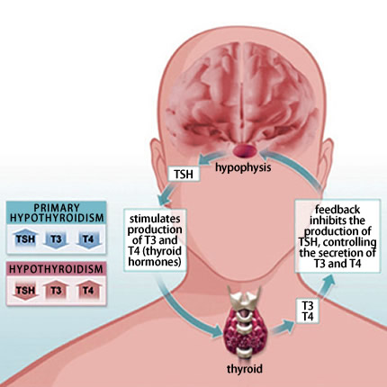
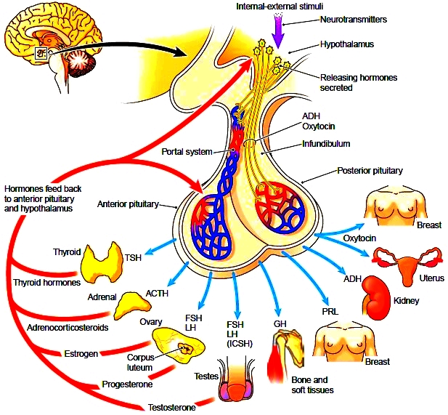
22

Slide 23
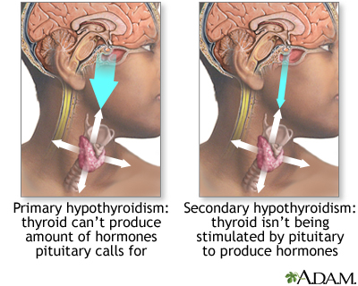
23

Slide 24
Next Week:
We will continue with part 2 of our lesson!
The Endocrine System
Operates and Functions like
(The Tribe of Asher)
The Veil to the Most Holy
The Body of Christ
“I Am The Door”
(John 10:7)
His Life is the way to Holiness

