Slide 1
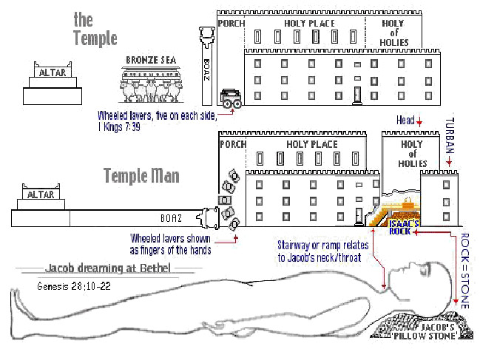
The Sanctuary of our Body
THE THIRD TEMPLE
Series 2
The Endocrine System Part 2
By : sister rose

Slide 2
We will continue with part 2 of our lesson!
The Endocrine System
Operates and Functions like
(The Tribe of Asher)
The Veil to the Most Holy
The Body of Christ
“I Am The Door”
(John 10:7)
His Life is the way to Holiness

Slide 3
3
Christ sets before such an open door and no man can shut it.
The Veil His flesh, is the only way to the Heavenly Father.
(Revelation 3:8) (Mark 15:38)
(Luke 23:45) ( John 10:7) (Hebrew 9:3; 10:20)
For the LORD is our judge,
The LORD is our Lawgiver,
The LORD is our King, he will save us.
(Isaiah 33:22)
(Romans 2:16) (James 4:12) (Psalms 89:18)

Slide 4
The Sanctuary
Margins …..Within the second vail was placed the ark of the testimony, and the beautiful and rich curtain was drawn before the sacred ark. This curtain did not reach to the top of the building. The glory of God, which was above the mercy-seat, could be seen from both apartments, but in a much less degree from the first apartment. Directly before the ark, but separated by the curtain, was the golden altar of incense. The fire upon this altar was kindled by the Lord himself, and was sacredly cherished by feeding it with holy incense, which filled the sanctuary with its fragrant cloud, day and night. Its fragrance extended for miles around the tabernacle. When the priest offered the incense before the Lord, he looked to the mercy-seat. Although he could not see it, he knew it was there; and as the incense arose like a cloud, the glory of the Lord descended upon the mercy-seat, and filled the most holy place, and was visible in the holy place; and the glory often so filled both apartments that the priest was unable to officiate, and was obliged to stand at the door of the tabernacle. The priest in the holy place, directing his prayer by faith to the mercy-seat, which he could not see, represents the people of God directing their prayers to Christ before the mercy-seat in the heavenly sanctuary. They cannot behold their Mediator with the natural eye, but with the eye of faith they see Christ before the mercy-seat, and direct their prayers to him, and with assurance claim the benefits of his mediation.
{The Spirit of Prophecy Volume One -1SP 273.3}

Slide 5
An Opened Door No Man Can Shut!
5
I saw the commandments of God and shut door could not be separated.
I saw the time for the commandments of God to shine out to
His people was when the door was opening in the inner apartment of
the heavenly sanctuary in 1844.
Then Jesus rose up and shut the door in the outer apartment and opened the door in the inner apartment and passed into the Most Holy Place, and the faith of Israel now reaches within the second veil where Jesus now stands by the ark.
I saw that Jesus had opened the door in the Most Holy Place and no man can shut it; and that since Jesus had opened the door in the Most Holy Place the commandments have been shining out and God has been testing His people on the holy Sabbath.
(Manuscript Releases --Letter 5, 1849, pp. 1-3.)

Slide 6
Christ changed his ministration from the holy to
the most holy place.
When, in the ministration of the earthly sanctuary, the high priest on the day of atonement entered the most holy place, the door of the holy place was closed, and the door of the most holy was opened. So, when Christ passed from the holy to the most holy of the heavenly sanctuary, the door, or ministration, of the former apartment was closed, and the door, or ministration, of the latter was opened.
Christ had ended one part of his work as our intercessor, to enter upon another portion of the work; and he still presented his blood before the Father in behalf of sinners. "Behold," he declares, "I have set before thee an open door, and no man can shut it.“
{4SP- The Spirit of Prophecy Volume 4. 268.3}
I know thy works: behold, I have set before thee an open door, and no man can shut it: for thou hast a little strength, and hast kept my word, and hast not denied my name.
(Revelation 3:7-8) (Exodus 26:30-33) (Exodus 36:36)
6

Slide 7
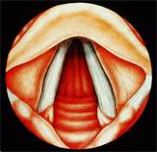
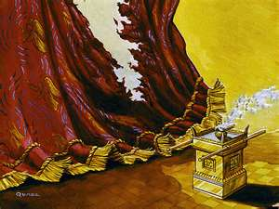
The Veil to the Most Holy The Life of Christ the way to Holiness
Larynx is also known as voice box or Adam’s apple and is formed of 9 cartilage. It extends from the epiglottis to the cricoids cartilage out of which 4 are important. If larynx stops functioning we will be dead in no time.
And so it is written, The first man Adam was made a living soul; the last Adam [was made] a quickening spirit.(1 Corinthians 15:45)
I am the way, the truth, and the life: no man cometh unto the Father, but by me. (John 14:6)
Type of Christ Flesh
(Galatians 2:20)
Alta of Incense

Slide 8
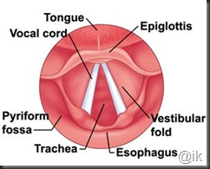
And thou shalt hang up the veil under the taches, that thou mayest bring in thither within the veil the ark of the testimony: and the veil shall divide unto you between the holy [place] and the most holy.
(Exodus 26:30-33)
8
Movement of the vocal
cords folds
The space between the two
folds of tissue is glottis.

Slide 9
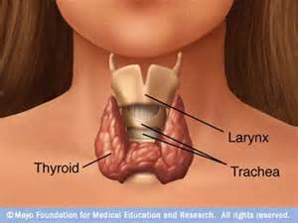
The Larynx = the Altar of Incense
The Larynx = the Altar of Incense
(Exodus 37:25-29)
25. And he made the incense altar [of] shittim wood: the length of it [was] a cubit, and the breadth of it a cubit; [it was] foursquare; and two cubits [was] the height of it; the horns thereof were of the same.
26. And he overlaid it with pure gold, [both] the top of it, and the sides thereof round about, and the horns of it: also he made unto it a crown of gold round about.
27. And he made two rings of gold for it under the crown thereof, by the two corners of it, upon the two sides thereof, to be places for the staves to bear it withal.
28. And he made the staves [of] shittim wood, and overlaid them with gold.
29. And he made the holy anointing oil, and the pure incense of sweet spices, according to the work of the apothecary.
(Revelation 8:4) (Proverbs 18:10)
(Romans 8:26, 27)
The Larynx:
(known as Adam’s apple)
Christ the Second Adam before the Altar of Prayer adding His merit with our prayers to reach to heaven

Slide 10
The Altar of Incense
10
Within the first apartment the high priest offered incense upon the golden altar, and trimmed and lighted the lamps.
None but the high priest could perform this sacred work, which typified the adding of the fragrant incense of Christ's righteousness to the prayers of God's people, to render them acceptable before God
{1914 SNH, The Cross and Its Shadow 182.1}
Our prayers, made fragrant by the righteousness of Christ our Saviour,
are presented by the Holy Spirit before the Father.
{1914 SNH, CIS 61.2}
h
k
k
Angels offer the smoke of the fragrant incense for the praying saints.
Then in every family let prayer ascend to heaven
(ML- My Life Today 29.2)
g

Slide 11
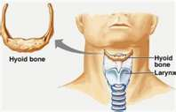
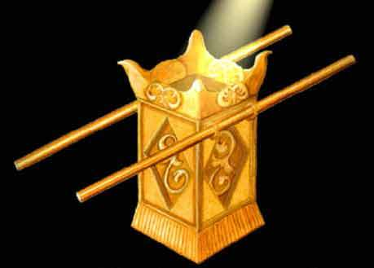
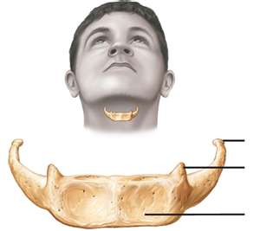
The Greater Horn of Hyoid
11
Hyoid Bones
Leviticus 16:13
Christ Righteousness
Mingle with our Prayers
Windpipe with an
“up escalator”
Psalms 141:2, Exodus 30:6-8
Exodus 30:1-3; 40:26, Revelation 8:3-4

Slide 12
The Single Bone resting above the Larynx Known as
The Greater Horn stand as our Hyoid Bone
What could more fitly represent the real incense,
Christ's righteousness
Which He adds to the prayers of His people from the golden altar before the Father's throne in heaven? The earthly priests served "unto the example and shadow of heavenly things." Those who believe this may know that every morning there is an abundant supply of Christ's righteousness offered, and as they pour out their soul before God, their prayers will not ascend alone; for the great High Priest will add "much incense" with them, and the Father, looking upon the righteousness of His Son, will accept the feeble petitions of His child. All day and all night the incense ascended; it represented a never failing supply, and testified that whenever a sinner cries out for help there is righteousness for him. Margin
{1905 SNH, The Story of the Seer of Patmos 364.3
Upon this altar the priest was to burn incense every morning and evening;
its horns were touched with the blood of the sin offering, and it was sprinkled with blood upon the great Day of Atonement.
The fire upon this altar was kindled by God Himself and was sacredly cherished.
Day and night the holy incense diffused its fragrance throughout the sacred apartments, and without, far around the tabernacle.
{Patriarchs and Prophets 348.1 } (Proverbs 18:10; Romans 8:26,27)

Slide 13
The Greater Horn of Hyoid
The four horns on the altar
(Exodus 30:10)
And Aaron (Type) shall make an atonement upon the horns of it once in a year with the blood of the sin offering of atonements: once in the year shall he make atonement upon it throughout your generations: it [is] most holy unto the LORD.
(The Great High Priest; Jesus our Anti-type)
blameless able to secure our prayers before the Father
(Hebrew 4:14-16)
(The axial skeleton is the hyoid bone, a name that means “U-shaped” Ligaments in the neck support the hyoid, and the tongue attaches to it.)
The Hyoid is the only bone in the body that does not form
a joint with other bones.
(He Is the Word and The embodiment of the Law)
Ligaments are bundles, or strips, of dense connective tissue that usually hold bones to bones but in this case are supportive structures.
Within the second veil was placed the ark of the testimony, and the beautiful and rich curtain was drawn before the sacred ark.
13

Slide 14
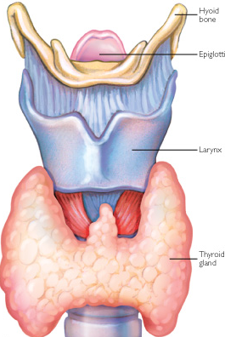
Lets Take a Closer Look at the Altar!
14

Slide 15
Revelation 8:4
And the smoke of the incense, [which came] with the prayers of the saints, ascended up before God out of the angel's hand.
The religious services, the prayers, the praise, the penitent confession of sin ascend from true believers as incense to the heavenly sanctuary; but passing through the corrupt channels of humanity, they are so defiled that unless purified by blood, they can never be of value with God. They ascend not in spotless purity, and unless the Intercessor who is at God's right hand presents and purifies all by His righteousness, it is not acceptable to God. All incense from earthly tabernacles must be moist with the cleansing drops of the blood of Christ. He holds before the Father the censer of His own merits, in which there is no taint of earthly corruption. He gathers into this censer the prayers, the praise, and the confessions of His people, and with these He puts His own spotless righteousness. Then, perfumed with the merits of Christ's propitiation, the incense comes up before God wholly and entirely acceptable.
Then gracious answers are returned.
O, that all may see that everything in obedience, in penitence, in praise and thanksgiving must be placed upon the glowing fire of the righteousness of Christ. The fragrance of this righteousness ascends like a cloud around the mercy seat
{Bible Commentary Vol.6 10781-2} (Exodus 30:1-10, 23-24, 34-38)
g
15

Slide 16
ENDOCRINE SYSTEM HORMONE FUNCTIONS
To maintain homeostasis and communicate and integrate the body’s hormonal needs, the endocrine system is closely linked with the central nervous system.
This communication and cooperation allows for complete function of the endocrine system and prevents overload of hormonal secretions. Electrochemical impulses are sent through neurons to indicate fluctuations of hormones, which entices the endocrine system to respond in short but intense rapid responses.
The endocrine system does have however, its own response system to help the appropriate amounts of hormones reach their intended destination.
This means that the endocrine system releases chemical regulators which travel throughout the body in search of the appropriate destination. These chemical regulators are able to respond with longer lasting hormonal adjustments in the areas that may require additional hormones.
In the body’s communication system, neurologically based communications are very fast, measurable in milliseconds. The endocrine system’s communication system takes much longer, even as long as several days before being able to effectively communicate the body’s needs for chemical adjustments. The hormonal response typically lasts for days, weeks, or months. The endocrine system and the central nervous system stay in constant communication in order to maintain the body’s proper chemical functions. http://www.medicalook.com/human_anatomy/systems/Endocrine_system.html
16

Slide 17
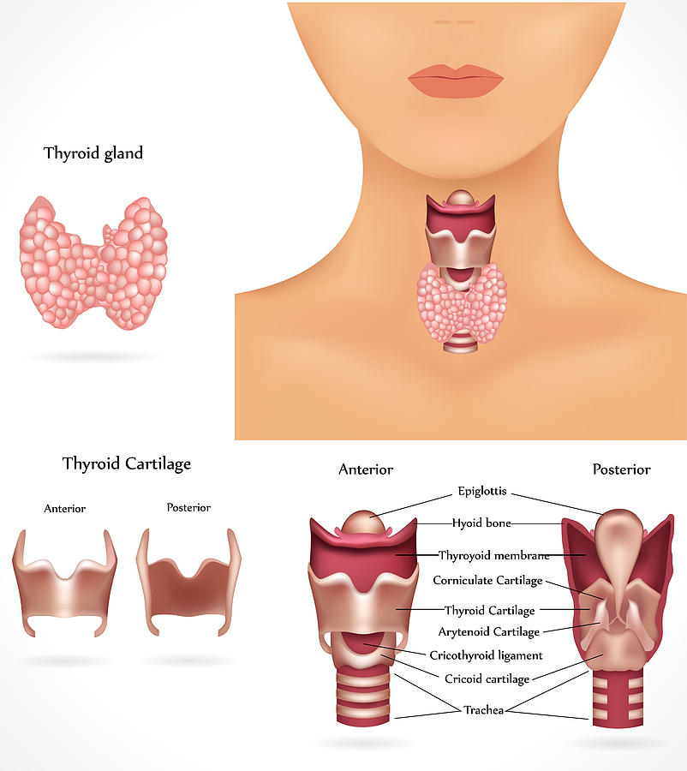
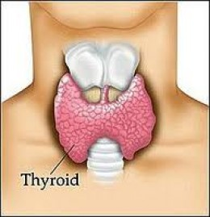
Thyroid hormones
Regulate metabolism, therefore body temperature and weight.
The thyroid hormones contain iodine, which the thyroid needs in order to manufacture these hormones. If a person lacks iodine in his/her diet, the thyroid cannot make the hormones, causing a deficiency.
In response to the body’s feedback loops calling for more thyroid hormones, the thyroid gland then enlarges to attempt to compensate (The body’s plan here is if it’s bigger it can make more, but that doesn’t help if there isn’t enough iodine.)
This disorder is called goiter.
( Dietary sources of iodine include and seaweeds like kelp)
4 or 5 inches of garden hose
attached to its bottom end.
Exodus 26:8-9
Your trachea
is reinforced with rings
of cartilage

Slide 18
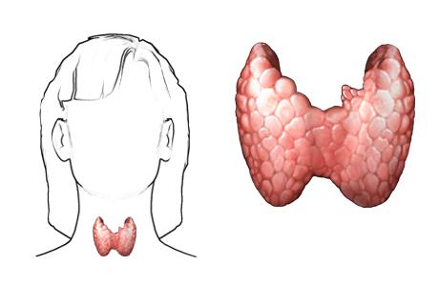
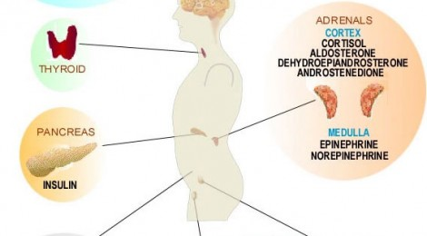
HORMONES
The cranial cavity contains three endocrine glands, located in close proximity to the brain’s structured ability to demand the release or the decline and prohibition of hormones. Hormone production in the endocrine system can be over ridden by the brain’s ability to release or restrict hormones. Likewise, the endocrine system has the ability to over rid the brain’s release or denial of hormone production.
This is a simple but effective form of the body’s system of checks and balances in achieving appropriate hormonal activity. Without this ability, the brain and the endocrine system could easily produce the same hormones for the same location and the body would be overloaded with hormone production. Like wise, a hormonal excretion dysfunction of either system could lead the significant and detrimental denial of basic hormones for one particular body function.
18
"shield”
Psalms 91: 1-4, 11

Slide 19
Thyroid Gland: the thyroid gets its name from the Greek word for
"shield”, due to the shape of the related thyroid cartilage. The thyroid gland controls how quickly the body uses energy, makes proteins and controls how sensitive the body is to other hormones. (Palms104:4) (Hebrew 1:7) (Genesis 15:1)
Who maketh his angels spirits; his ministers a flaming fire:
(Deuteronomy 33:29)(2 Samuel 22:3, 36) (Luke 22:43-44)
Hormonal output from the thyroid is regulated by TSH and TRH (Hebrew 1:14)
TSH =Thyroid Stimulating Hormones produced by the Anterior Pituitary,
which itself is regulated by Christ Jesus (Salvation by His Glory).
TRH =Thyrotropin-releasing hormone produced by the Hypothalamus.
which itself is regulated by Christ Jesus (Righteousness by His Grace).
The Grace Of God takes men as they are, and works as an educator, using every principle on which an all-sided education depends. The steady influence of the
Grace of God trains the soul after Christ's methods, and every fierce passion, every defective trait of character, is worked upon the molding influence of the Spirit of Christ,
until the man has a new motive power, and becomes filled with the
Holy Spirit of God, after the likeness of the divine similitude.
The Holy Spirit is the source of all power, and works as a living, active agent in the new life created in the soul. The Holy Spirit is to be in us a divine indweller.
{Healthful Living 300.5, 301.1}
19

Slide 20
Jesus conveys the circulating vitality of a pure and sanctified Christ-like love through every part of our human nature. When this love is expressed in the character, it reveals to all those with whom we associate that it is possible for God to be formed within,
the hope of glory.
To whom God would make known what [is] the riches of the glory of this mystery among the Gentiles; which is Christ in you, the hope of glory: (Colossians 1:27)
Christ is to live in his human agents, and work through their faculties, and act through their capabilities. Their will must be submitted to his will, they must act with his Spirit, that it may be no more they that live, but Christ that liveth in them.
It is not you that work the Holy Spirit, but the Holy Spirit must work you. There is a winning, compelling power in the gospel of Jesus Christ. It is the Holy Spirit that makes the truth impressive.
To those who truly love God the Holy Spirit will reveal truths that have faded from the mind, and will also reveal truths that are entirely new.
Each one must fight his own battle against self. Heed the teachings of the Holy Spirit. If this is done, they will be repeated again and again, until the impressions are, as it were, "lead in the rock forever.”
As we give ourselves wholly to Christ, our countenances will reflect his image. They will be purified, sanctified, and ennobled by his grace.
{HL- Healthful Living 301.1-3; 302.2-4}
20

Slide 21
21
Parathyroid Glands: are small endocrine glands in the neck that produce
parathyroid hormone. (Revelation 8:4)
Humans usually have four parathyroid glands, (Revelation 8:3)
which are usually located on the rear surface of the thyroid gland or, in rare cases, within the thyroid gland itself or in the chest. Parathyroid glands control the amount of calcium in the blood and within the bones.
They are four or more small glands, about the size of a grain of rice, located on the posterior surface (back side) of the thyroid gland.
The parathyroid glands are named for their proximity to the thyroid but serve a completely different role than the thyroid gland.
The parathyroid glands are quite easily recognizable from the thyroid as they have densely packed cells, in contrast with the follicle structure of the thyroid.
(ACTH) Hormone= Adrenocorti-Cotropic Hormone stimulates the adrenal glands to produce certain steroid hormones.
(Guardian Angels Hebrew 8:1-2) located on top of the kidneys.
ACTH: After Christ Crucifixion Through Holiness
(Philippians 3:9) (Hebrew 9:14-15, 24)
These angels aids the cells and stimulates Growth is secreted by the Anterior Pituitary Gland. This Hormone, as its name implies, stimulates the Adrenal Cortex.

Slide 22
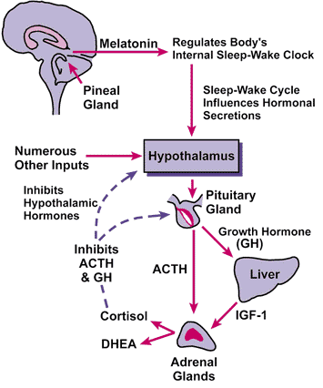
The juices of the vine, ascending from the root, are diffused to the branches, sustaining growth and producing blossoms and fruit. So the life-giving power of the Holy Spirit, proceeding from Christ, and imparted to every disciple, pervades the soul, renews the motives and affections and even the most secret thoughts, and brings forth the precious fruit of holy deeds.—
Sketches from the Life of Paul, p. 131.
{Healthful Living 300.3}
22

Slide 23
23
The Two Main Type Of Corticosteroids
(Revelation 5:8) (Exodus 30:34)
produced by the adrenal cortex are:
Mineralorticoids: (MN-er-al-oh-KOR-tih-koidz) are a class of steroid hormones characterized by their similarity to aldosterone and their influence on salt and water balances and electrolytes in the body secreted by the adrenal cortex.
Glucocorticoids: (GLOO-ko-KOR-tih-koidz)are used to stop the inflammation process. The inflammatory process has evolved in the body for a useful purpose; namely as a defensive reaction to the damage or injury to tissue. By a series of reactions, inflammation is designed to isolate whatever is causing the irritation, help eradicate the presumed invader, and help repair the surrounding damaged tissue.
Adrenal Medulla (muh-DuLL-uh)
Perfume principles of morality
(medulla Latin word meaning “marrow “or “middle”).
The whole plan of salvation is provided to accomplish the restoration of the moral image of God in man. The Adrenal Medulla is the inner reddish portion of the gland and is surrounded by the cortex.

Slide 24
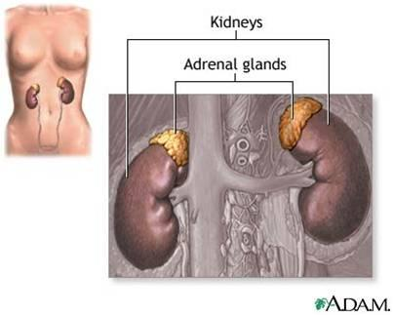
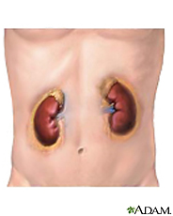
The Adrenal Glands
24
These sit on top of the kidneys.
They consist of
two parts, the outer cortex
and the inner medulla.
Kidney: Cleanser of the Blood:
(Ad meaning “near”) the kidneys(renal meaning “Kidney” (Hebrew 9:22-23)(1Timothy 2:5)
The Adrenal Glands
The medulla secretes epinephrine (Adrenaline) and other similar hormones in response to stressors such as fright, anger, caffeine, or low blood sugar.
The cortex secretes corticosteroids such as cortisone.(suppress immune system help to fight). The Adrenal = Two Glands Outer Cortex and Inner Medulla are named for their position in the body: Above
Adrenal Cortex= Oil (cortex Latin word meaning “rind or bark”
it regulate production of glucose from noncarbohydrates such as fats and proteins.)

Slide 25
There are gifts that we rightly proportion to the character and necessities of the ones upon whom we bestow them. Not many of the poor would appreciate Mary's offering, or our Lord's sacrifice of Himself, which gift was the highest that could be given. That ointment was a symbol of the overflowing heart of the giver. It was an outward demonstration of a love fed by heavenly streams until it overflowed. And that ointment of Mary, which the disciples called waste, is repeating itself a thousand times in the susceptible hearts of others. {Bible Commentary Vol. 5 1101.2}
This gland is often used to refer to the outer covering of a tissue, organ, or gland.
A group of hormones which assist in maintenance of the following:
Salt: Represents the Saints who reflects the Light of the Word in Christ Jesus (Colossians 4:6; Mark 9:50) (Mark 9:49-50)
for every one shall be salted with fire, and every sacrifice shall be salted with salt. Salt [is] good: but if the salt have lost his saltness, wherewith will ye season it? Have salt in yourselves, and have peace one with another.
(Leviticus 2:13) it removes and prevents corruption.
Water: Represent The Word of Life the Santification throught the Truth
(John 17:17) (Ephesians 5:26) (John 19:34)
(1 Corinthians 6:11) (Psalm 114:8) (Isaiah 32:2) (2 Peter 3:5)
25

Slide 26
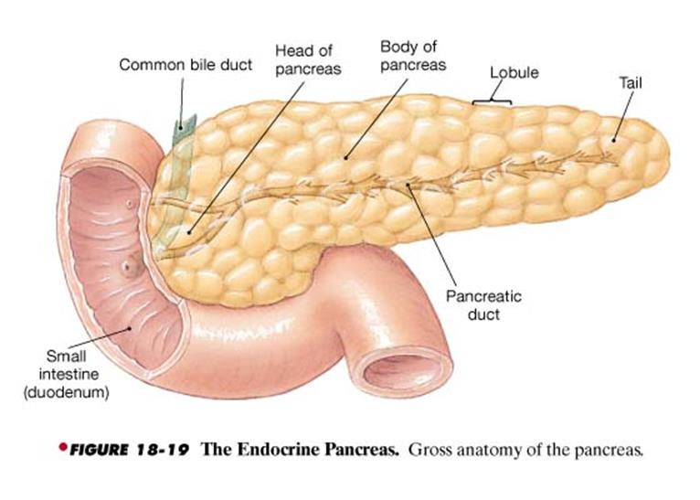
The Pancreas
The pancreas is a long, flat gland, six inches long, one inch thick, and weighs from four to six ounces: situated across the abdomen, behind the stomach, opposite the first and second lumbar vertebrae. Its greater end or head is toward the right, surrounded by the curve of the duodenum; the lesser end extends to the left as far as the spleen. The duct through which the pancreas pours its juice into the duodenum, enters the duodenum about four inches below the pyloric orifice of the stomach. The pancreas, in structure and in the character of its secretion, very closely resembles the salivary glands.
The office of the pancreas: To secrete and pour into the second stomach the pancreatic fluid, which is employed in perfecting the process of chymification in the small intestine.
{1868 JNL Loughborough, John N. , HBH-Hand Book of Health 170.7-8}
26
The saliva acts upon the food in the mouth, if it has an opportunity, and then in the stomach. The gastric juice acts upon the food while it is in the stomach; the bile from the liver next does its work; then the fluid from the pancreas; and lastly the intestinal juices. All kinds of food can be digested in the intestines. Cane sugar can be digested here only.
{ Periodicals - February 8, 1895 N/A, General Conference Bulleting 74.2}
h
secreting digestive
enzymes into
the small intestine.

Slide 27
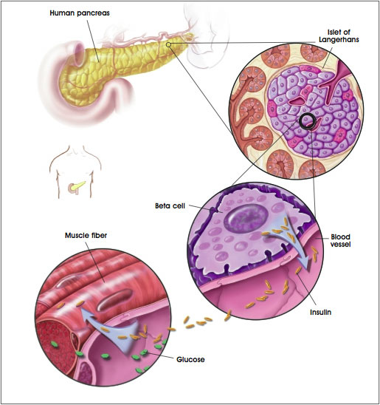
27

Slide 28
The Pancreas Organ has two functions
The Endocrine Function and The Exocrine Function
28
Insulin (Help release sugar from the Blood)
In to the
Bloodstream
To cells
Enzymes (Digest Fats and Proteins)
In to the
Duodenum
for digestion
It serves as a ducted gland, The pancreas also serves as a ductless gland in that the islets of Langerhans secrete insulin and glucagon to regulate the blood sugar level.
(Sugar is poison it paralyze our body’s defense through the white blood cell to fight )
The -islet cells secrete glucagon, which tells the liver to take carbohydrate out of storage to raise a low blood sugar level. The -islet cells secrete insulin to tell the liver to take excess glucose out of circulation to lower a blood sugar level that’s too high. If a person’s body does not make enough insulin (and/or there is a reduced response of the target cells in the liver), the blood sugar rises, perhaps out of control, and we say that the person has diabetes mellitus.
(Enzymes and bile help digest food before it passes into the second part of the small intestine the jejunum)
(Isaiah 8:13-14, 20)
Sanctify the LORD of hosts himself; and [let] him [be] your fear, and [let] him [be] your dread.
And he shall be for a sanctuary; but for a stone of stumbling and for a rock of offence to both the houses of Israel, for a gin and for a snare to the inhabitants of Jerusalem.
To the law and to the testimony: if they speak not according to this word,
[it is] because [there is] no light in them.

Slide 29
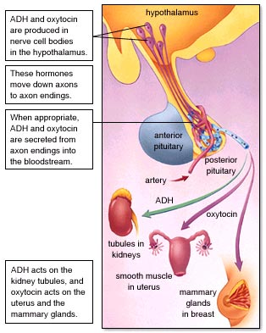
Christ is our advocate, pleading in our behalf. The Spirit pleads within us. Then let us show perfect trust in our Leader, and not inquire of false guides.
{HL-Healthful Living 300.4}

Slide 30
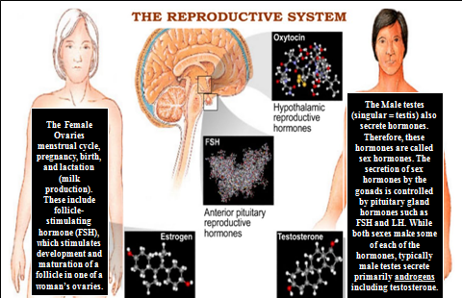
The Reproductive System
30
The Male testes
(singular = testis) also secrete hormones. Therefore, these hormones are called sex hormones.
The secretion these hormones by the gonads is controlled by pituitary gland hormones such as FSH and LH. While both make some of each of the hormones, typically male testes secrete primarily androgens including testosterone
The Female Ovaries menstrual cycle, pregnancy, birth, and lactation
(milk production).
These include follicle-stimulating hormone (FSH), which stimulates development and maturation of a follicle in one of a woman’s ovaries.
The male and female reproductive system work together to produce offspring.
The Female system also includes organs for sustaining the growth of embryos and fetuses

Slide 31
31
The Gonads are the Male and Female Reproduction organs,
the testes and ovaries.
The Gonadotropins are hormones that affect these organs which are considered endocrine glands because they secrete hormones.
The Two Gonadotropins are follicle-stimulating hormone:
(FSH) and Follicle-stimulating hormone = The Godhead the Life Givers
The Powers of The Father, The Son, and of the Holy Spirit. (Genesis 1:26)
In females, FSH targets the ovaries and triggers the maturation of the egg each month. In addition, it stimulates cells in the ovaries to secrete female sex hormones called estrogens.
In men FSH targets the testes and triggers the production of sperm.
(LH) and Luteinizing hormone = The Comforter and Spirit of Truth
Led by the Holy Spirit (John 14:17, 26) (John 15:26; 16:7-14)
The Control of the Passion (Vice)
Impure thoughts lead to impure actions. . . . Some . . . are in danger of paralysis of the brain. Already the moral and intellectual powers are weakened and benumbed.
Many sink into an early grave, while others have a sufficient force of constitution to pass this ordeal. . . . Nature will make them pay the penalty for the transgression of her laws . . .
by numerous pains in the system, . . . neuralgia, . . . affection of the spine.
{Healthful Living 203.1-2}

Slide 32
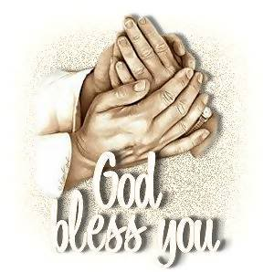
Next Week:
The Sanctuary of our Body
The Third Temple
Series #3
The Skeleton System
Operates and Functions like
(The Tribe of Issachar)
“Strong as Donkey”

