Slide 1
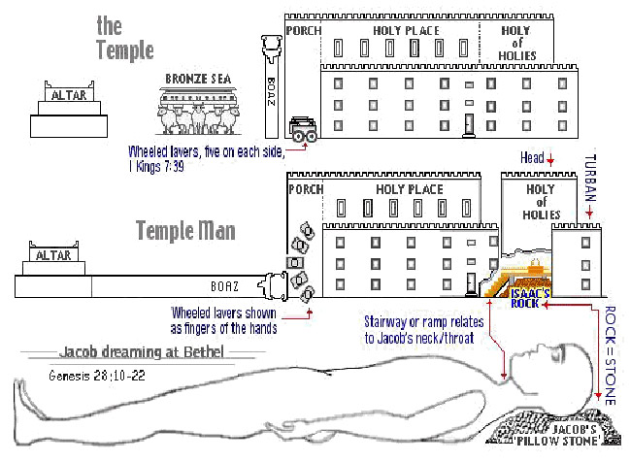
The Sanctuary of our Body
THE THIRD TEMPLE
Series 9
The Digestive System
By : sister rose

Slide 2
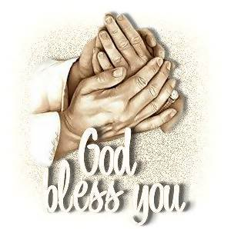
The Digestive System
Operates and Functions like
(The Tribe of Benjamin)
“Ravin as a Wolf ”
Genesis 49:27
Benjamin shall ravin [as] a wolf:
in the morning he shall devour the prey,
and at night he shall divide the spoil.

Slide 3
Deuteronomy 33:12
[And] of Benjamin he said,
the beloved of the LORD shall dwell in safety by him; [and the LORD] shall cover him all the day long, and he shall dwell between his shoulders.

Slide 4
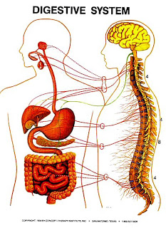
The Digestive System
THE DIGESTIVE SYSTEM DEFINITION
The digestive system removes and processes nutrients (vitamins, minerals, carbohydrates, fats, proteins, and water) from foods and helps pass waste material out of the body. The digestive system is made up of the esophagus, stomach, and the small and large intestines. The first 6 feet of the large intestine are called the large bowel or colon. The last 6 inches are the rectum and the anal canal. The anal canal ends at the anus (the opening of the large intestine to the outside of the body).
http://cancer.osu.edu/patientsandvisitors/cancerinfo/cancertypes/gi/about/colon/pages/index.aspx

Slide 5
The Ministry of Jesus as Our High Priest began with His
Crucifixion Christ Presented Himself in Heaven
Office and Work of The High Priest (Hebrew 9:14,26)
It was impossible for one man to perform all the work of the sanctuary that typified the work of Christ, and for that reason there was a company of common priests to assist the high priest. It is always a rule that a higher official can fill the offices below him. The high priest offered burnt-offerings in the court and sin-offerings in the first apartment. Paul speaks of the high priest offering the sin-offerings where the blood was taken into the sanctuary. 17 In the sin-offerings for the priests and the congregation the blood was taken within the sanctuary. Leviticus 4:3-7,13-18. (Great Controversy 420.2)
{1914 SNH, CIS- The Cross and Its Shadow 77.1 margin..}
Upon the sixteenth day, or as the Bible states it, "On the morrow after the Sabbath," the first-fruits were waved before the Lord. Margin….
Leviticus 23:5-11 {1914 SNH, The Cross and Its Shadow 108.3}
It was a beautiful service. The priest clad in his sacred robes, with a handful of yellow heads of ripened grain, entered the temple. The glow of burnished gold from walls and furniture blended with the tints of the golden heads of grain.
The priest paused in front of the golden altar, (The Larynx Altar of Incense
Exodus 40:26) and waved the grain before the Lord. Those first heads kept a pledge of the bountiful harvest to be gathered, and the waving indicated thanksgiving and praise to the Lord of the harvest.
{1914 SNH, CIS- The Cross and Its Shadow 109.1}
5

Slide 6
It is a sad fact that even the disciples who loved their Lord were so blinded
that they could not recognize the fact that the time had come for the appearance of the great Antitype of the service they had yearly celebrated all their lives; and even when they listened to the announcement of His resurrection, it seemed to them as an idle tale, and they believed it not. (Luke 24:10,11)
But God never lacks for agents. When living human beings are dumb, He awakens sleeping saints to perform his appointed work. In the type the grain was waved in the temple, and to fulfil the antitype Christ must present Himself and the company who had risen with Him before God in the first apartment of the heavenly temple. {1914 SNH, CIS The Cross and Its Shadow 110.2}
Paul tells us that when Christ ascended up on high, "He led a multitude of captives." Ephesians 4:8, margin. In speaking of them in (Rom. 8:29,30), he tells how this company of resurrected saints, who came forth from their graves with Christ, were chosen.
They were "predestinated," then called, "and whom He called, them He also justified: and whom He justified, them He glorified". This was done that "He might be the first-born among many brethren.“ This company was composed of individuals chosen from every age, from that of Adam down to the time of Christ. They were no longer subject to death, but ascended with Christ as trophies of His power to awaken all that sleep in their graves. As the handful of grain in the typical service was a pledge of the coming harvest, so these saints were a pledge of the innumerable company that Christ will awaken from the dust of the earth when He comes the second time as King of kings and Lord of lords. John 5:28,29
{1914 SNH, CIS The Cross and Its Shadow 111.2}
6

Slide 7
The Teeth, The Molar and Their Wisdom
7
The Teeth is Composed
Of a firm crust, called enamel;
the tooth bone proper, called the ivory, and a cortical substance, called cementum.
The enamel covers the exposed surface of
the crown, and the cementum forms a thin
coating over the root of the tooth.
(Revelation 11:16)
And the four and twenty elders, which sat before God on their seats, fell upon their faces, and worshipped God,
1 Chronicles. 24:1-19, 31.
Priests were divided into
twenty-four courses,
with a chief over each course.
James 1:5-7 The Wisdom of Christ
Plan of Justification and
Sanctification In to Holiness
(The 8 Ceremonial Ordinance)
Various Offerings See
(Series 4 Slide #6)
We have Three different kinds of teeth
four cutters, or front teeth, in each jaw; two pointers, or eye teeth, in each jaw; and ten grinders, or back, double teeth, in each jaw;
half on each side of the face. The most important use of the teeth:
Their leading and most important use is to cut and chew, or grind the food so finely that it may be mixed with the saliva, or the moisture of the mouth, before passing into the stomach. {1868 John Norton Loughborough , Hand Book Health 32.5-33.1}
These processes are a Symbol of the work performed with the Sacrifices offered in the Courtyard (Type- Meets- Anti-type)

Slide 8
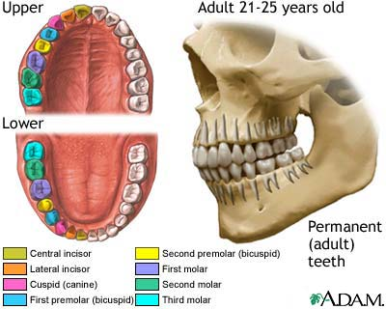
At age 25 the Priest was
called to service at the Temple
Numbers 8:24
12 +12=24 Courses
1 Chronicle 24:1-19
The Levitical Priest
24 Tooth Elders
Revelation 3:2; 4:4-5:8-12
Christ the Anti-type (Lamb)
waved before the Lord
Of the first-fruits
Leviticus Chapter 23:10-11, 15
Wave Sheaf was symbolic of the greater harvest in the near future (Revelation 7:9)
The Ceremonial Sabbaths
The 8 Molars left: Represent
The Symbol of Wisdom
Leviticus Chapter 23:12
8
24 + 8= 32
7 Ceremonial
Sabbaths
The Lord of The
Sabbath Christ
Leviticus 23
1+ 7 =8
Christ the Lord
Of The Sabbath
Rest. Our
Passover Lamb
Leviticus 23:12
It was a beautiful service. The priest clad in his sacred robes, with a handful of yellow heads of ripened grain, entered the temple. The glow of burnished gold from walls and furniture blended with the tints of the golden heads of grain. The priest paused in front of the golden altar, and waved the grain before the Lord. Those first heads kept a pledge of the bountiful harvest to be gathered, and the waving indicated thanksgiving and praise to the Lord of the harvest. {1914 SNH, The Cross and Its Shadow 109.1}

Slide 9
The Angels that stand before
the Throne of Christ Revelation 8:3
The religious services, the prayers, the praise, the penitent confession of sin ascend from true believers as incense to the heavenly sanctuary; but passing through the corrupt channels of humanity, they are so defiled that unless purified by blood, they can never be of value with God. They ascend not in spotless purity, and unless the Intercessor who is at God's right hand presents and purifies all by His righteousness, it is not acceptable to God. All incense from earthly tabernacles must be moist with the cleansing drops of the blood of Christ. He holds before the Father the censer of His own merits, in which there is no taint of earthly corruption. He gathers into this censer the prayers, the praise, and the confessions of His people, and with these He puts His own spotless righteousness.
Then, perfumed with the merits of Christ's propitiation, the incense comes up before God wholly and entirely acceptable. Then gracious answers are returned.
O, that all may see that everything in obedience, in penitence, in praise and thanksgiving must be placed upon the glowing fire of the righteousness of Christ. The fragrance of this righteousness ascends like a cloud around the mercy seat
(MS Manuscript releases - 50, 1900). {6BC- Bible Commentary Vol.6, 1078. 1-2}
Personal Character of Christ's Intercession.--Christ is watching. He knows all about our burdens, our dangers, and our difficulties; and He fills His mouth with arguments in our behalf. He fits His intercessions to the needs of each soul, as He did in the case of Peter. . . . Our Advocate fills His mouth with arguments to teach His tried, tempted ones to brace against Satan's temptations. He interprets every movement of the enemy. He orders events (Letter 90, 1906). {7BC- Bible Commentary Vol. 7, 931.2}
9

Slide 10
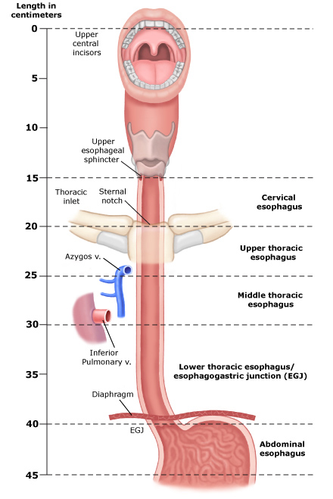
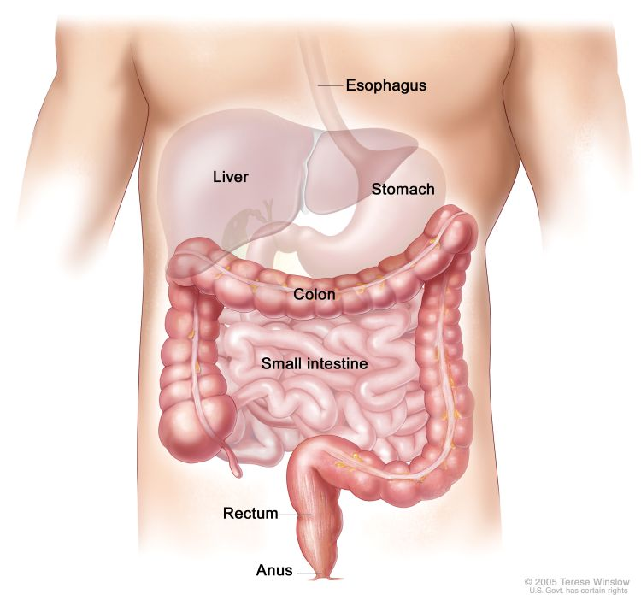
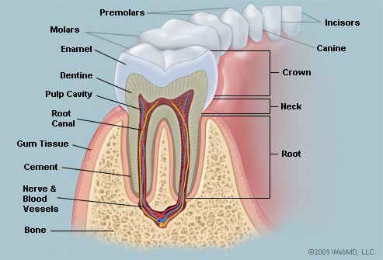
The History of the Priesthood from the Earthly Courtyard
to the Heavenly
10
The Altar
of Incense
The esophagus or gullet is a long muscular tube that passes from the pharynx into the stomach. The word esophagus is derived from a Greek word oisophagos, that means 'entrance for eating'. The esophagus connects the mouth to the stomach and is about 25 to 30 cm long.
Ancient Ceremonial Sabbaths Days
Leviticus Chapter 23
Christ Earthly Ministry
15th day of 1st month Unleavened Bread v. 5, 6, 7, 11
21st day of 1st month 7th day of Unleavened Bread v. 8
50th day from morrow Pentecost also known as v. 15, 16, 21 15th of 1st Feast of weeks
Christ Heavenly Ministry as High Priest
1st day of 7th month Blowing of Trumpets v. 24, 25
10th day of 7th month Day of Atonement v. 27-32
15th day of 7th month Feast of Tabernacles v. 34, 35, 39
22nd day of 7th month 8th day of Feast of Tabernacles v. 36, 39

Slide 11
The Ten Kingdoms rent from Rehoboam: The Courtyard in the Body
(1 King 11:28-31) (Exodus 30:18-21) (Zechariah 13:1) (John 7:37-39)
1. Mouth: The Head of the Lower Body: It was connected with the Heavenly Sanctuary
(Job 12:11) (Deuteronomy 33:12)
2. Esophagus: The esophagus or gullet is a muscular canal, about 23 to 25 cm.
long, extending from the pharynx to the stomach. The highway of our daily bread
3. Stomach: Christ the Living word Fill with the Spirit
(John3:5) (Titus 3:5) (Ephesians 5:26)
The position of the full stomach is the right and the whole organ assumes an oblique position, so that its surfaces are directed more forward and backward.
The stomach is The Brain of the Lower Kingdom;
The Shape of a “J” for Jesus who washes away our sins Anti-type.
(Leviticus 1:8-9) And the priests, Aaron's sons, shall lay the parts, the head, and the fat, in order upon the wood that [is] on the fire which [is] upon the altar: But his inwards and his legs shall he wash in water: and the priest shall burn all on the altar, [to be] a burnt sacrifice, an offering made by fire, of a sweet savour unto the LORD.
God has established the laws of our being. If we violate these laws, we must, sooner or later, pay the penalty. The laws of our being cannot be more successfully violated than by crowding upon the stomach unhealthy food, because craved by a morbid appetite.
To eat to excess, of even simple food, will eventually break down the digestive organs;
but add to this the eating in too great an amount of food, and that unwholesome, and the evil is greatly increased. The constitution must become impaired.
{2SM- Selected Messages Book 2 411.4}
11

Slide 12
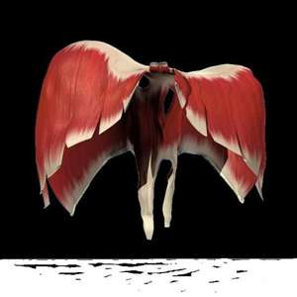
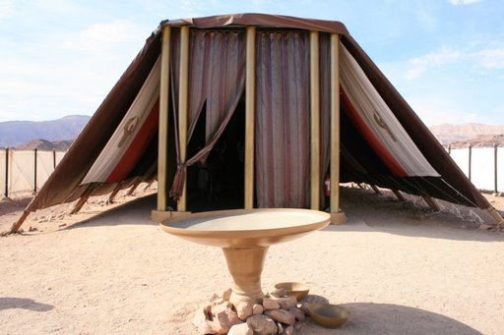
The Door to the Holy The Truth to Sanctification
12
The diaphragm is the primary muscle of inspiration. It is a thin, dome-shaped sheet of muscle that inserts into the lower ribs. The diaphragm moves a centimeter or two up and down, but during exercise, it can move more than (10 centimeter)
The Curtain (the Door) that separates the Holy place and the Courtyard. And thou shalt make an hanging for the door of the tent, [of] blue, and purple, and scarlet, and fine twined linen, wrought with needlework. (Exodus 26:36-37) (John 10:9)

Slide 13
Entering through the Door by Faith
13
The Diaphragm
(It Represents: the door made of curtain that separates the Holy place and the Courtyard)
The Diaphragm is the primary muscle of inspiration.
It is a thin, dome-shaped sheet of muscle that inserts into the lower ribs.
The diaphragm moves a centimeter or two up and down, but during exercise,
it can move more than 10 cm.
Because the diaphragm is covered by the inferior surface of the parietal pleura, when it contracts it pulls the pleura with it. This lowers the pleural pressure, which causes the alveolar pressure to drop, which, in turn, causes air to flow into the lungs. During quiet expiration, the diaphragm passively relaxes and returns to its equilibrium position.
{HR- The Health Reformer December 1, 1871 par. 25}
And thou shalt make an hanging for the door of the tent, [of] blue, and purple, and scarlet, and fine twined linen, wrought with needlework. And thou shalt make for the hanging five pillars [of] shittim [wood], and overlay them with gold, [and] their hooks [shall be of] gold: and thou shalt cast five sockets of brass for them. (Exodus 26:36-37) (Exodus 40:6)

Slide 14
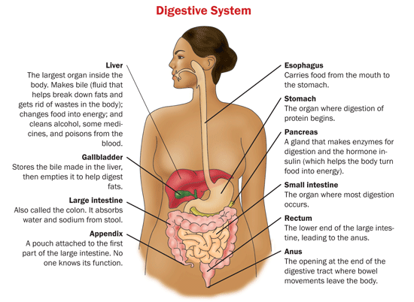
The Ten Kingdoms that were rent from Rehoboam:
Represent a Symbol of 10 Organs in the Digestive System.
14
1 King 11: 28-31
for thus saith the LORD, the God of Israel, Behold, I will rend the kingdom out of the hand of Solomon, and will give ten tribes to thee: margin…
Jeroboam set up his golden calves, one in Bethel in the territory of Ephraim, the other in the city of Dan; Judges 18:30
margin… {1914 SNH, The Cross and Its Shadow 374.1}
In Solomon’s Temple there was 10 Lavers (1 Kings 7:38 )
Then made he ten lavers of brass: one laver contained forty baths: [and] every laver was four cubits: [and] upon every one of the ten bases one laver.

Slide 15
Next Sabbath:
We will continue Part 2 of our study
The Third Temple
Series 9
The Digestive System
“Ravin as a Wolf”
What is the Anti-type of the Laver in our Body?
Christ is the only Way to Eternal Life
Through His Purity and the
Righteousness of His Merit

