Slide 1
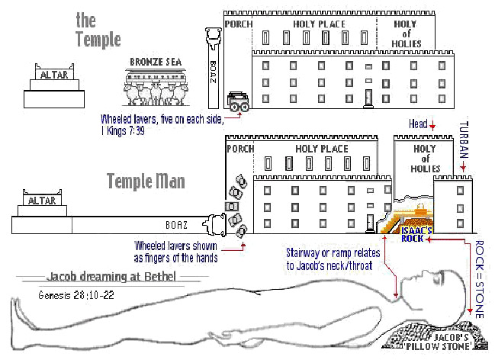
The Sanctuary of our Body
THE THIRD TEMPLE
Series 9
The Digestive System Part 2
By : sister rose

Slide 2
We will continue our study
The Digestive System
Functions and Operates like,
The Tribe of Benjamin
“Ravin as a Wolf”
Our Stomach A Symbol of the Laver.
Christ is the only Way to Eternal Life to Holiness
Through His Righteousness and Purity

Slide 3
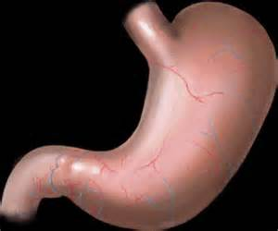
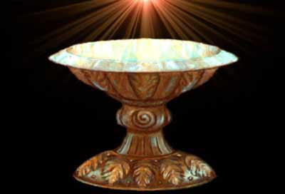
Christ a Symbol of The Laver
3
The Stomach is an expanded J-shape
segment of the digestive track. It is divided in to 4 regions. The very shape give homage to His Creator and Redeemer
(The #4 is a symbol of divinity)
And he made the laver [of] brass, and the foot of it [of] brass, of the looking glasses of [the women] assembling, which assembled [at] the door of the tabernacle of the congregation.
(Exodus 38:8)
The “J” Like Shape of this Organ
Gives His Own Identity
Jesus
Acts 4:10-12
Christ
is become
The head
of the corner
Margin..verse 11
Genesis 49:27
Exodus 30:18-21

Slide 4
4
No Thirst for the World
Whosoever drinketh of the water that I shall give him shall never thirst”
ever crave the world's advantages and attractions--"but the water that I shall give him shall be in him a well of water springing up unto everlasting life“
(Letter 5, 1900). John 4:14.
A Channel
You must seek to have an indwelling Saviour, who will be to you as a well of water, springing up into everlasting life.
The water of life flowing from the heart always waters the hearts of others.
(Manuscript Release 69, 1912). {Vol. 5 Bible Commentary 1134. 1-2}
A Revelation of Grace
The water that Christ referred to was the revelation of His grace in His Word.
His Spirit, His teaching, is as a satisfying fountain to every soul. . . . In Christ is fullness of joy forevermore. . . . Christ's gracious presence in His Word is ever speaking to the soul, representing Him as the well of living water to refresh the thirsting. It is our privilege to have a living, abiding Saviour. He is the source of spiritual power implanted within us, and His influence will flow forth in words and actions, refreshing all within the sphere of our influence, begetting in them desires and aspirations for strength and purity, for holiness and peace, and for that joy which brings with it no sorrow. This is the result of an indwelling Saviour.
(Letter 73, 1897)

Slide 5
The Stomach
For certain things fasting and prayer are recommended and appropriate.
In the hand of God they are a means of cleansing the heart and promoting a receptive frame of mind. We obtain answers to our prayers because we humble our souls before God. If our appetites clamor for the flesh of dead animals, it is a necessity to fast and pray for the Lord to give His grace to deny fleshly lusts which war against the soul.
There should be far less anxiety as to what we shall eat and what we shall drink to gratify our fleshly appetites; but we may well encourage the appetite of the soul, and pray for especial enlightenment upon the Word of God, and eat and drink that Word.
Jesus says, "I am that bread of life." "I am the living bread….
{20 Manuscript Releases 105.3-4}
We must be constantly meditating upon the Word, eating it, digesting it, and by practice, assimilating it, so that it is taken into the life current. He who feeds on Christ daily will by his example teach others to think less of that which they eat and to feel much greater anxiety for the food they give to the soul.
{20 Manuscript Releases 106.1}
The True Fast
The true fasting which should be recommended to all, is abstinence from every stimulating kind of food, and the proper use of wholesome, simple food, which God has provided in abundance. Men need to think less about what they shall eat and drink of temporal food, and much more in regard to the food from heaven, that will give tone and vitality to the whole religious experience.
{CD Counsels on Diet and Foods188.3} [LETTER 73, 1896] Medical Ministry. 283
5

Slide 6
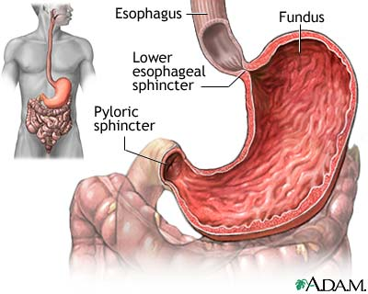
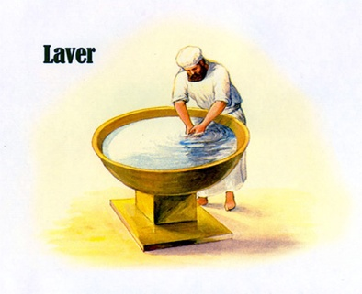
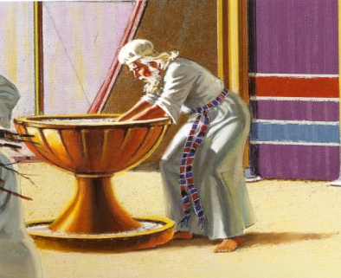
Genesis 49:27
Benjamin shall ravin [as] a wolf: in the morning he shall devour the prey, and at night he shall divide the spoil.
6
Stomach
The muscular, hollow bag in the alimentary canal is the stomach. The stomach is the primary organ of the digestive system that is involved in the second phase of food digestion. The location of the stomach is between the esophagus and small intestine.
The function of the stomach is to churn food with help of smooth muscular contortions, secrete protein digesting enzymes and strong acids for food digestion.
It then passes the partially digested food towards the small intestine.
Christ The Living Word
Fill with the Spirit
The Smooth Muscles
A symbol
Of
Priest
The Stomach
Breaks down the food.
(At Night it shall divide the Spoil)
Genesis 49:27
James 1:22-25

Slide 7
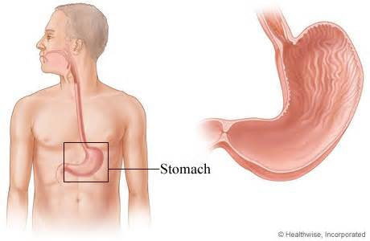
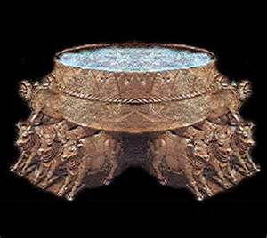
The Laver is a Symbol of The Stomach
7
If the stomach is not properly cared for,
the formation of an upright, moral character will be hindered. The brain and nerves are in sympathy with the stomach. Erroneous eating and drinking result in erroneous thinking and acting.
{CCh-Counsels for the Church 236.1}
Margin.. To labor to convert to the truth, men and women out of the world who have never heard it. The Lord requires of his ministers to be pure and holy, and to rightly represent the principles of truth in their own lives, and by their example bring them up upon a high level. {RH, May 30, 1871 par. 14}
In the court, beside the door of the tabernacle, stood a brazen laver, wherein the priests washed their hands and their feet before going in to minister before the Lord. All who officiated in the sanctuary were required of God to make special preparation to enter the place where his glory was revealed.
{ST, April 14, 1881 par. 2}
(Exodus 40:11,30)(Jeremiah 17:13, 2:13)
( John 4:10-17, 21-24; 7:38-39)
(Revelation 1:6; 7:17 ;21:6)
2 Chronicles 4:14-15
One sea, and
twelve oxen under it
Please see.
{CTr -Christ Triumphant 340.2}
The Living Water is an
Emblem of the Holy Spirit
The Laver
Solomon's Temple

Slide 8
8
The Fountain of Living Waters
“The Laver”
Was between the brazen altar and the door of the sanctuary.
The laver and its base were both of brass. Water was kept in them, for the priests to wash both their hands and their feet before they entered the sanctuary to perform any service. They were also required to wash both hands and feet before they went "near the altar to minister, to burn offering made by fire unto the Lord."
Death was the penalty for performing service at the altar or within the tabernacle without first washing in the laver. As the people in the court beheld the priests wash in the water before they performed the work of the holy office, may it not have taught them the truth that Christ gave to Nicodemus, "Except a man be born of water and of the Spirit, he cannot enter into the kingdom of God"?
{1914 SNH, CIS- The Cross and Its Shadow 179.1}
(Exodus 30:17-21) (John 3:5) (Titus 3:5)( Ephesians 5:26)
The service of Christ is a heavenly and holy and blessed thing.
The Word is to be diligently searched, for the ministry of the Word discovers the imperfections in our characters and teaches us that the sanctification of the Spirit is a work of heavenly devising, presenting in Christ Jesus the true perfection that if maintained will become a perfect whole in behalf of every soul. We are educated in Bible lines to become complete in Christlikeness and to see His Father’s face in Him who gave His own life for the saving of the soul. {Our Fathers Care 129.5}

Slide 9
I am Alpha and Omega, the beginning and the end. I will give
unto him that is athirst of the fountain of the water of life freely.
(John 7:38)
He that believeth on me, as the scripture hath said,
out of his belly shall flow rivers of living water. (Jeremiah 17:13)
O LORD, the hope of Israel, all that forsake thee shall be ashamed, [and] they that depart from me shall be written in the earth, because
they have forsaken the LORD, the fountain of living waters.
(Jeremiah 2:13)
For my people have committed two evils; they have forsaken me the fountain of living waters, [and] hewed them out cisterns, broken cisterns, that can hold no water. To Jeremiah, Christ is "the fountain of living waters;" to Zechariah, "a fountain opened . . . for sin and for uncleanness." Jeremiah 2:13; Zechariah 13:1. {PP-Patriarchs and Prophets 413.1}
"When the poor and needy seek water, and there is none, and their tongue faileth for thirst, I the Lord will hear them, I the God of Israel will not forsake them." "I will pour water upon him that is thirsty, and floods upon the dry ground;" "in the wilderness shall waters break out, and streams in the desert." The invitation is given, "Ho, every one that thirsteth, come ye to the waters.
" Isaiah 41:17; 44:3; Isaiah 35:6; 55:1.
And in the closing pages of the Sacred Word this invitation is echoed. The river of the water of life, "clear as crystal," proceeds from the throne of God and the Lamb; and the gracious call is ringing down through the ages, "Whosoever will, let him take the water of life freely.
" Revelation 22:17. {PP-Patriarchs and Prophets 413.2}
9

Slide 10
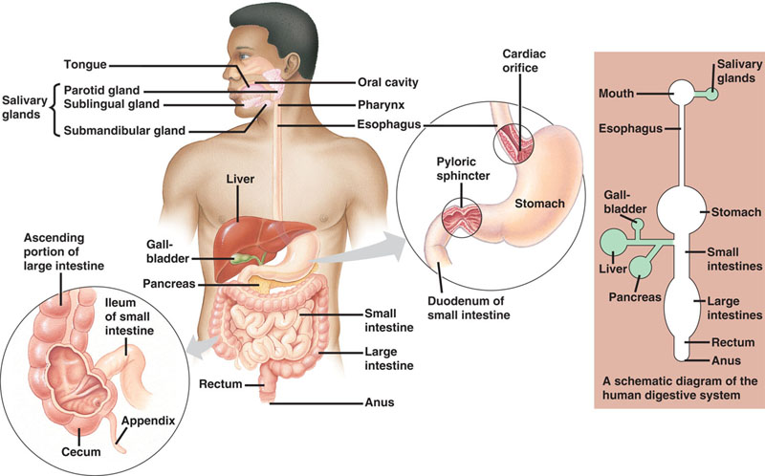
The Digestive System is composed of Ten Organs.
Represent: A symbol of the Tribe of Benjamin ten sons.
(See Genesis 46:21)
10
Genesis 46:21
And the sons of Benjamin [were] Belah, and Becher, and Ashbel, Gera, and Naaman, Ehi, and Rosh, Muppim, and Huppim, and Ard
Isaiah 42:16
Mouth
Revelation 7:17
For the Lamb which is in the midst of the throne shall feed them, and shall lead them unto living fountains of waters: and God shall wipe away all tears from their eyes.
Matthew 7:14
Because strait [is] the gate, and narrow [is] the way, which leadeth unto life, and few there be that find it.
Matthew 7:13
Margin…and broad [is] the way,
that leadeth to destruction,
and many there be which go in thereat:

Slide 11
Liver: The Heart in The Courtyard: Only the Perfect Life of our
Saviour Jesus Christ Can Remove from us our impurities and
create a new man in us. (Leviticus 7:3-5) (Ephesians 2:13) (Galatians 3:29)
The liver, the largest gland in the body, has both external and internal secretions, which are formed in the hepatic cells. Its external secretion, the bile, is collected after passing through the bile capillaries by the bile ducts, which join like the twigs and branches of a tree to form two large ducts that unite to form the hepatic duct. The bile is either carried to the gall-bladder by the cystic duct or poured directly into the duodenum by the common bile duct where it aids in digestion. (Job 20:14)
http://www.bartleby.com/107/pages/page1188.html
One of the most vital internal human organ is the liver.
The liver is an absolute necessity for survival and no individual can survive without the liver. The liver carries out many functions that includes detoxification of blood,
production of biochemical for digestion and protein synthesis.
Gall Bladder: Stores bile until it is needed. It’s produced by the liver is
carried through the ducts to small intestine, where it helps digest fat.
(1 Corinthians 5:7) (Deuteronomy 29:18 the penalty for sin)
gallbladder, also known as the cholecyst is one of the small internal organs of the human body. It helps in digestive process and the bile produced in the liver is stored in the gall bladder. It is located in the concavity of liver that is called as the gallbladder fossa. The length of the gall bladder is about 8 cm in adults when fully distended.
11

Slide 12
12
Pancreas: Represents the Messengers/Helpers for the
Word of God to edify the Body of Christ in the Earth (Ephesians 4:7-12).
Is a compound gland, analogous in its structures to the salivary glands:
Represents (the moisture for the Word of God helps ease with digestion), though softer and less compactly arranged than those organs. Its secretion, the pancreatic juice, carried by the pancreatic duct to the duodenum, is an important digestive fluid.
It produces a juice containing enzymes, which cause chemical reactions that pass into the small intestine. There, they break down carbohydrates, fats, and proteins in the food. It is long and irregularly prismatic shape; its right extremity, being broad,
Is called the head: (Represent the helpers in Gospel order (Ephesians 4:12-16) apostles, prophets, evangelists, pastors and teachers; For the perfecting of the saints, for the work of the ministry, for the edifying of the body of Christ:) and is connected to the main portion of the organ, or body, by a slight constriction, the neck; (Deuteronomy 28:43-48) while its left extremity gradually tapers to form the tail..(Deuteronomy 28:13) Its length varies from 12.5 to 15cm: and its weight from 60 to 100 gram. http://www.bartleby.com/107/251.html
And these are they which are sown on good ground, such as hear the word, and receive [it], and bring forth fruit, some thirtyfold, some sixty, and some
an hundred (Mark 4:20) (Matthew 13:23) (Matthew 28:19, 20).
The pancreas are gland organs of the endocrine system and digestive system. They produce the most important hormones like insulin, glucagon and somatostatin. They also produce pancreatic juice that contains digestive enzymes. If the pancreas do not function normally, it may lead to Diabetes Mellitus.

Slide 13
13
Small Intestine: Represents a symbol of the Narrow Way
(Small Colon) is the Way that leads to eternal Life.
(Matthew 7:14) (1 Peter 3:2) (John 3:5)
Is a convoluted tube, extending from the pylorus to the colic valve, where it ends in the large intestine.
It is about 7 meters long: Represents the perfection in the life in Christ.
(Ephesians 4:13) a portion of it extends below the superior aperture of the pelvis and lies in front of the rectum. It is in relation, in front, with the greater omentum and abdominal parietes, and is connected to the vertebral column by a fold of peritoneum, the mesentery. The small intestine is divisible into three portions: Christ Fullness. (Galatians 2:20) (Ephesians 1:3, 10)
The duodenum, the jejunum, and the ileum.
It is joints the large intestine about 7 centimeters up from its end.
Large Intestine: Represents a symbol of the Broad Way:
(Large Colon) is the way that leads to Perdition (Matthew 7:13)
no digestion takes place within the large intestine. It’s much shorter than the Small intestine only about a meter and a half, or 5 feet, long
(The way of the five Foolish Virgins) (Exodus 27:1-8)
extends from the end of the ileum to the anus. It is about 1.5 meters long, being one-fifth of the whole extent of the intestinal canal.

Slide 14
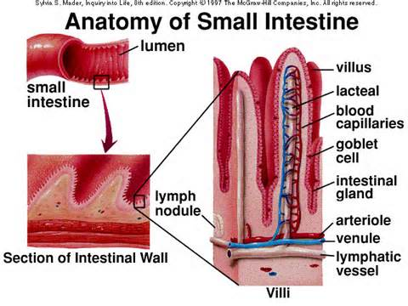
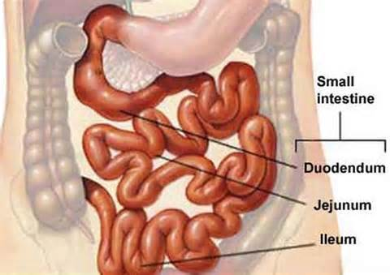
Christ is The Way and the Life through the Narrow Path.
14
If we take Christ for our guide, He will lead us safely along the narrow way. The road may be rough and thorny; the ascent may be steep and dangerous; there may be pitfalls upon the right hand and upon the left; we may have to endure toil in our journey; when weary, when longing for rest, we may have to toil on; when faint, we may have to fight; when discouraged, we may be called upon to hope; but with Christ as our Guide we shall not lose the path to immortal life, we shall not fail to reach the desired haven at last. {Our Father Cares 134.6}
Christ is our “For-runner”
to Everlasting life by His Perfect Life,
we most follow in His Foot Step.
"Looking unto Jesus, the Author and Finisher of our faith."
(Hebrew 12:2)
The Small Intestine twenty-five feet
in length,
and is divided into three parts
{1868 JNL, Hand Book of H ealth169.2}
(du’’o-de’num)
(Je-joo’num)
( il’e-um)

Slide 15
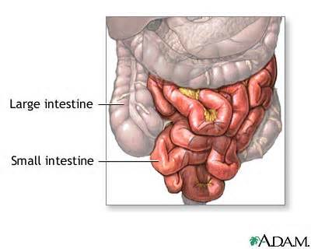
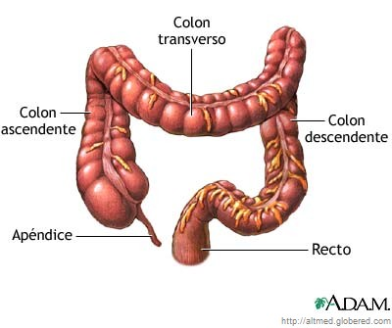
The Intestines: A Symbol of the two Paths in Life The intestines or bowels are a segment of alimentary canal. The intestines extend from the stomach to the anus and is divided into small intestine and large intestine.
The small intestine is divided into duodenum, jejunum and ileum.
The large intestine is divided into the cecum and colon.
15
We may think it pleasant at first to follow pride and worldly ambition, but the end is pain and sorrow. Selfish plans may present flattering promises and hold out the hope of enjoyment, but we shall find that our happiness is poisoned and our life embittered by hopes that center in self.{ Margin.. OFC-Our Father Cares 135.2}
The Broad
The Way that Leads to
Perdition
Matthew 7:13
The Narrow
The Way which Leadeth
unto Life
Matthew 7:14
Christ Himself has trod the rough pathway before us and has smoothed the path for our feet.
The narrow path of holiness, the way cast up for the ransomed of the Lord to walk in, is illuminated by Him who is the light of the world. As we follow in His steps, His light will shine upon us, and as we reflect the light borrowed from the glory of Christ, the path will grow brighter and brighter unto the perfect day.
{OFC-Our Father Cares 135.1}

Slide 16
16
The cecum in Humans cannot digest cellulose, so it becomes a
digestive waste. This waste, however, is important to the regular movements of the feces through the large intestine. Also called dietary fiber. Its caliber is largest at its commencement at the cecum, and gradually diminishes as far as the rectum, where there is a dilatation of considerable size just above the anal canal. It differs from the small intestine in its greater caliber, its more fixed position, its sacculated form, and in possessing certain appendages to its external coat, the appendices.
Appendix: a structure that serves no digestive function in humans, but does contain Lymphatic tissue. (a symbol or our bodies defenses Martyr’s) Revelation. 2:9-11) (Judges 5:19) An infection of the appendix is called appendicitis and can be quite serious and painful.
Rectum: The way to perdition: sin and sinners will be burned to ashes on the Earth.(Malachi 4:1-3) (2 Peter 3:4) (Ezekiel 28:18-19)
The stored of the matter waiting to be expelled from the body.
(Deuteronomy 32:32-36) (Leviticus 4:7, 18, 25, 30.)
Anus: The way to the pit (from Latin anūs meaning "ring", "circle")
is the external opening. (Leviticus 6:10,11) (Leviticus 4:31)
The chain that is let down from the throne of God is long enough to reach to the lowest depths of sin. Hold up a sin-pardoning Saviour before the lost and lonely, for Jesus has made divine intercession in their behalf. He is able to lift them from the pit of sin, that they may be acknowledged as the children of God, heirs with Christ to an immortal inheritance. They may have the life that measures with the life of God.
{ Margin… Review and Herald, April 11, 1912 par. 6}

Slide 17
Next Week:
The Sanctuary of our Body
The Third Temple
Series 10
The Urinary System
Operates and Functions Like
(The Tribe of Gad)
“ A troop shall Overcome him”

